Slide 1
Updates 04/12/2024
Alberto TONDA, Ph.D. (Senior permanent researcher, DR)
UMR 518 MIA-PS, INRAE, AgroParisTech, Université Paris-Saclay UAR 3611, Institut des Systèmes Complexes de Paris Île-de-France

Slide 2
Dr. Pietro Barbiero’s seminar
December 02 Introduction, ML summary, Basics of deep neural networks
December 04 Deep neural networks,
Convolutional Neural Networks
December 06 Recurrent Neural Networks, Embeddings,
Autoencoders
December 09
Generative models, Deep reinforcement learning, Concept bottlenecks
December 11
Morning: Discussion + recent topics
Afternoon: Seminar
Relational concept based models

Slide 3
Visualizing the behavior of a neural network

Slide 4

Visualizing the behavior of a neural network

Slide 5
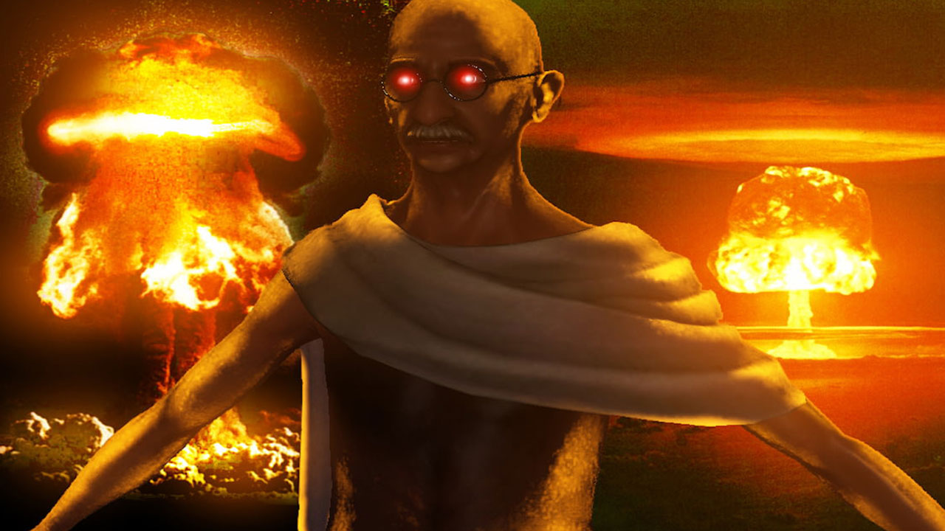
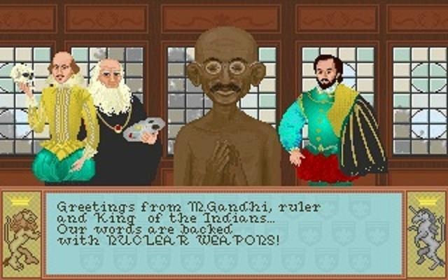
Nuclear Ghandi
The game was Sid Meier’s Civilization

Slide 6
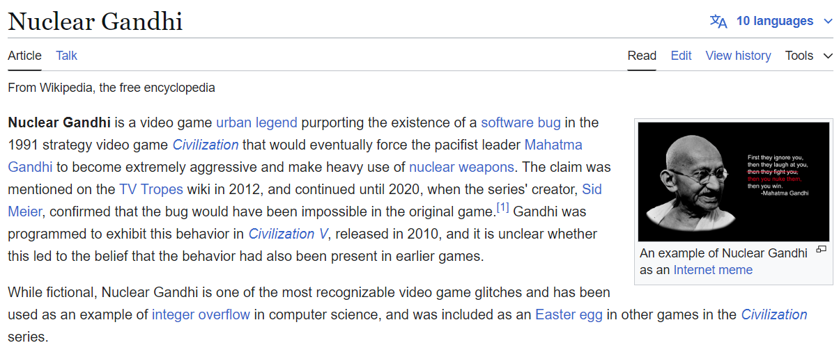
Nuclear Ghandi is not real
https://en.wikipedia.org/wiki/Nuclear_Gandhi

