Slide 1
Decision trees (and ensembles of)
Alberto TONDA, Senior Researcher (DR)
UMR 518 MIA-PS (Applied Mathematics and Computer Science) INRAE, AgroParisTech, Université Paris-Saclay Institut des Systèmes Complexes, Paris-Ile-de-France

Slide 2
Outline
Decision trees
Classification and regression trees
Optimization algorithm for CARTs
Ensembles
Random forest
Bagging
Boosting

Slide 3
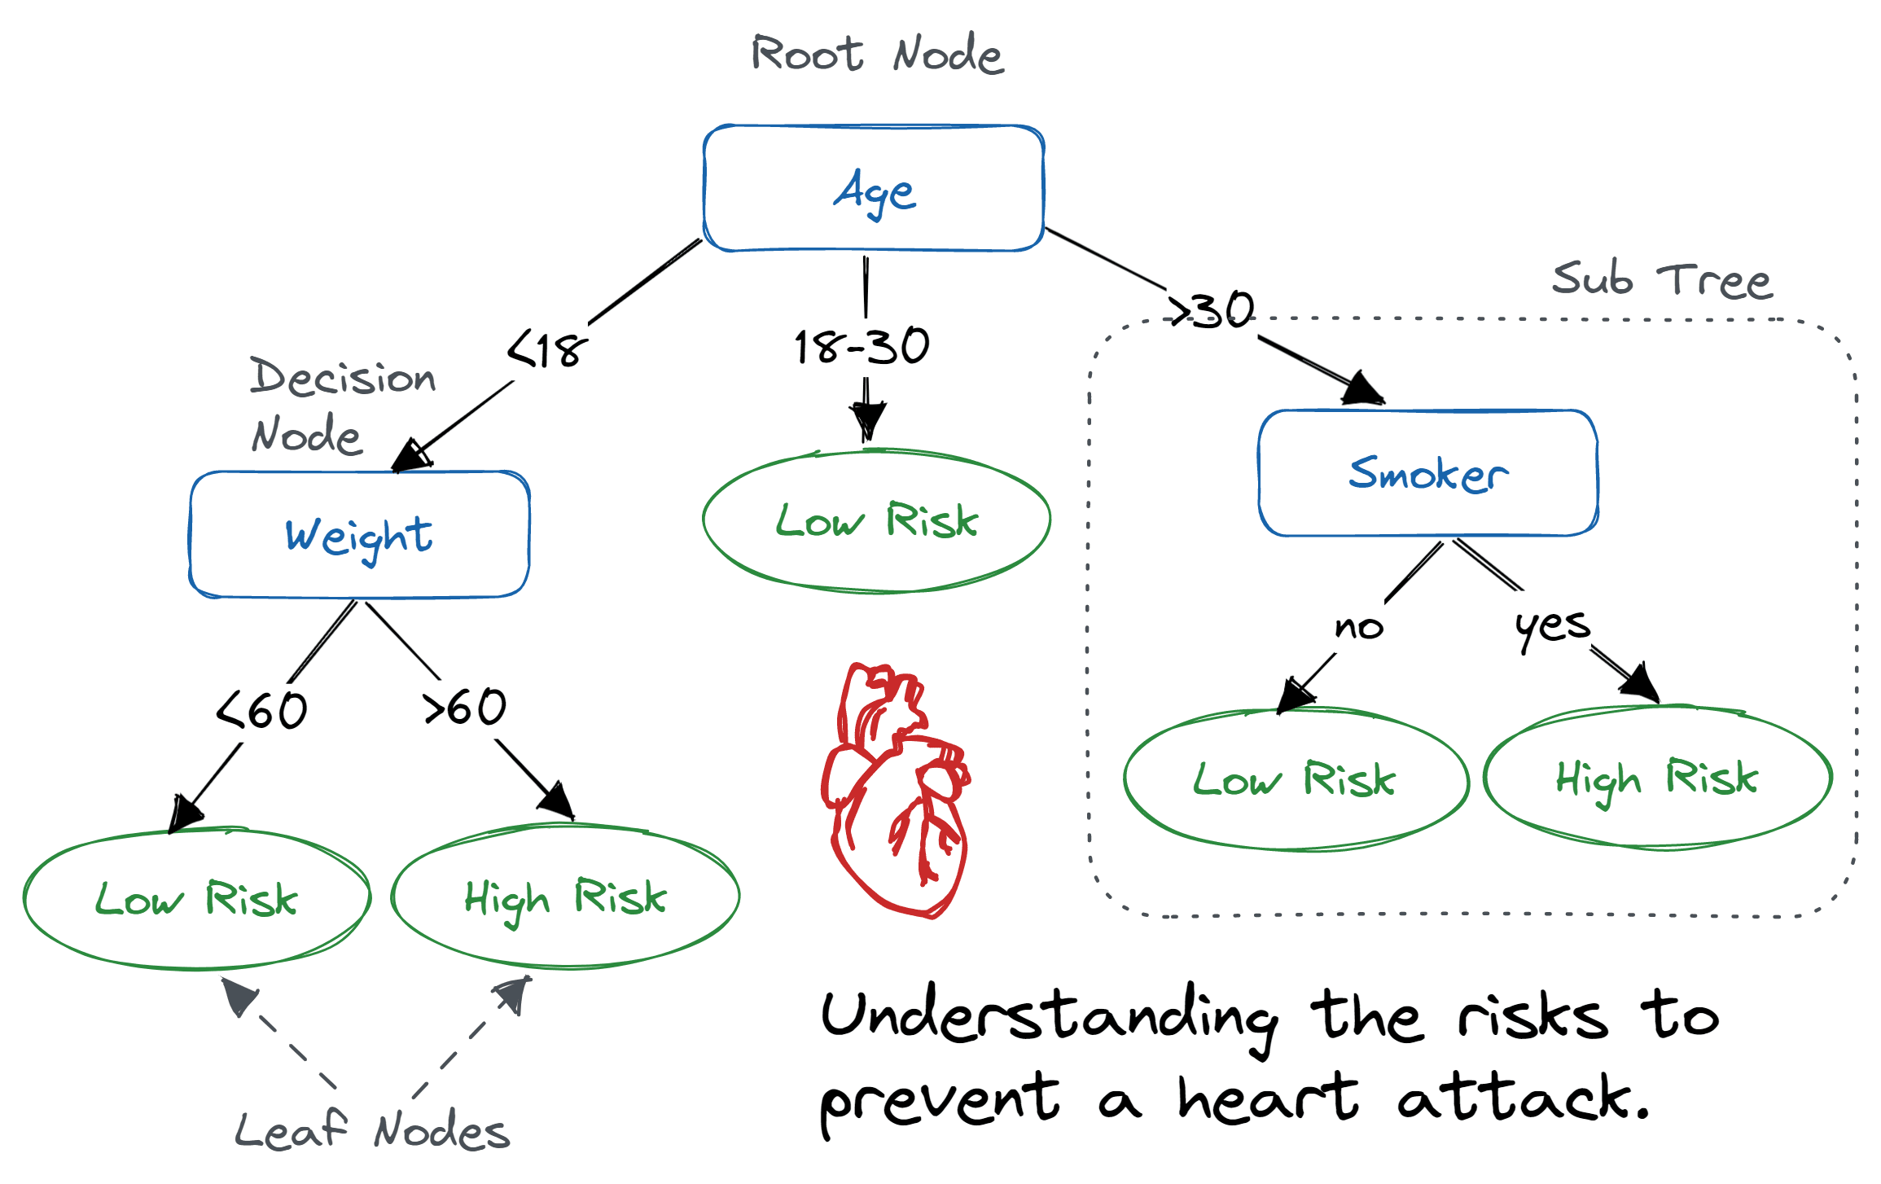
Decision trees
Decision trees are one of the simplest kinds of AI algorithms
Easy to read* for humans, we can follow the decision process
Can be hand-crafted! Encode expertise
Or created from data (ML)
*for small trees

Slide 4
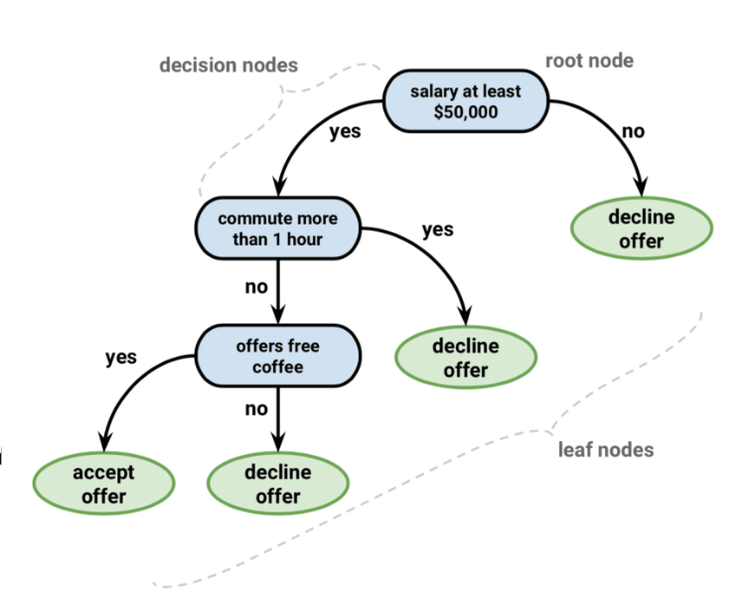
Decision trees
Classification trees: leaves are CLASSES
Assign a sample to a “category”
For each job offer, should I accept or decline it?

Slide 5
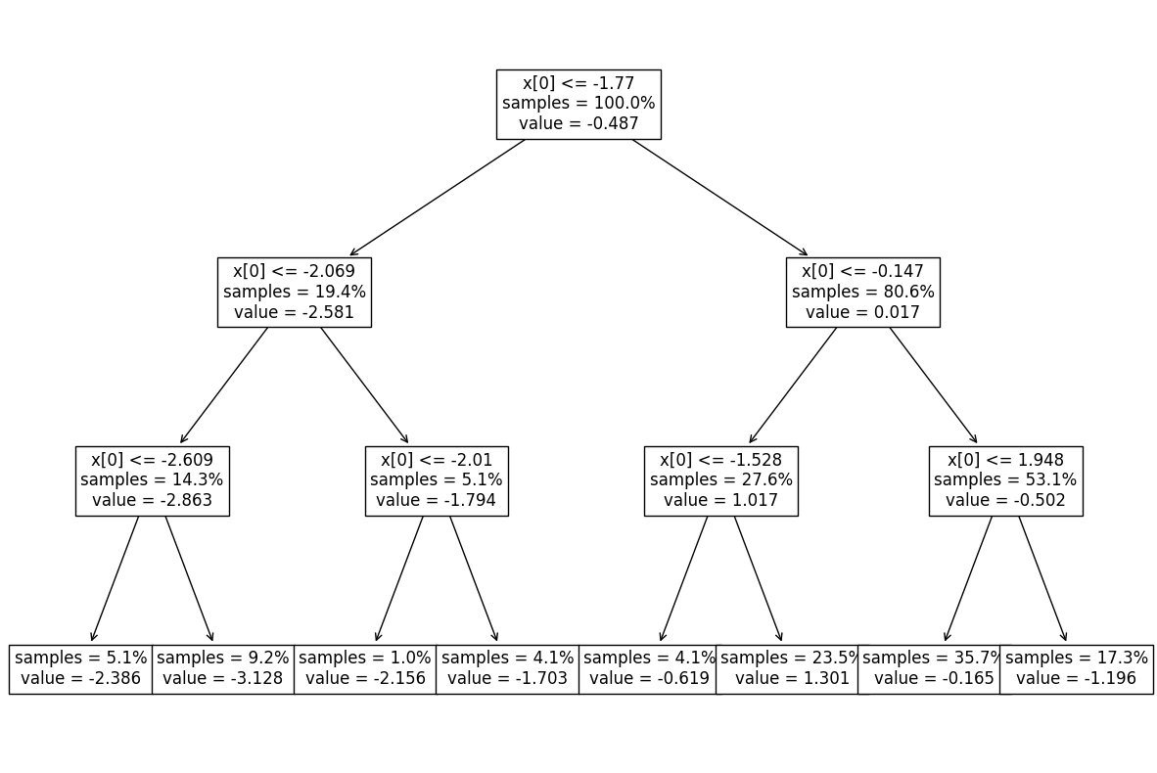
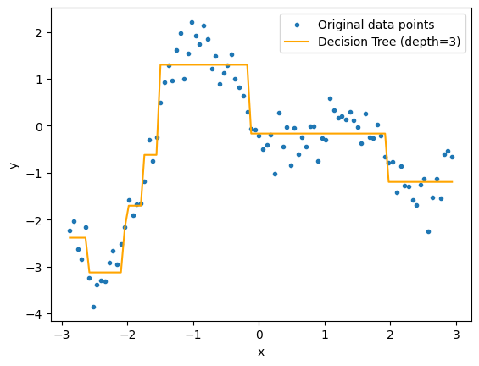

Decision trees
Regression trees: leaves are VALUES
Hypothesis: function can be approximated by linear segments
Each leaf is in the form $f\left(x\right)=k$ with $k$ a floating-point value

Slide 6
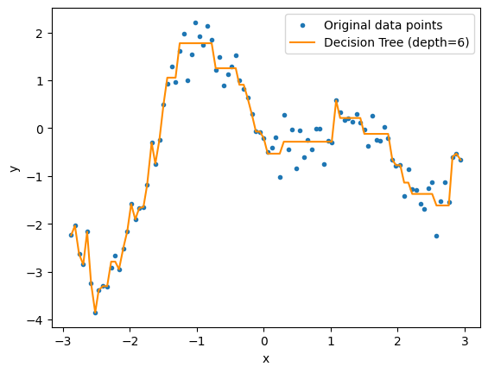
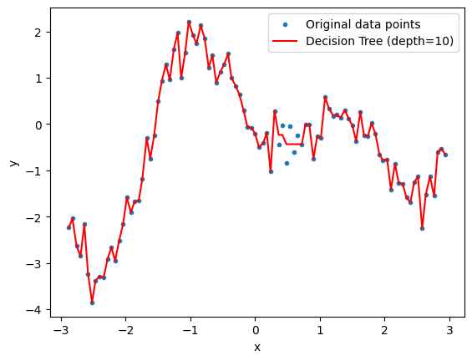
Decision trees
Several hyperparameters
Maximum depth of the tree
Type of

Slide 7
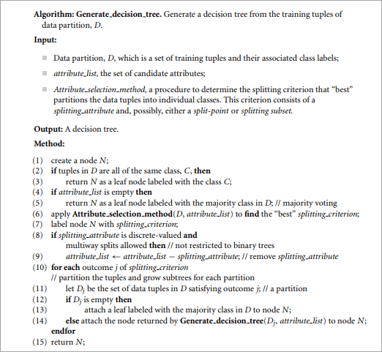
Decision trees: optimization algorithm
It’s greedy!
Every time it needs to create a split, it finds the feature (or attribute) that best divides the remaining data into groups
Quality is measured by purity (samples belonging to the same class) or mean squared error

Slide 8
Decision trees
For the moment, they seem fantastic! Any drawbacks?

Slide 9
Decision trees
For the moment, they seem fantastic! Any drawbacks?
Yep, they are pretty terrible at predictions

Slide 10
Ensembles
A single decision tree is a weak predictor
“Performs slightly better than random guessing” (Freund & Schapire, 1995)
However, ensembles of weak predictors can perform well

