Slide 1

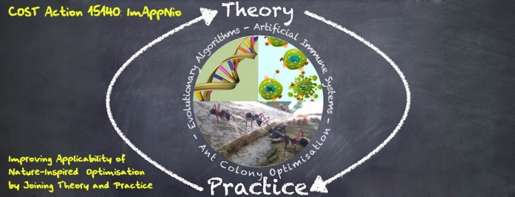

Generative Adversarial (Networks)
Alberto TONDA, INRA, Université Paris-Saclay

Slide 2
Generative Adversarial ML
Motivation: understanding/robustness
ML models are often black boxes
Where does it go wrong? Why?
Samples with errors can be injected in training
Solution: create «errors»
Generate samples that will be misclassified
Analyze their characteristics
Feed them back into the input

Slide 3
Generative Adversarial ML
Two ML algorithms “against” each other
“A” is trained on real data
“B” is creating new data samples to make “A” fail
“B” contains human expertise
A
DATA SAMPLE
B
FEEDBACK
FEEDBACK IS MORE COMPLEX THAN JUST PREDICTED CLASS
Notes:
Basically, there is also an evaluation called “confidence”, that tells you how confident algorithm A is in its own prediction

Slide 4
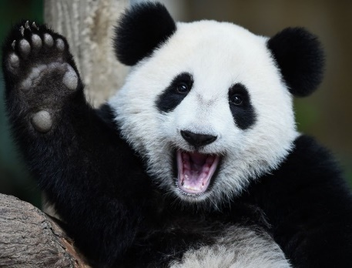
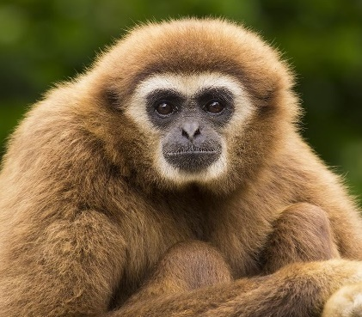
Generative Adversarial ML
PANDA
GIBBON
A
B

Slide 5
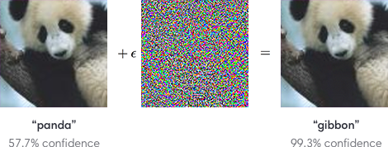
Generative Adversarial ML
I CAN ONLY APPLY SMALL MODIFICATIONS TO IMAGES, SO THAT A HUMAN WOULD STILL RECOGNIZE THEM
A
B

Slide 6
Generative Adversarial ML
https://openai.com/blog/adversarial-example-research/

Slide 7
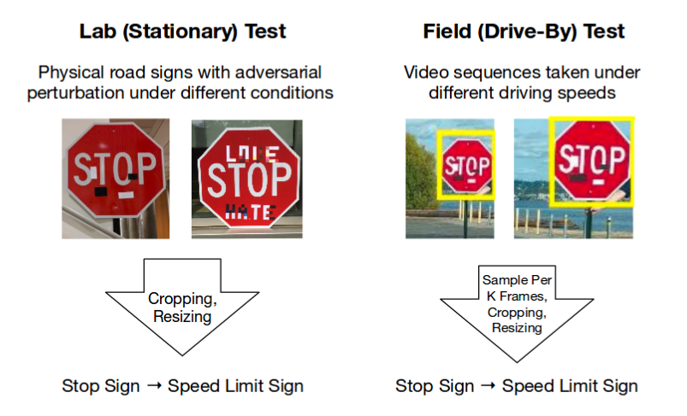
Generative Adversarial ML
Robust Physical-World Attacks on Deep Learning Models: https://arxiv.org/pdf/1707.08945.pdf

Slide 8
Evolutionary GAML
One Pixel Attack for Fooling Deep Neural Networks, Su, Vasconcellos Vargas, Sakurai (2019)
Universal Rules for Fooling Deep Neural Networks based Text Classification (2019)

Slide 9
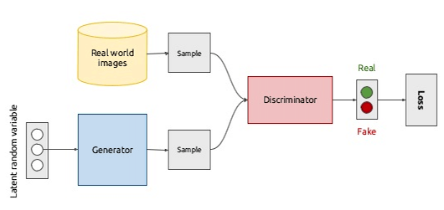
Generative Adversarial ML

Slide 10
This Person Does Not Exist
DNN face classification (or similar task)
Take N last layers as an embedding (weights of the NN)
Every input is a point in the embedding
Interpolate points -> go back to inputs (pixels)
https://thispersondoesnotexist.com/

