Slide 1
Discrete optimization
Alberto TONDA
UMR 518 MIA-PS, INRAE, AgroParisTech, Université Paris-Saclay UAR 3611, Institut des Systèmes Complexes de Paris Île-de-France

Slide 2
Outline
Definition of discrete optimization
Combinatorial optimization
Mixed-integer linear programming
SAT solvers (Boolean satisfiability problem)
Evolutionary algorithms (again)

Slide 3
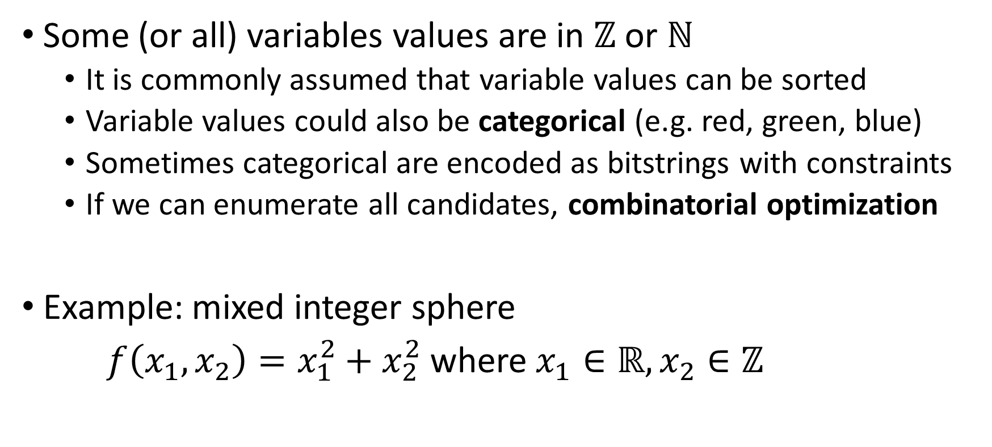
Definition of discrete optimization
Some (or all) variables values are in $ℤ$ or $ℕ$
It is commonly assumed that variable values can be sorted
Variable values could also be categorical (e.g. red, green, blue)
Sometimes categorical are encoded as bitstrings with constraints
If we can enumerate all candidates, combinatorial optimization
Example: mixed integer sphere
$f\left(x_{1},x_{2}\right)=x_{1}^{2}+x_{2}^{2}$ where $x_{1}∈ℝ, x_{2}∈ℤ$

Slide 4
Evolutionary algorithms (again)

Slide 5
Covariance Matrix Adaptation (again)
Classic CMA-ES with continuous variables
Round up the discrete variables to the closest integer

Slide 6
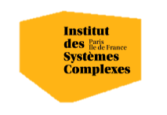

Questions?
Bibliography - Kochenderfer & Wheeler, Algorithms for Optimization, MIT Press, 2019 - Vanderbei, Linear Programming: Foundations and Extensions, 2014 - Hamano et al., CMA-ES with Margin: Lower-Bounding Marginal Probability for Mixed-Integer Black-Box Optimization, 2022
Images: unless otherwise stated, I stole them from the Internet. I hope they are not copyrighted, or that their use falls under the Fair Use clause, and if not, I am sorry. Please don’t sue me.

