Slide 1
Remarks on Deep Learning (I)
Alberto TONDA, Ph.D. (Senior permanent researcher, DR)
UMR 518 MIA-PS, INRAE, AgroParisTech, Université Paris-Saclay UAR 3611, Institut des Systèmes Complexes de Paris Île-de-France

Slide 2
Outline
Neural Networks vs Deep Learning
Why are Neural Networks winning?
Overparametrization
Practical obstacles

Slide 3
Neural Networks vs Deep Learning
What is the difference?

Slide 4
Neural Networks vs Deep Learning
(1) Considerable improvements over classic Neural Networks
New (more effective!) algorithms to optimize parameters
New architectures to deal with structured data
Better software engineering
More computing power available, better results
(2) Rebranding
Interest for Neural Networks declined in the 1990s
At the time, considered less effective than other methods
Any network with more than one hidden layer is “deep”

Slide 5
Neural Networks vs Deep Learning
(1) Considerable improvements over classic Neural Networks
New (more effective!) algorithms to optimize parameters
New architectures to deal with structured data
Better software engineering
More computing power available, better results
(2) Rebranding
Interest for Neural Networks declined in the 1990s
At the time, considered less effective than other methods
Any network with more than one hidden layer is “deep”
But sometimes, “Deep Learning” with just one layer! Inclusive term :-D

Slide 6
Why are neural networks winning?
Lots of competitors! Why is Deep Learning so dominant?

Slide 7
Why are neural networks winning?
On tabular data, they are not winning
Current consensus is that ensembles of boosted trees are better
See Grinsztajn et al. (2022) Why do tree-based models still outperform deep learning on tabular data?
On structured data, they are massively dominant
Remove the need for feature construction (and maybe selection)
Any type of structure: sequences, graphs, images, videos, …

Slide 8
Why are neural networks winning?
Generative models: how can a NNs output an image?

Slide 9
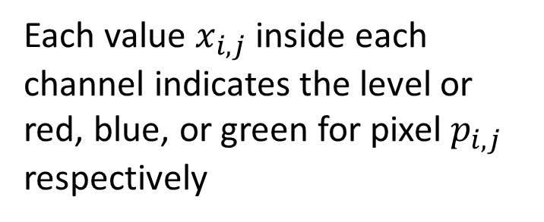
Why are neural networks winning?
Output tensors interpreted as (approximately) anything!
Example: image
Tensor (c * w * h)
Each value $x_{i,j}$ inside each channel indicates the level or red, blue, or green for pixel $p_{i,j}$ respectively
Image channel (w * h)

Slide 10
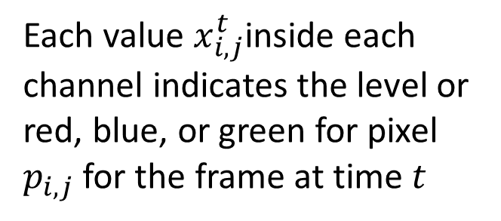
Why are neural networks winning?
Output tensors interpreted as (approximately) anything!
Example: video
Tensor (t*c*w*h)
Each value $x_{i,j}^{t}$inside each channel indicates the level or red, blue, or green for pixel $p_{i,j}$ for the frame at time $t$
Image channel (w * h)
Image channel (w * h)
…
t=0
t=T

Slide 11
Why are neural networks winning?
And when we have to choose between n discrete values?

Slide 12
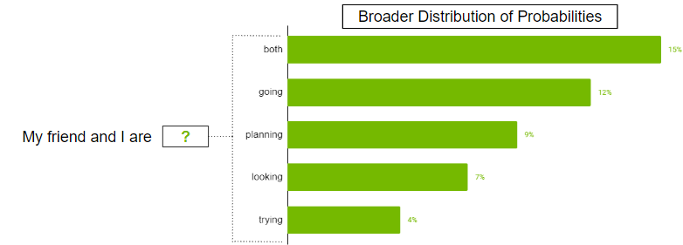
Why are neural networks winning?
Tensor is interpreted as a probability distribution
Each cell in output tensor is “probability” of picking element
Tensor (1 * n)

Slide 13
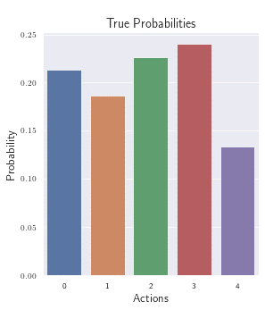
Why are neural networks winning?
Tensor is interpreted as a probability distribution
Each cell in output tensor is “probability” of picking element
Tensor (1 * n)

Slide 14

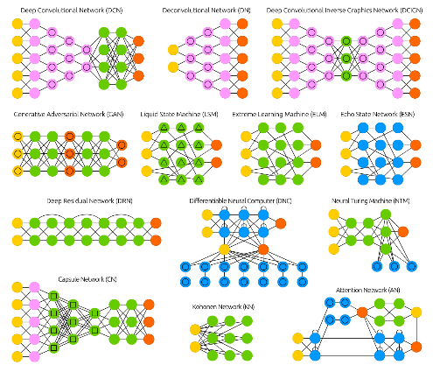
Why are neural networks winning?
General approach, works well in practice
Chaotic and dynamic reality
Some sort of neural network
Tensor (n₁ * n₂ * n₃ …)
Tensor (d₁ * d₂ * d₃ …)
Input tensor (fixed size, meaningful)
Output tensor (fixed size, interpreted)

Slide 15
Why are neural networks winning?
General approach, works well in practice
?
Chaotic and dynamic reality
Some sort of neural network
Tensor (n₁ * n₂ * n₃ …)
Tensor (d₁ * d₂ * d₃ …)
Input tensor (fixed size, meaningful)
Output tensor (fixed size, interpreted)

Slide 16
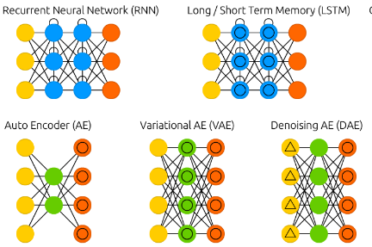
Why are neural networks winning?
General approach, works well in practice
Feature construction
Chaotic and dynamic reality
Some sort of neural network
Tensor (n₁ * n₂ * n₃ …)
Tensor (d₁ * d₂ * d₃ …)
Input tensor (fixed size, meaningful)
Output tensor (fixed size, interpreted)
Notes:
Why is it another neural network?

Slide 17
Why are neural networks winning?
Transfer learning
Really started with Deep Learning
Using multiple layers creates a “funnel” of knowledge
Early layers learn generic problem information, can be reused!
Checkpoints, restarting training is easy
Not unique to neural networks
But it is still an under-researched topic for other ML algorithms
It’s probably more straightforward for DL

Slide 18


Multiple architectures!
https://www.asimovinstitute.org/neural-network-zoo/

Slide 19
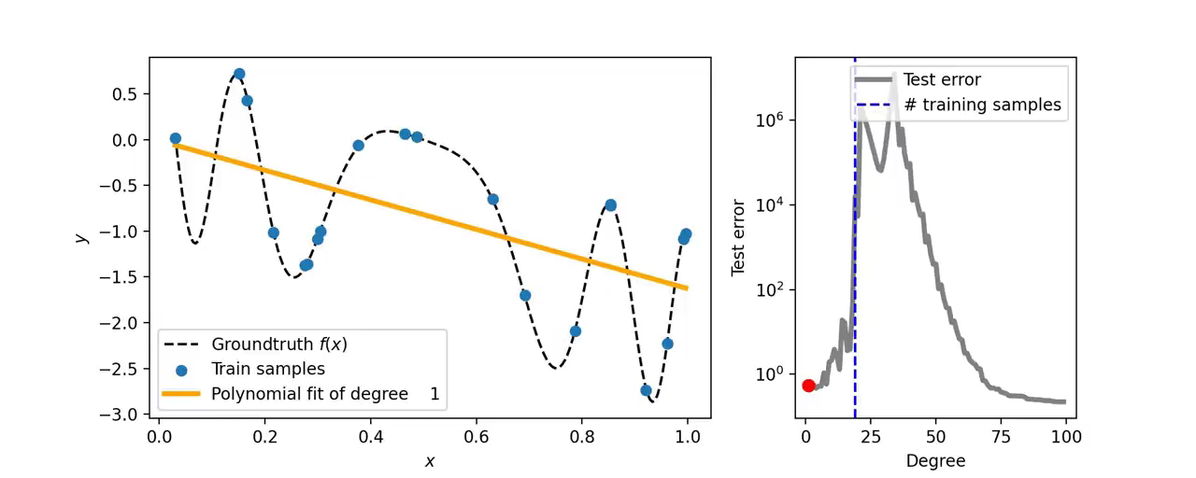
Overparametrization
Wait a second!
From ML, we learned that having too many parameters is bad!
Models with too many parameters tend to overfit terribly…right?

Slide 20
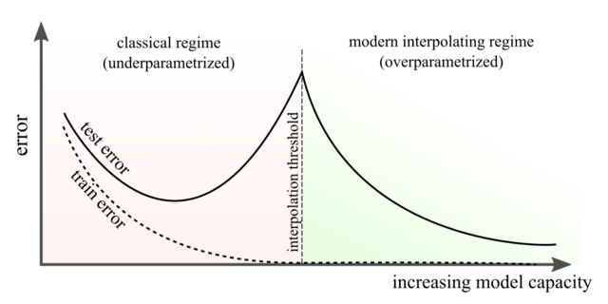
Overparametrization
What is happening here? Well, we don’t really know
Empirical results, overparametrizing improves generalization
“Double descent” or “W figure”

Slide 21
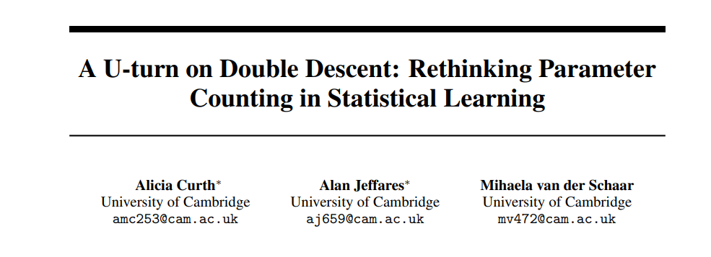
Overparametrization
Research and discussion are still ongoing
Curth, Jeffares, and van der Schaar. 2023. In: Proceedings of NeurIPS

Slide 22
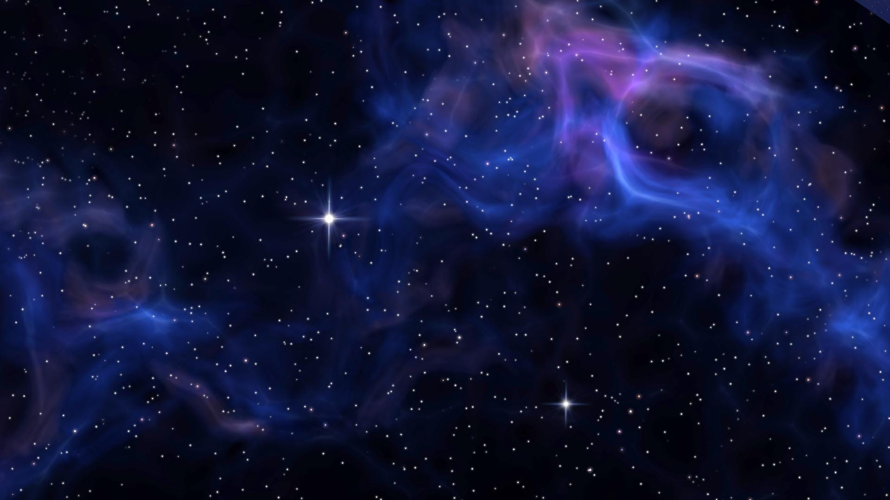
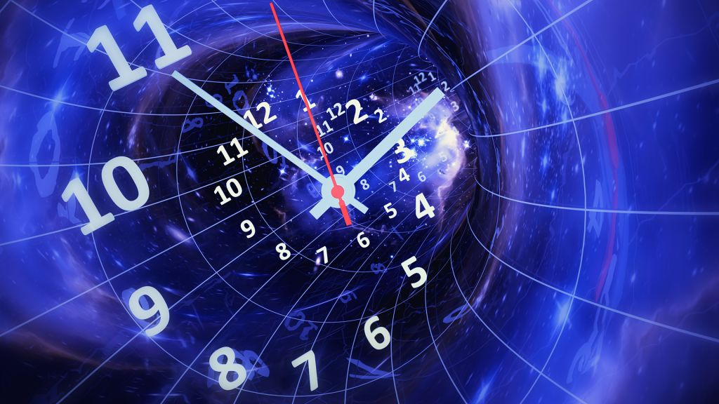


Worst enemies of DL (in this class, at least)
Space
Time

Slide 23
Worst enemies of DL (in this class, at least)
(Disk) Space
Modern DL models contain billions (10⁹) of parameters
GPT-4 has ~220 billion parameters
If a single parameter is a floating point represented on 32 bits…
…that is 220 * 10⁹ * 32 / 8 = 880 Giga Bytes (!!!)
They have to be stored on a hard drive and IN MEMORY!
During training, you’ll need to also store the gradient IN MEMORY!
(Training) Time
Training takes a lot of time, depending on parameter count

Slide 24
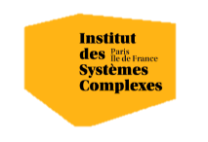

Questions?
Bibliography - Grinsztajn, L., Oyallon, E., & Varoquaux, G. (2022). Why do tree-based models still outperform deep learning on typical tabular data?. Advances in Neural Information Processing Systems, 35. - Curth, A., Jeffares, A., & van der Schaar, M. (2024). A U-turn on double descent: Rethinking parameter counting in statistical learning. Advances in Neural Information Processing Systems, 36.
Images and videos: unless otherwise stated, I stole them from the Internet. I hope they are not copyrighted, or that their use falls under the Fair Use clause, and if not, I am sorry. Please don’t sue me.

