Slide 1
Making sense of CNNs: Visualization techniques
Alberto TONDA, Ph.D. (Senior permanent researcher, DR)
UMR 518 MIA-PS, INRAE, AgroParisTech, Université Paris-Saclay UAR 3611, Institut des Systèmes Complexes de Paris Île-de-France

Slide 2
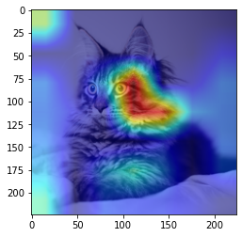
Outline
xAI: eXplainable AI
Visualization of feature patterns
Saliency maps
Grad-CAM

Slide 3
Black-box effect is even worse for CNNs
Feature construction step
What are the features used?

Slide 4
xAI: eXplainable AI
Relatively new research field
“Open the black box”, answer “Why is it behaving like that?”
Local explanation: why behavior for this sample?
Global explanation: why behavior in general, or for a class?
Ongoing discussion
What is the definition of explanation?
Difference between explanation and interpretation
Is it possible to build white-box ML algorithms? Yes, but…*

Slide 5
xAI: eXplainable AI
Model-agnostic methods
LIME
SHAP/SHAPLY
Relative feature importance (e.g. permutation importance)
For CNNs, we have some model-specific methods
Since the models are performing feature construction/extraction
We are not even sure of what the features are!

Slide 6
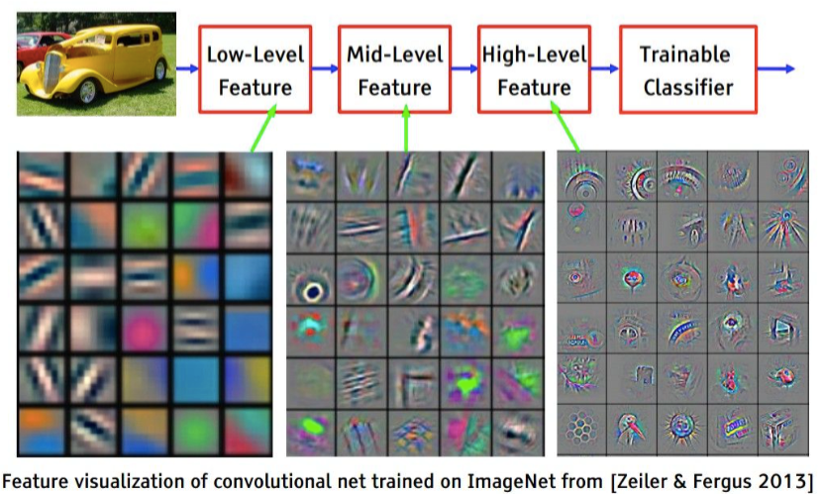
Visualization of feature patterns

Slide 7
Saliency maps

Slide 8
Grad-CAM

Slide 9


Questions?
Bibliography - Selvaraju, R. R., Cogswell, M., Das, A., Vedantam, R., Parikh, D., & Batra, D. (2017). Grad-cam: Visual explanations from deep networks via gradient-based localization. In Proceedings of the IEEE international conference on computer vision (pp. 618-626). - Springenberg, J. T., Dosovitskiy, A., Brox, T., & Riedmiller, M. (2014). Striving for simplicity: The all convolutional net. arXiv preprint arXiv:1412.6806.
Images and videos: unless otherwise stated, I stole them from the Internet. I hope they are not copyrighted, or that their use falls under the Fair Use clause, and if not, I am sorry. Please don’t sue me.

