Slide 1
This is an example of a title, it should be bigger!
Alberto TONDA, Ph.D. (Senior permanent researcher, DR)
UMR 518 MIA-PS, INRAE, AgroParisTech, Université Paris-Saclay UAR 3611, Institut des Systèmes Complexes de Paris Île-de-France

Slide 2
This is a new thing
Ciao
Ciaooooooooooooooo

Slide 3
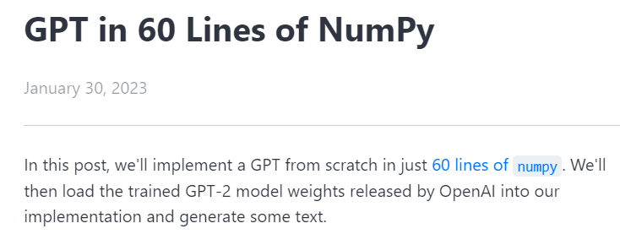
Reference(s)
https://jaykmody.com/blog/gpt-from-scratch

Slide 4
GPT
Generative: A GPT generates text.
Pre-trained: A GPT is trained on lots of text from books, the internet, etc ...
Transformer: A GPT is a decoder-only transformer neural network.

Slide 5
Vocabulary
Vocabulary: limited set of discrete items
For example: all words* in the English language
Vocabulary is used for both inputs and outputs
What is the vocabulary of a Transformer generating text?

