Slide 1
Slides that I should put back in somewhere
Alberto TONDA
UMR 518 MIA-PS, INRAE, AgroParisTech, Université Paris-Saclay UAR 3611, Institut des Systèmes Complexes de Paris Île-de-France

Slide 2
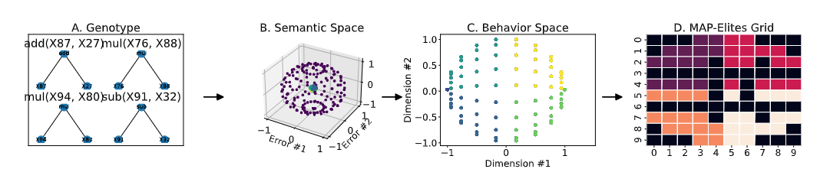
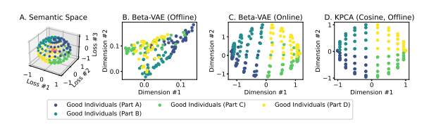
Complex Example: GP+diversity+coevolution
H. Zhang et al., “MAP-Elites with Cosine-Similarity for Evolutionary Ensemble Learning”, EuroGP 2023

Slide 3
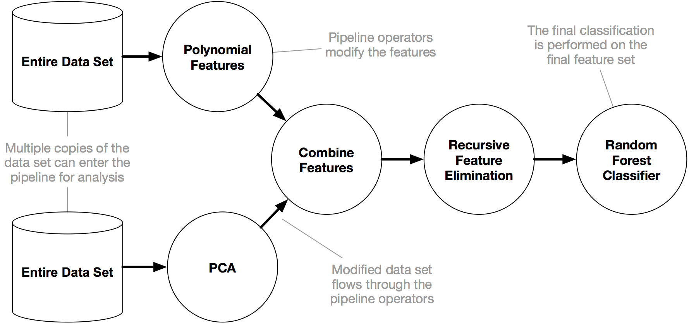
Evolving ML Workflows
TPOT
https://epistasislab.github.io/tpot/
Notes:
In ML, you have several choices to make. How do I normalize the variables? Which variables do I choose?

