Slide 1
Optimization: Advanced Topics
Alberto TONDA
UMR 518 MIA-PS, INRAE, AgroParisTech, Université Paris-Saclay UAR 3611, Institut des Systèmes Complexes de Paris Île-de-France

Slide 2
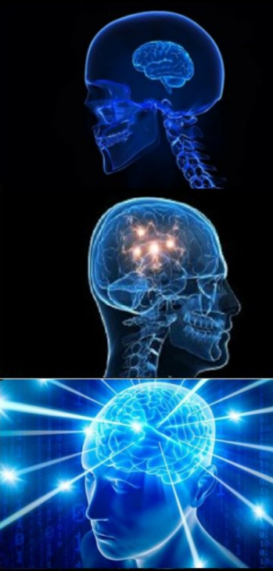
Outline
Finding multiple optima
Deceptive objective functions
Flat objective functions
Expensive objective functions
Optimizing under incertitude
Dynamic objective functions

Slide 3
Finding multiple optima
Multimodal functions
Several global optima
Or a global optimum and several strong local optima
Optimization algorithms tend to end up in the same places
How to force the algorithm to explore other areas?
Any ideas?

Slide 4
Finding multiple optima
BIPOP-CMA-ES
Set a budget with a total number of evaluations
After a run stops for heuristic conditions
Restart the run with larger populations, until budget exhausted

Slide 5
Finding multiple optima
Flattening explored areas of the objective function
Run algorithm once, store best point found
Modify value of objective function around best point
Set the value around best point to undesired (e.g. 0.0 if maximize)
Run the algorithm a second time; iterate several times
“Removing” areas of the search space already explored
Changing the objective function lead algorithms elsewhere

Slide 6
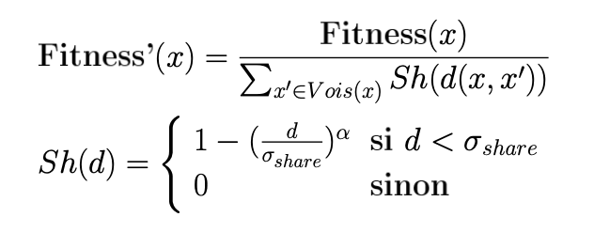
Finding multiple optima
All the techniques require restarting!
Niching: push for exploration during a single runtime
Technique developed for Evolutionary Algorithms
Lower value of candidate solution based on crowding
Isolated solutions are favored
if
otherwise
Optima visited

Slide 7
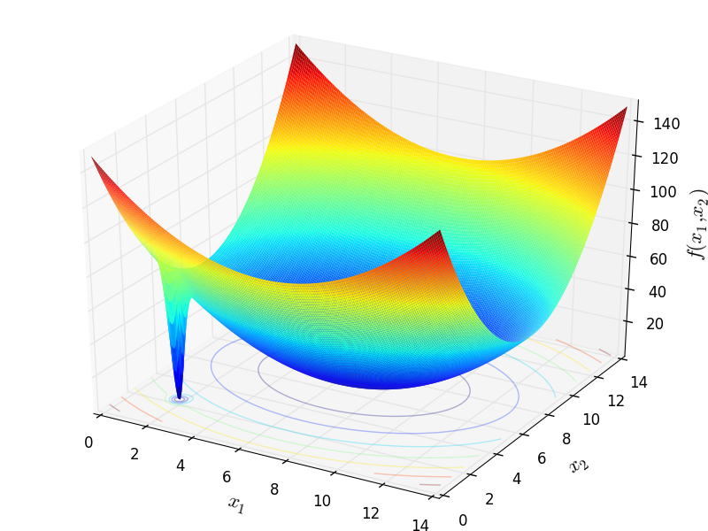
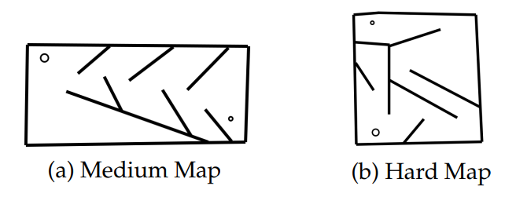
Deceptive objective functions
Feedback from the objective function is deceptive
Following feedback leads away from global optimum
Strong local optima surrounding the global one

Slide 8
Deceptive objective functions
Solution (?): Novelty Search
Ignore feedback from the objective function
Evaluate candidate solutions based on diversity
Keep archive of solutions, search near solutions that are “novel”
Measure novelty: problem-dependent
Example: Average distance from k nearest neighbors
Value of the objective function used to stop

Slide 9
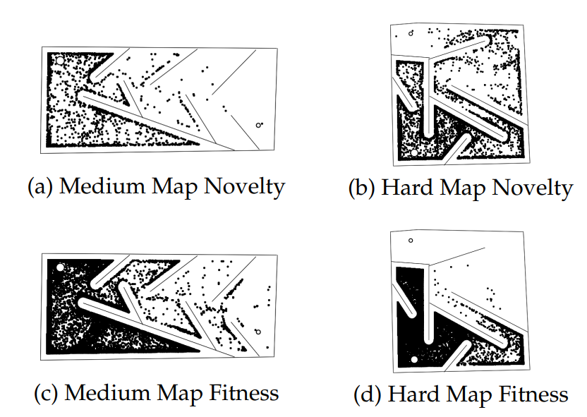
Deceptive objective functions

Slide 10
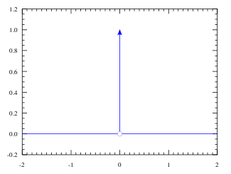

Flat objective functions
Your objective function has the same value everywhere…
…EXCEPT in one (or few) specific points you are interested in
Example: bug in software/hardware
$$f(x)$$

Slide 11


Flat objective functions
There is NO SOLUTION
However, we can smoothen the objective function $f(x)$
Using domain knowledge, create another function $f^{′}(x)$
New function is at least correlated to the “true” one
Global optimum of $f(x)$ is on or near an optimum (local or global) of $f^{′}(x)$
$$f(x)$$
$$f^{′}(x)$$

Slide 12
Flat objective functions
Example: finding bugs in software / hardware
Candidate solution: input to the device under test
Fitness function: we found a bug (crash) / we did not find a bug
Smoothening: number of different functionalities activated
“The more functions activated, the more likely to trigger a bug”
As there are no gradients, stochastic/approximate (EAs)
Meta (Facebook) uses Sapienz to test/debug user interfaces
Motorola used it to test phones (2008)
“Search-based software engineering”

Slide 13
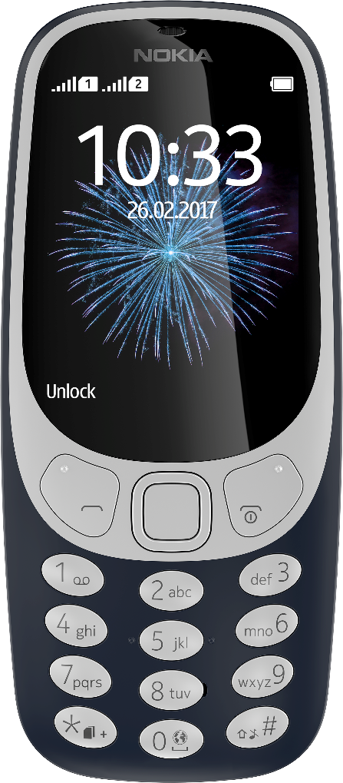
Example
Candidate solution
Evolutionary Algorithm
Sequence of inputs
Objective function value
Bug?
Phone logs
Estimate number of states traversed
Gandini et al., A framework for automated detection of power-related software errors in industrial verification processes, 2010

Slide 14

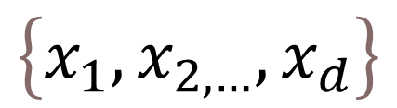
Expensive objective functions
Evaluating one candidate solution takes a lot of time
Surrogate models
With domain knowledge, create function that is faster to compute
Same inputs, output is approximate but useful
Surrogate function discriminates solutions before long evaluation
Objective function
Candidate solution
$$\left\{x_{1},x_{2,…},x_{d}\right\}$$
$$f(x)$$
Value
…a long time

Slide 15

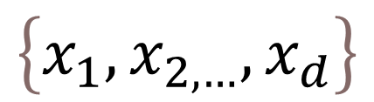

Expensive objective functions
Evaluating one candidate solution takes a lot of time
Surrogate models
With domain knowledge, create function that is faster to compute
Same inputs, output is approximate but useful
Surrogate function discriminates solutions before long evaluation
Surrogate function
Objective function
Candidate solution
Good enough?
$$\left\{x_{1},x_{2,…},x_{d}\right\}$$
$$f′(x)$$
$$f(x)$$
Yes
…a long time
No
Discard

Slide 16
Expensive objective functions
Examples of surrogate models
Classifier (yes/no)
Regressor trained on samples of your original function
A physics-based model with less precision
(ML) Same function, but use only a subset of the samples
However, surrogate models are problem-specific
Require domain knowledge and expertise from user

Slide 17
Expensive objective functions
Bayesian optimization
Use a generic surrogate model, a random function with a prior
Most common methodology uses kriging with Gaussian processes
The surrogate model is updated at each evaluation
Next point explored where surrogate model predicts improvement
Gaussian processes also estimate incertitude around a point
Sampling the point reduces uncertainty around it
De-facto build approximate model of the search space

Slide 18
Expensive objective functions

Slide 19
Optimizing under incertitude
Objective function is noisy or stochastic
Evaluate each candidate solution several times
Obtain a mean and a standard deviation
Compare candidate solutions using statistical tests
Multi-objective: add minimization of standard deviation

Slide 20
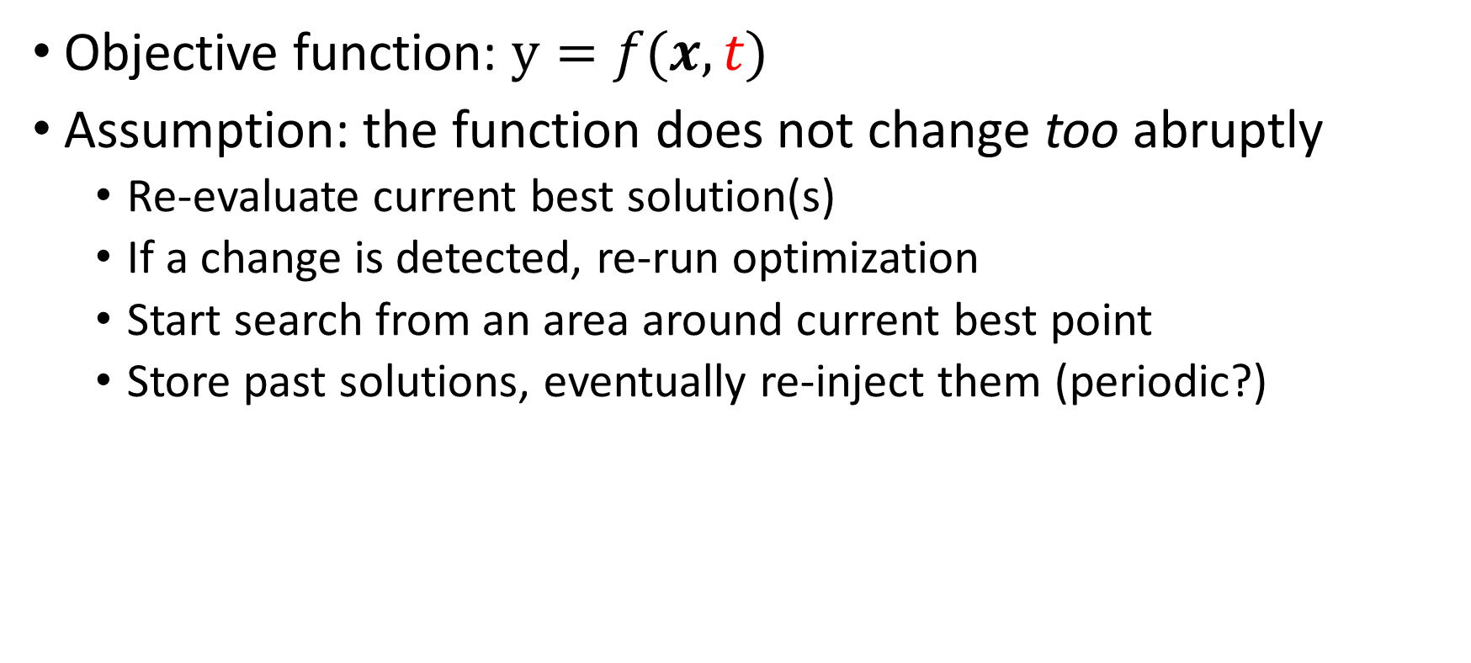
Dynamic objective functions
Objective function: $y=f(x,t)$
Assumption: the function does not change too abruptly
Re-evaluate current best solution(s)
If a change is detected, re-run optimization
Start search from an area around current best point
Store past solutions, eventually re-inject them (periodic?)

Slide 21


Questions?
Bibliography - Lehman & Stanley, Abandoning Objectives: Evolution through the Search for Novelty Alone, 2011 - Alshawhan et al., Deploying Search Based Software Engineering with Sapienz at Facebook, 2018 - Frazier, A Tutorial on Bayesian Optimization, 2018 - Branke & Schmeck, Designing Evolutionary Algorithms for Dynamic Optimization Problems, 2003
Images: unless otherwise stated, I stole them from the Internet. I hope they are not copyrighted, or that their use falls under the Fair Use clause, and if not, I am sorry. Please don’t sue me.

