Slide 1
Classification and AI models
Alberto TONDA, Ph.D. (Senior permanent researcher, DR)
UMR 518 MIA-PS, INRAE, AgroParisTech, Université Paris-Saclay UAR 3611, Institut des Systèmes Complexes de Paris Île-de-France

Slide 2
Why should we care about machine learning?
ML can create predictive (and not only) models from data
Algorithms are (relatively) easy to use, lots of libraries
Great amount of interest (and hype) since 2012
Useful for complex interactions (physics/chemistry/biology)
Details might be difficult, high-level ideas are intuitive
Have you already used any machine learning techniques?

Slide 3
What’s in this presentation?
General overview of machine learning for modelling
Practical advice on algorithms and metrics to use
A couple of exercises in ipython notebooks (browers)
Current trends in machine learning research
Examples on the “données fil rouge”
Funny pictures from the 2000s-2010s, hot takes on ML

Slide 4
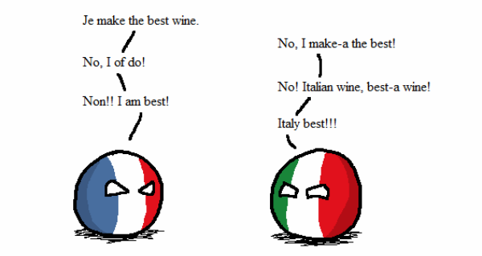
Who am I?
Career
Bachelor and Master in Computer Science Engineering
Ph.D. from Politecnico di Torino, Italy, in 2011
Permanent researcher in France since late 2012 (INRAE)
Senior researcher (DR2) since 2023
Research interests
Stochastic optimization
Machine learning (Explainable AI)
Applied to biological/agri-food data
Notes:
I am NOT an expert of ALL methods that I am going to present.

Slide 5
What is Artificial Intelligence?
Short answer, there is no clear definition
We do not have a good definition of intelligence, so...
Broadly speaking, AI defines a field more than a method
Machine learning, reinforcement learning, symbolic AI, ...
Tentative definitions (there is no agreement)
«When a non-biological being successfully completes a task commonly believed to require biological intelligence»
«Perceiving, synthesizing, and inferring information»
«Efficiency and speed, in learning a new task» (Chollet, 2019)
How do we measure intelligence?

Slide 6
What is Artificial Intelligence?
NARROW / WEAK
Focused on a specific task
Symbolic AI
E.g. rule-based systems
Machine learning
Supervised, unsupervised
Natural language processing
Image recognition/segmentation
Reinforcement learning
Neuro-symbolic AI
GENERAL (AGI)
Can perform any type of (human?) task
Does not exist (...yet?)
Closest thing is NLP: Large Language Models (LLM) like ChatGPT

Slide 7
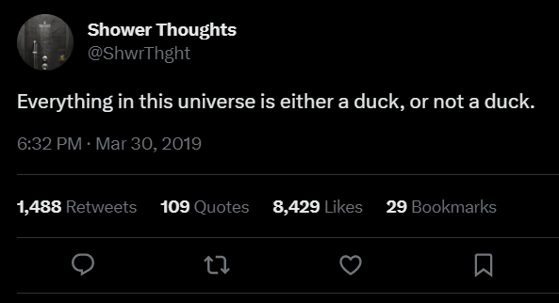
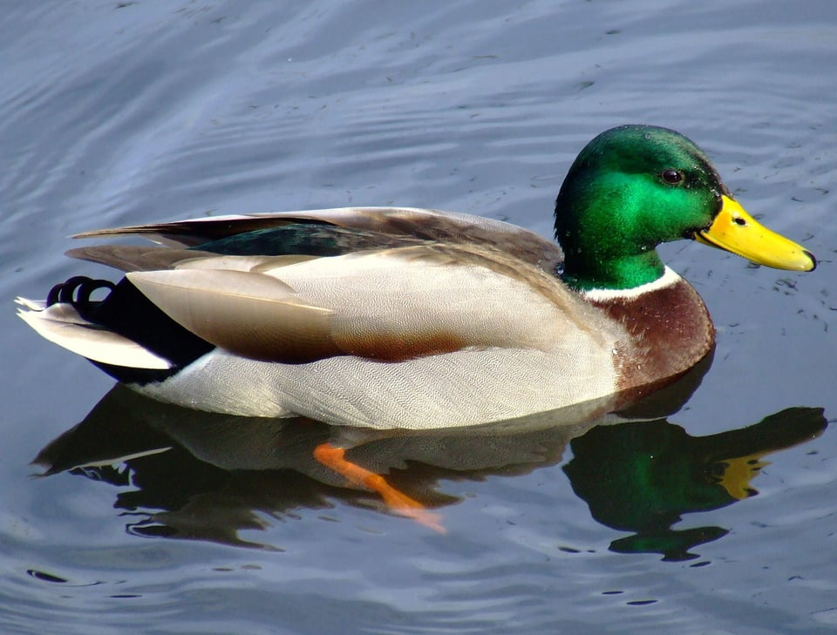
Symbolic AI
Symbolic manipulation
Reality is continuous (with good approximation)
Symbols are discrete, and humans are good at using them

Slide 8
Symbolic AI
Symbols seem normal and natural, map into the real world (in linguistics, it’s called extension)
Natural language is a powerful human symbol manipulator
However, there is chaos hidden under the surface
What is the reality of a river?
What is the reality of a chair?
What is the reality of a number?

Slide 9
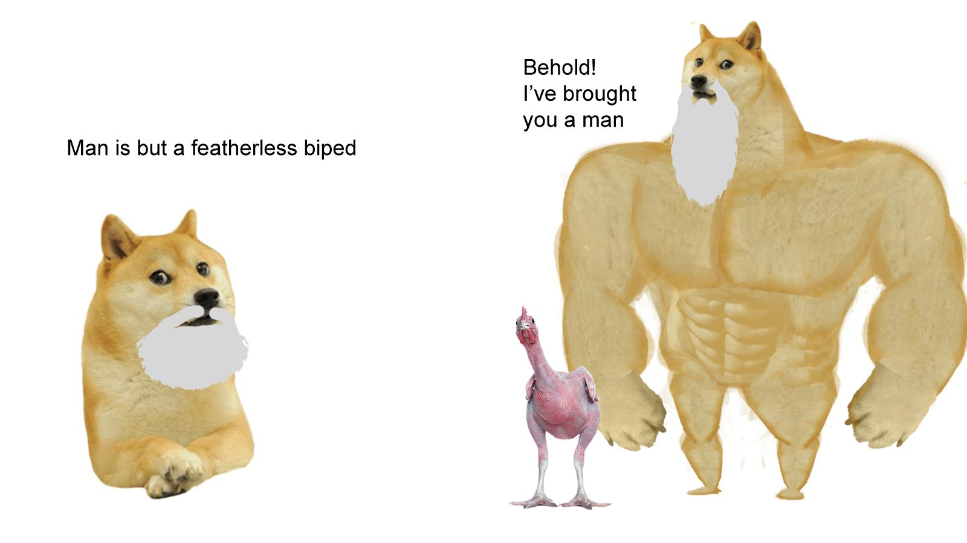
Symbolic AI
Symbol can be hard to define, but we grasp it intuitively
It’s an old, old problem: see Plato and Diogenes
Entire fields of research on this (neuroscience, cognitive sciences, neurolinguistics, …)
“Explaining” symbols to AI is harder yet
Issues with “common sense”
Reached limits in the 1980s

Slide 10
Symbolic AI
In practice, find or exploit human-readable rules
Expert systems (“if-then-else” rules)
Knowledge graphs, linking entities with relationships
First-order logic rules
Ontologies
Decision trees (that are also considered part of ML!)
Before the advent of ML, considerable success stories
Symbolic AI is still in use, paired with ML

Slide 11
Machine learning
Learn a task directly from examples
No need for theory, just large quantities of data
Samples (rows) and features (columns)
“Dirty secret” of ML: it’s mostly optimization
Restate learning task as optimization task
Solve it relying on available (training) data
Learning Task
Optimization Task

Slide 12
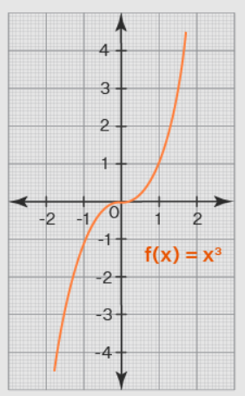
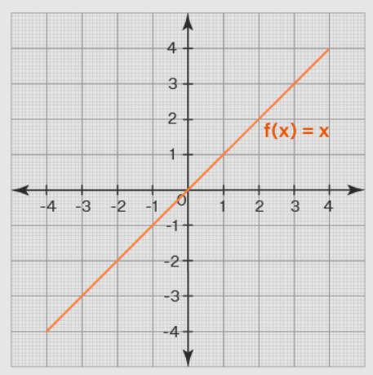

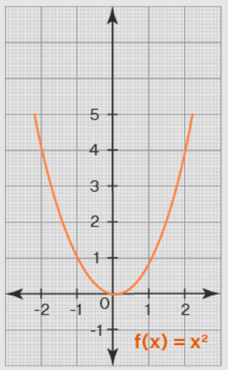
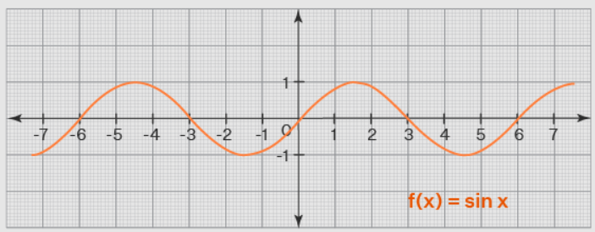
Machine learning algorithms
e
e
ML algorithm (model+optimizer)
e
e
Internal parameters (to be optimized)

Slide 13
Supervised machine learning
Learn from (hopefully) correct examples
Data contains measured values of the target (ground truth)
Minimize difference between model predictions and ground truth
Regression
Target is a continuous value (0.9, 22.5, 0.0017, …)
From the values of the features of a sample, predict target value
Classification
Target is a category (good/bad, high/medium/low, toxic/ok, …)
From the values of the features of a sample, assign to category

Slide 14
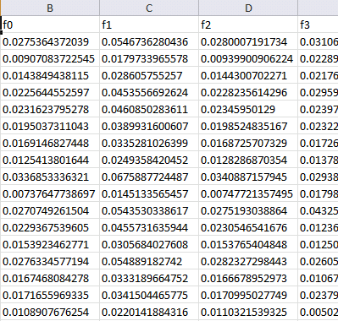
Machine learning (supervised)
Training data
Features
Training...
Predictions
Prediction 1
Prediction 2
Prediction 3
Prediction 4
…
Ground truth
Truth 1
Truth 2
Truth 3
Truth 4
…
ML algorithm (model+optimizer)
Samples
Internal parameters (to be optimized)

Slide 15
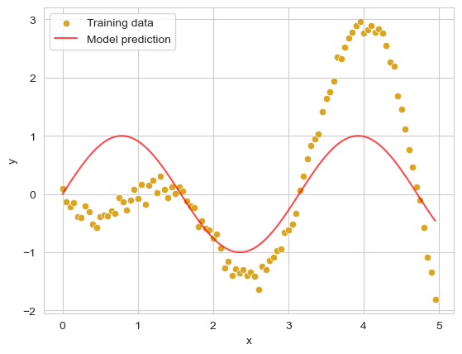
Machine learning (supervised)
Training data
Features
Training...
ML algorithm (model+optimizer)
Samples
Internal parameters (to be optimized)

Slide 16
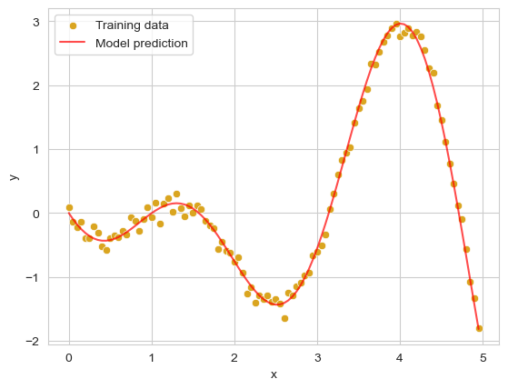
Machine learning (supervised)
Training data
Features
Training...
ML algorithm (model+optimizer)
Samples
Internal parameters
(to be optimized)
Notes:
Here, I can speak about a linear regression

Slide 17
Machine learning (supervised)
Test (unseen) data
Features
Prediction...
ML algorithm (model+optimizer)
Samples
Internal parameters
(fixed)
Notes:
Here, I can speak about a linear regression

Slide 18
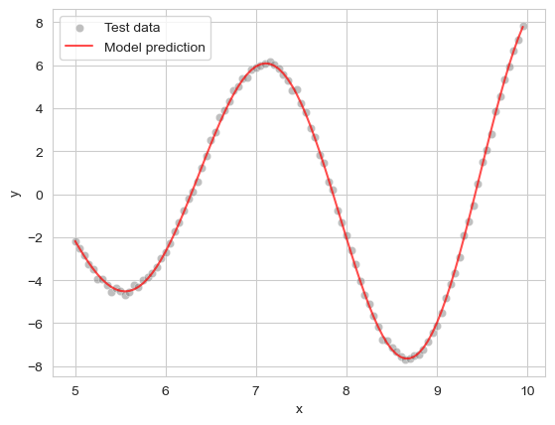
Machine learning (supervised)
Test (unseen) data
Features
Prediction...
ML algorithm (model+optimizer)
Samples
Internal parameters
(fixed)
Notes:
Here, I can speak about a linear regression

Slide 19
Machine learning
Throw your data at a ML algorithm, it will work! …Right?
There is no understanding or (human-like) intelligence
Just fitting a curve, or optimizing a metric (minimize error)
Results can be hard/impossible to interpret

Slide 20
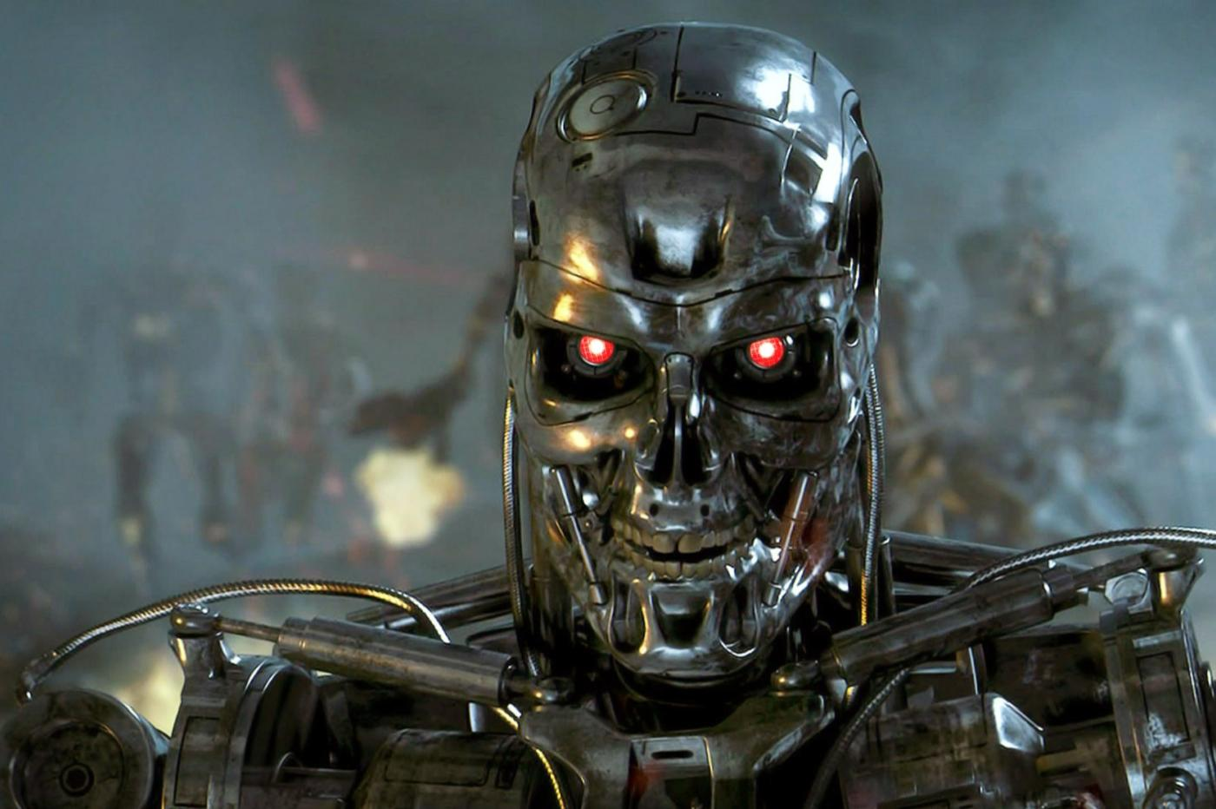
Machine learning
Throw your data at a ML algorithm, it will work! …Right?
There is no understanding or (human-like) intelligence
Just fitting a curve, or optimizing a metric (minimize error)
Results can be hard/impossible to interpret
“Theory”? “Meaning”? Meaning is for MEATBAGS. I only care about OPTIMIZING A FUNCTION.

Slide 21
Machine learning: pre-processing
ML algorithms work with matrices of real values
Remove outliers (it’s really difficult)
How to handle missing values? Drop the row, imputation
Normalization is necessary for some methods (SVM, NNs, …)
Be very careful with normalization!
Learn normalization on training, apply it to test
Convert categorical features (blue/green, high/medium/low)

Slide 22
Machine learning: pre-processing
Categorical features to numbers?
If ordered (high/medium/low), to integers (2/1/0)
If not ordered (red/blue/green), one-hot encoding
Create additional binary (0/1) features, equal to number of values of categorical feature
Set binary feature to ‘1’ and others to ‘0’ to represent values
E.g. red=100, blue=010, green=001

Slide 23
Machine learning: quality metrics
For regression, R2 is a common choice
Technically, using R2 is wrong (assumptions of model linearity)
You should use another metric called Explained Variance
But in practice, the two return really close values
So, in literature people use (incorrectly) R2
Other regression metrics
Mean Squared Error (MSE)
Root of Mean Squared Error (RMSE)
…

Slide 24
Overfitting
Model can learn wrong patterns
Noise in the training data
Information that only exists in that batch of training data (domain shift or covariate shift)
Does not generalize to unseen data, only works for training set

Slide 25
Overfitting
Model can learn wrong patterns
Noise in the training data
Information that only exists in that batch of training data (domain shift or covariate shift)
Does not generalize to unseen data, only works for training set
I found a GREAT VALUE for the optimum! What do you mean by “it only works in training”?

Slide 26
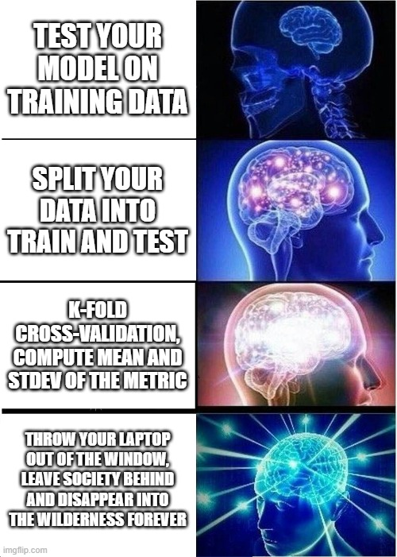
Overfitting
How to deal with overfitting?
Separate data into train and test
Better yet, cross-validation
k-fold (5- or 10-fold)
Leave-one-out
Compute mean and stdev
Cross-validation can also uncover samples that are hard to predict

Slide 27

k-fold cross-validation

Slide 28
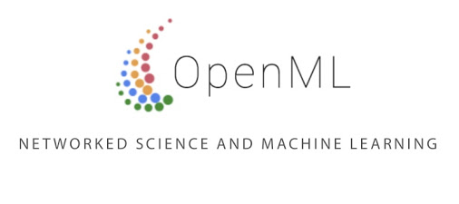
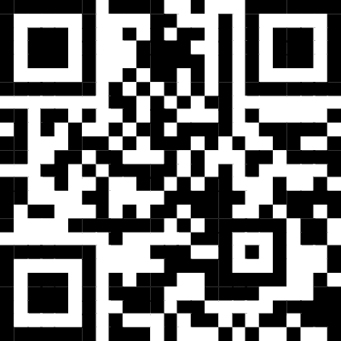
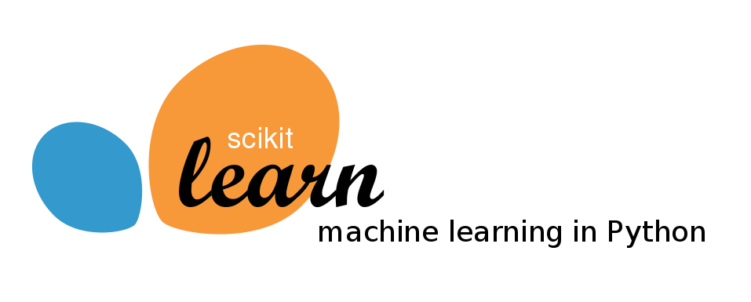
Example #1
tinyurl.com/4t3khrbn
Is everybody familiar with ipython notebooks?
Also in the shared nextcloud space, as .ipyn

Slide 29
Example #1
Did you notice anything interesting?
Did you try running the same cell multiple times?
If you haven’t, try re-running the last cell
Did you always get the same results?

Slide 30
Randomness
Several ML algorithms use random numbers
In optimization, randomness helps escape local optima
In ML proper, increases chances of generalizing well
Most state-of-the-art ML algorithms include randomness
…except that it’s not really random
Generating random numbers in a computer is impossible*
What we generate are pseudo-random numbers
With the same initialization (seed), generates same sequence
Set and store the random seed!

Slide 31
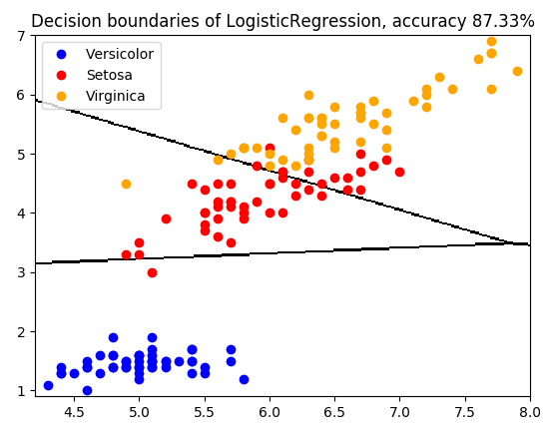
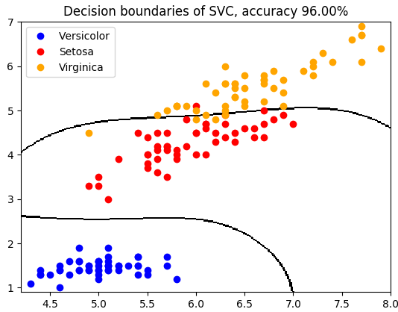
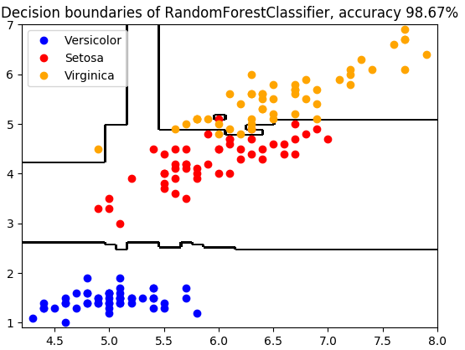
Classification
Regression: find function best approximating training points
Classification: find function best separating training points
Function often called “decision boundary”

Slide 32
Classification
How to evaluate classification quality?

Slide 33
Classification
How to evaluate classification quality?
Accuracy
Ratio of correct answers over total answers
Easy to understand and interpret (closer to 1.0 is better)
Issues with accuracy
Imbalanced class labels (if two classes, further from 50-50)
Do you have Type I diabetes? Always answer “no”, accuracy: 99.9%
We need to take into account relative class numerosity

Slide 34
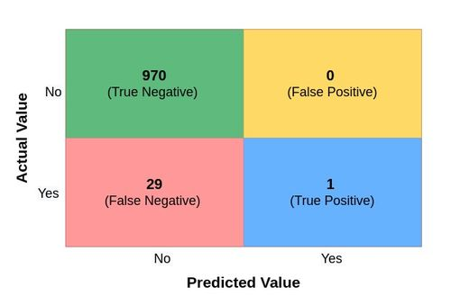
Classification
How to evaluate classification quality?

Slide 35
Classification
How to evaluate classification quality?
Accuracy: 971 (samples correctly classified) over 1,000 (total samples) = 0.971
However, the probability of correctly classifying a sample of class “Yes” is 1/30 = 0.033

Slide 36
Classification
How to evaluate classification quality?
Maximize performance? Easy! If I always predict class “No”, I reach 0.971 accuracy.

Slide 37
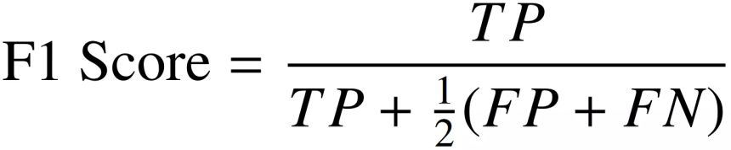

Classification
How to evaluate classification quality?
F1 score
Matthew’s Correlation Coefficient (MCC)
Easier to interpret, behaves similarly to accuracy score, close to 1.0 is better

Slide 38
Classification
How to evaluate classification quality?
Accuracy: 971 (samples correctly classified) over 1,000 (total samples) = 0.971
However, F1 score is 1/(1+1/2*(29)) = 0.06

Slide 39
Classification
What if we cannot define a “positive” or “negative”?
Compute F1 using each class as “positive”, return average

Slide 40
Classification
Class “Yes” is “positive”, F1 = 1/(1+1/2*(29)) = 0.06
Class “No” is “positive”, F1 = 970/(970+1/2*(29)) = 0.985
F1 score (average) = 0.5225

Slide 41

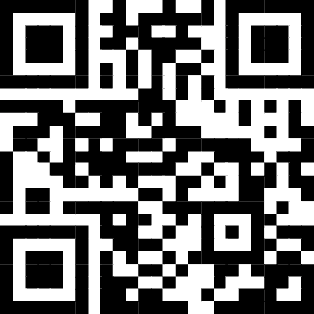
Example #2
tinyurl.com/mr2k3s2j
Also in the shared nextcloud space, as .ipyn

Slide 42
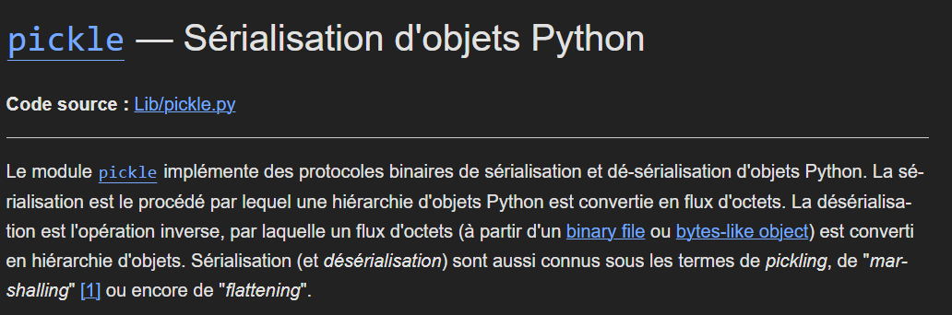
What if I want to save and load models?
Pickle!

Slide 43
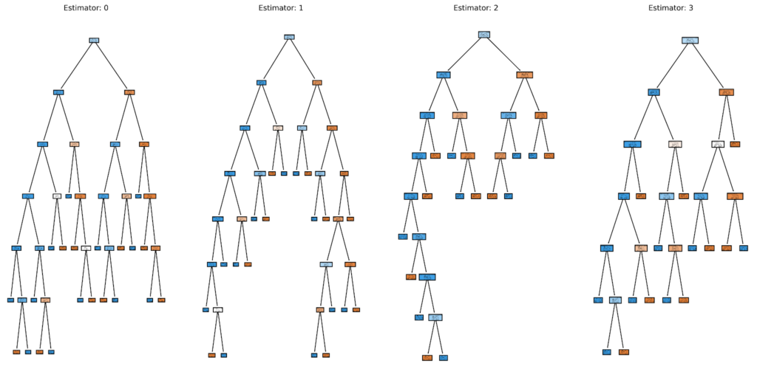
Interpretability of the models
Once trained, ML models are hard or impossible to interpret
It’s giving a prediction, but why?
A “ML model” can look like 100k numbers
Or 100+ decision trees (e.g. Random Forest)

Slide 44
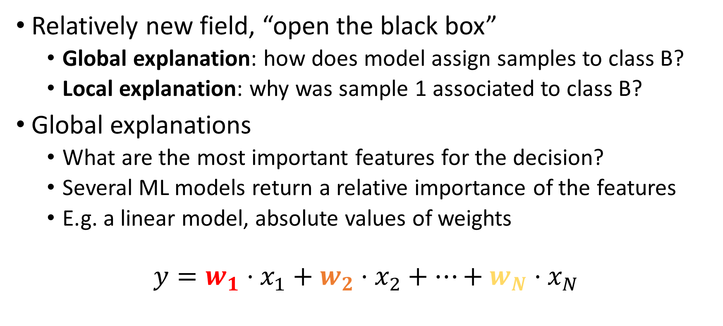
Explainable AI (XAI)
Relatively new field, “open the black box”
Global explanation: how does model assign samples to class B?
Local explanation: why was sample 1 associated to class B?
Global explanations
What are the most important features for the decision?
Several ML models return a relative importance of the features
E.g. a linear model, absolute values of weights
$$y=w_{1}⋅x_{1}+w_{2}⋅x_{2}+…+w_{N}⋅x_{N}$$

Slide 45
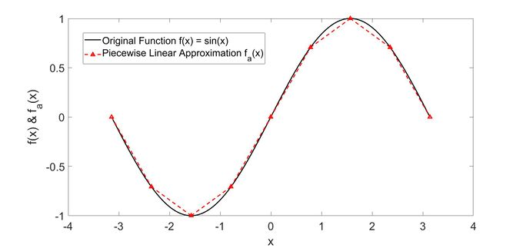
Explainable AI
Local explanations (LIME)
Approximate function described by ML as piecewise linear
Check weights of the linear function around a sample

Slide 46
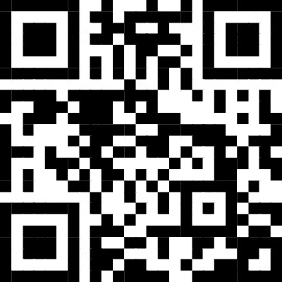

Example #3
tinyurl.com/y4tk6yfn
Also in the shared nextcloud space, as .ipyn

Slide 47

White-box machine learning
Symbolic regression
*
Operators: +, -, *, /, ln…
Terminals: real, int, feature, …
-
ln
0.2
x
*
10
y
$$f\left(x,y\right)=\left(0.2−x\right)∗ln⁡(10 ∗y)$$

Slide 48
White-box machine learning
SR is an evolutionary algorithm (optimization technique)
Return best solution(s)
Yes
Stop condition reached?
Generate and evaluate
initial population
Select parents and create offspring
Evaluate new solutions
Remove worst solutions
No

Slide 49
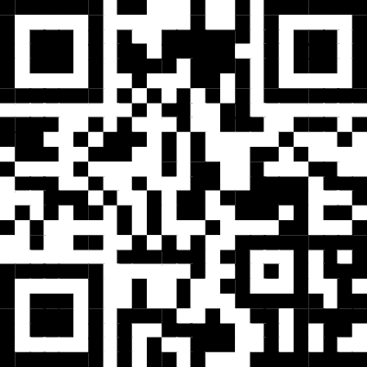
Example #4
tinyurl.com/yc39wert
Also in the shared nextcloud space, as .ipyn

Slide 50
Unsupervised…?
What if we have no ground truth? What do we optimize?
Find good dimensionality reduction for visualization (PCA)
Find groups of samples that behave similarly (clustering)
Train a generative model for text or images (stable diffusion, transformers, …)
Optimize a metric linked to what we want to obtain

Slide 51
Tabular data vs Relational data
Specific algorithms work better on tabular or relational data
Tabular data (Excel spreadsheet)
Order of columns or rows does not matter
Example: most data sets
Best algorithms: Random Forest, XGBoost, CatBoost
Relational data
Adjacencies between samples or features have meaning
Example: time series, images, videos, sounds, DNA/RNA, …
Best algorithms: Neural Networks (Deep Learning)

Slide 52
Hyperparameter tuning and AutoML
ML algorithms have hyperparameters
Number of trees in an ensemble
Number of layers in a neural network
Type of kernel in a support vector machine
…
Values of hyperparameters have influence on performance
How do we select the best values?

Slide 53
Hyperparameter tuning and AutoML
Simple approach: trial and error
Try combinations of values, pick the best on training data
Probably best to have training, validation and test sets
Grid search, Random search, Halving search…
Advanced: AutoML
Frame search for hyperparameters as an optimization problem
TPOT, Auto-sklearn, Auto-Weka (Java), …

Slide 54
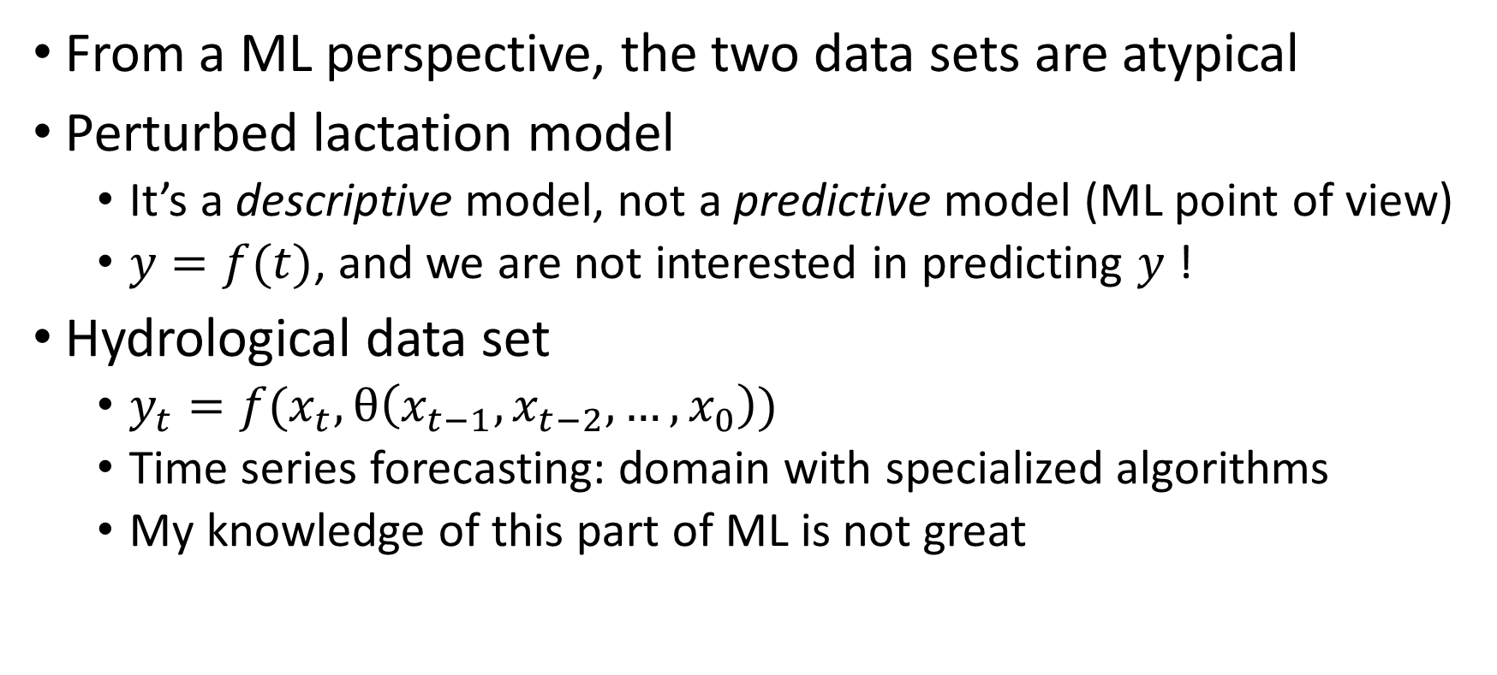
Données fil rouge: issues
From a ML perspective, the two data sets are atypical
Perturbed lactation model
It’s a descriptive model, not a predictive model (ML point of view)
$y=f(t)$, and we are not interested in predicting $y$ !
Hydrological data set
$y_{t}=f(x_{t},θ\left(x_{t−1}, x_{t−2}, …, x_{0}\right))$
Time series forecasting: domain with specialized algorithms
My knowledge of this part of ML is not great

Slide 55
Perturbed lactation model
What do we optimize?
Minimize error? Easy! With “only” 3,200 perturbations, I can reach MSE=0.00001

Slide 56
Perturbed lactation model
What do we optimize?
Certainly not MSE/R2 on unseen data, it’s not predictive
We want a good fitting on training data (minimize error)
We also want to use as few perturbations as possible (minimize number of perturbations)
Fitting curve with thousands of perturbations is easy
It’s also useless for the human expert
What kind of optimization problem does this look like?

Slide 57
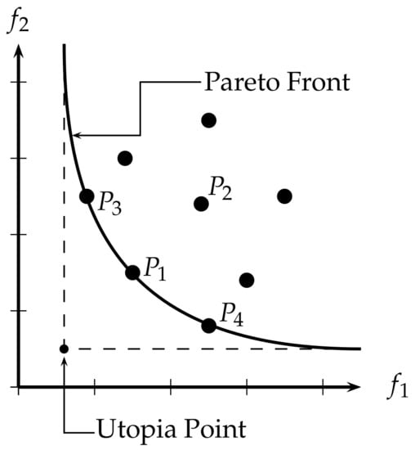
Perturbed lactation model
Pareto front, error vs number of perturbations (complexity)
Error
Each point represents a different candidate solution, a compromise between error and complexity
Number of perturbations

Slide 58
Perturbed lactation model
What is the shape of a candidate solution?

Slide 59
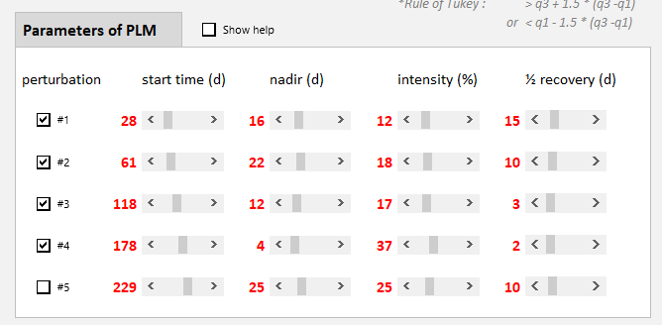
Perturbed lactation model
What is the shape of a candidate solution?

Slide 60
Perturbed lactation model
What is the shape of a candidate solution?
A variable number of perturbations (np_min, np_max)
Each perturbation has 4 parameters: (start time, nadir, intensity, recovery)
For each parameter, set a minimum and a maximum
Once all details are defined, we have the search space
The search space is the collection of all possible solutions
We want to find the best ones! How to explore this space?

Slide 61
Perturbed lactation model
Stochastic exploration, evolutionary algorithms
Return best solution(s)
Yes
Stop condition reached?
Generate and evaluate
initial population
Select parents and create offspring
Evaluate new solutions
Remove worst solutions
No

Slide 62
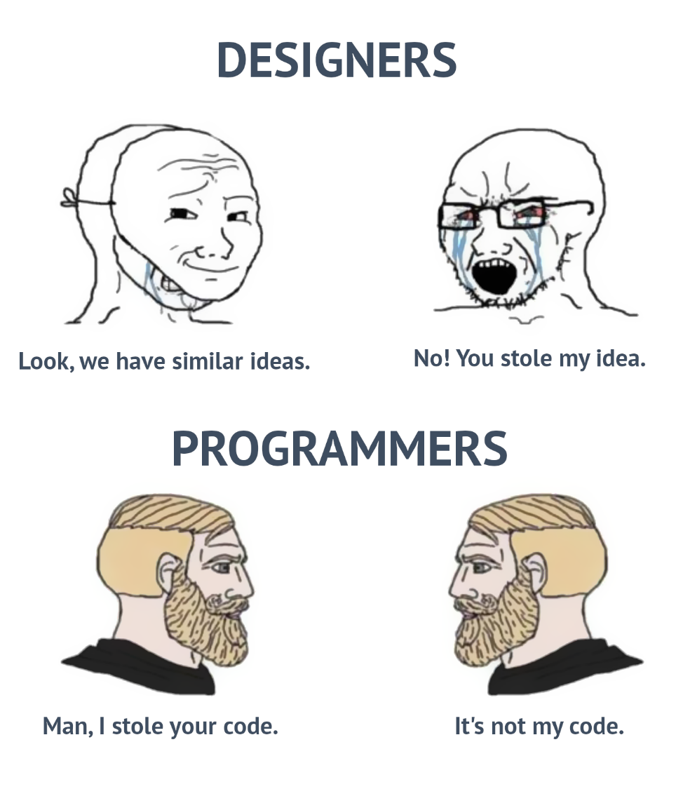
Example #5 (does not exist)
François Bourgin gave me working code
But I did not manage to make it run
(Sorry)

Slide 63
Practical advice
Data preprocessing? Yes! Careful normalization, imputation
Imbalanced data? Weights assigned to samples, resampling
Tabular data? XGBoost, CatBoost, or Random Forest
Structured data? Neural networks (CNNs, RNNs, Transf.)
Hyperparameter tuning? Don’t do it. Or AutoML. Or pretend
Classification? F1, MCC, AUC, confusion matrix
Regression? R2, MSE, RMSE
What matters most? Quality of the data

Slide 64
Practical advice
How much data do we need?
All the data you have! And more
~50 samples per class…?
It depends on how hard your problem is
There is no way to know without trying
Which algorithm should I choose?
There is no silver bullet
Try as many as you can (AutoML)

Slide 65
(Near) future: Hybrid models
The best of two worlds!
Differential equation models…
…with a ML part, able to take into account complex interactions, hard to describe with equations
In general, models with ML + codified expert knowledge
Physics-inspired neural networks are another example
Data-driven nature of ML, plus expert constraints

Slide 66
THANK YOU FOR YOUR TIME! QUESTIONS?
alberto.tonda@inrae.fr

