Slide 1
Crash course on data science
Alberto Tonda, Ph.D., Senior permanent researcher (DR)
UMR 518 Mathématiques et Informatique Appliquées - PS, INRAE, U. Paris-Saclay UAR 3611 Institut des Systèmes Complexes Paris Ile-de-France, CNRS
alberto.tonda@inrae.fr

Slide 2
Objectives of this class
Give you an idea of what happens “under the hood” of a PC
Good practices for organizing your data and code
Improve speed, replicability of experiments
Caveats
Strong focus on Python, advice might not generalize well
Practical advice, theory might not be 100% accurate
Mostly taken from my own experience, might not be best
Pacing might be an issue; too many topics, not enough

Slide 3
Subjects
A quick glance at computer science
Version control with git
Good practices of coding (in Python)
Machine learning

Slide 4
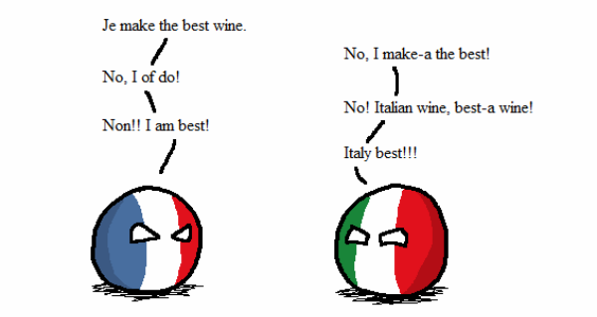
Who am I?
Career
Bachelor and Master in Computer Science Engineering
Ph.D. from Politecnico di Torino, Italy, in 2011
Permanent researcher in France since late 2012 (INRAE)
Senior researcher (DR2) since 2023
Research interests
Stochastic optimization
Machine learning (Explainable AI)
Applied to biological/agri-food data

Slide 5
Questions?

