Slide 1
Good coding practices (in Python)
Alberto Tonda, Ph.D., Senior permanent researcher (DR)
UMR 518 Mathématiques et Informatique Appliquées - PS, INRAE, U. Paris-Saclay UAR 3611 Institut des Systèmes Complexes Paris Ile-de-France, CNRS
alberto.tonda@inrae.fr

Slide 2
Another example of title for a slide
This is some text
And some smaller text

Slide 3
Why is this tricky to explain?
There are a lot of interdependent pieces
Definitions kinda depend on each other
Usually I learn a language by trying to do something with it
We might swing from trivial to extremely difficult concepts!

Slide 4
Why Python?
High level of abstraction
Just like MatLab, or R: don’t bother with small details (memory)
Easy(-ier) to learn than lower-level languages (C++)
Widely used in research
Open source, seen as an alternative to MatLab
Interpreted, same program can run on Windows/Linux/Mac
Vast amount of libraries
Since it’s easy to use, lots of people added their own packages
Especially for Machine Learning/Data Science

Slide 5
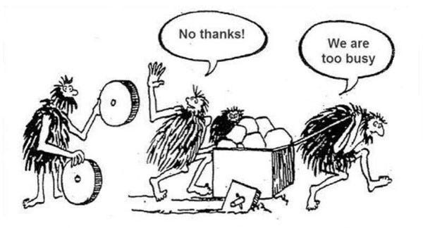
Libraries, packages, …?
Collection of code written by someone else
Popularity of languages heavily depends on libraries
In Python, they are called packages
Python has a considerable amount of packages!
Do not reinvent the wheel
Check if someone else already did it
Learn to use their code

Slide 6



Integrated Development Environment
In theory, you can edit code using a text editor
In practice, much better use an IDE
Editor, debugger, help installing packages, autocompletion, etc.
Some IDEs also have AI code autocompletion! Don’t trust it 100%
For Python, I have experience with
Anaconda suite and Spyder (IDE)
Visual Studio Code
PyCharm is another popular IDE

Slide 7
Integrated Development Environment
Let’s install the full Anaconda suite!
If you already have Anaconda, install VSCode

Slide 8
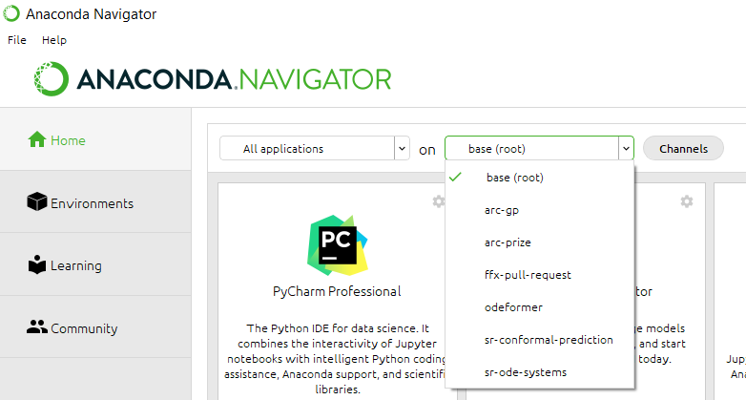
Environments
Set of installed libraries
There are several ways of obtaining separate environments
Why should we do that?
Install only needed packages, and specific versions
Create minimal list of packages
Obtain requirements.txt

Slide 9
Coding: basics
What happens when you click “Run” on your IDE?
“python name_of_your_script.py” in the background
The directory where your script is run is the working directory
It’s important to know, for relative paths, e.g. “../data/myfile.txt”
For example, Spyder and VSCode used different choices of wd
In doubt, check working directory with pwd()
You can change the working directory in the code, if needed
In general, get used to Google around for information
Or ask ChatGPT/Copilot (but beware!)

Slide 10
Coding: variables and data types
Python has several basic data types
Booleans (bool), ints (int), floating point (float), strings (str), tuple
Lists (list), dictionaries (dict)
Other data types are usually objects imported from packages
Why do data types exist?
Python is an untyped (or semi-typed) language
As in, you are not forced to declare the type of each variable
Python interpreter “guesses” data type from “a = 12” or “b=2.5”
Typing your code can be useful for debugging or readability

Slide 11
Coding: variables and data types
In Python, you can declare variables anywhere in the code
Variables are only accessible inside the scope they are declared in
What is a “scope”? A region (part) of a program
A function, a loop*, a branch*
You can declare global variables (accessible from everywhere)…
…but don’t do it; just never do it
https://github.com/albertotonda/crash-course-data-science/

Slide 12
Value and reference
Variables can be used by value or by reference
Assignment/use by value
The variable represents an area of memory containing a value
Their value is copied to another area of memory (independent)
This is what happens for bool, int, float, string, tuple
Assignment/use by reference
The variable represents a pointer to an area of memory with value
The pointer is copied, but still points to the same memory area
Modifying the copy also modifies the original (!!!)

Slide 13
Value and reference
a=12
list_a=[1,2,3]
 | 12
 |  |  | 13
 | 1 | 2 | 3
b=a+1
list_b=list_a
 | 12 | 2 | 3
list_b[0]=12
print(list_a[0])
“12”

Slide 14
Value and reference
What I just said is not completely correct
Actually, in Python everything is stored by reference
However bool, int, float, string, tuple are immutable
So, if you try to modify an immutable, you create a copy
In practice, it works as assignment by value

Slide 15
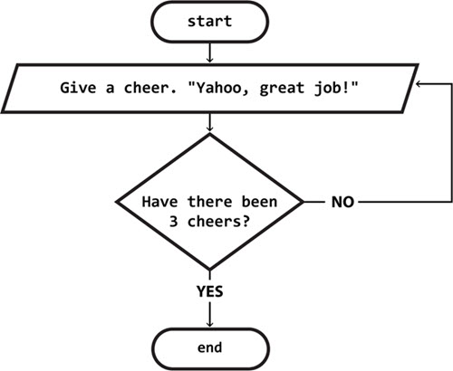
Coding: flow
A program is typically executed top-down, line by line
However, you can change the flow
Flow control (if – then – else )
Loops (while / for)
Flow control is based on Booleans
True/False conditions
Boolean algebra! AND/OR
a AND b is True only if both a == b == True
a OR B is True if either a == True, or b == True
NOT a is True is a == False

Slide 16
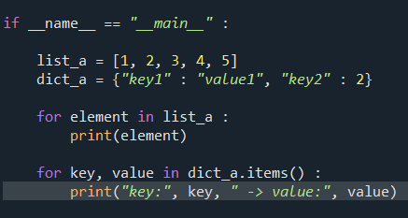

Coding: loops
Python easily iterates over elements in list or dict
Sometimes you need a numerical index; use enumerate

Slide 17
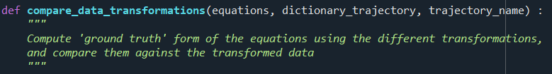
Coding: organizing your code
Signature
Organize your code
Instead of cut/pasting your code
Define functions, structures, objects
Functions
Isolated parts (scopes) of code
Useful when called multiple times, or to reason in isolation
Everything stays inside, but beware of references!

Slide 18
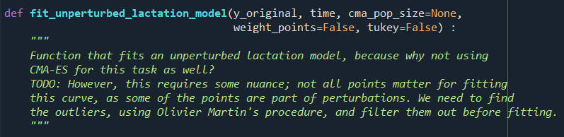
Coding: organizing your code
Functions can have default values for arguments in signature
When the function is invoked, unspecified arguments will have their default values

Slide 19

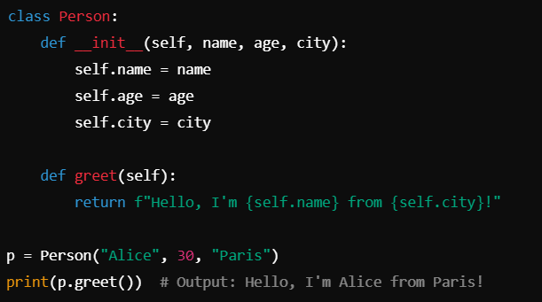
Coding: organizing your code
Structures are collections of variables
Useful when you have information related to the same thing
E.g. a person’s name, surname, age, …
In Python it’s probably better to use dictionaries or Classes

Slide 20
Coding: using different files
Once you have a function, you can re-use it over and over
You can even put it in a separate file and import it!
If it’s in the same folder, just “import <filename>”
Use function as “filename.my_function(argument1, argument2)”
Usefulness of if __name__ == “__main__” for imports
If you have a lot of related, useful functions, you could even consider creating a package and make it available!

Slide 21
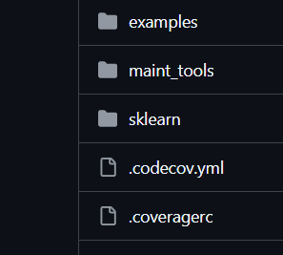
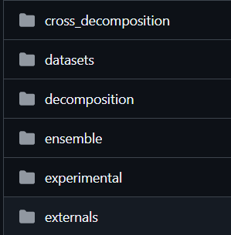
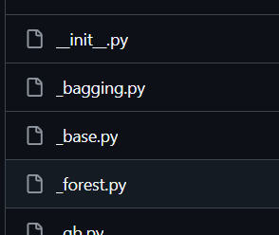
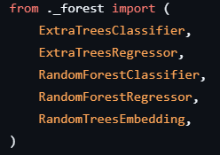
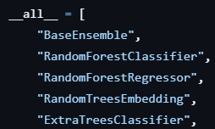
Coding: using different files
In fact, you can import a whole folder!
All scripts inside the folder are accessible
import folder.scriptname
from folder.scriptname import functioname
Packages are structured folders, potentially with subfolders
E.g. sklearn.ensemble.RandomForestRegressor

Slide 22
Coding: organizing your code
Different views
Classic: structures and functions
Object-oriented: classes, attributes, and methods
Objects are instances of the same Class
Each object can contain variables, called attributes
And functions, called methods
Why add functions to an object? Maybe you need to perform some procedure that depends on its attributes

Slide 23
Coding: objects
Object A1
Builder()
Attributes1
Methods
Objects A1…A3 are also called instances of Class A
Class A
Attributes
Methods
Object A2
Python syntax
Attributes: object.attribute
Methods: object.method()
Attributes2
Methods
Object A3
Attributes3
Methods

Slide 24
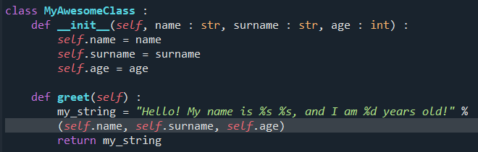
Coding: objects
Builder method (always called __init__())
Assigns values from the arguments to the internal attributes
self is a reference to the current instance of the Class
Builder
Other method

Slide 25
Coding: objects
An interesting method: __str()__
Generates a string representation of your objects
Called automatically if someone tries to print(object)
Can we implement it for MyAwesomeClass?

Slide 26
Coding: objects
Object-oriented programming is a dominant paradigm
Why? Several advantages
Using objects is easier* than structures and functions
Classes can inherit attributes and methods from each other
This allows for easy creation of new classes with same methods

Slide 27
Coding: objects
Object B1
Builder()
Attributes1
Methods
Objects B1…B3 are instances of Class B
Class A
Class B(A)
Attributes
Methods
Attributes(A)
Methods(A)
Attributes(B)
Methods(B)
Object B2
Attributes2
Methods
Class B inherits (some) attributes and methods from Class A
Object B3
Attributes3
Methods

Slide 28
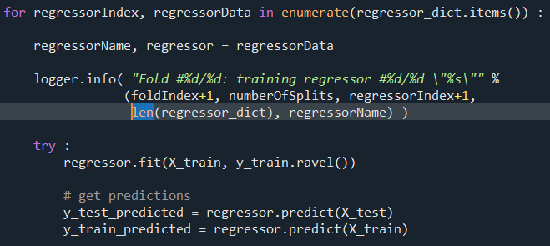
Example: scikit-learn
Regressors and classifier inherit from BaseEstimator
So they all share the same methods .fit() and .predict()
We can use all of them with the same calls!
Even if we don’t know the exact type of regressor!

Slide 29
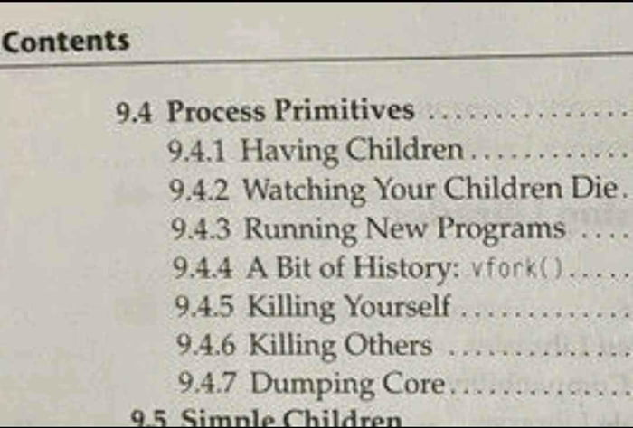
Coding: parallel computations
Modern microprocessors can run several programs in parallel
Multi-threading or multi-processing
This can save a lot of time! But it’s not easy, and OS-dependent
Multi-process
Copies the whole memory of the program
It’s a separate scope, it needs to return info
Multi-thread
All parallel processes share same memory
They need to coordinate to access it!

Slide 30
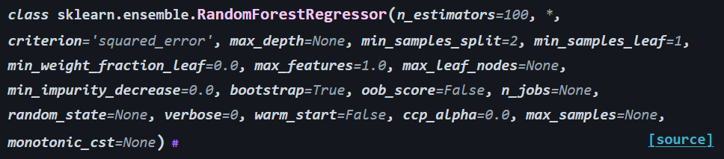
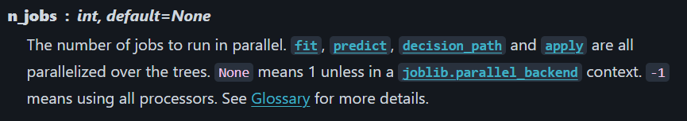
Coding: parallel computations
Python is often not super-efficient with multithreading
This is due to the Global Interpreter Lock
Go for multiprocessing, if you can
In many cases, parallelization has been done for you
For example, scikit-learn methods have a n_jobs argument
They exploit parallelism on n_jobs processes

Slide 31
Coding: scripts vs notebooks
Notebooks are good for teaching, data analysis, visualization
Mix of text and Python code cells; you can write notes!
Run everything online in Google Colaboratory
However, be really really careful with code execution
Variables of previously executed cells stay in memory
Running same cell multiple times may lead to undesired effects
I use notebooks for prototyping and plotting images

Slide 32
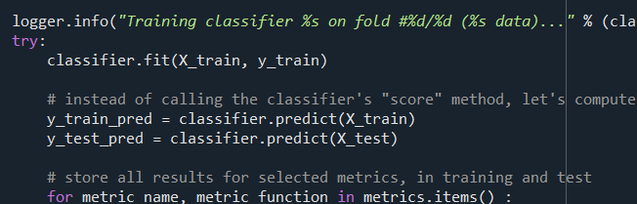

Coding: what if there is a crash?
We call them exceptions
You can actually manage exceptions, if you expect them (hehe)
In a block of code “if something bad happens”, run a branch
try/except construct

Slide 33
Make your code understandable
Put A LOT OF COMMENTS EVERYWHERE
“Code is there to explain comments to the computer”
Your future self will thank you!
Naming conventions
more_readable_with_underscores than CamelCase
everything_lowercase, ClassNames are uppercase/camel

Slide 34

Make your code understandable
Coders used to use short names for variables (memory!)
Variable naming
Use long names, who cares?
Names of variables should be just nouns
Function naming
Function names should be verbs (they do something)
Again, you can and should use long names

Slide 35
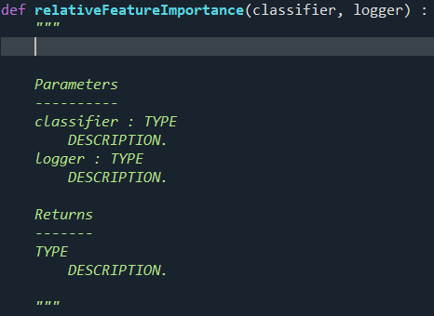
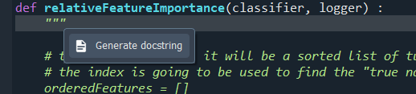
Make your code understandable
IDEs can create special comments for functions
Can be automatically extracted to create documentation
More work now, for less work later…?
Notes:
Observation: here I am not respecting the naming convention (old code)

Slide 36
Make your code understandable
Example
https://github.com/albertotonda/HumanModels
https://humanmodels.readthedocs.io/en/latest/

Slide 37
Refactoring
Once a first version of your code runs, reorganize it
Start from an empty repository, and create new files
Long, boring, and high risk of introducing bugs
Nobody wants to do it, but it’s extremely useful long-term
It’s a good moment to structure your own package

Slide 38
Packaging
It’s actually easy* to create your own Python package
Other people will be able to easily* install it
Organize the code in your repository in a specific way
Add some files, following a step-by-step guide
Upload your package to pypy
Install it using pip install <package_name>

