Slide 1
Organizing repositories
Alberto Tonda, Ph.D., Senior permanent researcher (DR)
UMR 518 Mathématiques et Informatique Appliquées - PS, INRAE, U. Paris-Saclay UAR 3611 Institut des Systèmes Complexes Paris Ile-de-France, CNRS
alberto.tonda@inrae.fr

Slide 2
Another example of title for a slide
This is some text
And some smaller text

Slide 3
Caveat
This is mostly a mix of recommendations + experience

Slide 4
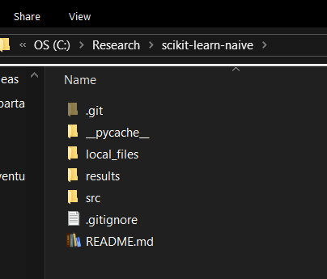
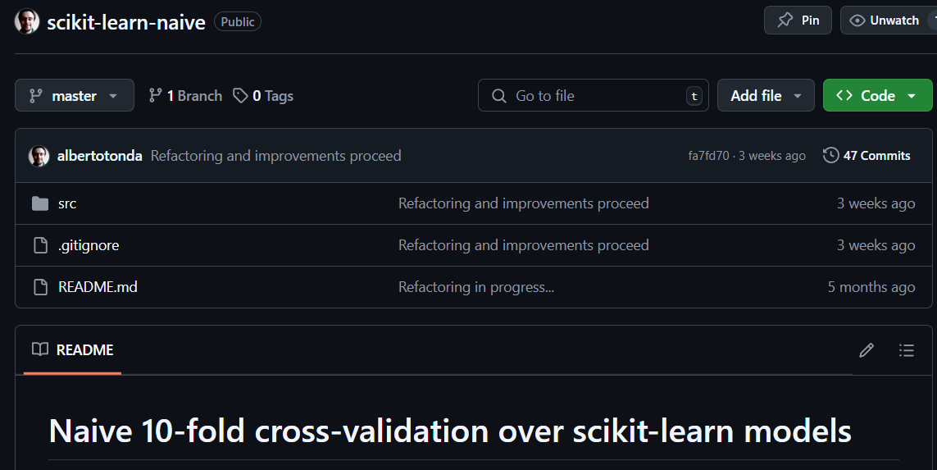
Exploit functionalities of git

Slide 5
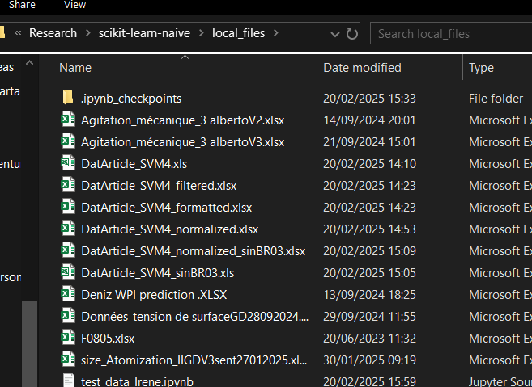
Exploit functionalities of git
You can ask git to ignore entire folders!
Good for files you don’t want to put under version control
E.g. sensitive data from your collaborators

Slide 6
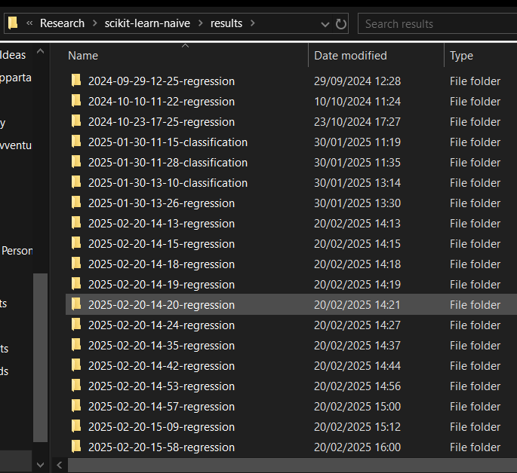
Exploit functionalities of git
But also useful to not clutter folder with results!
Put all results of your scripts (text files, CSV, etc.) in another folder

Slide 7
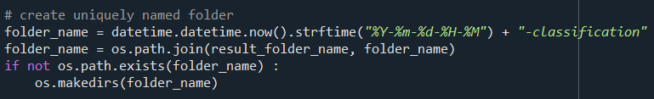
Create meaningful subfolders for results
Each time you run your script, create a subfolder
How to name subfolder? datetime
If you go Year-Month-Day-Hour-Minute-Second, your system will sort alphabetically in a descending order by recency!

Slide 8
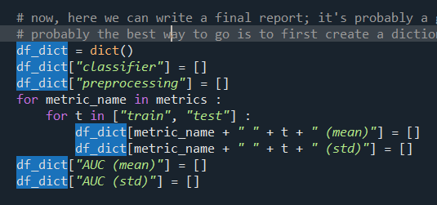
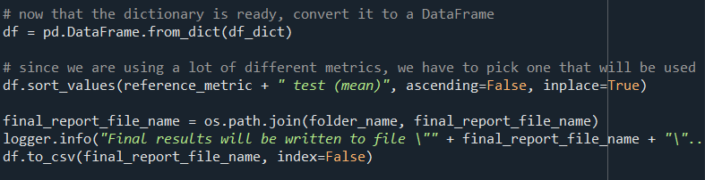
How to save results?
CSV tables are pretty convenient
The best workflow I found so far is
Create dictionary of lists
Keys are the column names, lists are elements in each row
Use pandas to convert dictionary to a pandas.DataFrame
Save dictionary to CSV using built-in to_csv() method

Slide 9
Don’t hard-code values in your code!
Hard-coding means writing values by hand in the code
Try to limit this as much as possible
Way better to read values from outside (e.g. CSV, text or JSON file)
Why? Don’t modify code every time you change something
JSON is more convenient to parse if data don’t fit a table

Slide 10
Logging
Sometimes the output of your program is LONG
Going through the console is too difficult
Save output to console AND text file at the same time
Some messages just in the text file
Logging! Using the logging module
Creates a logger object (needs to be passed to functions)

Slide 11
Scripts or notebooks?
Always scripts, except for images or data summaries
For example, notebooks for plotting images for papers
And also generating tables as text files (Latex)
If you create images during a run, save them as part of script
Examples from symbolic-regression-ode-systems

Slide 12
General wisdom on scripts
One script == One function
In other words, don’t try to do too much stuff in one script
One script runs the experiment, another analyzes the results
Save intermediate results
For long computations, save intermediate results
So that you can resume computations in case of crash

