Slide 1
Useful Python packages
Alberto Tonda, Ph.D., Senior permanent researcher (DR)
UMR 518 Mathématiques et Informatique Appliquées - PS, INRAE, U. Paris-Saclay UAR 3611 Institut des Systèmes Complexes Paris Ile-de-France, CNRS
alberto.tonda@inrae.fr

Slide 2
Another example of title for a slide
This is some text
And some smaller text

Slide 3
Python packages for data science
One of main strengths of Python is packages
Lots of good packages for data science
Going into the details of each is impossible, read documentation
This list is from my own personal experience

Slide 4
Basic functionalities
datetime if you need to get information on current time
logging for logging
os for managing paths, creating directories, etc.
pickle for saving complex data structures to disk
sys for stuff related to system

Slide 5
Managing data and plotting
Managing data and plotting
pandas for managing CSV/Excel files
matplotlib and seaborn for nice plots
Basic mathematical functionalities
numpy and scipy for a lot of convenient mathematical functions
sympy for symbolic computation (e.g. compute derivative)

Slide 6
Machine learning and optimization
Machine learning
scikit-learn for machine learning pipelines
PySR for symbolic regression
xgboost, catboost, and other scikit-learn based packages
pytorch or keras for deep learning
Optimization
inspyred for evolutionary optimization
cma for the CMA-ES
pymoo for multi-objective optimization

Slide 7
Other stuff
Regular expressions
re is the Python module for regular expressions
RegExps are complicated to use, excellent for parsing text
Describe a pattern to look for in a string, search for pattern
I use them often for simple applications
“([0-9|a-z|\_]+)\:\s+” matches a string containing digits [0-9], lowercase letters [a-z] or underscores [\_], repeated any number of times, ending with “:” and any number of spaces after

Slide 8
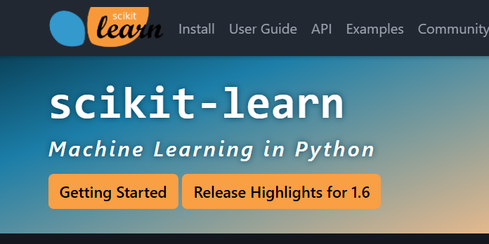
How to decide if a package is worth using?
Check popularity and community
Simple metric, but adoption usually correlates with usefulness
Number of stars on GitHub repo? How many people talk about it?
Check documentation
Is the documentation well done and readable?
Are there examples, code that can be cut/pasted?
Are authors responsive to issues and pull requests?

