Slide 1
Neural networks technical jargon
Alberto TONDA, Ph.D. (Senior permanent researcher, DR)
UMR 518 MIA-PS, INRAE, AgroParisTech, Université Paris-Saclay UAR 3611, Institut des Systèmes Complexes de Paris Île-de-France

Slide 2
Outline
What is jargon
Neurons, units, filters, dimensions...?
Names for types of layers

Slide 3
Jargon = confusing terminology
Multiple sub-communities, using different terminology
Different ways of viewing/formalizing same thing
Layers vs Modules
Units vs Filters vs Neurons
Fully connected layers, convolutional layers…?

Slide 4
Neurons, units, filters, dimensions…?
All terms describe shape of tensors in output to a module
One tensor dimension depends on <term>
Fundamental idea: unitary operation
The operation can be repeated several times by different units
Each unit will produce a new dimension in the output tensor

Slide 5
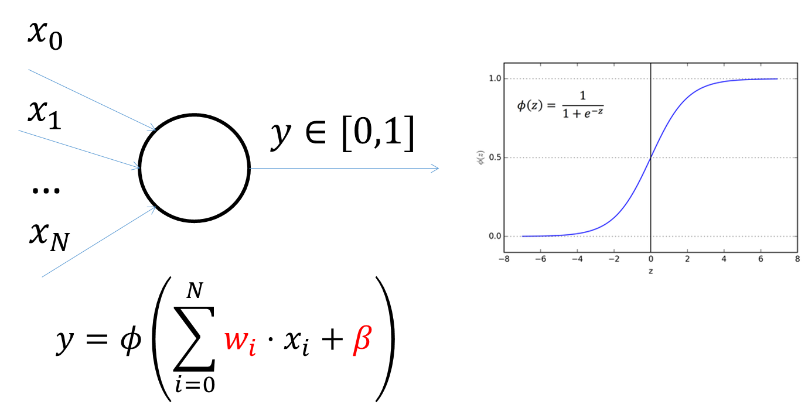
Neurons, units, filters, dimensions…?
“Neurons”
One neuron outputs one value, two neurons, two values, etc.
Number of neurons -> Output tensor dimension

Slide 6
Neurons, units, filters, dimensions…?
“Neurons”
One neuron outputs one value, two neurons, two values, etc.
Number of neurons -> Output tensor dimension
Linear module
10 “neurons”
Input: (n_features, n_samples)
Output: (10, n_samples)
Parameters: ?

Slide 7
Neurons, units, filters, dimensions…?
“Neurons”
One neuron outputs one value, two neurons, two values, etc.
Number of neurons -> Output tensor dimension
Linear module
10 “neurons”
Input: (n_features, n_samples)
Output: (10, n_samples)
Parameters: (n_features + 1) * 10

Slide 8
Linear module + activation
Structure often found in NNs of all kinds
pytorch encodes it as a linear module followed by activation
More “historical” names found in literature
Fully-connected (FC) layer
Multi-layer perceptron (MLP)
Feed-forward module (maybe more general

Slide 9
Neurons, units, filters, dimensions…?
“Filters” in CNNs
Each “filter” corresponds to a set of weights in a convolution
Each filter outputs the result of a single convolution
Terminology: number of channels == number of filters
Output shape
Imagine an input tensor of one image (1, c, h, w)
Conv. module: padding=1, stride=1, kernel=3, out_channels=64
Size of the output tensor?

Slide 10
Neurons, units, filters, dimensions…?
“Filters” in CNNs
Each “filter” corresponds to a set of weights in a convolution
Each filter outputs the result of a single convolution
Terminology: number of channels == number of filters
Output shape
Imagine an input tensor of one image (1, c, h, w)
Conv. module: padding=1, stride=1, kernel=3, out_channels=64
Shape of the output tensor: (1, 64, h, w)

Slide 11
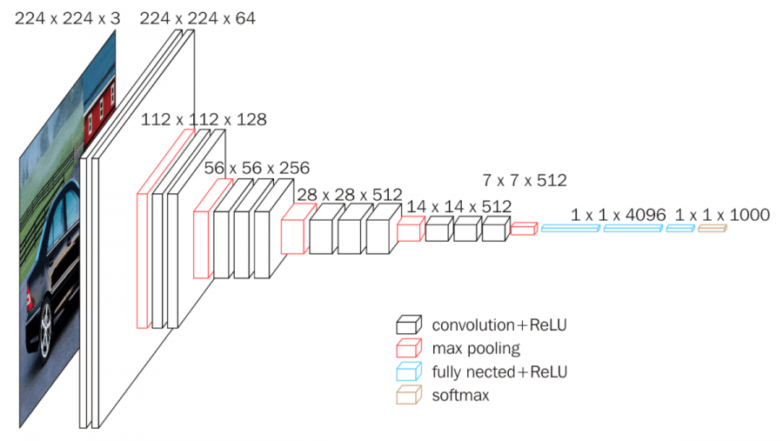
Convolutional layer
Imprecise, but generally a structure like
Convolutional module
Activation
Downscaling (MaxPooling, or AvgPooling)
Sometimes it can be more complex
Convolutional module
Activation
Convolutional module
Activation
Downscaling

Slide 12
Neurons, units, filters, dimensions…?
“Units” in RNNs
Each “unit” corresponds to a set of weights
Size of the hidden state tensor == number of units
Output shape depends on number of units

Slide 13
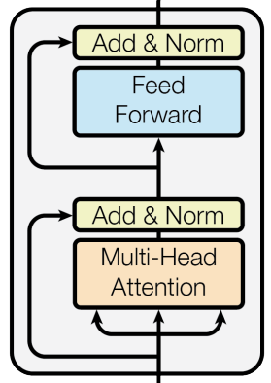
Transformer module/block
Typical composition
Attention module
Addition and normalization
Linear module
Activation
Normalization

Slide 14


Questions?
Bibliography
Images and videos: unless otherwise stated, I stole them from the Internet. I hope they are not copyrighted, or that their use falls under the Fair Use clause, and if not, I am sorry. Please don’t sue me.

