Slide 1
Overview of Classification and Modeling with Machine Learning
Alberto TONDA, Ph.D. (Senior permanent researcher, DR)
UMR 518 MIA-PS, INRAE, AgroParisTech, Université Paris-Saclay UAR 3611, Institut des Systèmes Complexes de Paris Île-de-France

Slide 2
This is a new thing
Ciao
Ciaooooooooooooooo

Slide 3
Why should we care about machine learning?
ML can create predictive models from data
Algorithms are (relatively) easy to use, lots of libraries
Great amount of interest (and hype) since 2012
Useful for complex interactions (physics/chemistry/biology)
Have you already used any machine learning technique?

Slide 4
What is the objective of this presentation?
General overview of machine learning for modelling
Practical advice on algorithms and metrics to use
A couple of exercises in Ipython Notebooks (browers)
Examples on the “données fil rouge”

Slide 5

Who am I?
Career
Bachelor and Master in Computer Science Engineering
Ph.D. from Politecnico di Torino, Italy, in 2011
Permanent researcher in France since late 2012 (INRAE)
Senior researcher (DR2) since 2023
Research interests
Stochastic optimization
Machine learning (Explainable AI)
Applied to biological/agri-food data
Notes:
I am NOT an expert of ALL methods that I am going to present.

Slide 6
Machine learning
Learn a task directly from examples
No need for theory, just large quantities of data
Samples (rows) and features (columns)
“Dirty secret” of ML: it’s mostly optimization
Restate learning task as optimization task
Solve it relying on available (training) data
Learning Task
Optimization Task

Slide 7
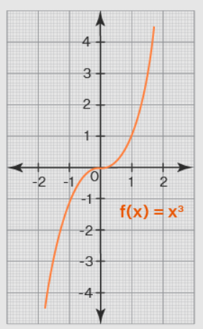
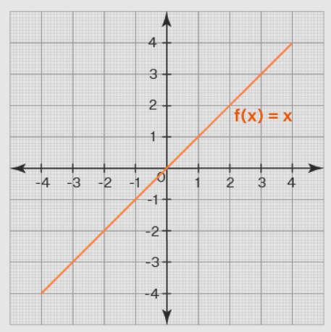

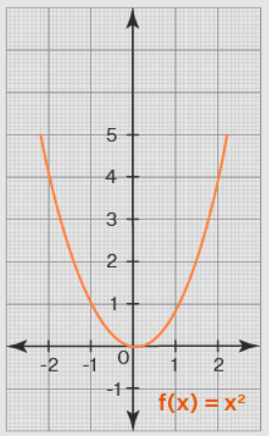
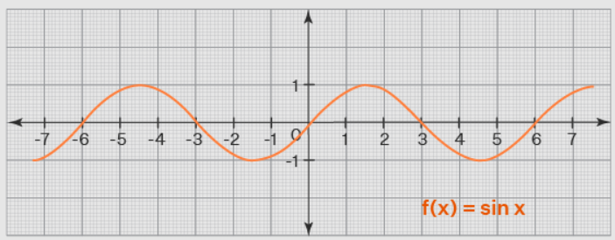
Machine learning
e
e
ML algorithm (model+optimizer)
e
e
Internal parameters (to be optimized)

Slide 8
Supervised machine learning
Learn from (hopefully) correct examples
Data contains measured values of the target (ground truth)
Minimize difference between model predictions and ground truth
Regression
Target is a continuous value (0.9, 22.5, 0.0017, …)
From the values of the features of a sample, predict target value
Classification
Target is a category (good/bad, high/medium/low, toxic/ok, …)
From the values of the features of a sample, assign to category

Slide 9
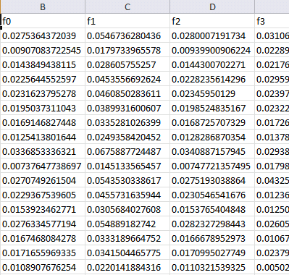
Machine learning (supervised)
Training data
Features
Training...
Predictions
Prediction 1
Prediction 2
Prediction 3
Prediction 4
…
Ground truth
Truth 1
Truth 2
Truth 3
Truth 4
…
ML algorithm (model+optimizer)
Samples
Internal parameters (to be optimized)

Slide 10
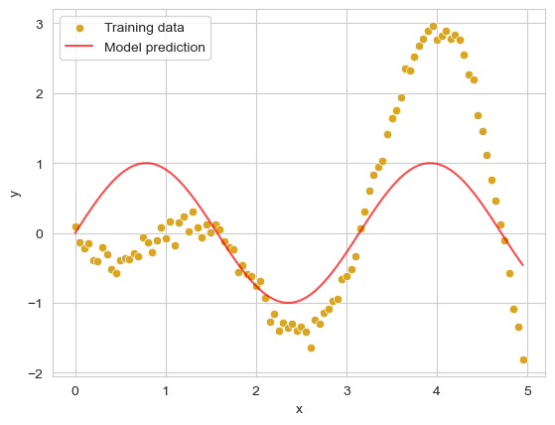
Machine learning (supervised)
Training data
Features
Training...
ML algorithm (model+optimizer)
Samples
Internal parameters (to be optimized)

Slide 11
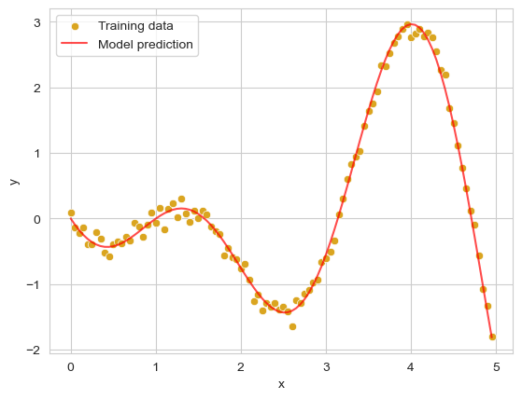
Machine learning (supervised)
Training data
Features
Training...
ML algorithm (model+optimizer)
Samples
Internal parameters
(to be optimized)
Notes:
Here, I can speak about a linear regression

Slide 12
Machine learning (supervised)
Test (unseen) data
Features
Prediction...
ML algorithm (model+optimizer)
Samples
Internal parameters
(fixed)
Notes:
Here, I can speak about a linear regression

Slide 13
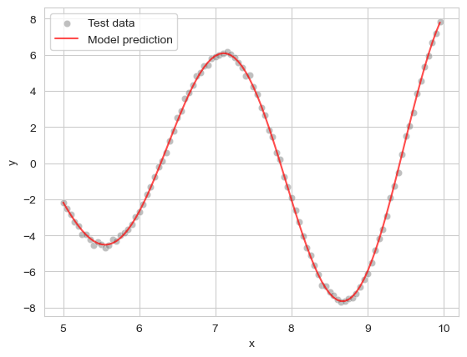
Machine learning (supervised)
Test (unseen) data
Features
Prediction...
ML algorithm (model+optimizer)
Samples
Internal parameters
(fixed)
Notes:
Here, I can speak about a linear regression

Slide 14
Example #1

Slide 15
Overfitting
Model can learn wrong patterns
Noise in the training data
Information that only exists in that batch of training data
Does not generalize to unseen data

Slide 16
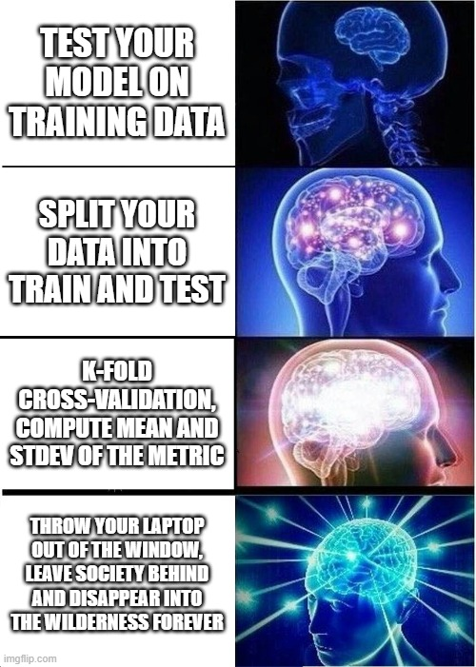
Overfitting
How to deal with overfitting?
Separate data into train and test
Better yet, cross-validation
k-fold (5- or 10-fold)
Leave-one-out
Compute mean and stdev
Cross-validation can also uncover samples that are hard to predict

Slide 17
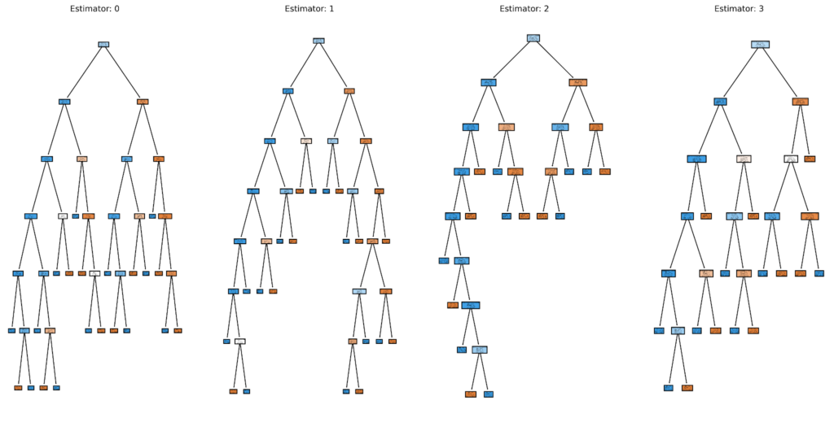
Interpretability of the models
Once trained, AI models are hard or impossible to interpret
An “AI model” can look like 100k numbers
Or 100+ decision trees

Slide 18
Unsupervised…?
What if we have no ground truth? What do we optimize?
Find good dimensionality reduction for visualization (PCA)
Find groups of samples that behave similarly (clustering)
Train a generative model for text or images (stable diffusion, transformers, …)
Optimize a metric linked to what we want to obtain

Slide 19
Classification
Accuracy is bad: use F1, MCC

Slide 20
Example #2

Slide 21
Tabular data vs Structured data
Specific algorithms work better on tabular or structured data
Tabular data (Excel spreadsheet)
Order of columns or rows does not matter
Example: most data sets
Best algorithms: Random Forest, XGBoost
Structured data
Adjacencies between samples or features have meaning
Example: time series, images, videos, sounds, DNA/RNA, …
Best algorithms: Neural Networks (Deep Learning)

Slide 22
Example #3

Slide 23
Hyperparameter tuning and AutoML
ML algorithms have hyperparameters
Number of trees in an ensemble
Number of layers in a neural network
Type of kernel in a support vector machine
…
Values of hyperparameters have influence on performance
How do we select the best values?

Slide 24
Hyperparameter tuning and AutoML
Simple approach: trial and error
Try combinations of values, pick the best on training data
Probably best to have training, validation and test sets
Grid search, Random search, Halving search…
Advanced: AutoML
Frame search for hyperparamters as an optimization problem
TPOT, Auto-sklearn, Auto-Weka (Java), …

Slide 25
Données fil rouge : lactation

Slide 26
THANK YOU FOR YOUR TIME! QUESTIONS?

