Slide 1
Version control with git
Alberto Tonda, Ph.D., Senior permanent researcher (DR)
UMR 518 Mathématiques et Informatique Appliquées - PS, INRAE, U. Paris-Saclay UAR 3611 Institut des Systèmes Complexes Paris Ile-de-France, CNRS
alberto.tonda@inrae.fr

Slide 2
Another example of title for a slide
This is some text
And some smaller text

Slide 3

What is GIT?
Version control software
Similar to Dropbox, Google Drive, and many others
Differences: open source, independent from environment
GitHub.com exists (Microsoft), local servers (Forge INRAE)
Author: Linus Torvalds (of Linux fame)
“Git” is British slang for “stupid idiot”, there is no official meaning for the acronym
Computer Scientists think they are hilarious

Slide 4

Why should we care?
Git is great for collaborative development of code
Other uses: personal storage, share code, website
Optimized for text files (and maybe a few images)
Git is fantastically integrated with a lot of other tools (Overleaf)
E.g. you can create your own Python package with Git!
Also, keep track of just a few files (different from DBX!)
Show here example of git-based, GitHub hosted site

Slide 5
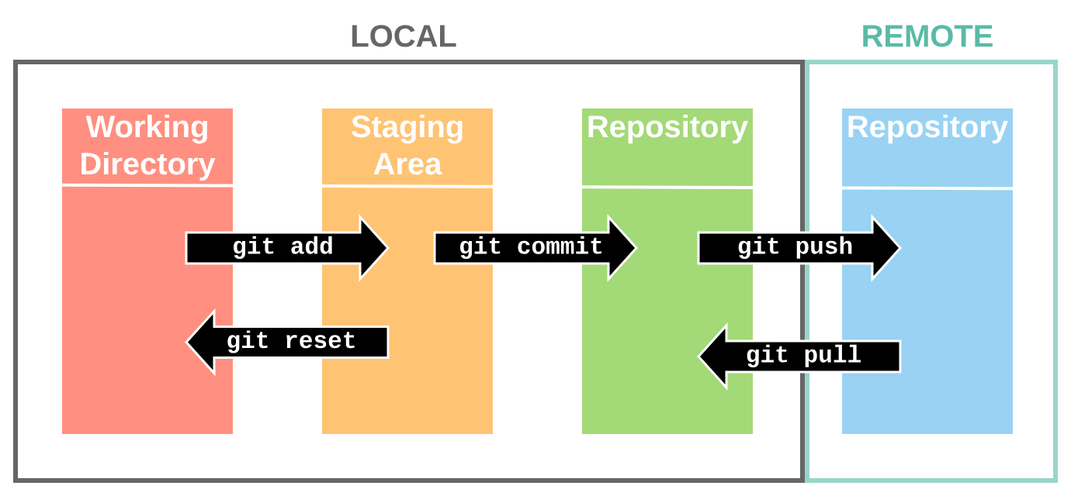
How does it work?

Slide 6

GitHub Desktop
Git was originally designed as a command-line tool
But now we have Graphical User Interface (GUI) tools
In fact, in CS almost everything is command line hidden by GUI
Follow these steps
Create an account on GitHub
Create a new repository on GitHub
Download GitHub desktop
Generate public/private key pair
Create local copy of your repository

Slide 7
More git fun!
Create two new files
“added.txt” and “ignored.txt”
GitHub Desktop automatically adds local files to commits
You can manually tell it to ignore files
Add “added.txt” and ignore “ignored.txt”
commit the changes, then push them
Check the repository page on GitHub.com ; did it change?
Commit messages
Useful to keep track of what happened, don’t leave them empty

Slide 8

Advanced use: git merge
What happens if you modify local files with git…
…and someone else in the meantime commits/push?
The remote repository and your local files differ greatly!
It becomes necessary to reconciliate the two versions
Let’s try it out live!

Slide 9
Advanced use: branches
You can create different “branches” on the same repository
Work independently on separate parts without merging every time
At the end of development, big merge between branches
main is the default branch
Let’s try to create two different branches, then
Merge the first branch with main
Then merge the second branch also with main

Slide 10
Advanced use: recover previous versions

Slide 11
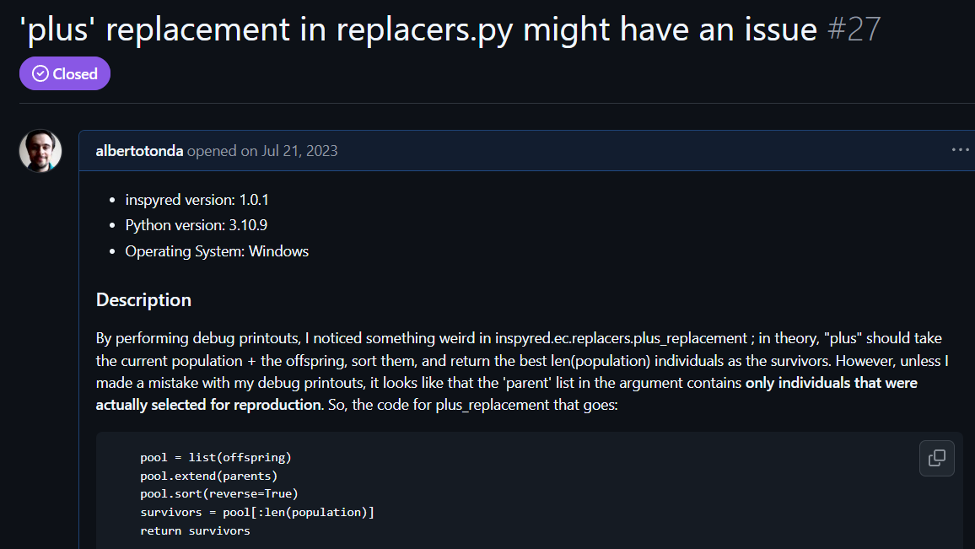
Advanced use: issues
This is more of a GitHub use than git
If you are using a package and you identify a problem
You can open an issue on their repository page

Slide 12
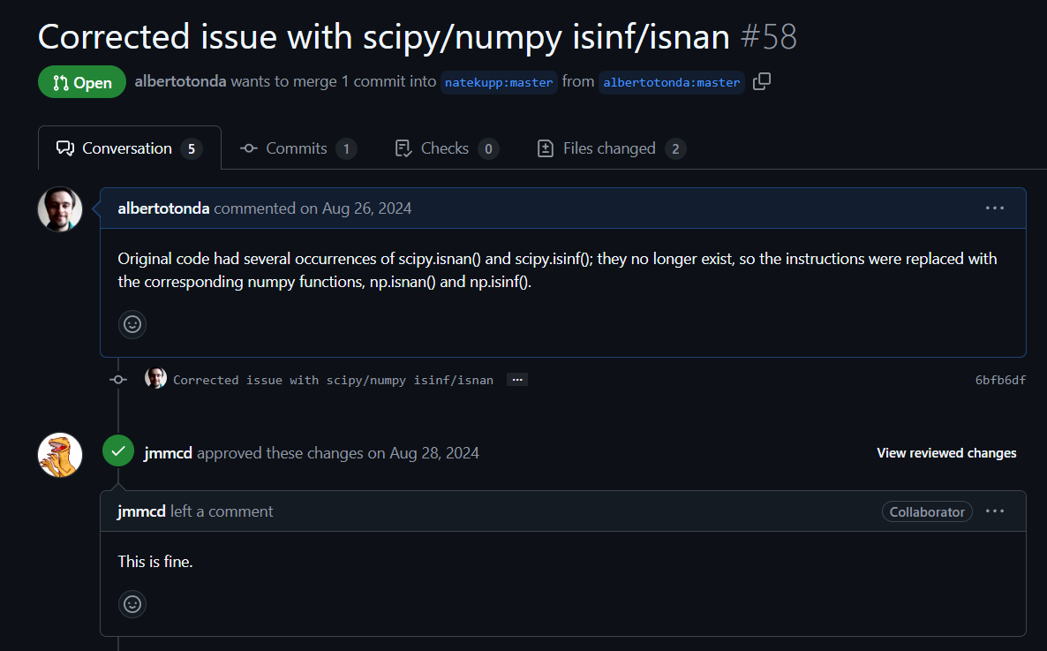
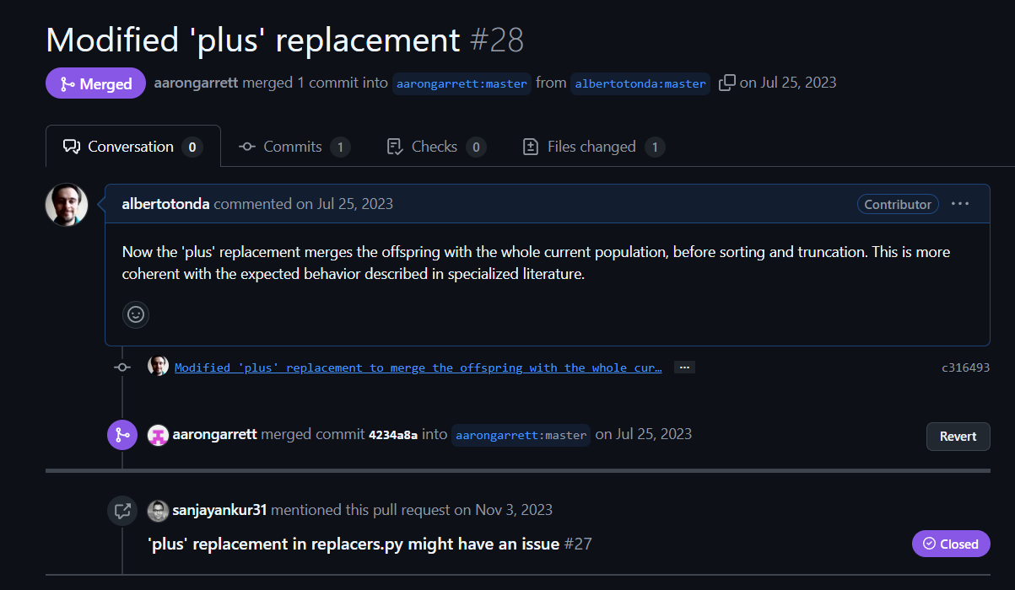
Advanced use: pull requests
Ask for permission: “Can I merge these changes?”
Require review from repo owners
I used this feature twice

Slide 13
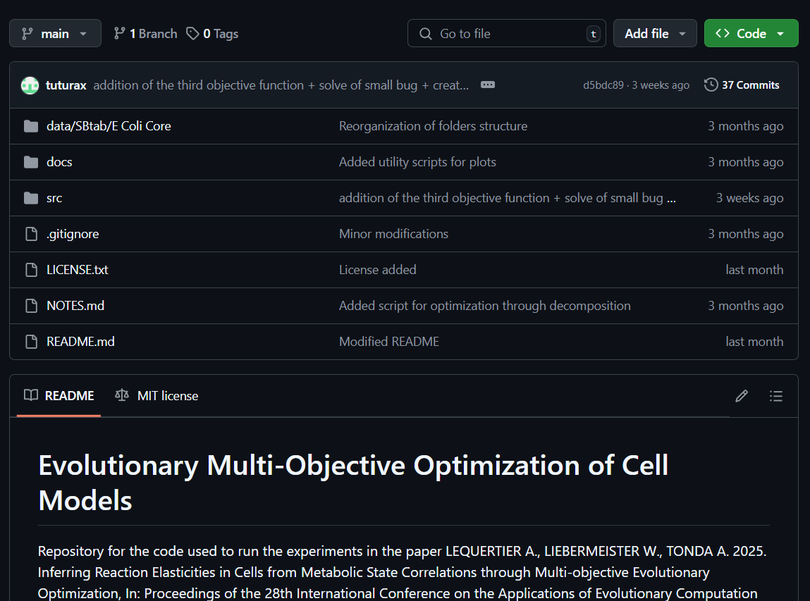
Practical advice: structure your repository
Create subfolders in your repository
data/ for all data files
docs/ for papers and stuff
src/ for code
Root usually contains
.gitignore
README.md (markdown)
LICENSE.txt (optional)
Other stuff

Slide 14
Questions?

