Slide 1
Constrained optimization and linear programming
Alberto TONDA
UMR 518 MIA-PS, INRAE, AgroParisTech, Université Paris-Saclay UAR 3611, Institut des Systèmes Complexes de Paris Île-de-France

Slide 2
Outline
Constrained optimization
Linear programming
Other approaches

Slide 3
Constrained optimization
Optimizing objective function is not enough
We also have to respect additional constraints on variables
In general, different from boundaries (although, terminology…)
Some algorithms only check if solution exists
Example: optimize the diet of soldiers
Minimize cost of meals
Attain at least a certain amount of each nutrient type

Slide 4
Constrained optimization

Slide 5
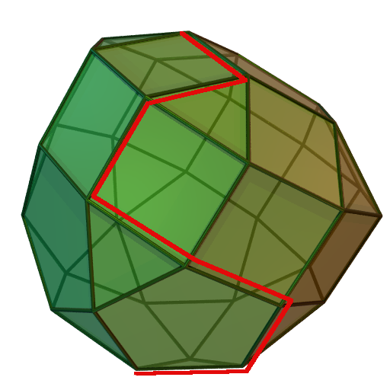
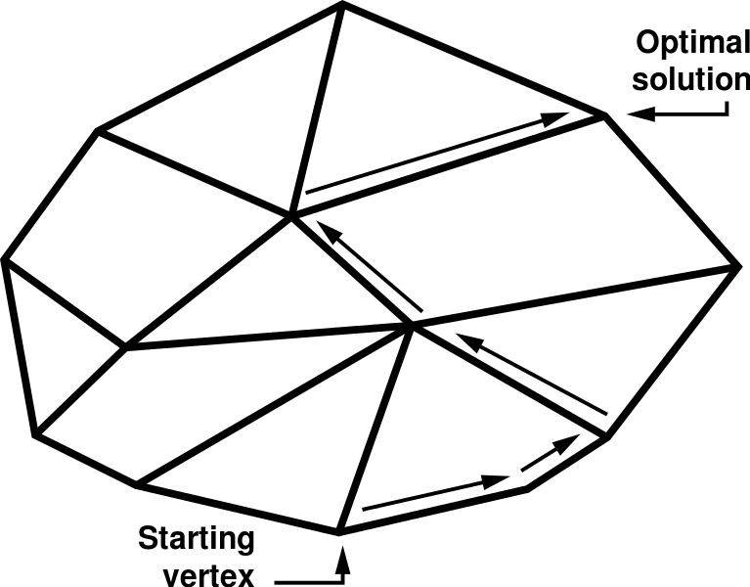
Linear programming
Linear objective function, linear constraints
Stating the problem properly ensures finding global optimum
Simplex: explore vertices of a polytope (hyper-polygon)

Slide 6
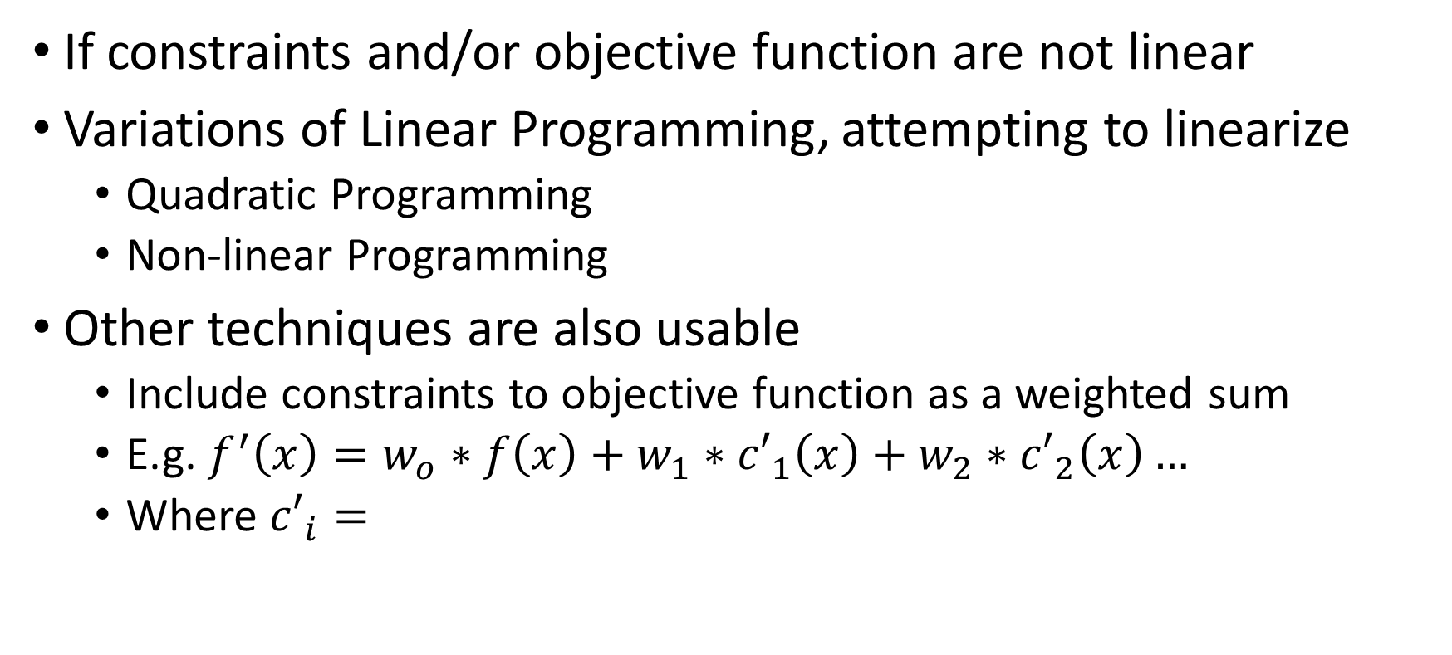
Other approaches
If constraints and/or objective function are not linear
Variations of Linear Programming, attempting to linearize
Quadratic Programming
Non-linear Programming
Other techniques are also usable
Include constraints to objective function as a weighted sum
E.g. $f^{′}\left(x\right)=w_{o}∗f\left(x\right)+w_{1}∗{c′}_{1}\left(x\right)+w_{2}∗{c′}_{2}\left(x\right)…$
Where ${c′}_{i}=$

Slide 7


Questions?
Bibliography - Kochenderfer & Wheeler, Algorithms for Optimization, MIT Press, 2019 - Vanderbei, Linear Programming: Foundations and Extensions, 2014
Images: unless otherwise stated, I stole them from the Internet. I hope they are not copyrighted, or that their use falls under the Fair Use clause, and if not, I am sorry. Please don’t sue me.

