Slide 1
Optimization methods for Artificial Intelligence: Introduction
Alberto TONDA, Senior Researcher (DR)
UMR 518 MIA-PS (Applied Mathematics and Computer Science) INRAE, AgroParisTech, Université Paris-Saclay

Slide 2
Outline
What is this class about?
Who am I?
What is optimization?
What is Artificial Intelligence?
Is optimization a type of Artificial Intelligence?
What is the relationship between AI and optimization?
Why are we still here? Just to suffer? Every night, I can feel my leg... And my arm... even my fingers... The body I've lost... the comrades I've lost... won't stop hurting... It's like they're all still there. You feel it, too, don't you? I'm gonna make them give back our past!

Slide 3
What is this class about?
Optimization!
Overview of optimization techniques, when/how to use them
How these techniques power modern Artificial Intelligence
Optimization to improve performance of AI methods
At the end of the class, you should know
What kind of technique is more appriopriate to different kinds of problems
How (several) AI systems work, especially for Machine Learning
How to perform hyperparameter optimization for your AI applications

Slide 4
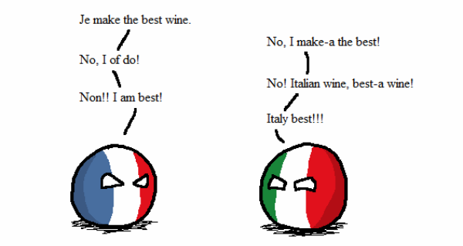
Who am I?
Career
Bachelor and Master in Computer Science Engineering
Ph.D. from Politecnico di Torino, Italy, in 2011
Permanent researcher in France since 2012 (INRAE)
Senior researcher since 2023
Research interests
Stochastic optimization
Machine learning (Explainable AI)
Applied to biological/agri-food data
Mostly applied research

Slide 5
What is optimization?
Nearly every choice is an optimization problem
Shape of a car to minimize wind resistance
Values of the weights of a neural network to best perform a task
Weight distribution in a plane to minimize shaking
Pick a stock market portfolio to maximize revenue
Trace route inside a city to reach a point as fast as possible
Choose career that makes you satisfied and happy
...

Slide 6
What is optimization?
Nearly every choice is an optimization problem
Shape of a car to minimize wind resistance
Values of the weights of a neural network to best perform a task
Weight distribution in a plane to minimize shaking
Pick a stock market portfolio to maximize revenue
Trace route inside a city to reach a point as fast as possible
Choose career that makes you satisfied and happy
...
OBJECTIVE FUNCTION

Slide 7
What is optimization?
Nearly every choice is an optimization problem
Shape of a car to minimize wind resistance
Values of the weights of a neural network to best perform a task
Weight distribution in a plane to minimize shaking
Pick a stock market portfolio to maximize revenue
Trace route inside a city to reach a point as fast as possible
Choose career that makes you satisfied and happy
...
OBJECTIVE FUNCTION
COST FUNCTION
FITNESS FUNCTION

Slide 8
What is optimization?
Objective function
Measure of goodness of a candidate solution
Quantitative, not qualitative (unless we can somehow sort it)
Good candidate solutions are usually close to other good solutions
Candidate solutions
Possible inputs of the objective function
High-level description that includes all possible solutions

Slide 9
What is Artificial Intelligence?
Short answer, there is no clear definition
We do not have a good definition of intelligence, so...
Broadly speaking, AI defines a field more than a method
Machine learning, reinforcement learning, symbolic AI, ...
When a non-biological being successfully completes a task commonly believed to require biological intelligence
Perceiving, synthesizing, and inferring information
How do we measure intelligence?

Slide 10
What is Artificial Intelligence?
NARROW / WEAK
Focused on a specific task
Symbolic AI
Rule-based systems
Machine learning
Supervised, unsupervised
Natural language processing
Image recognition/segmentation
Reinforcement learning
Neuro-symbolic AI
GENERAL (AGI)
Can perform any type of (human?) task
Does not exist (...yet?)
Closest thing is NLP: Large Language Models (LLM) like ChatGPT

Slide 11
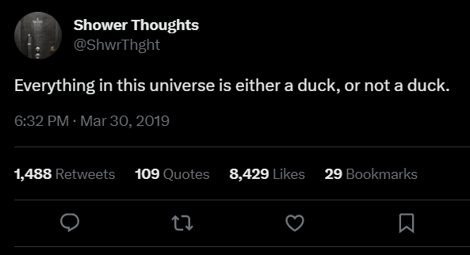
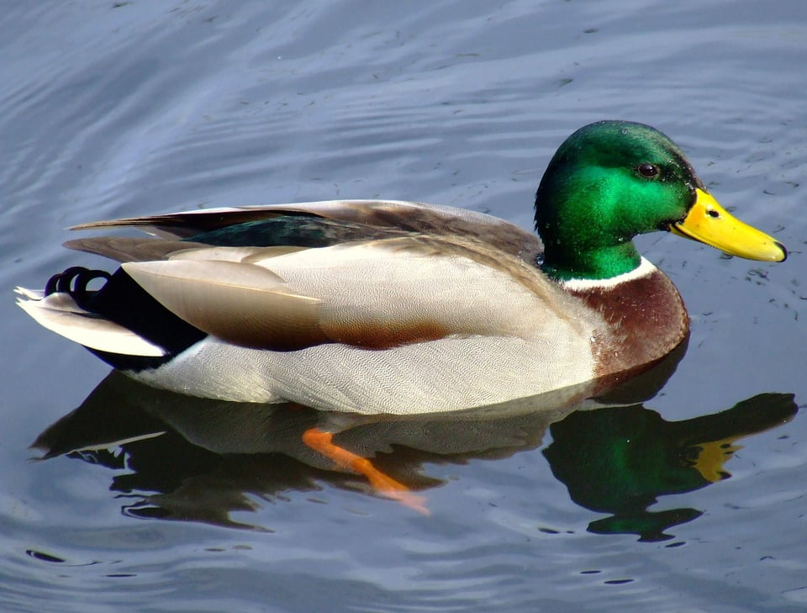
What is Artificial Intelligence?
Symbolic manipulation
Reality is continuous (with good approximation)
Symbols are discrete, and humans are good at using them

Slide 12
What is Artificial Intelligence?
Symbols seem normal and natural, map into the real world (in linguistic, it’s called extension)
Natural language is a powerful human symbol manipulator
However, there is chaos hidden under the surface
What is the reality of a river?
What is the reality of a chair?
What is the reality of a number?
In general, really hard to define, but we grasp it intuitively
Entire fields of research on this (neuroscience, cognitive, …)

