Slide 1

[Project 1] Real-Time Strategy Games
Goal:
Implement an AI bot for Starcraft and experiment with pathfinding techniques.

Slide 2
[Project 1] Basic RTS AI diagram
Perception
Unit Analysis
Map Analysis
Strategy
Strategy
Give Orders
Economy
Logistics
Attack
Arbiter
Execute Orders
Unit AI
Unit AI
Unit AI
Building Placer
Pathfinder

Slide 3
[Project 1] NOVA diagram
Perception
Unit Analysis
Map Analysis
Strategy
Strategy
Give Orders
Economy
Logistics
Attack
Arbiter
Execute Orders
Unit AI
Unit AI
Unit AI
Building Placer
Pathfinder

Slide 4
[Project 1] NOVA diagram
Perception
Information Manager
Black board pattern
Analyze the map (BWTA)
Track enemy units
Build threat map
Handle dependencies
Reserve resources
Strategy
Strategy
Give Orders
Economy
Attack
Arbiter
Execute Orders
Unit AI
Unit AI
Unit AI
Building Placer
Pathfinder

Slide 5
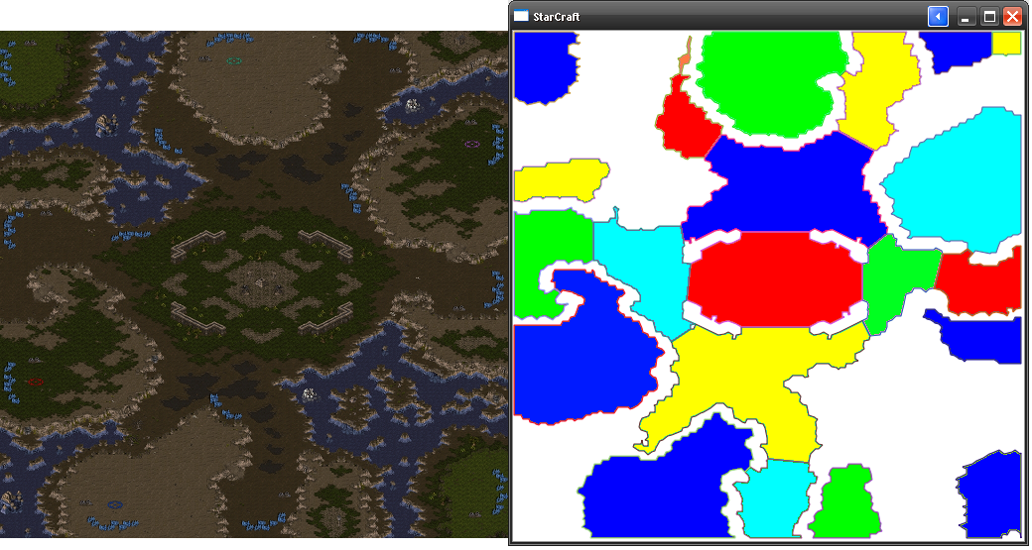
[Project 1] Analyze the map (BWTA)
BWTA uses Voronoi Diagrams to detect Regions and Chokpoints.

Slide 6
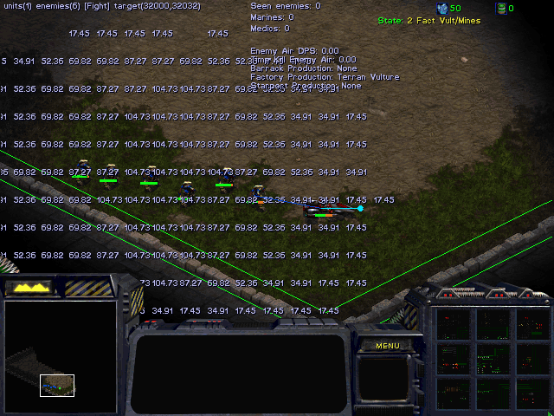
[Project 1] Threat map
Our threat map is a matrix of the map where every cell is the DPS (Damage Per Second) that our opponent can do.

Slide 7
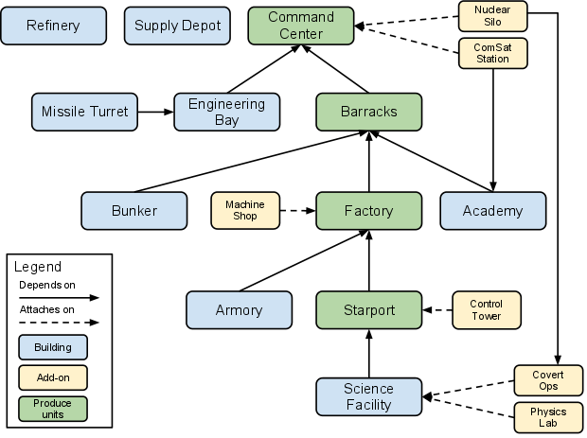
[Project 1] Handle dependencies
Example of Terran buildings dependencies

Slide 8
[Project 1] NOVA diagram
Perception
Information Manager
Strategy
Strategy
Give Orders
Economy
Attack
Arbiter
Execute Orders
Unit AI
Unit AI
Unit AI
Building Placer
Pathfinder

Slide 9
[Project 1] NOVA diagram
Perception
Information Manager
Strategy
FSM vs Terran
FSM vs Protoss
FSM vs Zerg
Reactive behavior
Give Orders
Economy
Attack
Arbiter
Execute Orders
Unit AI
Unit AI
Unit AI
Building Placer
Pathfinder

Slide 10
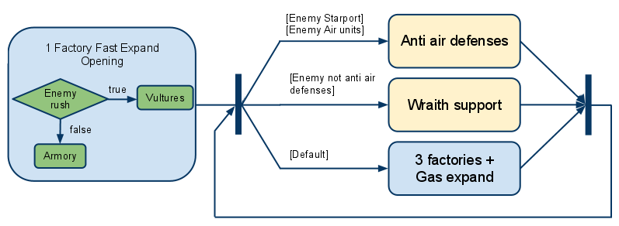
[Project 1] FSM vs Terran
Example of Finite State Machine against Terran race

Slide 11
[Project 1] NOVA diagram
Perception
Information Manager
Strategy
FSM vs Terran
FSM vs Protoss
FSM vs Zerg
Reactive behavior
Give Orders
Economy
Attack
Arbiter
Execute Orders
Unit AI
Unit AI
Unit AI
Building Placer
Pathfinder

Slide 12
[Project 1] NOVA diagram
Perception
Information Manager
Strategy
FSM vs Terran
FSM vs Protoss
FSM vs Zerg
Reactive behavior
Give Orders
Build Manager
Planner Manager
Attack
Keep a Build Order FIFO list (with exceptions)
Find best place to build
Track supply depot required
Arbiter
Execute Orders
Unit AI
Unit AI
Unit AI
Building Placer
Pathfinder

Slide 13
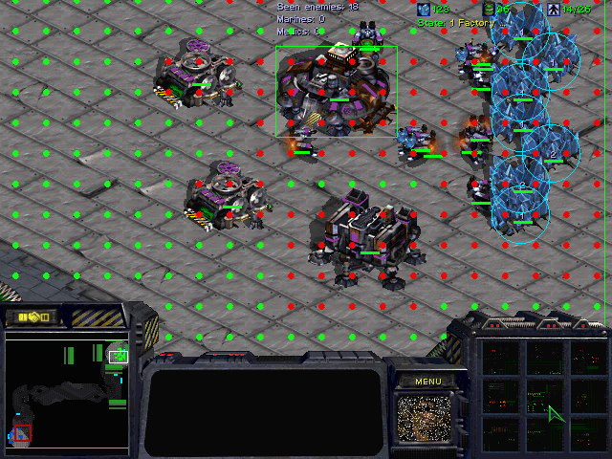
[Project 1] Find best place to build
Keep truck of a map with tilde buildable information.
Buildings that can produce units have one extra row and column reserved tile.

Slide 14
[Project 1] NOVA diagram
Perception
Information Manager
Strategy
FSM vs Terran
FSM vs Protoss
FSM vs Zerg
Reactive behavior
Give Orders
Build Manager
Planner Manager
Attack
Arbiter
Track army composition
Plan next unit to train.
Execute Orders
Unit AI
Unit AI
Unit AI
Pathfinder

Slide 15
[Project 1] NOVA diagram
Perception
Information Manager
Strategy
FSM vs Terran
FSM vs Protoss
FSM vs Zerg
Reactive behavior
Give Orders
Build Manager
Planner Manager
Attack
Arbiter
Execute Orders
Unit AI
Unit AI
Unit AI
Pathfinder

Slide 16
[Project 1] NOVA diagram
Perception
Information Manager
Strategy
FSM vs Terran
FSM vs Protoss
FSM vs Zerg
Reactive behavior
Give Orders
Build Manager
Planner Manager
Squad Manager
Squad Agent
Arbiter
Squad Agent
Squad Agent
Execute Orders
Unit AI
Unit AI
Unit AI
Pathfinder

Slide 17
[Project 1] NOVA diagram
Perception
Information Manager
Strategy
FSM vs Terran
FSM vs Protoss
FSM vs Zerg
Reactive behavior
Give Orders
Build Manager
Planner Manager
Squad Manager
Squad Agent
Arbiter
Squad Agent
Squad Agent
Execute Orders
Unit AI
Unit AI
Unit AI
Pathfinder

Slide 18
[Project 1] NOVA diagram
Perception
Information Manager
In our case, we don’t need an Arbiter because each “give manager” has its own “execute manager”
Strategy
FSM vs Terran
FSM vs Protoss
FSM vs Zerg
Reactive behavior
Give Orders
Build Manager
Planner Manager
Squad Manager
Squad Agent
Execute actions with workers unit
Execute actions with building unit
Squad Agent
Execute actions with combat unit
Squad Agent
Execute Orders
Worker Manager
Production Manager
Combat Agent
Combat Agent
Combat Agent
Pathfinder

Slide 19
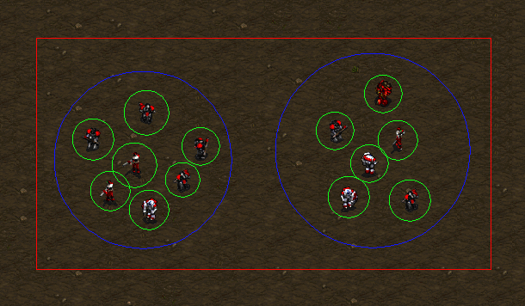
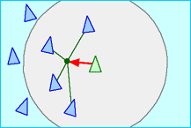
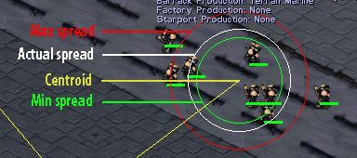
[Project 1] Micro management
We have a military hierarchical task command:
Squad Manager
Squad Agent
Combat Agent
Micro task can be complex:
- Influence maps using potential fields for kiting behavior http://www.youtube.com/watch?v=6QcEBFcMaBw
- Steering behaviors for effective squad movement

Slide 20
[Project 1] NOVA diagram
Perception
Information Manager
Strategy
FSM vs Terran
FSM vs Protoss
FSM vs Zerg
Reactive behavior
Give Orders
Build Manager
Planner Manager
Squad Manager
Squad Agent
Squad Agent
Squad Agent
Execute Orders
Worker Manager
Production Manager
Combat Agent
Combat Agent
Combat Agent
Pathfinder

Slide 21
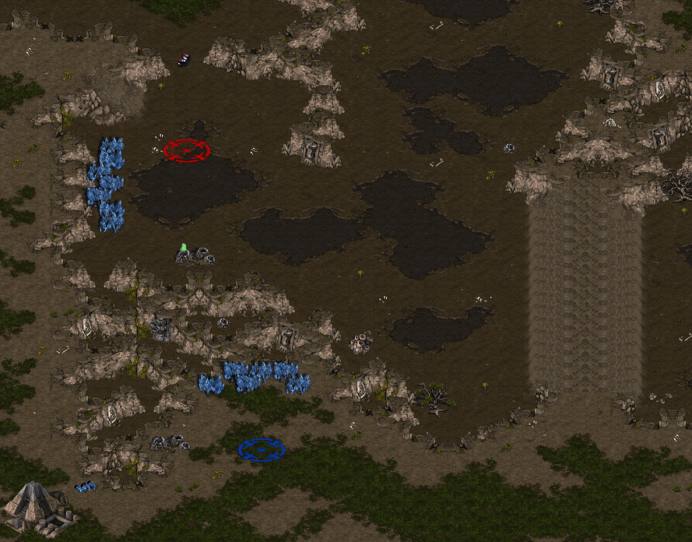
[Project 1] Pathfinder details
Starcraft built in pathfinding issue

Slide 22
[Project 1] Pathfinder details
Solution: building a high level pathfinding over built in using HPA* idea

Slide 23
[Project 1] Pathfinder details
Instead of cluster division, we use region and choke info from BWTA

Slide 24
[Project 1] Pathfinder details
Use the “waypoints” to reach our target location

Slide 25
[Project 2] Drama Management
Goal:
Implement hints to next objective in Anchorhead to prevent players getting stuck.

Slide 26
[Project 2] Drama Management
Extend IFPlotPoints to store a hint per plot point (if it exists)
If a plot point's precondition evaluates to true, store the PP and current time
If X seconds have elapsed, this hint has not been triggered before, and if this plot is not yet completed -> display hint

Slide 27
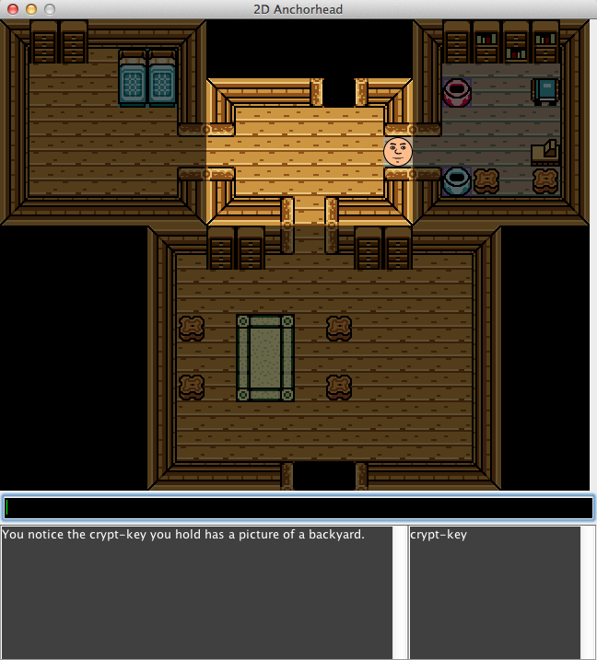
[Project 2] Drama Management
Picked up crypt-key, completing PlotPoint get-crypt-key
find-williams-grave's precondition now evaluates to true
Push to IFHelper's map:
(IFPlotPoint find-williams-grave, long currentTime)
On updates, we check each object in the IFHelper map
Since X seconds elapsed, find-williams-grave status is not FINISHED and we have not yet triggered this hint, render IFPlotPoint.m_hint to screen.

Slide 28
[Project 2] Current Hints
get-crypt-key
N/A (starts the plot)
find-williams-coffin
"You notice the crypt-key you hold has a picture of a backyard."
get-skull
"You realize you never took anything from the crypt you opened."
buy-magic-ball
"Come to think of it, that magic shop owner looked like he could use a magic ball."
give-bum-flask
"You think to yourself, 'maybe that bum could use a drink...'."

Slide 29
[Project 2] Improvements
Does not work as fluid when PP's have more than one precondition
Rather than generating internal monologue hints, perhaps an NPC delivers hints

Slide 30
[Project 3] Procedural Content Generation
Goal:
Generate balanced Starcraft maps procedurally.

Slide 31
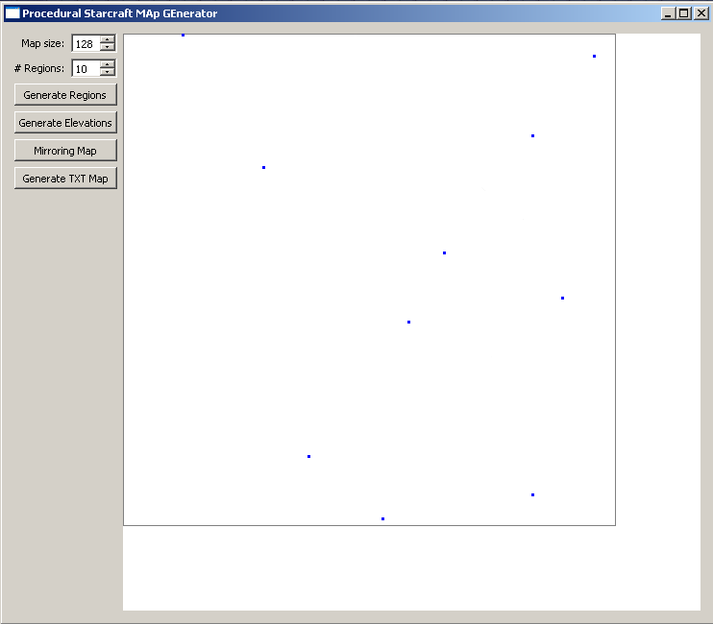
[Project 3] Procedural Content Generation
We designed the following algorithm:
1 – Setup the number of regions and the size of the map. Then generate a random seed point for each region.

Slide 32
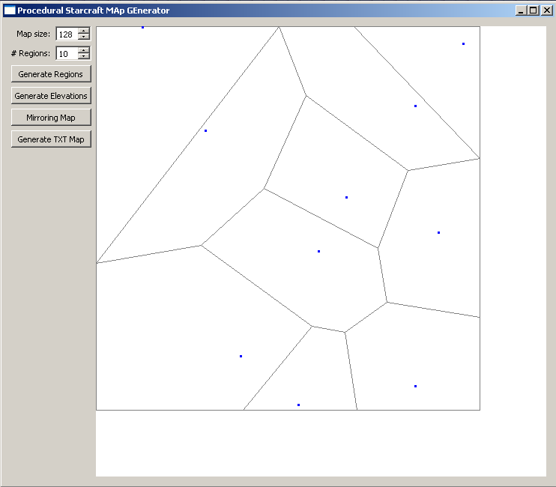
[Project 3] Procedural Content Generation
We designed the following algorithm:
2 – Create the Voronoi diagram from the given points. Here we used Fortune’s algorithm for a fast computation.

Slide 33
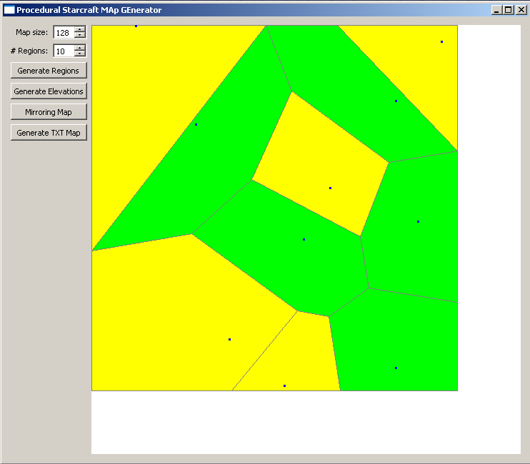
[Project 3] Procedural Content Generation
We designed the following algorithm:
3 – Assign randomly the elevation of each region. But we have to ensure the existence of a path between the right-bottom region to the left-top region.

Slide 34
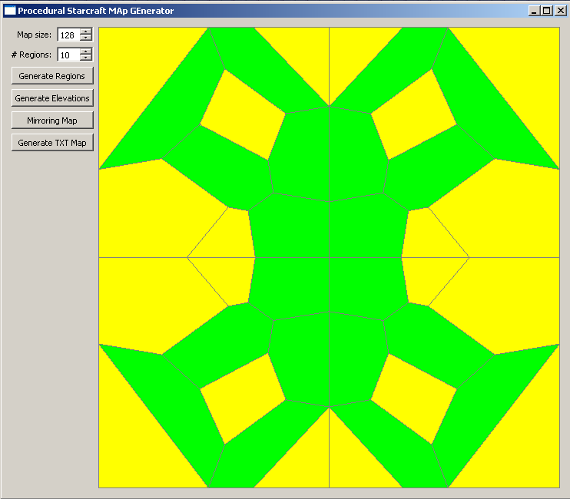
[Project 3] Procedural Content Generation
We designed the following algorithm:
4 – Mirror axis X and axis Y to get a balanced map.

Slide 35
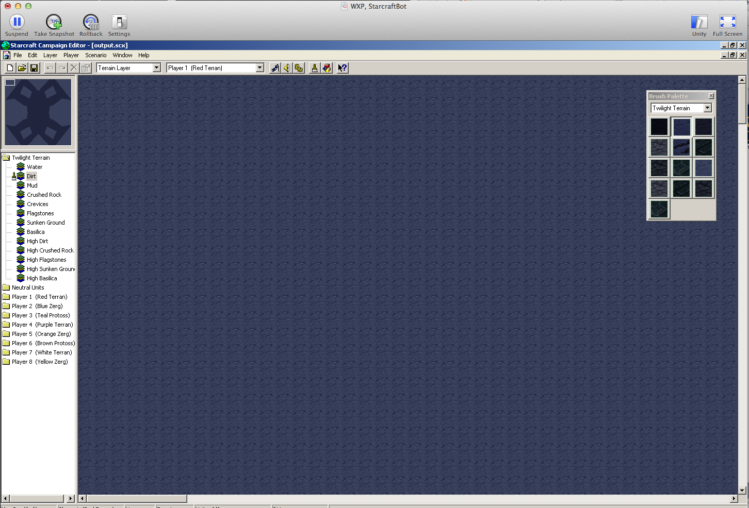
[Project 3] Procedural Content Generation
We designed the following algorithm:
5 – Convert our abstract map into Starcraft map

Slide 36
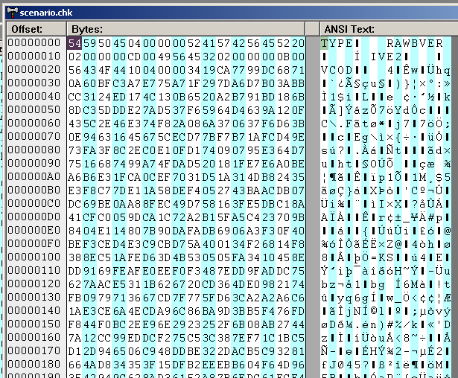
[Project 3] Procedural Content Generation
Conversion: Parses output from generator into a .chk file
Collection of bytes indicating terrain info as well as triggers, units, upgrades, buildings, etc.

Slide 37
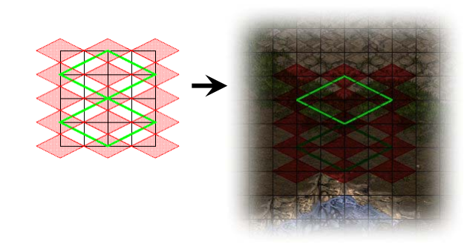
[Project 3] Procedural Content Generation
Difficulties with manipulating binary values for tiles converting to isometric tiles.
Difficult to debug collection of bytes!

