Slide 1
Microservices
Improve time to market with microservices
By Alberto Valverde Escribano
Senior R&D Engineer

Slide 2

“Clients are trying to modernize their applications to keep up with the rate of change... in the past, operations dictated how applications were written... people spent years writing monolithic applications in which a lot of application function was packaged inside the app... now they are seeing the difficulty developers are having in adding new features to respond to changing marketing demand.”

Slide 3
What are microservices?
Microservices is an architecture style which prescribes building large complex software applications using many small microservices. These microservices are narrowly focused, independently deployable, loosely coupled, language agnostic services fulfilling a business capability. These multiple microservices communicate with each other using language-agnostic APIs such as REST.
These microservices are applications in themselves and are often owned by small teams. Unlike the normal practice, the team which coded the microservices is also responsible for its support.

Slide 4
Why microservices?
Business drivers like agility, better reliability, improved scalability, security has forced architects to consider new paradigms like cloud computing and microservices. The traditional monolithic applications suffer from challenges like
Difficult to develop: The more is the code base, the more difficult is it to understand and maintain.
Difficult to test: One single change can affect multiple sub units forcing much larger testing effort. The testers should also be aware of the various code inter dependencies.
Slower to adapt: Changing even a single aspect of the application requires the entire code base to be affected, thus making it much slower to change and error prone.
In contrast, microservices, by definition itself are smaller manageable units of business capabilities which are easy to develop, test and maintain and also faster to adapt.

Slide 5
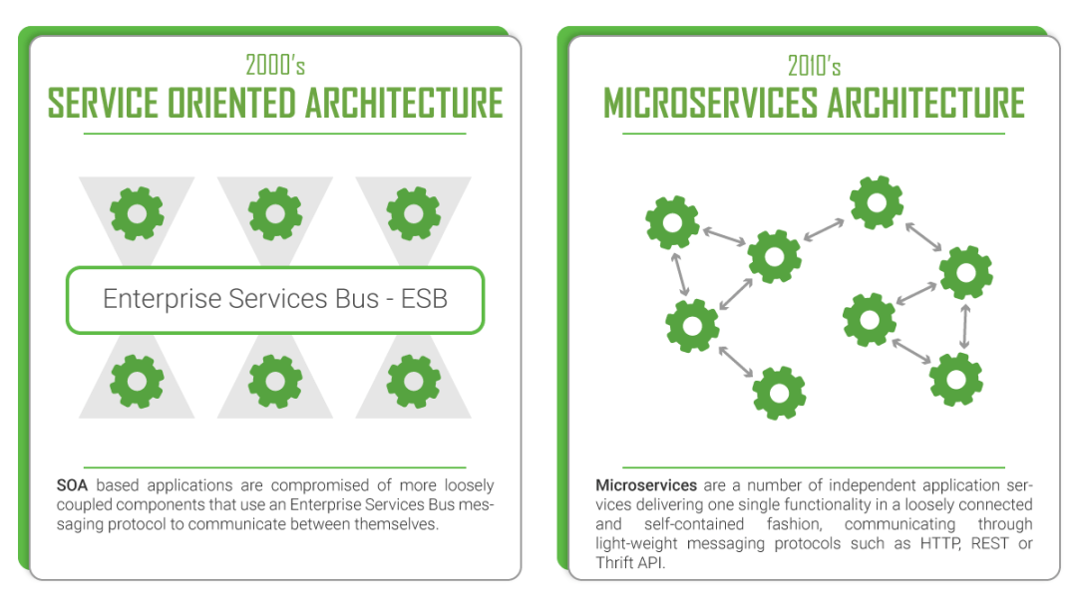
MICROSERVICES ARCHITECTURE

Slide 6
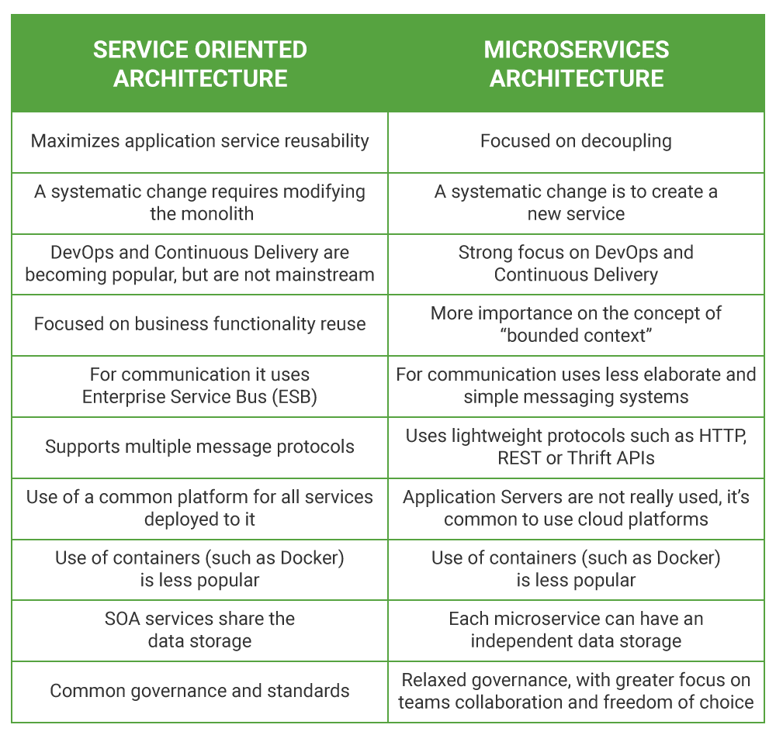
MSA VS SOA

Slide 7
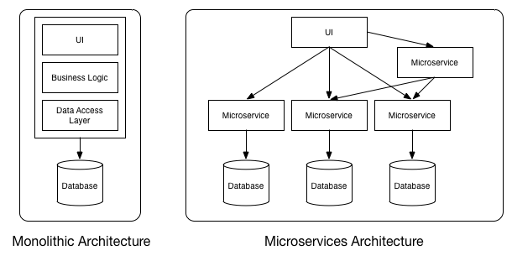

Slide 8
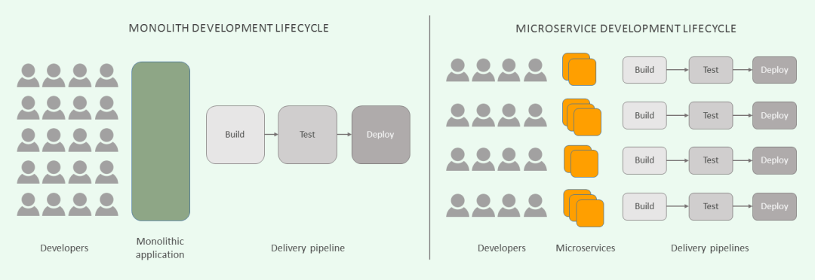
Abandon the old departmental structure and focus teams around certain microservices.
This means that each of these teams will consist of various members with different skill sets such as system analysts, UX/UI designers, backend & frontend developers, etc. This way, the teams are responsible for their project (microservice) from end to end – from development and deployment to operations, monitoring, and management. This, in turn, will increase their motivation to create the product they feel their own.

Slide 9
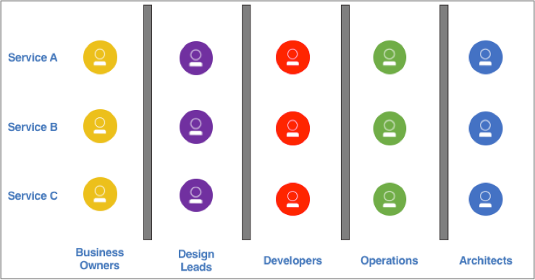
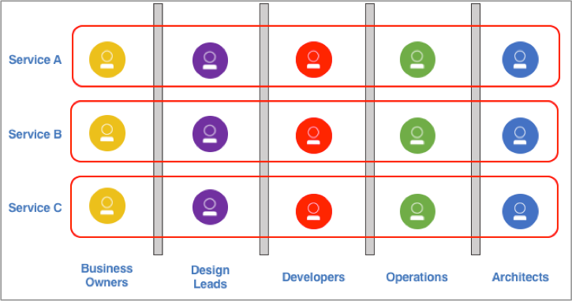
Understand your culture and skill set
Microservices architectures can only succeed when teams have the power to own the complete software development and operations lifecycle. Building cross-functional teams representing all roles and responsibilities is fundamental in implementing microservices-based architectures. Everyone—from design to development to operations to business owner—works closely together and is often collocated.
Since every stakeholder is represented in the team by design, development, and operations, work can move forward more quickly, efficiently, and with clear focus on improving user experience to achieve business goals.

Slide 10
Thanks you for attending!
Contact
Phone: +34 608 837 254
Email: valveraa@essilor.es
Online: https://sites.google.com/essilor.com/creativity/

