Slide 1

Go2 Reinforcement Learning Locomotion
and Sim-to-Real Transfer
Assignment 13 (E4): training in NVIDIA Isaac Lab, deployment on the real Unitree Go2
Richard Albert King Mechoda | ID 8525970
Cognitive Architectures for Robotics (COGAR), University of Genoa, DIBRIS

Slide 2
1 | RESEARCH PROBLEM
Make a real quadruped walk, without training on it
• Goal: a controller that makes the Unitree Go2 walk, trot and track velocity commands.
• Training on real legged hardware is slow, costly and damaging (thousands of falls, motor wear).
• Approach: learn the controller entirely in simulation, then deploy it zero-shot on the real robot.
• The research problem is the sim-to-real gap: a policy excellent in simulation can fail on hardware.
• Some signals the simulator gives for free, such as the body linear velocity, cannot be measured on the robot.
Train in Isaac Lab
>
Validate in Isaac Sim
>
Export to ONNX
>
Deploy on real Go2
Go2 RL Locomotion and Sim-to-Real | Richard (8525970)
2

Slide 3
1 | RESEARCH PROBLEM
Project at a glance
A walking controller trained entirely in simulation and transferred to the real robot with no real-world fine-tuning.
2 billion
16,384
1 h 40 m
99.7 %
0.22 m/s
training timesteps
robots in parallel
training, one RTX PRO 6000
survival in simulation
velocity tracking error
Flat terrain: deployed zero-shot on the real Go2 (works straight and smooth).
Rough terrain (stairs, uneven ground, all directions): trained and validated in simulation; hardware deployment pending.
Go2 RL Locomotion and Sim-to-Real | Richard (8525970)
3

Slide 4
2 | STATE OF THE ART
Four ways the field closes the sim-to-real gap
Simulator fidelity / system ID
Match the simulator to the robot: measured latency, learned actuator networks.
Tan 2018, Hwangbo 2019
Domain randomization
Train over a distribution of physics so reality is one more sample.
Tobin 2017, Peng 2018
Privileged learning / adaptation
Privileged critic or teacher; estimate what cannot be sensed.
Pinto 2018, Lee 2020, Miki 2022
Massive parallel simulation
Cheap GPU experience makes wide randomization affordable.
Rudin 2022, Isaac Lab
This project combines all four; its own choices are an asymmetric actor-critic and aggressive actuator-realism randomization.
Go2 RL Locomotion and Sim-to-Real | Richard (8525970)
4

Slide 5
3 | RESEARCH FORMULATION
Objectives and hypotheses
Objectives (assignment brief)
Hypotheses
• Set up the Go2 in Isaac Lab; configure PPO / RSL-RL.
• Train walking, trotting and velocity tracking.
• Apply domain randomization (friction, mass, delay, noise).
• Validate in Isaac Sim under perturbations.
• Compare two policy configurations.
• Export to ONNX; deploy via the SDK and ROS 2 Humble.
• Analyse the sim-to-real gap and limitations.
• H1: in simulation the gap is invisible; all good policies look excellent.
• H2: on hardware, a policy that needs an unmeasurable input drifts; an asymmetric design walks straight.
• H3: heavier action smoothness and latency randomization remove motor chatter.
Two configurations compared
V2 symmetric (48-dim, base velocity in the actor) vs V3 asymmetric (45-dim, base velocity to the critic only).
Go2 RL Locomotion and Sim-to-Real | Richard (8525970)
5

Slide 6
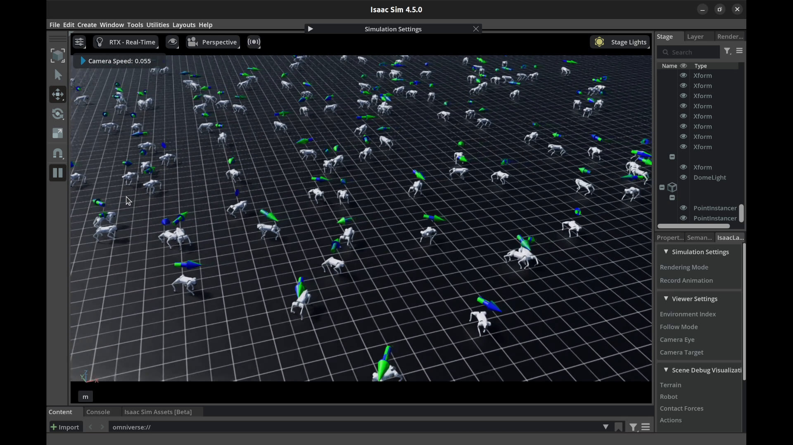
3 | METHODOLOGY
Training in Isaac Lab: flat terrain
• 16,384 robots step in parallel on one GPU.
• Reward: track command, stay upright, lift feet, save energy.
• PPO with RSL-RL and a custom reward recipe.
• A trot gait emerges; it is never hand-specified.
• 2 billion steps in 1 h 40 m on an RTX PRO 6000.
16,384 Go2 robots in parallel; arrows show each robot's commanded velocity.
Go2 RL Locomotion and Sim-to-Real | Richard (8525970)
6

Slide 7
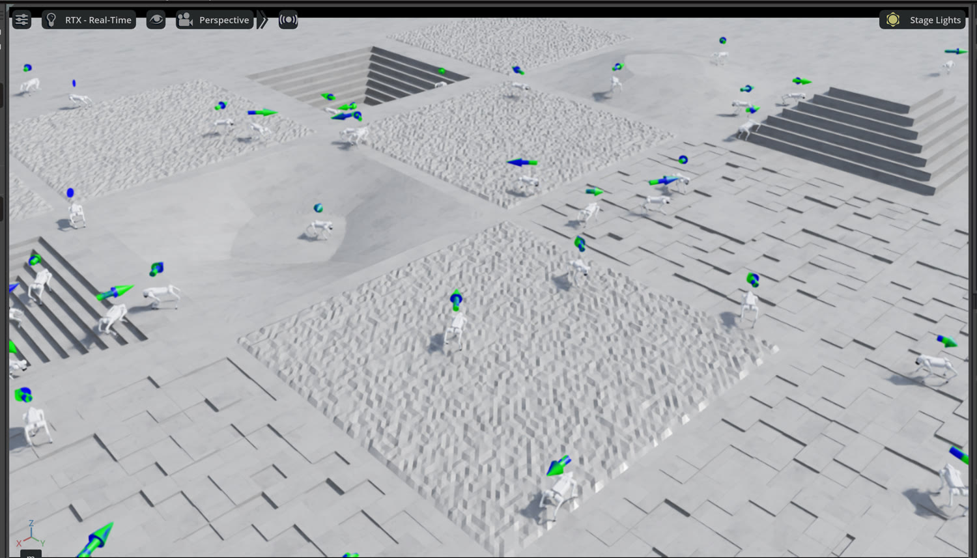
3 | METHODOLOGY
Training in Isaac Lab: rough terrain
• Same pipeline, harder terrain: stairs and uneven ground in all directions.
• A 187-dim height scan is added to the observation.
• Trained and validated in Isaac Sim, including stair climbing.
• Hardware deployment pending: the Go2 used has no depth sensor feeding the height scan.
Stairs, slopes and uneven blocks; the policy adds a height-scan observation.
Go2 RL Locomotion and Sim-to-Real | Richard (8525970)
7

Slide 8
3 | METHODOLOGY
Inside the policy: observation, action, reward
Observation (45-dim)
Action (12)
PPO
• Angular velocity (IMU)
• Projected gravity
• Velocity command
• Joint positions and velocities
• Last action (memory)
• Joint offsets from a nominal stance
• q = q_default + 0.25 a
• 500 Hz PD loop (Kp 40, Kd 1)
• Policy at 50 Hz, about 1 ms
• Actor-critic MLP 256-256-128
• Clipped objective, GAE
• KL-adaptive learning rate
• gamma 0.99, lambda 0.95
Reward = weighted sum of 12 terms; the gait emerges from these objectives:
Positive: velocity tracking (1.5), angular tracking (0.75), foot air-time (0.5)
Negative: flat orientation (2.5), vertical velocity (2.0), action rate (0.25), undesired contacts (1.0),
feet slide (0.25), joint deviation (0.1), torques and accelerations (small)
Go2 RL Locomotion and Sim-to-Real | Richard (8525970)
8

Slide 9
3 | METHODOLOGY
Domain randomization: the sim-to-real bridge
Every episode the simulator changes the physics, so the real robot is just one more variant.
Body mass
-2 to +4 kg
Centre of mass
+/- 5 cm
Friction (static / dynamic)
0.4-1.4 / 0.3-1.0
Actuator gains Kp / Kd
+/- 20 %
Actuator latency
0-20 ms (DelayedPDActuator)
Joint friction / armature
randomised
External force / push
+/- 3 N, +/- 0.5 m/s
Stand-still training
20 % of robots, zero command
Go2 RL Locomotion and Sim-to-Real | Richard (8525970)
9

Slide 10
4 | COGNITIVE APPROACH
Where the project sits: the Sense-Plan-Act loop
The COGAR course frames every architecture on one loop. Our controller is the reactive family: Sense to Act, with the Reasoning/Plan stage removed.
SENSE
Reasoning / Plan
ACT
>
>
IMU, encoders
removed (future: planner)
RL policy to PD
reactive loop, 50 Hz (Sense to Act directly)
• The policy is a behaviour in the course sense: a mapping of sensory inputs to motor actions (perceptual schema + motor schema).
• It is a Type-1, reactive behaviour, compiled down from a slow optimisation: exactly what reinforcement learning does.
Go2 RL Locomotion and Sim-to-Real | Richard (8525970)
10

Slide 11
4 | COGNITIVE APPROACH
Behaviour coordination and design patterns
Subsumption and fixed-priority coordination (Part 4)
• The deployment state machine (IDLE > STAND_UP > READY > WALK > DAMPING) is a fixed-priority, winner-take-all behaviour coordinator.
• Safety reflexes (tilt > 46 deg, sensor watchdog, NaN guard, clipping) suppress the walking behaviour, in Brooks' exact sense.
• These are reflexes in the ethological sense the course gives: rapid, automatic, involuntary responses.
Course design patterns realised (Part 2)
Adapter: the joint-order remap between Isaac Lab and the Unitree SDK conventions
Computational: the policy step: one periodic on_update() collecting inputs, one inference, all outputs
Publish-subscribe + Sensor-device: the IMU and encoder readers push state to the controller over DDS / ROS 2
Marr's three levels: what (a quadruped should walk) -> processes (schemas + FSM) -> implementation (ONNX on Jetson, PD on the driver).
Go2 RL Locomotion and Sim-to-Real | Richard (8525970)
11

Slide 12
5 | RESULTS AND CONGRUENCE
Two-configuration comparison and metrics
V2 (symmetric) vs V3 (asymmetric)
Simulation metrics
Actor observation
48-dim (+ base vel)
45-dim (no base vel)
Survival rate
99.7 %
Privileged info
none
base vel to critic only
Fall rate
0.33 %
Actuator model
ideal
delayed 0-20 ms
Velocity tracking error
0.22 m/s
Gain randomization
none
+/- 20 %
Angular tracking error
0.15 rad/s
Real-robot result
drifts sideways
walks straight
Final mean return
~31.2
H1 confirmed: in simulation both configurations are near-perfect. The gap appears only on hardware.
Go2 RL Locomotion and Sim-to-Real | Richard (8525970)
12

Slide 13
5 | RESULTS AND CONGRUENCE
The sim-to-real gap: failures and fixes
Failure
Root cause
Fix
Foot dragging
air-time reward too low
x40 air-time and feet-slide penalty
Collapsing
orientation penalty too harsh
rebalance so tracking dominates
Motor chatter
actions change too fast
x5 action-rate and accel. penalties
Sideways drift
actor used base velocity it cannot measure
asymmetric actor-critic (vel to critic only)
Gain sensitivity
real latency / gains / stiction
DelayedPDActuator and +/-20% gains
Twisted motion
sim vs SDK joint order
verified joint remap (Adapter pattern)
The asymmetric actor-critic was the single largest improvement to real-world performance.
Go2 RL Locomotion and Sim-to-Real | Richard (8525970)
13

Slide 14
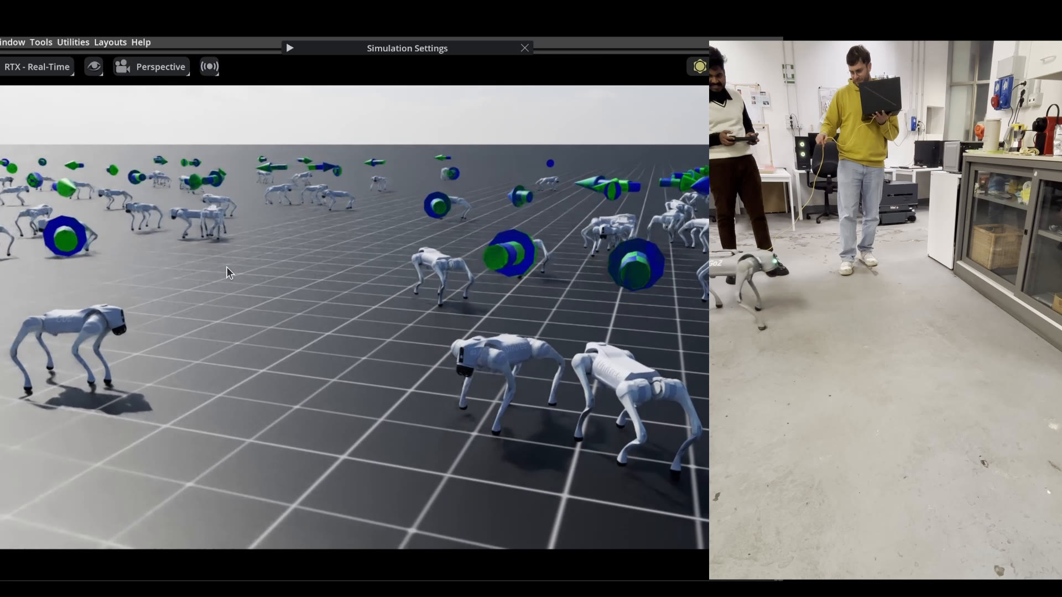
5 | RESULTS AND CONGRUENCE
Real-robot deployment: zero-shot on the Go2 EDU
• Same network that finished training; no fine-tuning.
• ONNX inference at 50 Hz.
• Run from a laptop over Ethernet and from the onboard Jetson Orin NX.
• The Jetson allows fully untethered operation.
• Walks straight (asymmetric actor-critic); holds station on neutral command.
Left: Isaac Sim validation. Right: the real Go2 walking under joystick command.
Go2 RL Locomotion and Sim-to-Real | Richard (8525970)
14

Slide 15
5 | CONGRUENCE OF RESULTS AND CONCLUSIONS
What the evidence supports, honestly
• Zero-shot flat walking on the real Go2: supported (demonstration; the specific failure modes were removed).
• Asymmetric actor-critic removes drift: supported by the V2 vs V3 comparison (H2).
• Domain randomization bridges the gap: supported by robustness across the training distribution.
Honest scope
Simulation metrics are quantitative; the hardware comparison is qualitative (a logged real-robot benchmark is future work).
The system realises the reactive behaviour and its fixed-priority coordinator, not a deliberative Reasoning/Plan layer.
Rough terrain is validated in simulation only. Next: add a planner (hybrid architecture), a depth sensor, and a learned velocity estimator.
Go2 RL Locomotion and Sim-to-Real | Richard (8525970)
15

Slide 16
Thank you
Go2 Reinforcement Learning Locomotion and Sim-to-Real Transfer
Acknowledgments
Sincere thanks to Prof. Fulvio Mastrogiovanni and Gianluca Galvagni for the Cognitive Architectures for Robotics course and for their guidance and support throughout this project.
Demonstration video (Isaac Lab training to real deployment):
https://drive.google.com/file/d/1e1jpoKKcbISyVp17HyGn1CQgQ9hJk3pM/view
Richard Albert King Mechoda | ID 8525970
Go2 RL Locomotion and Sim-to-Real | Richard (8525970)
16

