Slide 1
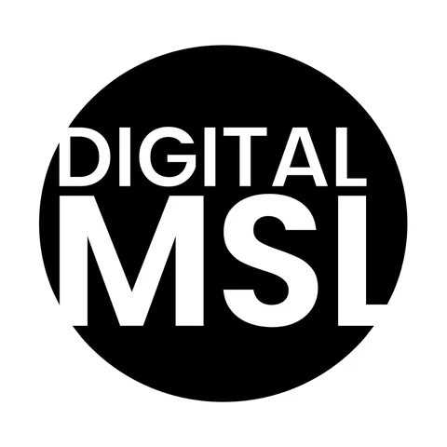
MODULE 10 · LESSON 4 OF 10
Omnichannel Medical & Digital Opinion Leaders
Digital medical education
Digital Medical Science Liaison Course

Slide 2
THE SHIFT ONLINE
Medical Education Moves to Digital Channels
Same goal as the medical education plan: close real knowledge gaps
1
Non-promotional formative activities, now delivered online
2
Digital adds scale, flexible access, and personalization
3
Complements in-person training rather than replacing it
4
DMSL COURSE · MODULE 10 — OMNICHANNEL MEDICAL & DIGITAL OPINION LEADERS
2 / 7

Slide 3
THE FORMAT RANGE
Three Ways HCPs Learn Digitally
Live webinars gather dispersed audiences with real-time Q&A
1
Asynchronous videos, infographics and podcasts fit a busy schedule
2
Structured e-learning offers progressive modules with formal accreditation
3
Each format suits a different depth and availability
4
DMSL COURSE · MODULE 10 — OMNICHANNEL MEDICAL & DIGITAL OPINION LEADERS
3 / 7

Slide 4
WHAT NEVER CHANGES
Rigor and Independence Still Apply
Content must rest on balanced, evidence-based material
1
Same MLR review as any other scientific material
2
Must stay clearly separate from promotional content
3
Applies to design, labeling and distribution alike
4
DMSL COURSE · MODULE 10 — OMNICHANNEL MEDICAL & DIGITAL OPINION LEADERS
4 / 7

Slide 5
THE DIGITAL ADVANTAGE
Personalization In-Person Can't Match
Format and depth adapt to each HCP's known profile
1
Modules sequence according to demonstrated knowledge level
2
Completion and interest are measured with precision
3
That data feeds the design of future content
4
DMSL COURSE · MODULE 10 — OMNICHANNEL MEDICAL & DIGITAL OPINION LEADERS
5 / 7

Slide 6
THE MSL'S ROLE
Recommend It, Then Build On It
Spot from field conversations which content fits a specific HCP
1
Recommend it as a starting point or a follow-up
2
Reinforces the omnichannel logic across every channel
3
DMSL COURSE · MODULE 10 — OMNICHANNEL MEDICAL & DIGITAL OPINION LEADERS
6 / 7

Slide 7
KEY TAKEAWAY
Digital medical education keeps the rigor of in-person training while adding scale and personalization
Webinars, asynchronous content and e-learning each serve a different need
MLR review and separation from promotion still apply online
MSLs connect field conversations to the right digital content
NEXT LESSON → Scientific content journeys
DMSL COURSE · MODULE 10 — OMNICHANNEL MEDICAL & DIGITAL OPINION LEADERS
7 / 7

