Slide 1

RECIPE
MANAGER
ALBERT SHIH & VANSH VENUGOPAL

Slide 2


PROJECT
SYNOPSIS
Recipes can be categorized by meal types, and users can generate shopping lists based on selected recipes. Additionally, we plan to allow users to filter recipes by ingredients or meal types and provides statistics on the most frequently used ingredients or meal types.
The Recipe Manager organizational application is designed to help users organize and manage recipes.

Slide 3
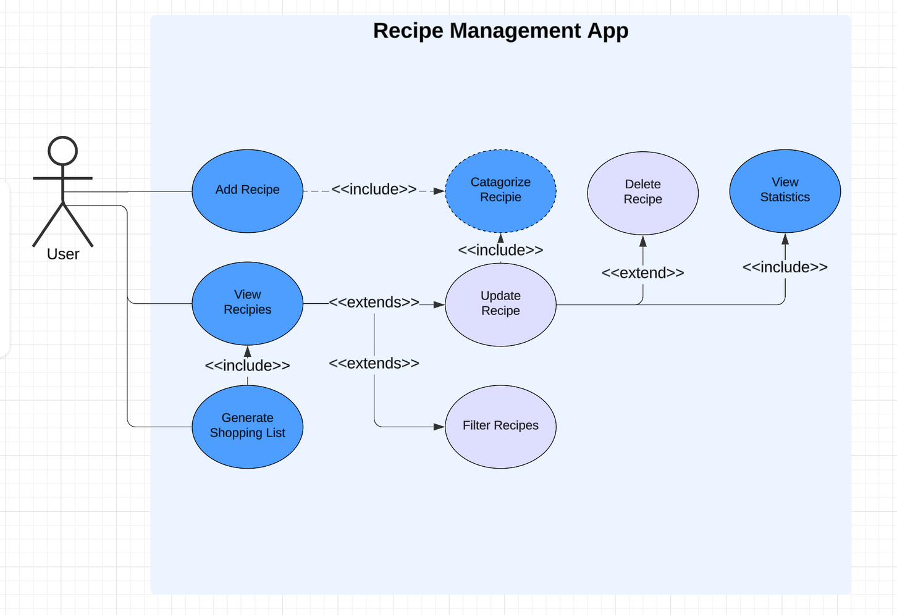
UML DIAGRAM

Slide 4
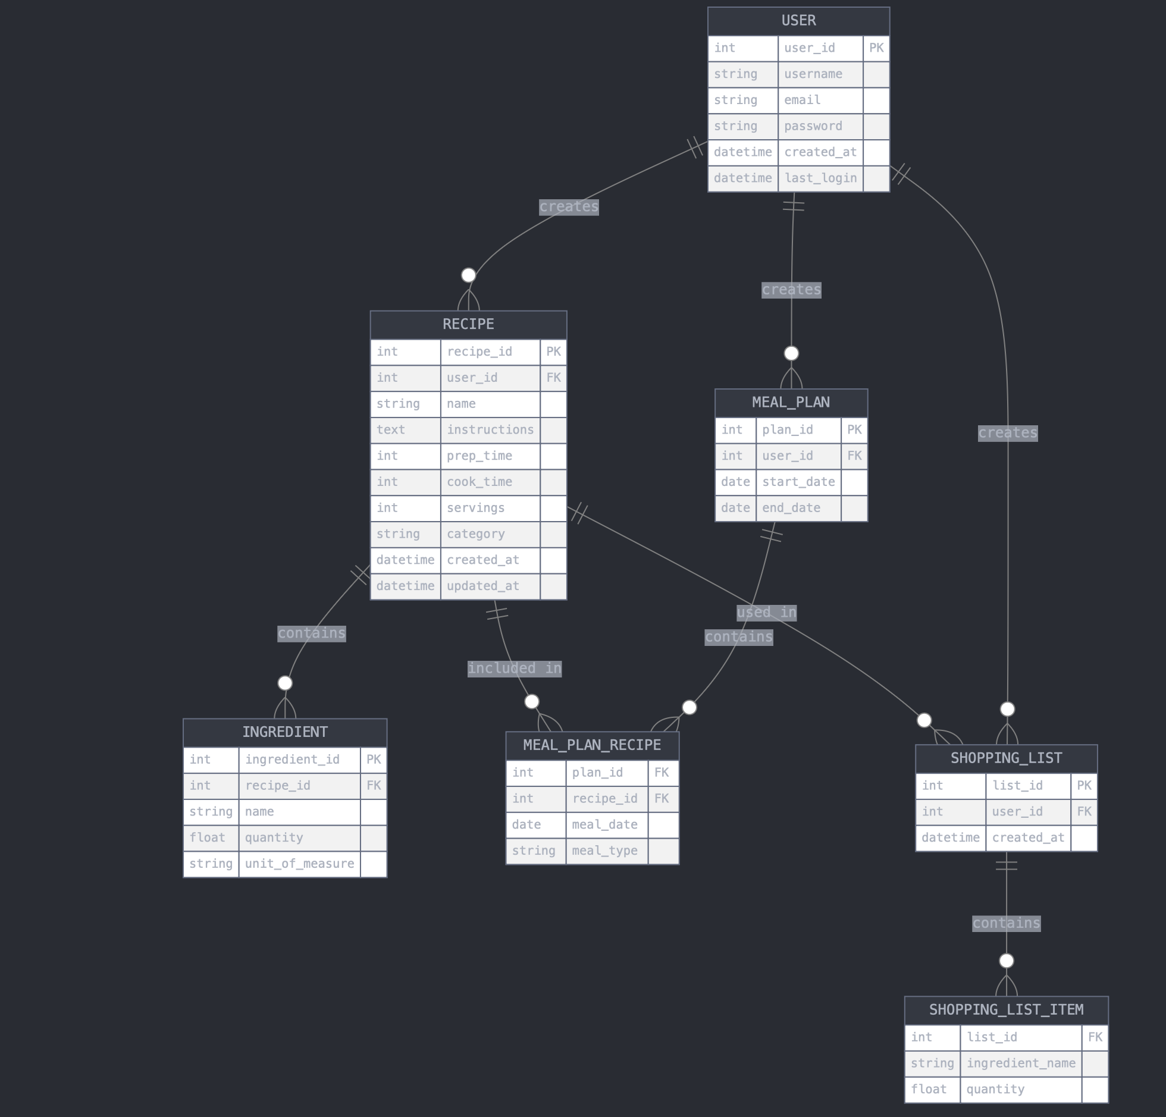
ER
DIAGRAM

Slide 5
User(user_id, username, email, password)
Category(category_id, name, description)
Recipe(recipe_id, name, instructions, prep_time, cook_time, servings, category_id, user_id)
Ingredient(ingredient_id, name, unit_of_measure)
MealPlan(plan_id, user_id, start_date, end_date)
ShoppingList(list_id, user_id, created_at)
RELATIONAL SCHEMA

Slide 6

THANK YOU

