Slide 1
CSE 111
Database Project
Recipe Manager
Albert Shih
Vansh Venugopal

Slide 2
Project Description
Core Features
Shopping List
Goal
Add, view, update, delete recipes
Categorize and filter recipes by meal types
Generate shopping lists based on selected recipes.
Database stores all recipe-related data
Streamline recipe management and shopping list creation for home cooks and meal planners
Publicly share recipes

Slide 3
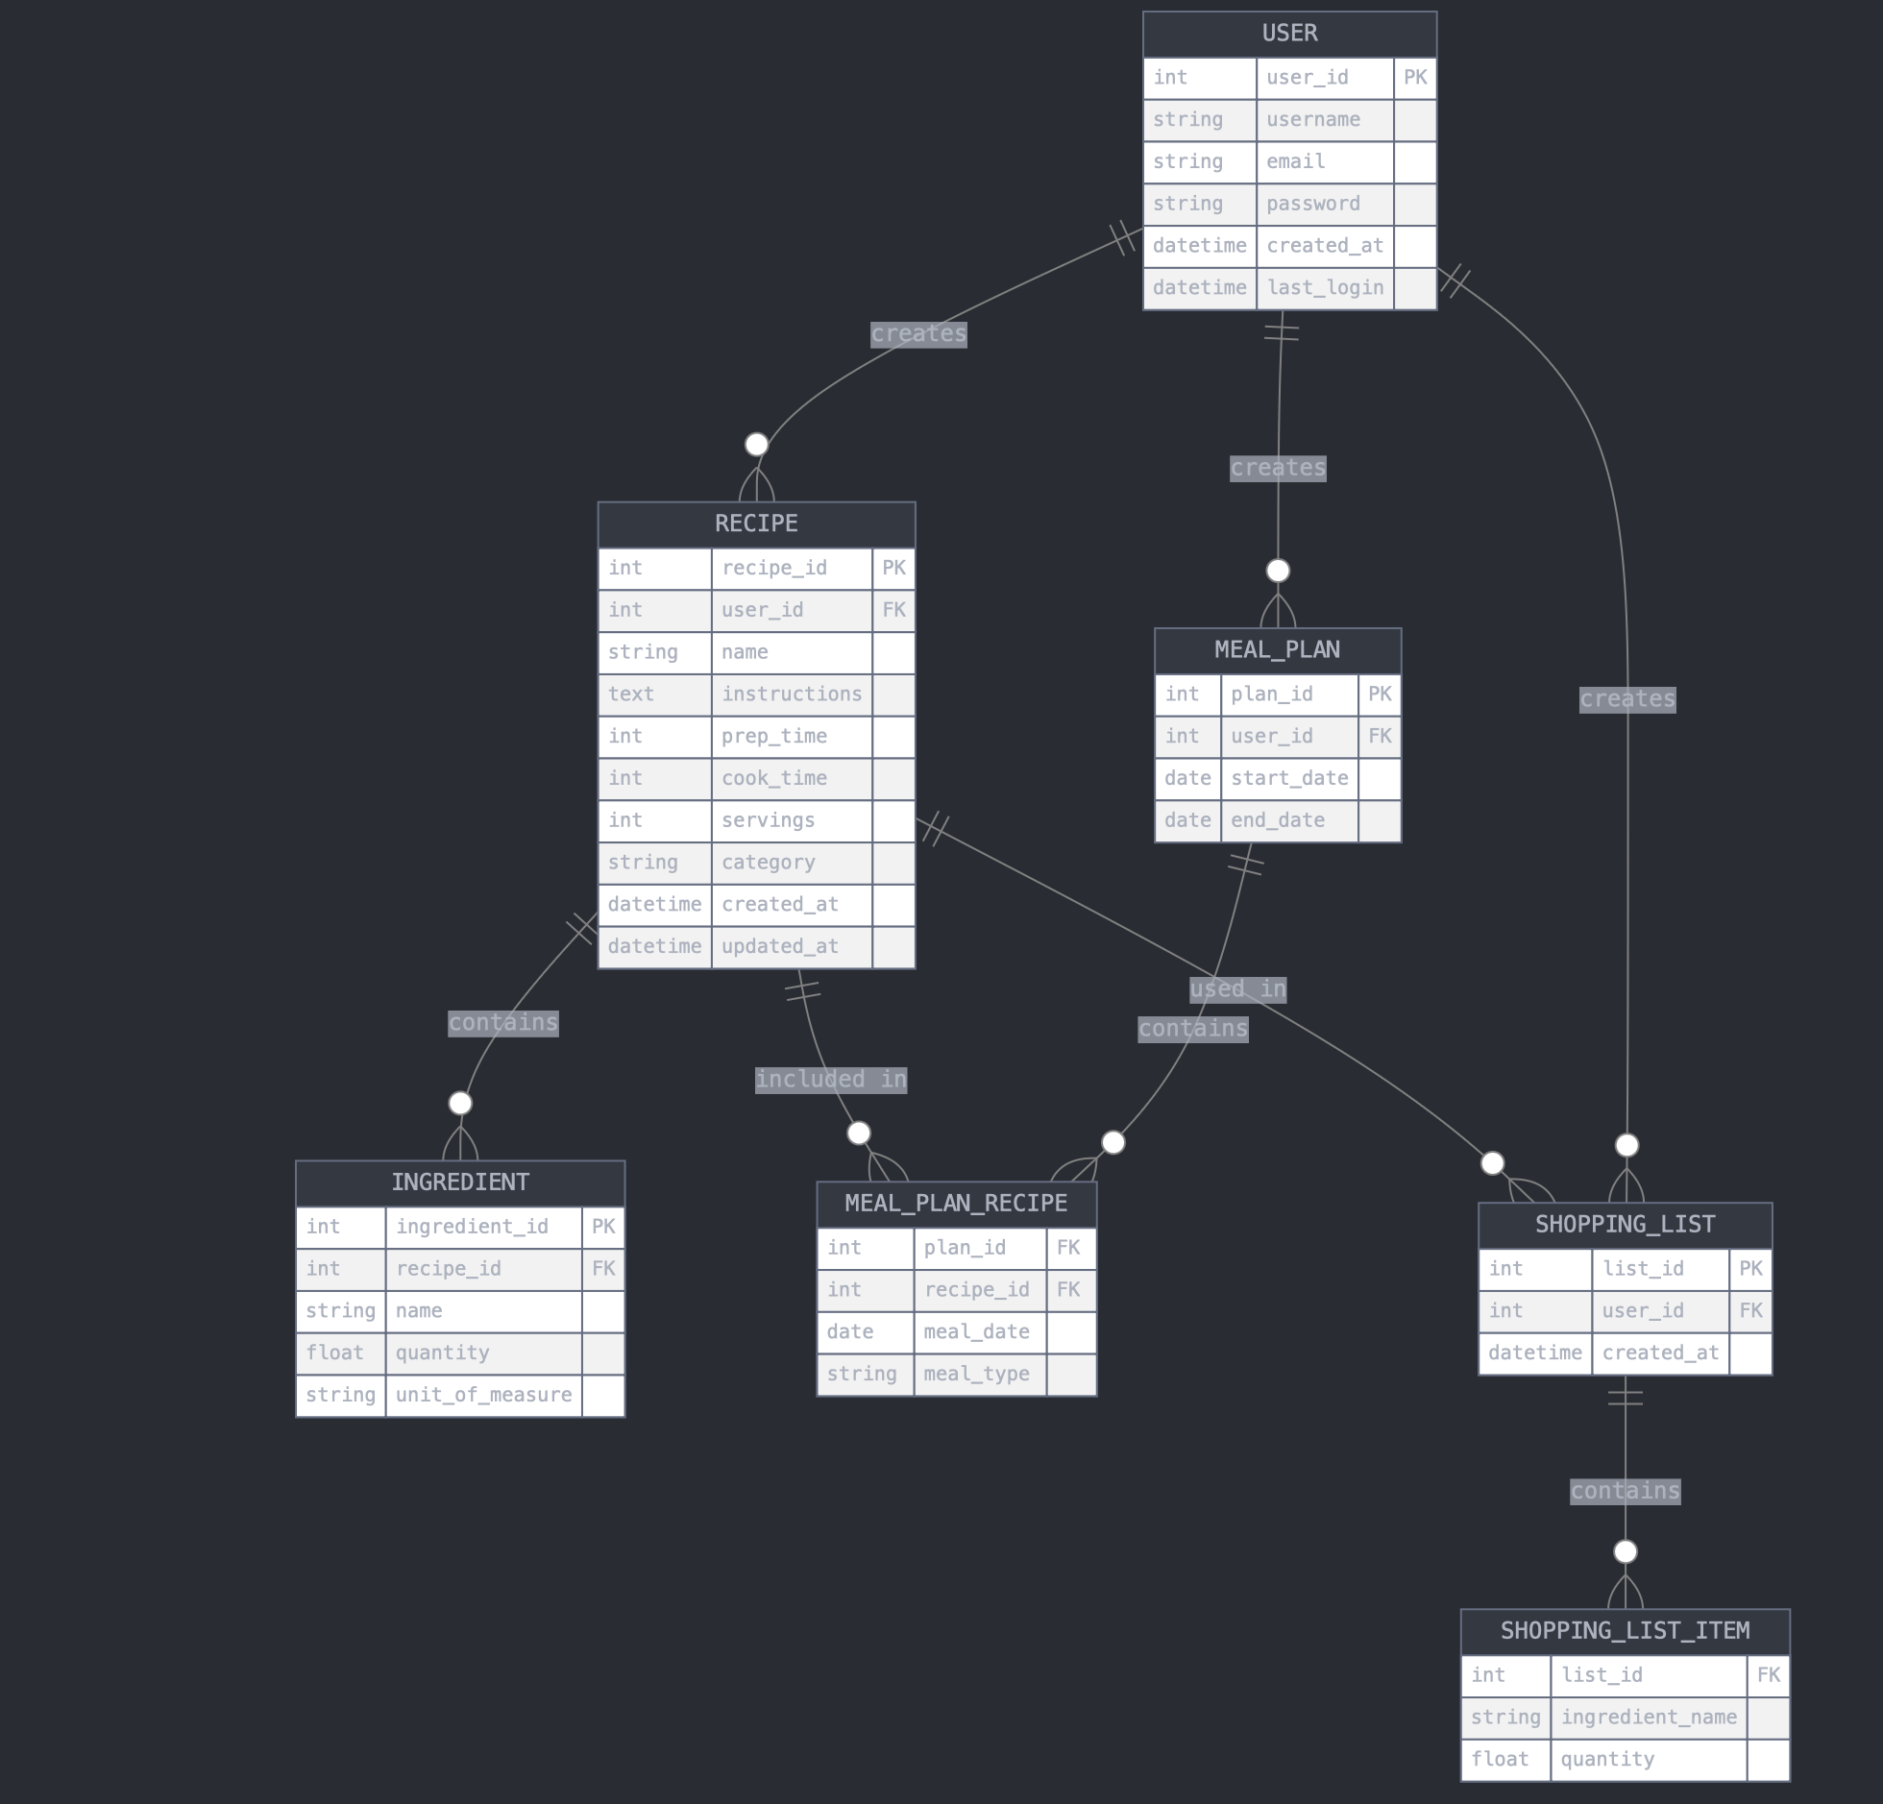
E/R Diagram

Slide 4
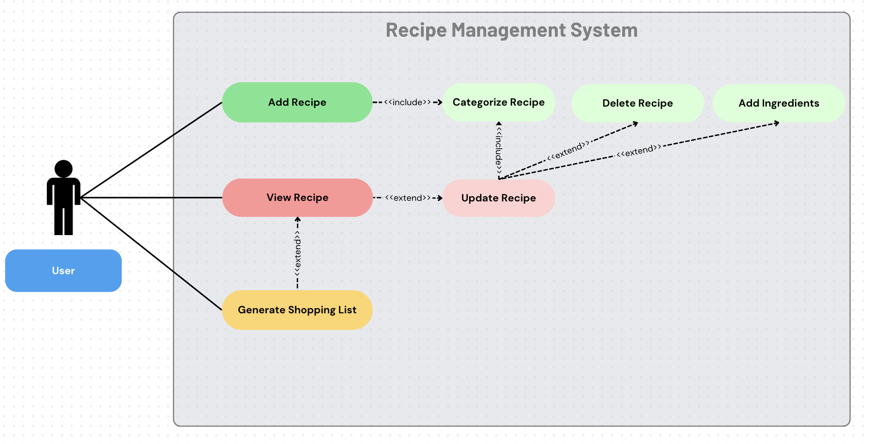
Use Case Diagram

Slide 5
Relational Schema
User(user_id, username, email, password)
Category(category_id, name, description)
Recipe(recipe_id, name, instructions, prep_time, cook_time, servings, category_id, user_id)
Ingredient(ingredient_id, name, unit_of_measure)
MealPlan(plan_id, user_id, start_date, end_date)
ShoppingList(list_id, user_id, created_at)
RecipeIngredient(recipe_id, ingredient_id, quantity)
ShoppingListItem(list_id, ingredient_id, quantity)
MealPlanRecipe(plan_id, recipe_id)

Slide 6
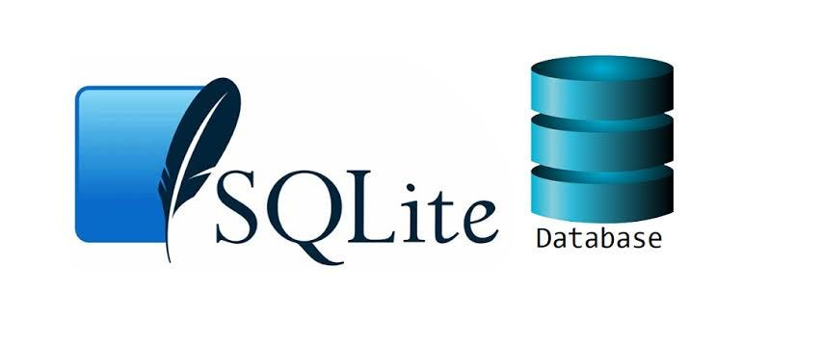
Implementation Details
Language & DB
We used a SQLite database. The app was built in python. Database connection through sqlite3
User Interface
We used a command line interface.
Menu Based usage
Dynamic depending on user
Validates input and provides feedback
Core Features
Implemented CRUD for recipes
Error handling

Slide 7
DEMO
!

