Slide 1
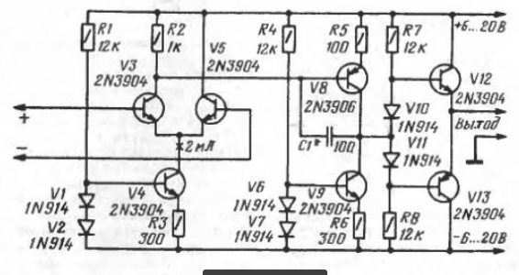
Notes:
BC547 DATU LAPA - http://pdf1.alldatasheet.com/datasheet-pdf/view/11551/ONSEMI/BC547.html
2N3904 DATU LAPA - https://pdf1.alldatasheet.com/datasheet-pdf/view/11470/ONSEMI/2N3904.html

Slide 2
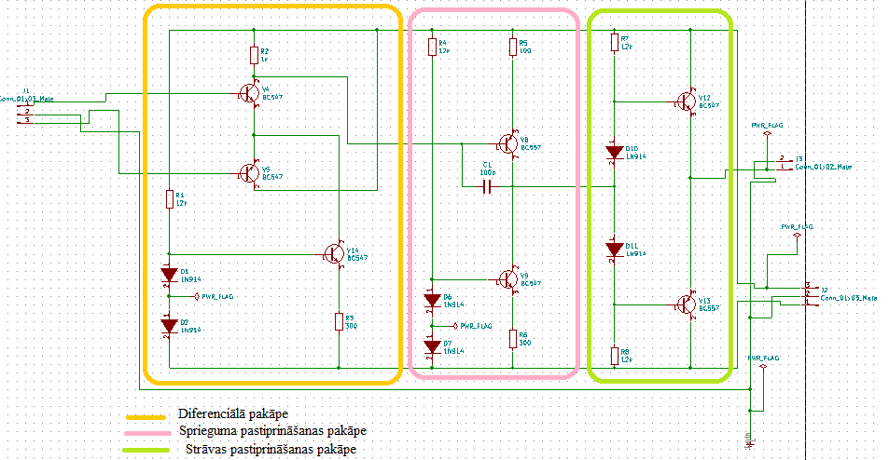
Notes:
BC547 DATU LAPA - http://pdf1.alldatasheet.com/datasheet-pdf/view/11551/ONSEMI/BC547.html
2N3904 DATU LAPA - https://pdf1.alldatasheet.com/datasheet-pdf/view/11470/ONSEMI/2N3904.html

Slide 3
