Slide 1


( NameOfApp )

Slide 2

Design
340
780
70
70

Slide 3
Information Architecture
Stats
User goal progress and summary page, the default main page for the app. Serves as an ‘at a glance’ series of key data streams most important to the users lifestyle.
Profile
Single page of tools for viewing and editing the user profile (current height, weight, age, etc).
Goals
Display and update the user’s lifestyle goals, handles all goal related data.
Tools
Collection of tools for helping the user achieve their lifestyle goals. The BMI and BMR explicit calculators live here, alongside the hike finder and weather.

Slide 4
Navigation
After reviewing the main functionality of the app described in the spec and sorting the behaviors into the 4 categories listed in the IA, we decided to use a tab-based scheme for the app navigation.
The bottom nav allows the user to switch between the 4 main views, and reinforces a fairly simple mental model of the app.
This layout avoids the need for back-behaviors with the exception of the tools tab, in which the more involved activities are housed in a list view. Each of these activities may be accessed from the list view but the user can still switch to any of the other main views using the bottom nav and return to the last tool used.
Additionally, this approach was chosen since it would be fairly easy to extend (especially the tools page) as more features are added, without significant reorganization of the app.

Slide 5

Navigation
Stats
Profile
Goals
Tools

Slide 6
Design
Due to time constraints on this project, it seemed very unlikely that we would be able to implement all the required functionality and create/test custom views for tablets as well.
For this reason, we went with a very simple, typography based look. A few other designs were tested but this approach seemed the simplest, while still being evocative of a highly designed digital product.
By using the largest font and refining the layouts, the same design for mobile scales up fairly well to the tablet views.

Slide 7
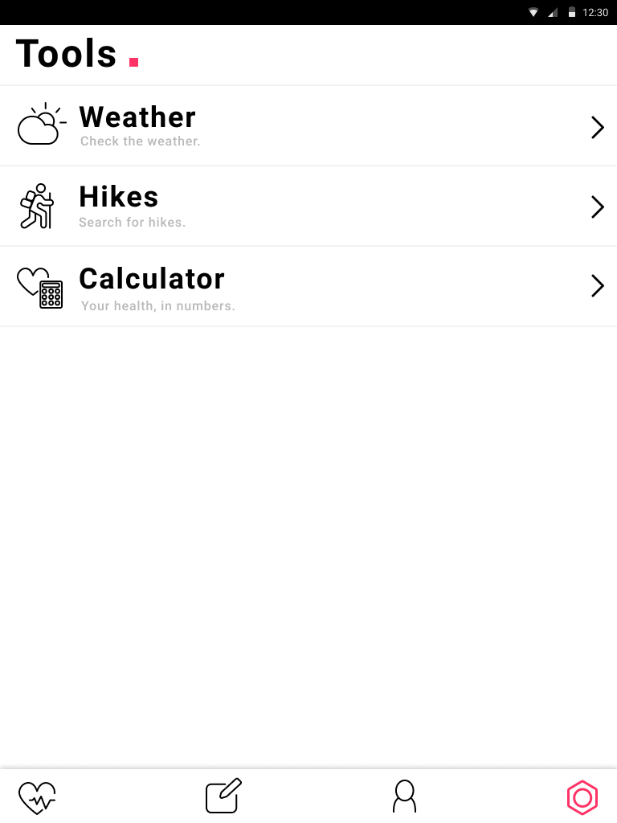
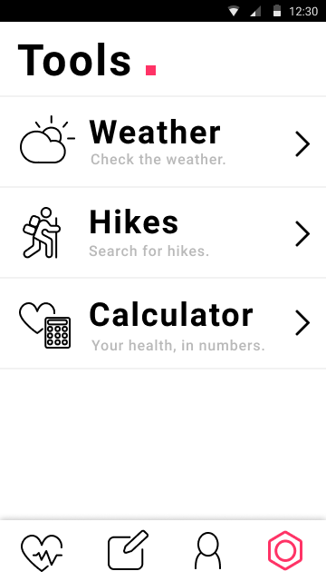
Design
View comparison, identical layouts scaled horizontally to match device screen size.

Slide 8
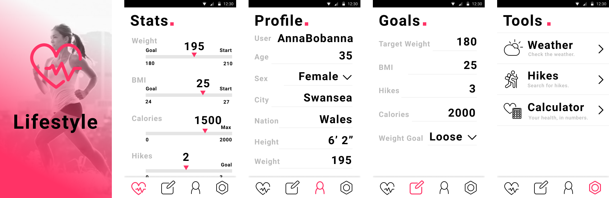
Main View Mockups
Splash
Stats
Profile
Goals
Tools

Slide 9
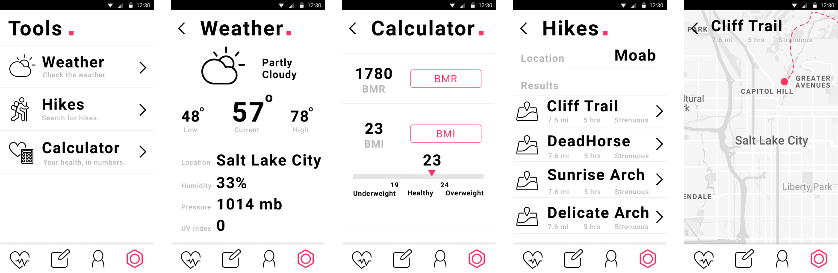
Tools Mockups

Slide 10
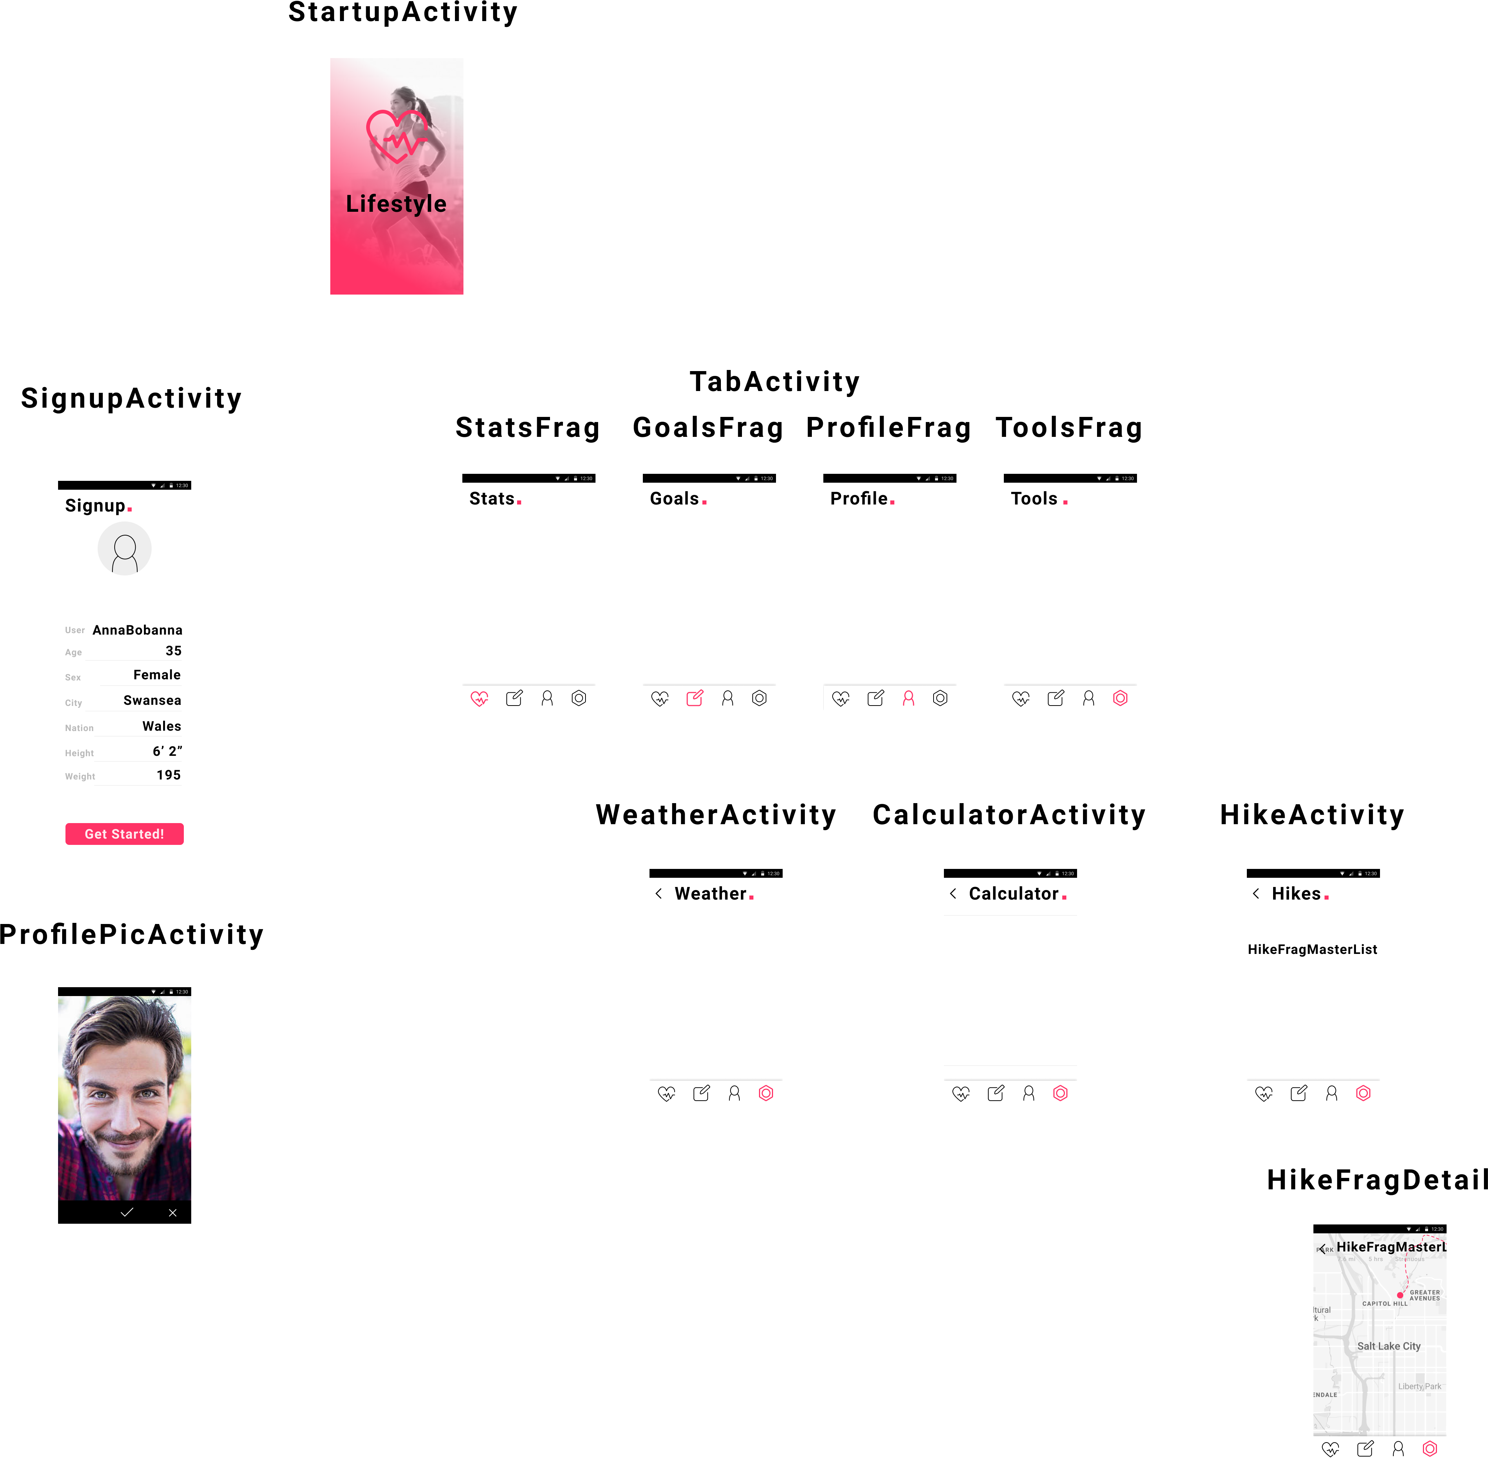
Class Diagram
Room DB
Repository
View Model

