Slide 1
( LifeStyle App )

Slide 2
Presenters
Adam Miles (Team Lead)
Jennifer Niang (Design Lead)
Chaofan Su (Test Lead)

Slide 3
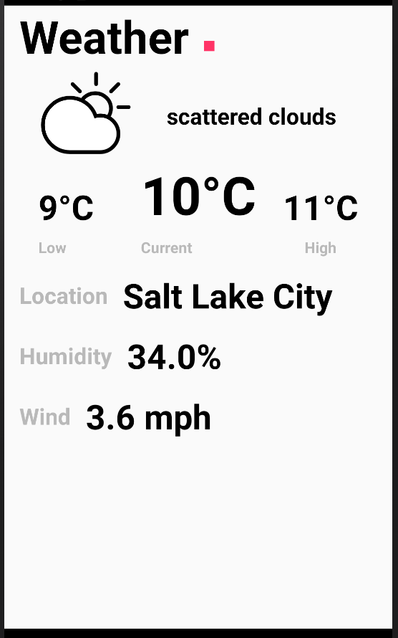
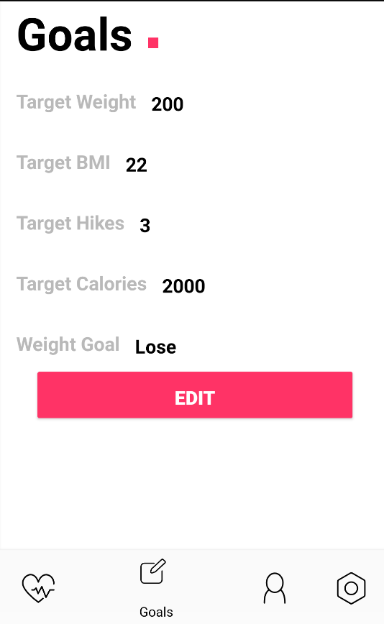

Slide 4
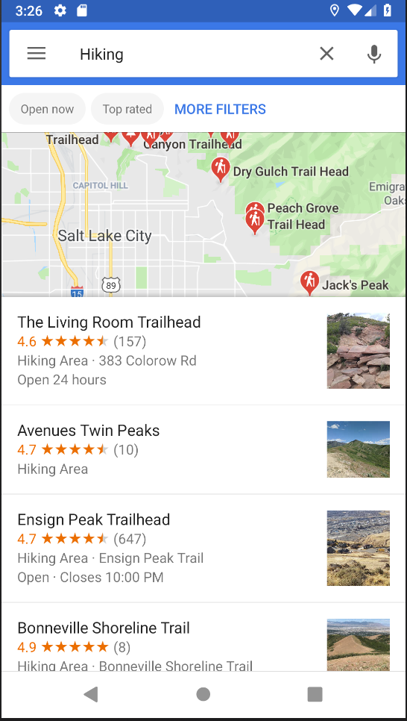
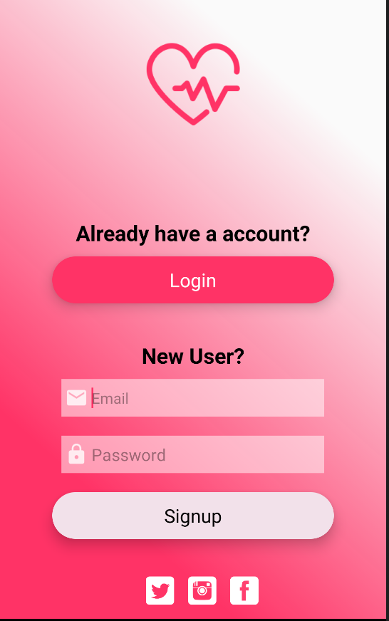

Slide 5
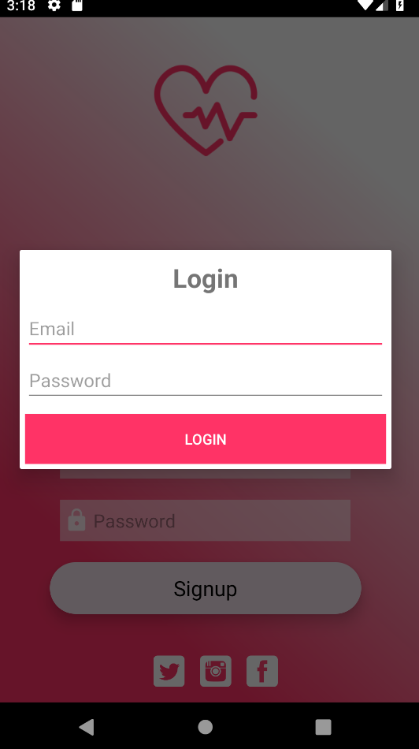
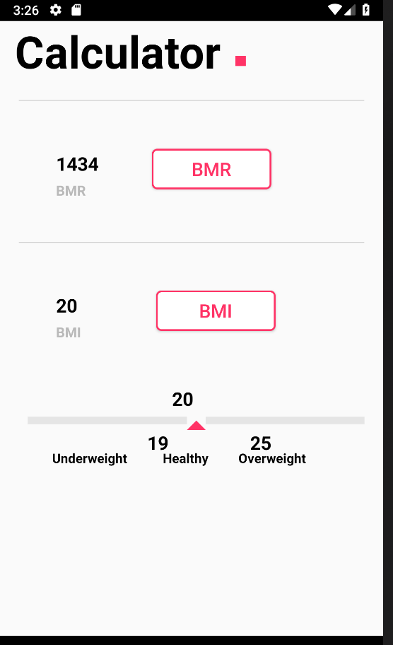

Slide 6
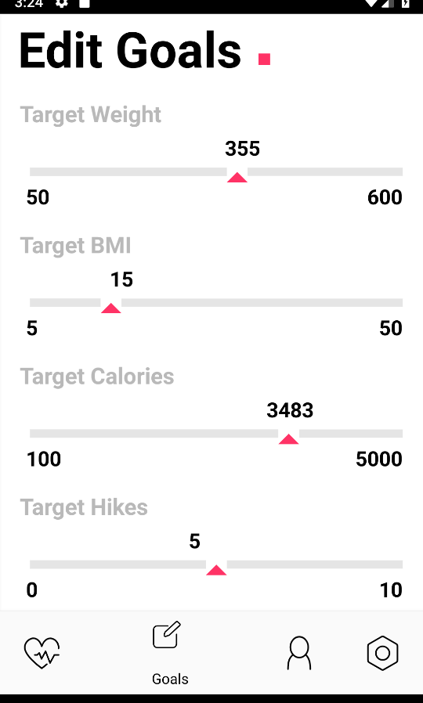
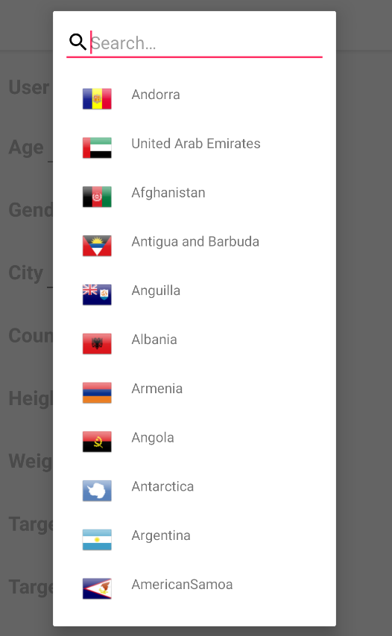

Slide 7
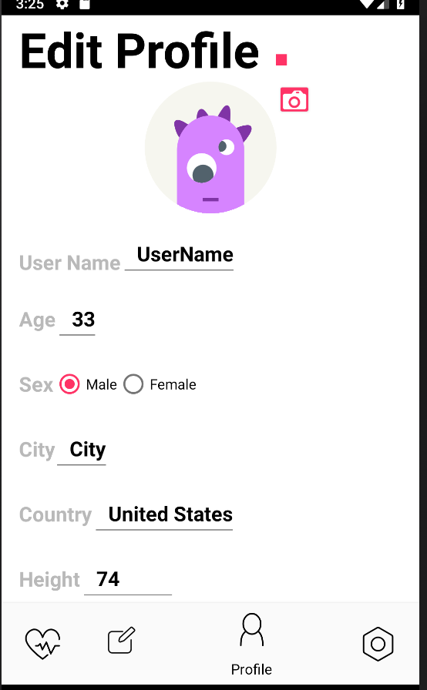
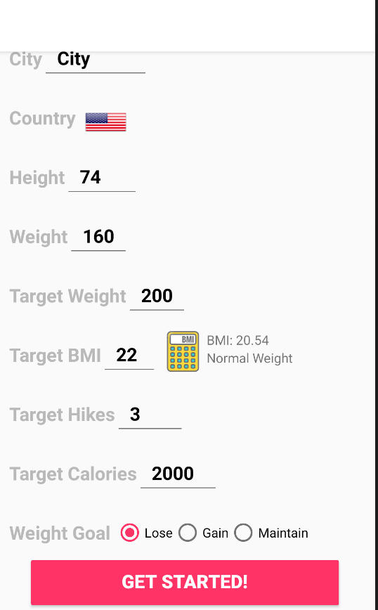

Slide 8
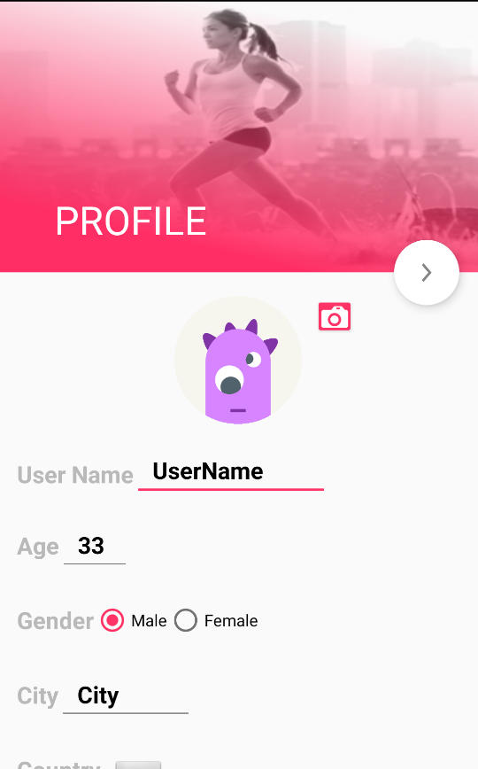
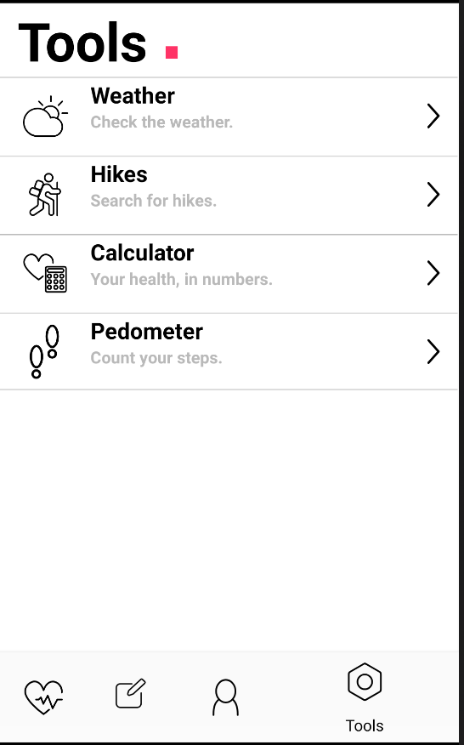

Slide 9
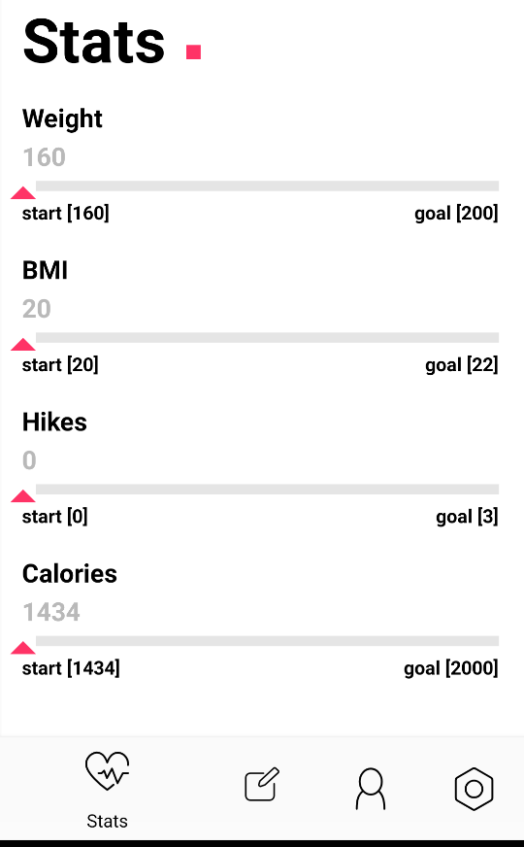

Slide 10
Design

Slide 11
Information Architecture
Stats
User goal progress and summary page, the default main page for the app. Serves as an ‘at a glance’ series of key data streams most important to the users lifestyle.
Profile
Single page of tools for viewing and editing the user profile (current height, weight, age, etc).
Goals
Display and update the user’s lifestyle goals, handles all goal related data.
Tools
Collection of tools for helping the user achieve their lifestyle goals. BMI, BMR, Calories, Hiking and Weather all here. New Feature Pedometer- calculating steps person takes per day and per week to reach their daily goal.

Slide 12
Navigation
Stats
Profile
Goals
Tools
Notes:
After reviewing the main functionality of the app described in the spec and sorting the behaviors into the 4 categories listed in the IA, we decided to use a tab-based scheme for the app navigation.
The bottom nav allows the user to switch between the 4 main views, and reinforces a fairly simple mental model of the app.
This layout avoids the need for back-behaviors with the exception of the tools tab, in which the more involved activities are housed in a list view. Each of these activities may be accessed from the list view but the user can still switch to any of the other main views using the bottom nav and return to the last tool used.
Additionally, this approach was chosen since it would be fairly easy to extend (especially the tools page) as more features are added, without significant reorganization of the app.

Slide 13
Design
View comparison, identical layouts scaled horizontally to match device screen size.
Notes:
Due to time constraints on this project, it seemed very unlikely that we would be able to implement all the required functionality and create/test custom views for tablets as well.
For this reason, we went with a very simple, typography based look. A few other designs were tested but this approach seemed the simplest, while still being evocative of a highly designed digital product.
By using the largest font and refining the layouts, the same design for mobile scales up fairly well to the tablet views.

Slide 14
Main View Mockups
Splash
Stats
Profile
Goals
Tools

Slide 15
Tools Mockups

Slide 16
Team Lead

Slide 17
App Structure
/ Class Design
Updated 10.29.18

Slide 18
Class Diagram
Room DB
Repository
View Models

Slide 19
Data Encapsulation
A User class for binding data(variables) with its related functionalities (methods)
Implementation is purely hidden from outside classes – improve maintainability and re-usability
Restrict access to critical data members – improve security

Slide 20
Extensibility
In MainActivity, having a fragment manager to store the state of hidden frag, also set the active fragment
Fairly easy to extend as more features are added, without significant reorganization of the app
No need to mess with bundles and back stack problems

Slide 21
Extensibility
List of tabs routing to specified activities
Easy to extend as more features are added
Calculator Utility Class as the provider for doing the calculation in different classes

Slide 23
Tester

Slide 25
Test Modules
Lifecycle Awareness –does it do what it is suppose to do
Halfway through the sign up - retain or start over
User log out or quit properly
Check that Navigation is seamless
Back Button to the right Fragment – only place for us Tools

Slide 26
Tester CheckOff List
UI and Junits test need to be implemented
Warning or Toasts need for Application
Reminders to clicks, buttons or use drop-downs
Conversion methods need to test
example: kg versus lbs

Slide 27
Major Bug/Challenge
Challenge
Trying to find an easy way switch between the 4 main views, and reinforces a fairly simple model of the app
Trying to avoid the need of back-behaviors with the exception of the tools tab,
in which the more involved activities are housed in a list view
Applying fragments to bottom navigation view is cool, but will face the fragment re-created issue when return back
Notes:
After reviewing the main functionality of the app described in the spec and sorting the behaviors into the 4 categories listed in the IA, we decided to use a tab-based scheme for the app navigation.
The bottom nav allows the user to switch between the 4 main views, and reinforces a fairly simple mental model of the app.
This layout avoids the need for back-behaviors with the exception of the tools tab, in which the more involved activities are housed in a list view. Each of these activities may be accessed from the list view but the user can still switch to any of the other main views using the bottom nav and return to the last tool used.
Additionally, this approach was chosen since it would be fairly easy to extend (especially the tools page) as more features are added, without significant reorganization of the app.

Slide 28
Major Bug/Challenge
Solution
In Main Activity, having the fragment manager to control the hidden and showing fragments
Commit the state of hidden fragment to manager so can restore it when coming back
Notes:
After reviewing the main functionality of the app described in the spec and sorting the behaviors into the 4 categories listed in the IA, we decided to use a tab-based scheme for the app navigation.
The bottom nav allows the user to switch between the 4 main views, and reinforces a fairly simple mental model of the app.
This layout avoids the need for back-behaviors with the exception of the tools tab, in which the more involved activities are housed in a list view. Each of these activities may be accessed from the list view but the user can still switch to any of the other main views using the bottom nav and return to the last tool used.
Additionally, this approach was chosen since it would be fairly easy to extend (especially the tools page) as more features are added, without significant reorganization of the app.

Slide 29
Any Questions?

Slide 30
Demo

Slide 31
THANKS!

