Slide 1
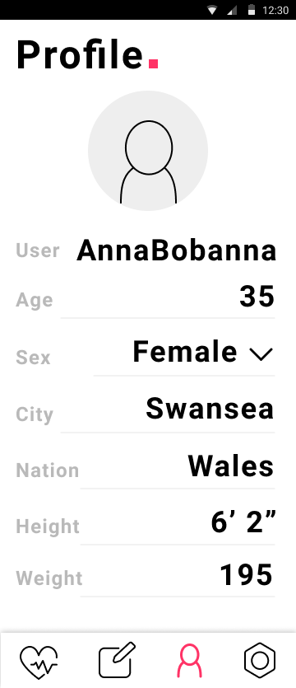
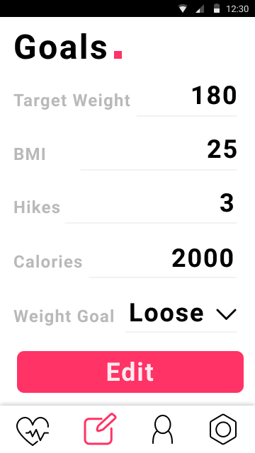
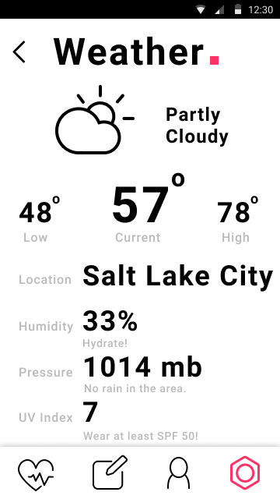
Testing 2a
Considerable error checking was added across the application, in response to a more rigorous testing protocol.
Check for empty inputs.
Check navigation states.
Catch malformed inputs (non-numeric in certain fields_
Validate image path in android resources.
Check alert context.
Shotgun, combinatorial testing of the above.
Validate observer behavior with edit.
Check navigation states (in HomeActivity, while editing).
Catch malformed/empty inputs
Validate image path in android resources.
Check that
Shotgun, combinatorial testing of the above.
API test
Tested cascade of ‘weather summary’ strings, and the corresponding pairing with the icon selector method.

