Slide 1
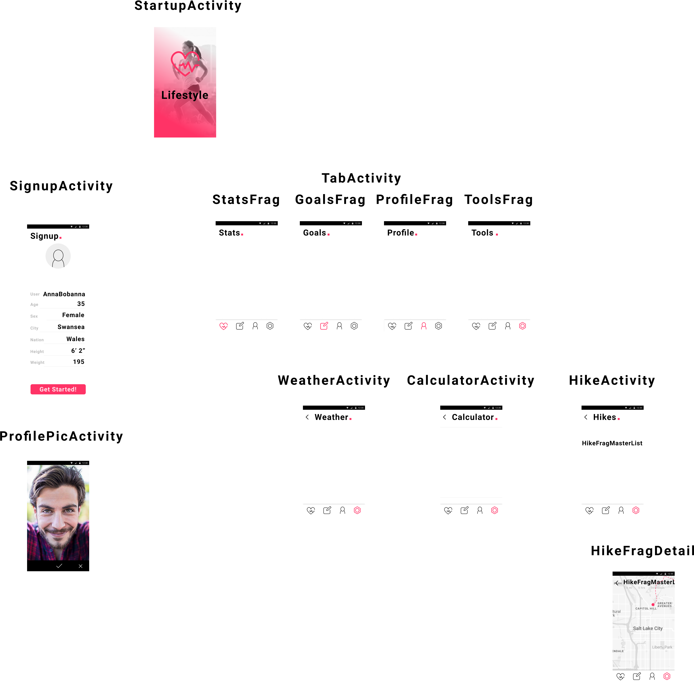
Class Diagram
Room DB
Repository
View Model

