Slide 1

CSCS 530 Agent-Based Modeling of Complex (Adaptive) Systems
2/18/15
Sarah Cherng

Slide 2
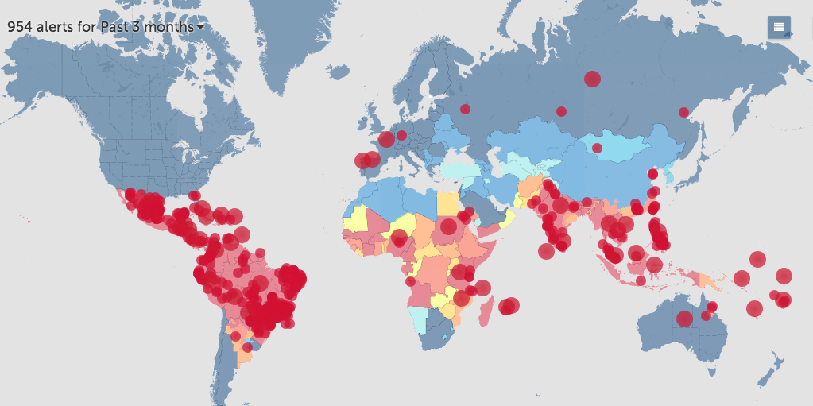
Dengue – An Emerging Disease
Slide by Yu-Han Kao

Slide 3
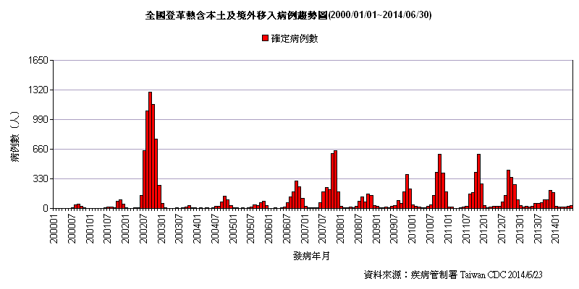
Model Fitting in Predictive Mathematical Models
Climate-Based Mathematical Model of Dengue by Yu-Han Kao in UM SPH Department of Epidemiology
Dengue in Taiwan
Slide by Yu-Han Kao

Slide 4
Climate Based Dengue Mathematical Model
Spatial heterogeneity
Southern Taiwan: Kaohsiung, Tainan, Pingtung
Seasonality
Multiple epidemics peaks
Climate factors
Temperature, rainfall, extreme rainfall events
Imported cases
Mosquito population dynamics
Slide by Yu-Han Kao

Slide 5
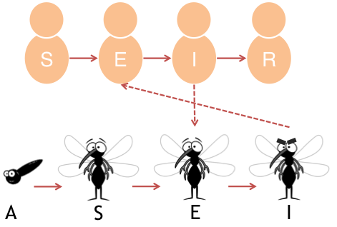
Climate Based Dengue Mathematical Model
Model written by Yu-Han Kao in UM SPH, Department of Epidemiology with Marisa Eisenberg
Slide by Yu-Han Kao
Notes:
A – Larvae and Pupei

Slide 6
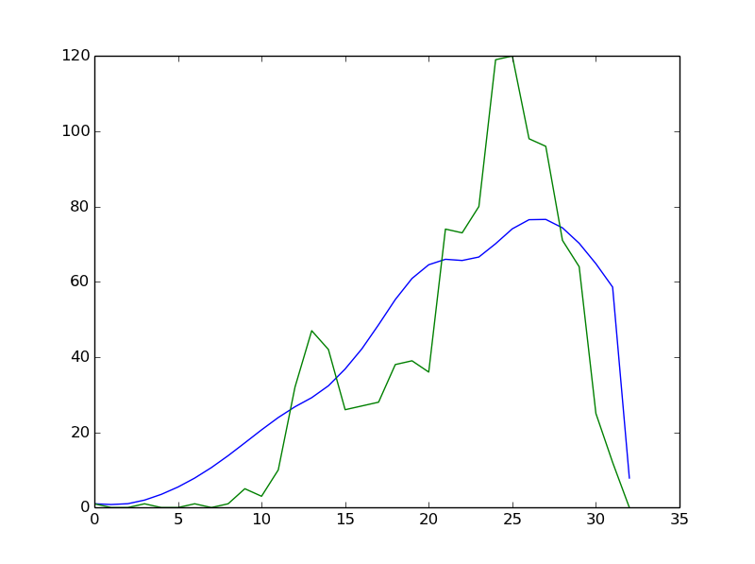
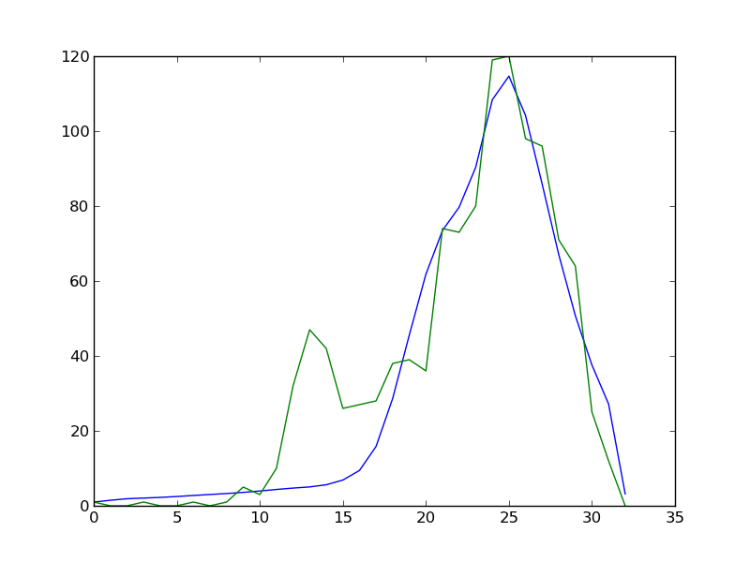
Model Fitting in Predictive Mathematical Models
Parameters = Mosquito reproduction rate, rate of disease transmission (human to mosquito, and mosquito to human), and many more -- Plots are incidence, or number of new cases (y) over time (x)
Fit measure: Least Squares (there are many others)
Side note about “un-identifiability” of model fit

Slide 7
HIV ABM Model Review
Agents
Person
Condom budget
Infection Status
Probability of hooking up with others
Institution
Condom subsidy
Environment
Condom cost
Probability of transmission with no condom
Probability of transmission with condom
Processes
Search for partner
Search neighbors
Move (between -1,0,+1 in each dimension)
Infection
Condom detection
Infect
Feedbacks
More infected people - > greater probability of infection
Results

Slide 8
Parameter Sweeps
What would we be interested in “sweeping” in the HIV model?
Why and what effects do we suspect they might have?
Remember the main “model question”!
How might the results be analyzed?

Slide 9
Parameter Sweep Exercise
Before I show you exactly how, what methods could we use to perform a parameter sweep in the program?

Slide 10
HIV Model Parameter Sweep Example
http://nbviewer.ipython.org/github/mjbommar/cscs-530-w2015/blob/master/code/003-basic-abm/003-hiv-parameter-sweep-harder.ipynb

