Slide 1

CSCS 530 Agent-Based Modeling of Complex (Adaptive) Systems
1/14/15
Sarah Cherng

Slide 2
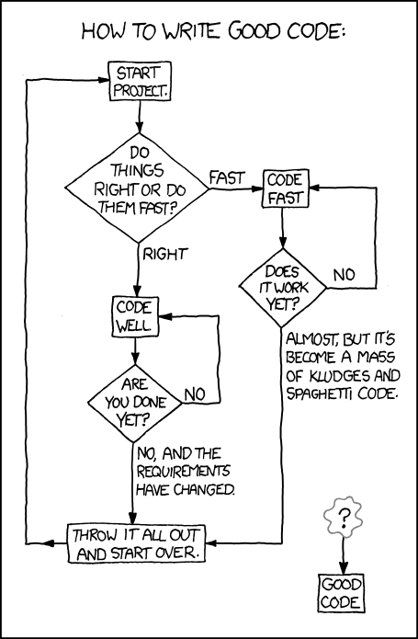
Programming Concepts
http://xkcd.com/844/

Slide 3
Programming Concepts
"Debugging is twice as hard as writing the code in the first place. Therefore, if you write the code as cleverly as possible, you are, by definition, not smart enough to debug it."
-Brian Kernighan
Programming as a relationship:
Your program will do exactly what you tell it to, no more, no less
When there are errors, they are usually because we did something confusing (though, unlike in successful relationships, you are almost always wrong) ☺
Python is very good at communicating errors, if you listen carefully, it can make all of your dreams come true (and give you very important hints about where you went wrong)
Be patient, debugging is a science

Slide 4
Programming Concepts
Variables
X, snowcone, numAgents
Types
Integer, float, string
Operators
+, -, *, /, **, ++
And more!
http://www.tutorialspoint.com/python/python_basic_operators.htm
Expressions and Statements
x+2, snowcone**snowcone
Comments
#use me often!

Slide 5
Programming Concepts
Invalid Things
Variable names that have invalid characters ($,#,@,etc.)
Variable names that start with numbers
Variable names that are keywords
Things you’ll discover as you learn more Python ☺
Python keywords:
And, elif, if, while, or
And more! http://www.pythonforbeginners.com/basics/keywords-in-python

Slide 6
Programming Concepts and Model Thinking
Programming is basically 4 things:
Input/Output
Math
Conditional Selection
Repetition
Why is computer programming useful for modeling?

Slide 7
Model Thinking – George Box
“All models are wrong, but some are useful.”
“Since all models are wrong the scientist cannot obtain a "correct" one by excessive elaboration… Just as the ability to devise simple but evocative models is the signature of the great scientist so overelaboration and overparameterization is often the mark of mediocrity.”
Just model philosophy, some very complex models have been used throughout history and are very good
Archimedes Diabetes Complication Model
Apply the right modeling technique and philosophy for your own purposes!

Slide 8
Model Thinking – ABMs
What are Agent-Based Models?
Why ABMs?
What can they do more effectively than other modeling methods?
ABM structures
Mechanisms and Processes

Slide 9
Model Thinking
Segregation
Schelling Model
Rules: 1) Move until you are happy
Outcome: Happiness, Segregation
Choice Optimization
El Farol Bar (Thursday night Irish music!)
Rules: 1) History of crowding, 2) Weight of history (-1,1)
Outcome: Go to the bar, Crowding

Slide 10
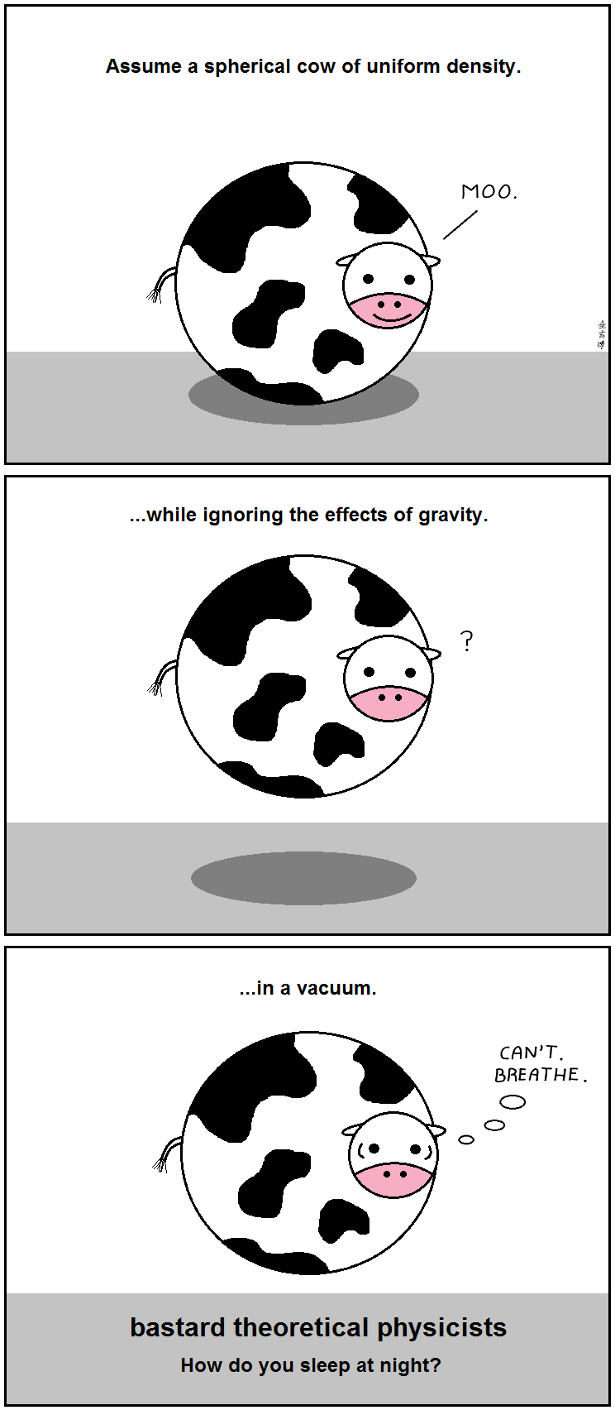
Model Thinking
http://abstrusegoose.com/strips/stop_the_massacre.png

Slide 11
Monte Carlo Simulation
Main variable of “uncertainty”:
How many people in a day could I convince to do the truffle shuffle?

Slide 12
Monte Carlo Simulation
What contributes to truffle shuffling?:
Self image
Environment
Anything else?
Strengths of Monte Carlo Simulation
Probabilistic Results
Sensitivity Analysis (which variables matter)
Correlation of Inputs (i.e., self image and environment)

Slide 13
Monte Carlo Simulation
Let’s go over the notebook ☺
http://nbviewer.ipython.org/github/mjbommar/cscs-530-w2015/blob/master/code/001-basic-random/002-monte_carlo.ipynb

