Slide 1

CSCS 530 Agent-Based Modeling of Complex (Adaptive) Systems
1/21/15
Sarah Cherng

Slide 2
Today’s Course Outline
Function Review
Using functions to interact with ipython notebook
Conditionals (if, else) and Loops (for, while)
Dictionaries
Basic Grid Space
Quick notes on basic graphs for next time (If there’s time!)

Slide 3
Programming – Function Review
Functions are anything that performs some procedure or routine on some input or argument
Can be programmer defined, or built into python packages, or python itself (e.g., numpy, math, etc.)
numpy.random.normal(1,0.5)
where 1 and 0.5 are function “arguments”
Help you maintain organization of your code ☺
Can return a value (or it can return nothing)
Programming with the interactive function in class notebook from the class Monte Carlo program
Reference Notebook:

Slide 4
Programming – Conditionals
Relational Operators
!=, ==, >, < , >=, <=
Logical Operators
and, or
Conditionals
if x > 10:
Print “x > 10!”
Chained Conditionals
if x > 10:
print “x > 10!”
elif x == 0:
print “x = 0!”
else:
print “x is less than 10 and not equal to 0”

Slide 5
Programming – Conditionals
Nested Conditionals
if x > 10:
print “x > 10”
else:
if x < 0:
print “x is less than 10 and negative”
else:
print “x is less than 10 and positive or 0”

Slide 6
Programming – Loops
For loops
for x in xrange (10):
print x
aside: xrange vs. range are basically interchangeable, but you’ll see xrange more because it uses fewer resources (i.e., xrange generates numbers as you need them, as compared to range, which generates numbers at the beginning)
While
while currentTime < maxTimeStep:
currentTime+=1
FYI – I messed up! currentTime++ will not work in python (like I said it would last class). Stick with += 1.
Note: The ++ operator does work in other programming languages such as java and C++.

Slide 7
Programming – Lists and Dictionaries (and their iteration / Modification)
Class notebook for examples and walkthrough
For Lists, see website for methods of list modification:
https://docs.python.org/2/library/functions.html#list
For Dictionaries, see website for methods of dictionary modification:
https://docs.python.org/2.7/library/stdtypes.html#dict

Slide 8
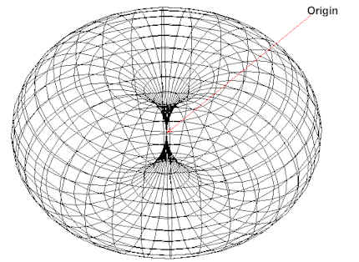
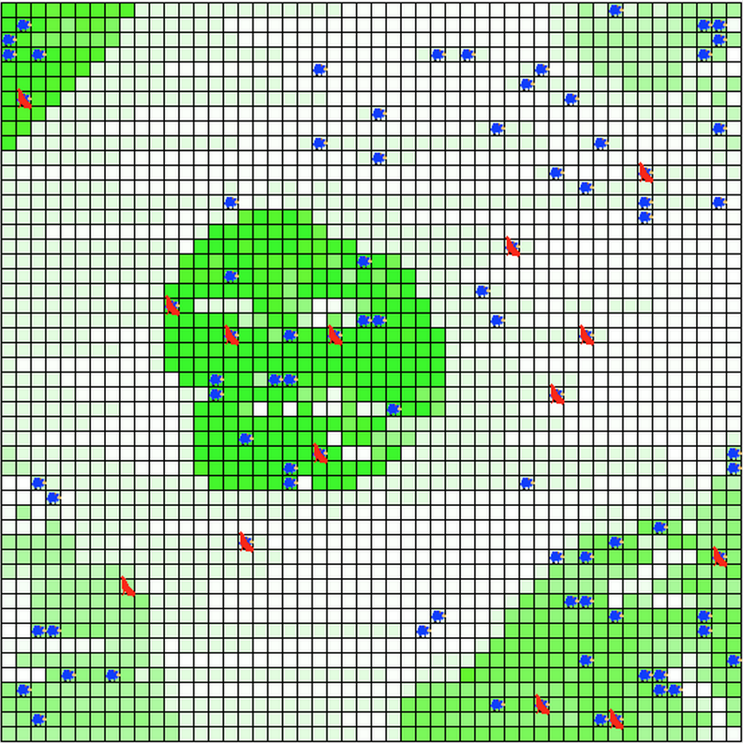
Basic Space
Wrapping Space or Non-Wrapping Space
Torodial Space
Discrete Space (Grid)
From:
http://www.harismind.com/euniverse.html
https://code.google.com/p/gama-platform/wiki/Tutorial__PredatorPreyTutorial

Slide 9
Basic Space
Neighborhoods
Movement
Targets
Sensory
Very difficult to utilize in mathematical models, but simpler in ABMs
Complexity
Simplified Realism
Coordinate System (Longitude, Latitude, X,Y, etc.)

Slide 10
Basic Space Notebook
http://nbviewer.ipython.org/github/mjbommar/cscs-530-w2015/blob/master/code/002-basic-space/001-basic_grid.ipynb

Slide 11
Basic Graphs
Terminology
Nodes
Edges
Directed
Undirected
Weight
Path
Connected vs. Not Connected

Slide 12
Basic Graph Measures
Average Path Length
The average length of the shortest path between all possible nodes
Degree Distribution
The distribution of the number of connections one node has to others
For directed graphs, in-degree and out-degree distinction
Clustering Coefficient
The amount that nodes tend to cluster (based on triplets of nodes)
Global
Entire network
Number of closed triplets over total number of triplets
Local
Single nodes
Proportion of links within a neighborhood (immediately connected neighbors) divided by the number of links that could possibly exist between them

Slide 13
Basic Graph Generation
Random (Using random graph generation)
Erdös-Rényi Model
Small-World (Using random graph generation)
Watts-Strogatz Model
Scale-Free (Using preferential attachment and growth)
Barabási-Albert
Notes:
Random Graphs
- Edges are added at random between a fixed number X verticies
- Begins with an unconnected set of nodes, and iteratively connects two randomly at every time step
Small-World Graphs
- This builds on the concept of “6 degrees of separation” where a person is only a couple of connections away from any other person in the world
- Grid-like structure, where you build a ring of verticies and connect each vertex with its neighbors, and rewire each edge at a probability
Scale-Free
- Power-law degree distribution – this suggests that very popular or famous people are very well connected, and much more connected than the average joe. Think about it as a positive feedback cycle, where the more connected you are, the more likely you are to gain more connections. Netowrk begins with initially connected number of nodes, for which new nodes are added, and linked to other nodes at a probability of how linked they are to other nodes. Highly linked nodes tend to accumulate even more links.

