Slide 1
Epidemiology 890 Computational Modeling of Health Care Systems
Sarah Cherng

Slide 2
Hi, my name is
1) Center for the Study of Complex Systems
2) Confused 21 year old → HMP! ☺
3) Law School Wannabe / Corporate Sellout
4) Network on Inequality, Complexity, and Health
5) PhD Student
6) Bouncy ball
7) ???
8) Happy and contributing human

Slide 3
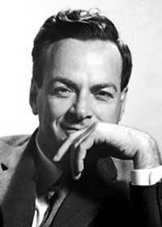
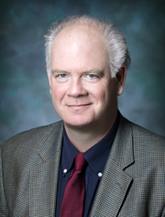
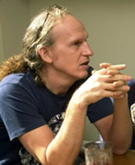
Disclaimer
Sarah’s opinions only … there are many others!
My first time giving this presentation ☺
Notes:
Interdisciplinary research

Slide 4
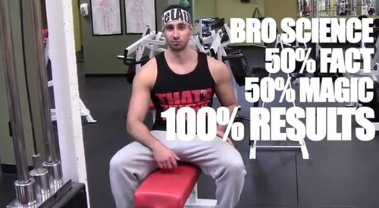

Slide 5
Why Model?
We all model
Predictive models are most popular in Epidemiology and other disciplines (also more widely understood)
I don’t love them
“Non-identifiability”
Data
Mechanisms (Cholera vs. Forest Fires)
Epstein has 16 other reasons other than prediction to model
Guide data collection
Illuminate core dynamics
Discover new questionsReveal the apparently simple (complex) to be complex (simple)
And many moooooreeee!
Explanation != Prediction
Notes:
Everyone is a modeler. Close your eyes and imagine how arthritis affects your joints. That’s a model! The choice isn’t whether or not to model, it’s whether or not to build explicit models

Slide 6

“Bad” and “Good” Models
CDC Ebola prediction model
Supreme court prediction models
Evolution of cooperation
Notes:
CDC model estimated 1.4 million ebola reported cases, by 1/20/2015, there were a total of 22,000
Robert Axelrod (who just won the National Medal of Science) and Rick Riolo were able to demonstrate, through an agent-based model, that cooperation can emerge without memory of history nor reciprocity, only signal-detection capabilities (that individuals are generous or donate to others similar to themselves).

Slide 7
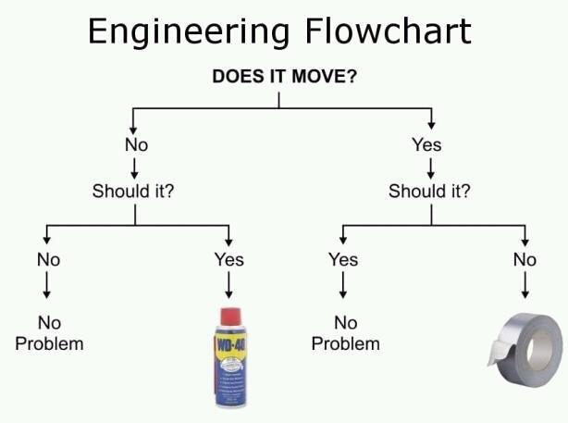
Basic Modeling Principles
KISS Principle

Slide 8
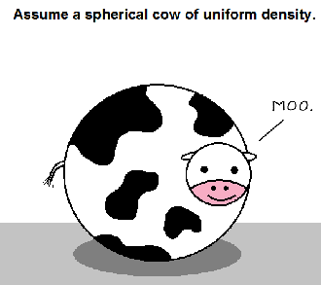
Basic modeling Principles
Assume the spherical cow

Slide 9

The Primary Care Question
“There are known knowns”
Primary care is associated, worldwide, with greater health equity and population health
Primary care is associated with lower concordance with evidence-based medicine as compared to specialty care
“There are known unknowns”
Why, when primary care is associated with lower disease-specific care quality, is it associated with greater health equity and population health?
“There are unknown unknowns”
Notes:
Rumsfeld

Slide 10
Delivery of Care Model
Question
How might the various processes of health care delivery change population health and health equity outcomes?
Method
Agent-Based Model (ABM)
Micro-level patterns produce Macro-Level (Population) Results
Why ABM?
Non-random, nonlinear interactions between adaptive agents
Computational, flexible, and allows us to study health care delivery in a formal and unambiguous context that can be replicated
Modular and mechanistic

Slide 11
Delivery of Care Model
Agents
Diseases
Severity
Probability of contraction
Providers
Effectiveness
People
Health
Diseases contracted
SES
Processes
Disease-specific Treatment
Amount of health you actually lost instead of what you could have lost as a result of treatment
Access (tied to SES)
The probability that you see a care provider
The amount of health you have to lose before you see a care provider
Disease Prevention
Loss to the probability that you contract a disease
Health Promotion
Bump in health as a result of seeing a care provider

Slide 12
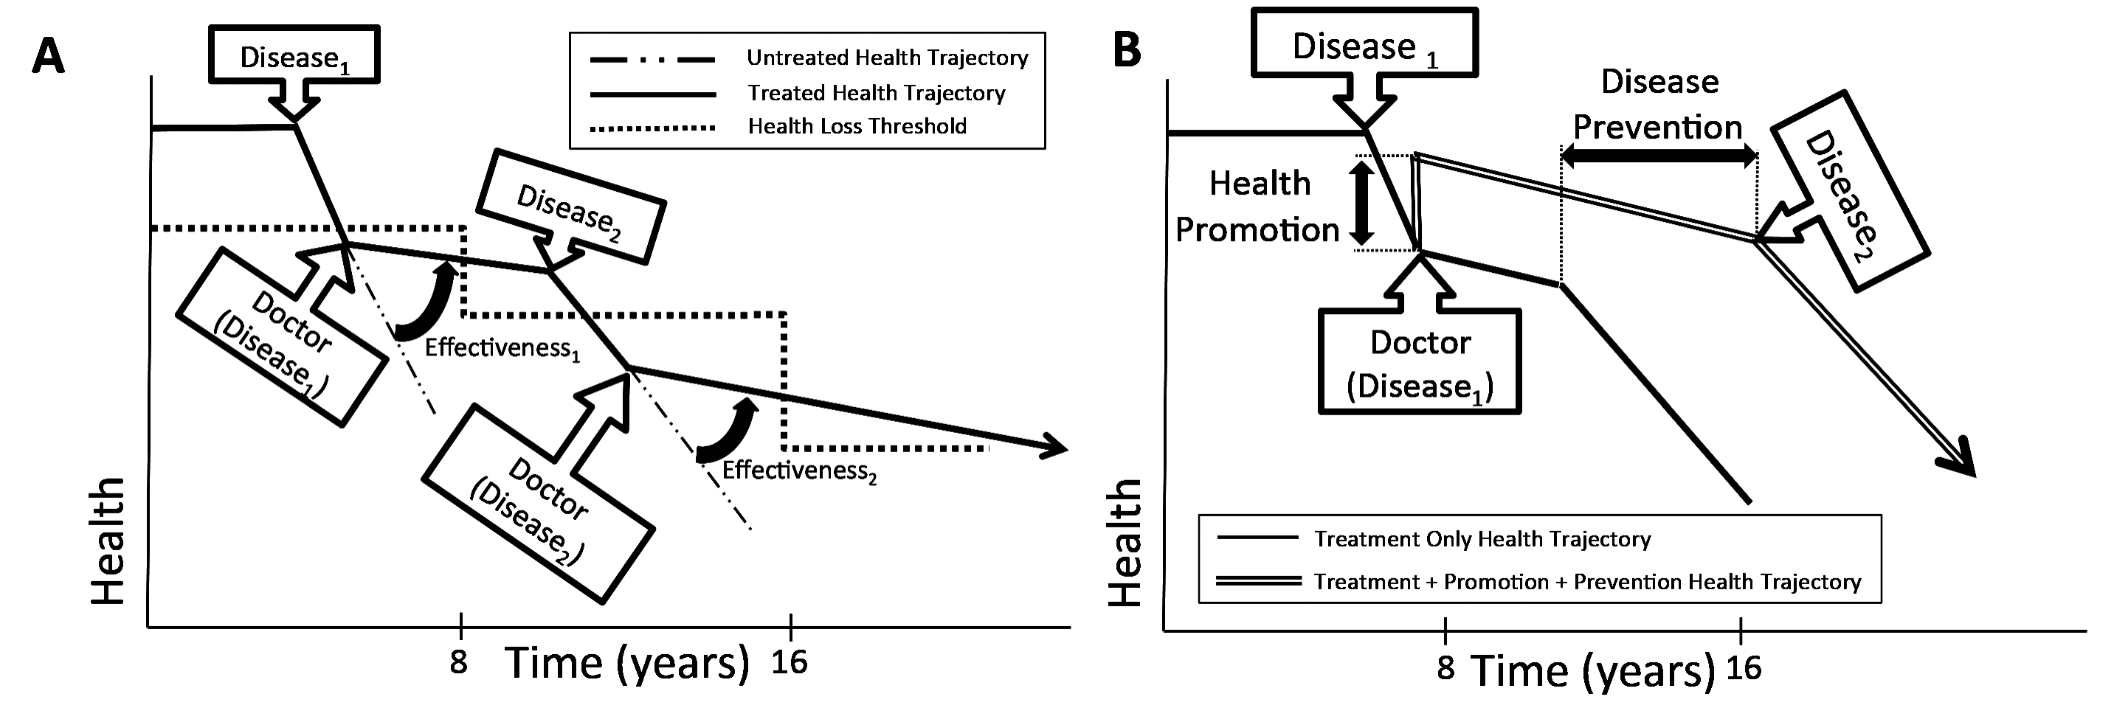
Model Overview

Slide 13
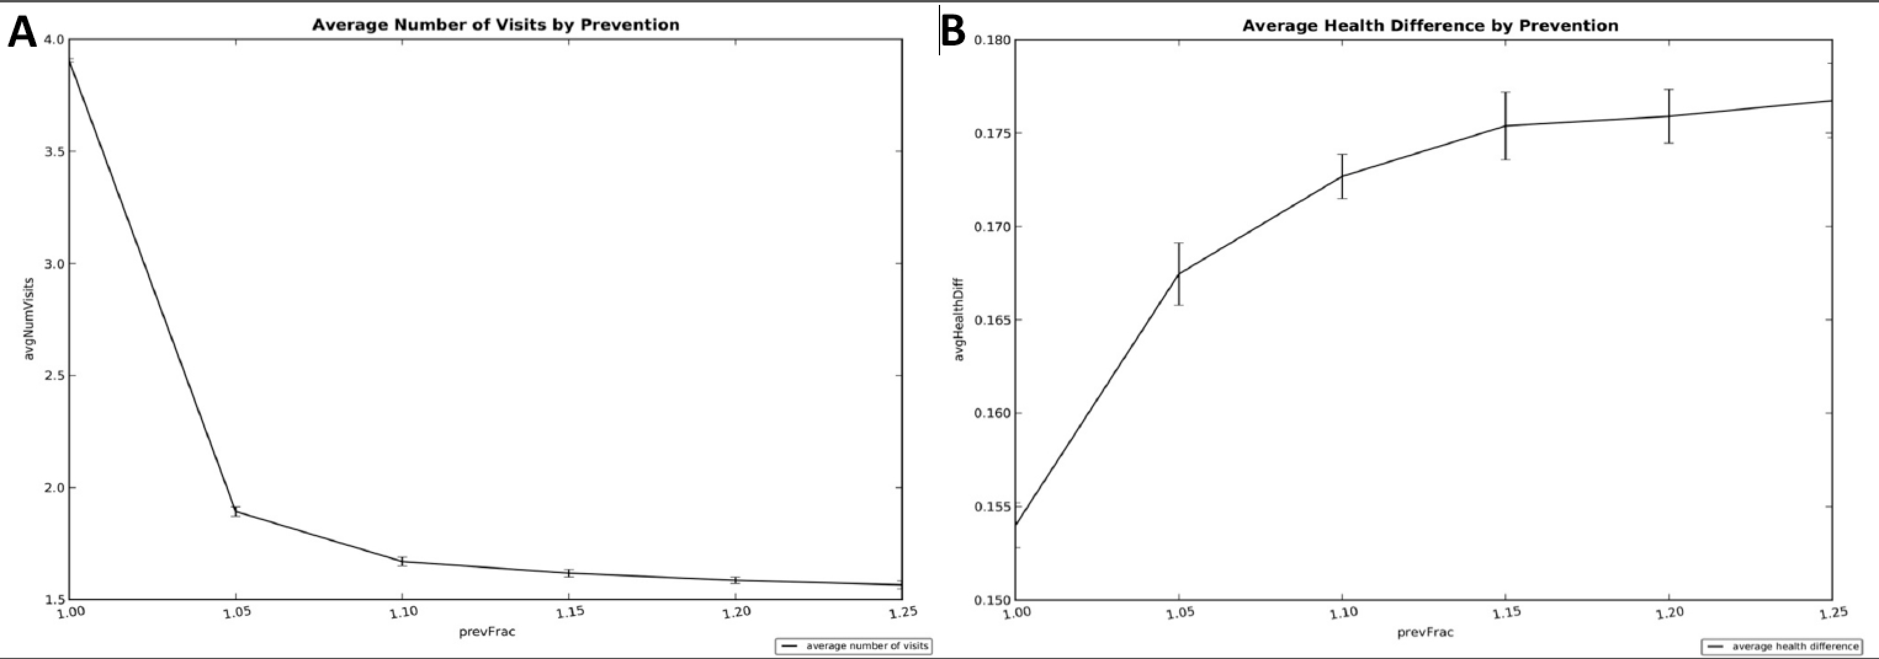
Model Results

Slide 14
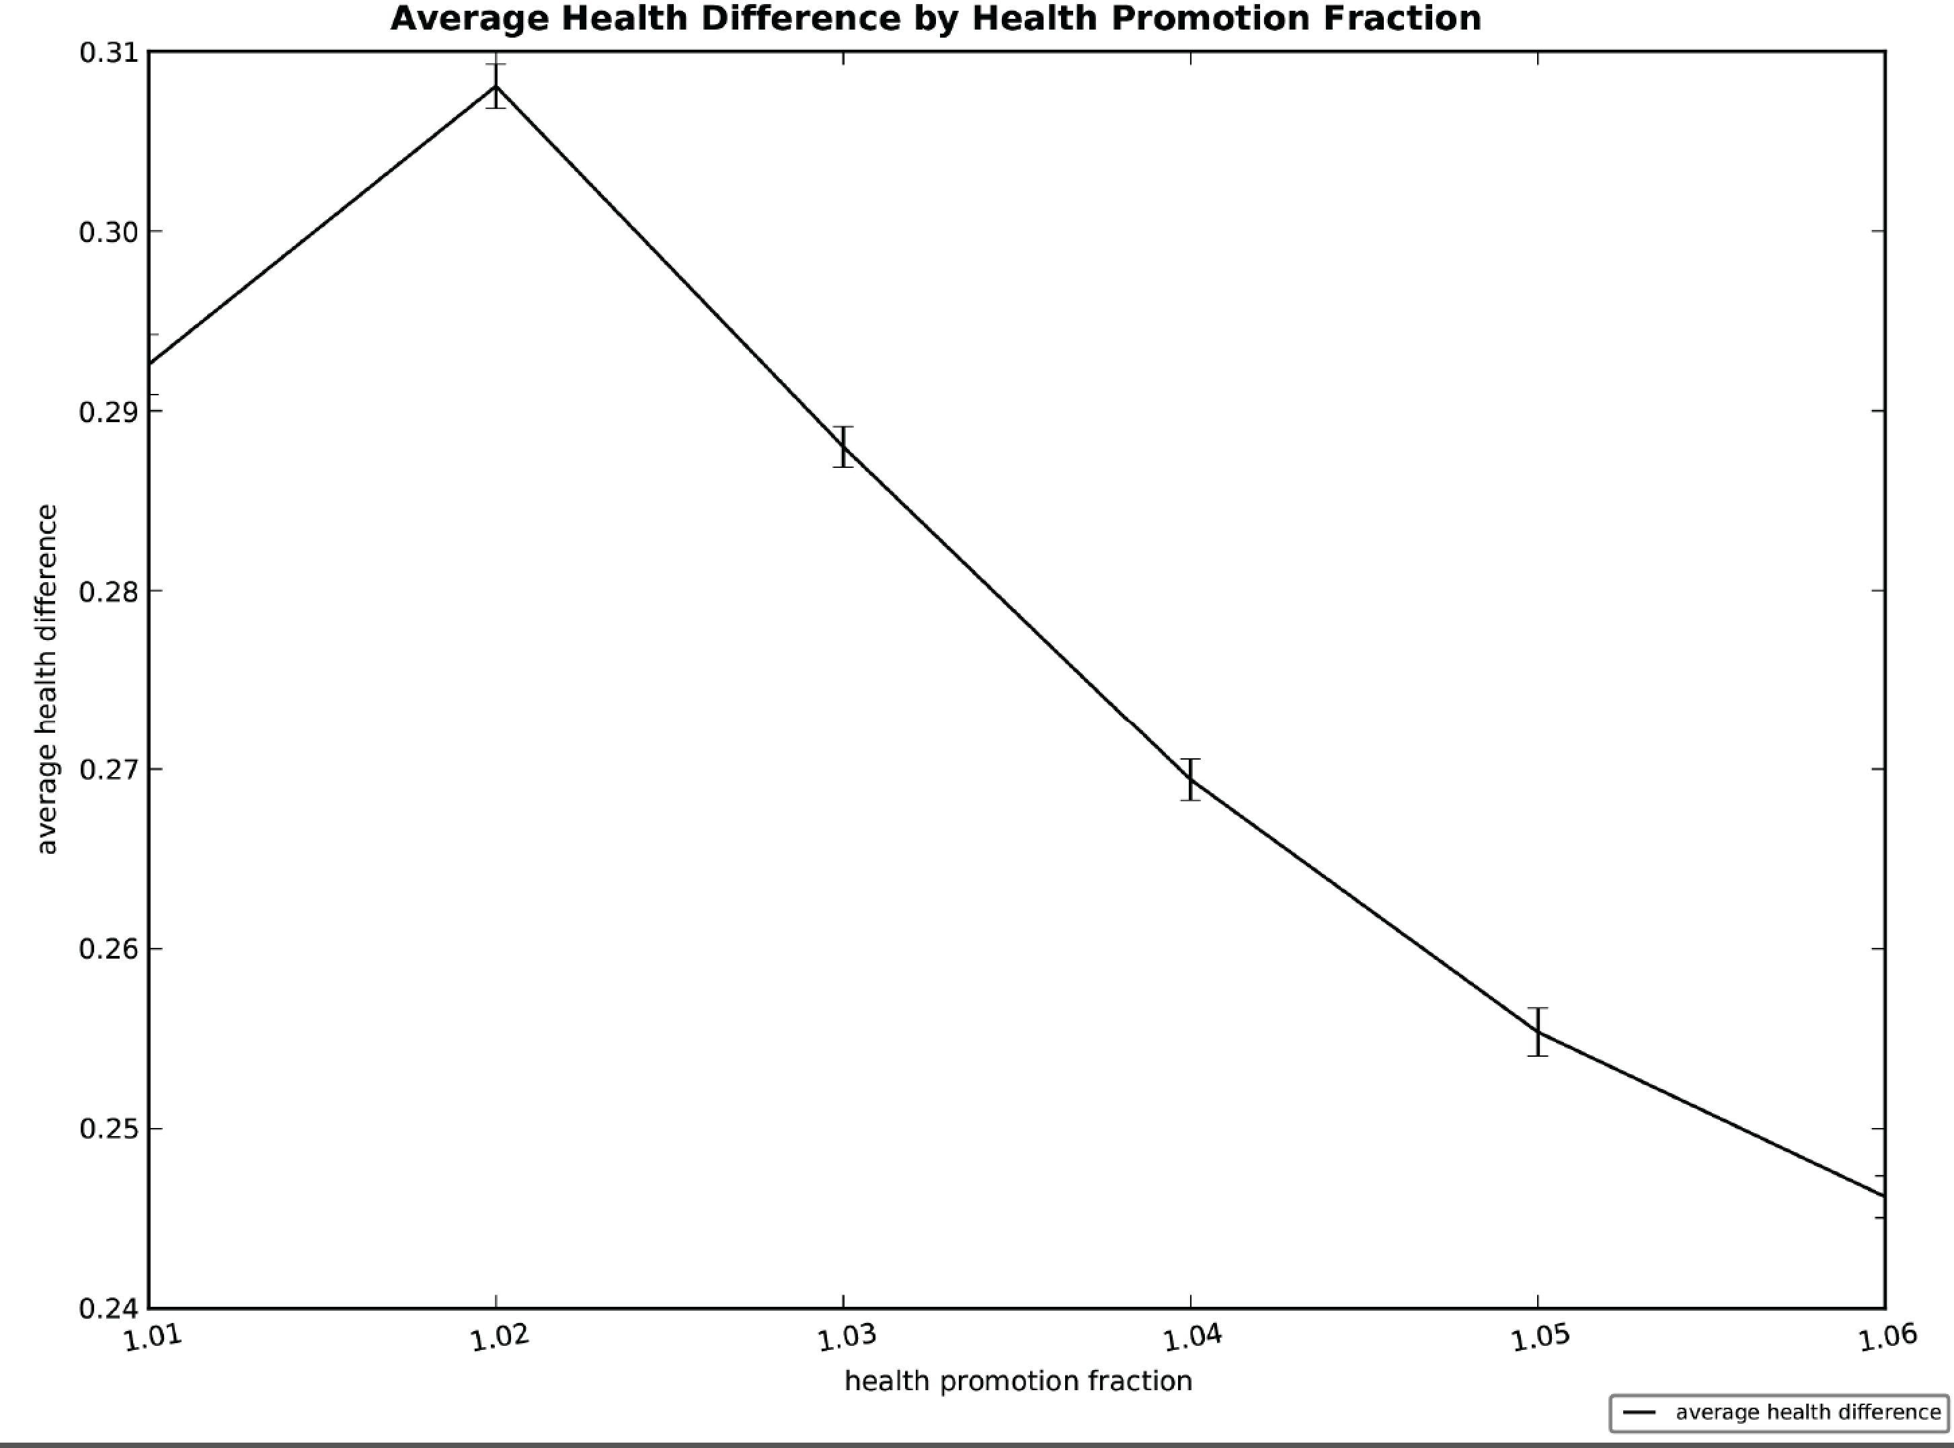
Model Results

Slide 15
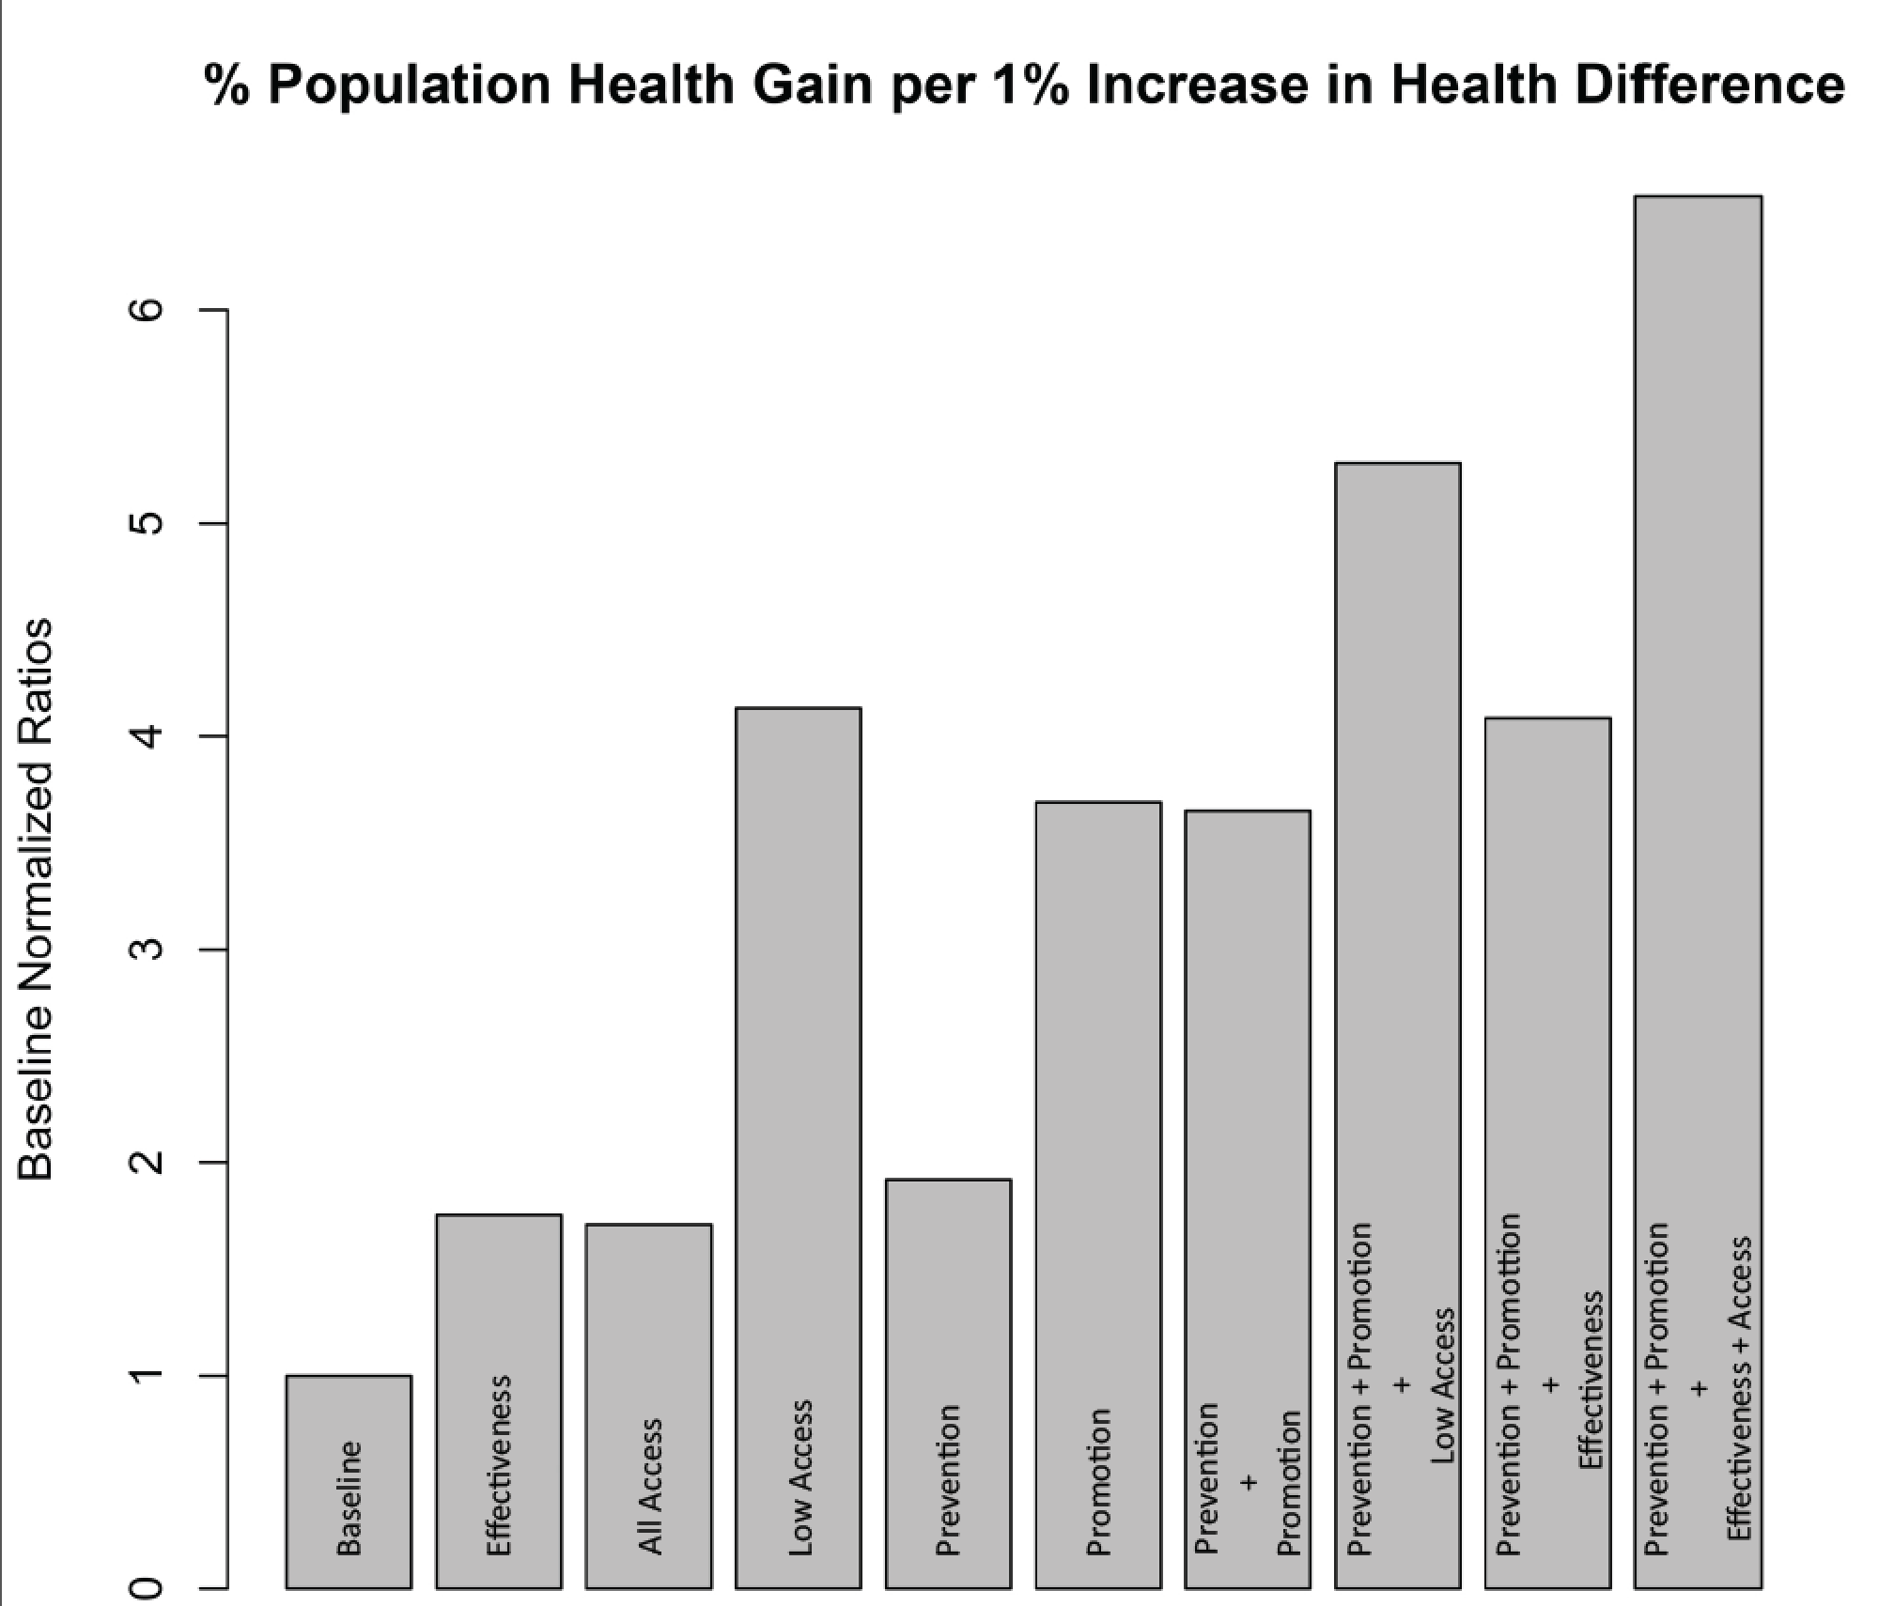
Model Results

Slide 16
The End!
Thanks to 890 class for feedback and patience
Members of the Network on Inequality, Complexity, and Health feedback and support
Rafael Meza for putting up with me doing stuff that he isn’t involved with
Co-authors:
Rick Riolo, PhD
Johnie Rose, MD PhD
Kurt Stange , MD PhD
Kala Groscurth, BA
Meza / Eisenberg / Eisenberg lab for listening to me complain about my life
University of Michigan Department of Epidemiology for being a great place to work
All of the scientists before us that make interdisciplinary research and freedom to doubt possible ☺

