Slide 1



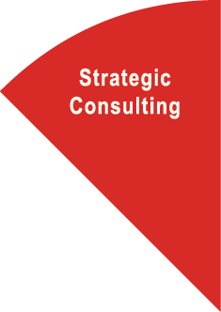
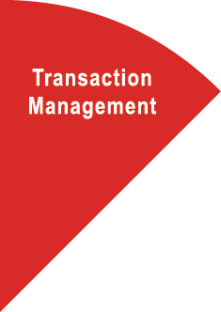





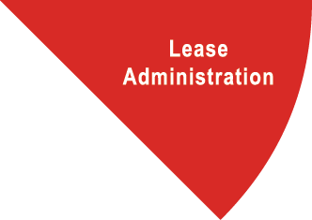




Access to a scalable platform
Business and economic incentives
• Strategic occupancy planning
• Location advisory / Labor analytics
• Supply chain and logistics
• “Six Sigma” process solutions
360 consultants
Renewal and relocation strategy
• Financial analysis of occupancy alternatives
• Long-term occupancy aligned with business goals
• Consistent standard of delivery
• Better deal economics
7,600 transactions annually
Strategic Consulting
Transaction Management
Variable resources
• Consistent standard of delivery
• Schedule and budget controls
• LEED certification and gap assessments
• Move management
12,000 projects annually
Dispositions
• Access to debt financing
• Expertise in accounting, tax and finance
• Sale/leaseback structuring
• Mergers and acquisitions
$22.7in capital market transactions annually
Capital Markets
Project & Development Services
International Desk
Lease Administration
Accurate lease data
• Certified SOX compliant
• Auditable accounts payable/receivable process
• Reliable management reports
• Lease audit services
$8.8B spend managed annually
Centralised leadership
• Domestic points of contact
• In-country execution
• Global platform of owned offices
200+ owned offices globally
Energy & Sustainability
Facility Management
IFM On Demand
Mobile engineering services
• Predictive and preventative maintenance
• Strategic sourcing
• Call Center work order management
• Baseline energy management
1.5B s.f. facilities under management globally
Portfolio-wide energy management
• Industry benchmarking of energy consumption
• LEED project and development management
• Carbon reduction strategies
• ENERGY STAR and Green Globes ratings
1,257+ accredited professionals

Slide 2
Access to a scalable platform
Business and economic incentives
• Strategic occupancy planning
• Location advisory / Labor analytics
• Supply chain and logistics
• “Six Sigma” process solutions
360 consultants
Renewal and relocation strategy
• Financial analysis of occupancy alternatives
• Long-term occupancy aligned with business goals
• Consistent standard of delivery
• Better deal economics
7,600 transactions annually
Strategic Consulting
Transaction Management
Variable resources
• Consistent standard of delivery
• Schedule and budget controls
• LEED certification and gap assessments
• Move management
12,000 projects annually
Dispositions
• Access to debt financing
• Expertise in accounting, tax and finance
• Sale/leaseback structuring
• Mergers and acquisitions
$22.7in capital market transactions annually
Capital Markets
Project & Development Services
International Desk
Lease Administration
Accurate lease data
• Certified SOX compliant
• Auditable accounts payable/receivable process
• Reliable management reports
• Lease audit services
$8.8B spend managed annually
Centralised leadership
• Domestic points of contact
• In-country execution
• Global platform of owned offices
200+ owned offices globally
Energy & Sustainability
Facility Management
IFM On Demand
Mobile engineering services
• Predictive and preventative maintenance
• Strategic sourcing
• Call Center work order management
• Baseline energy management
1.5B s.f. facilities under management globally
Portfolio-wide energy management
• Industry benchmarking of energy consumption
• LEED project and development management
• Carbon reduction strategies
• ENERGY STAR and Green Globes ratings
1,257+ accredited professionals

