Slide 1


Radio Code Hunt
Radio Callsign Hunt
Game
’Special agents’ radio call signs have been placed at certain ‘dead drop’ points on the map. Search and receive the call signs and check what country the agent is located
Learning Objectives:
Map reading, Route Planning, Social Skills, Teamwork, Orienteering, Phonetic Alphabet, Callsigns & Radio skills
Equipment required:
2 License free (PMR) walkie talkies per Six, Patrol, team, printed sheets & codes
Sections
Suitable for Cubs up
Appropriate for Cubs up

Slide 2
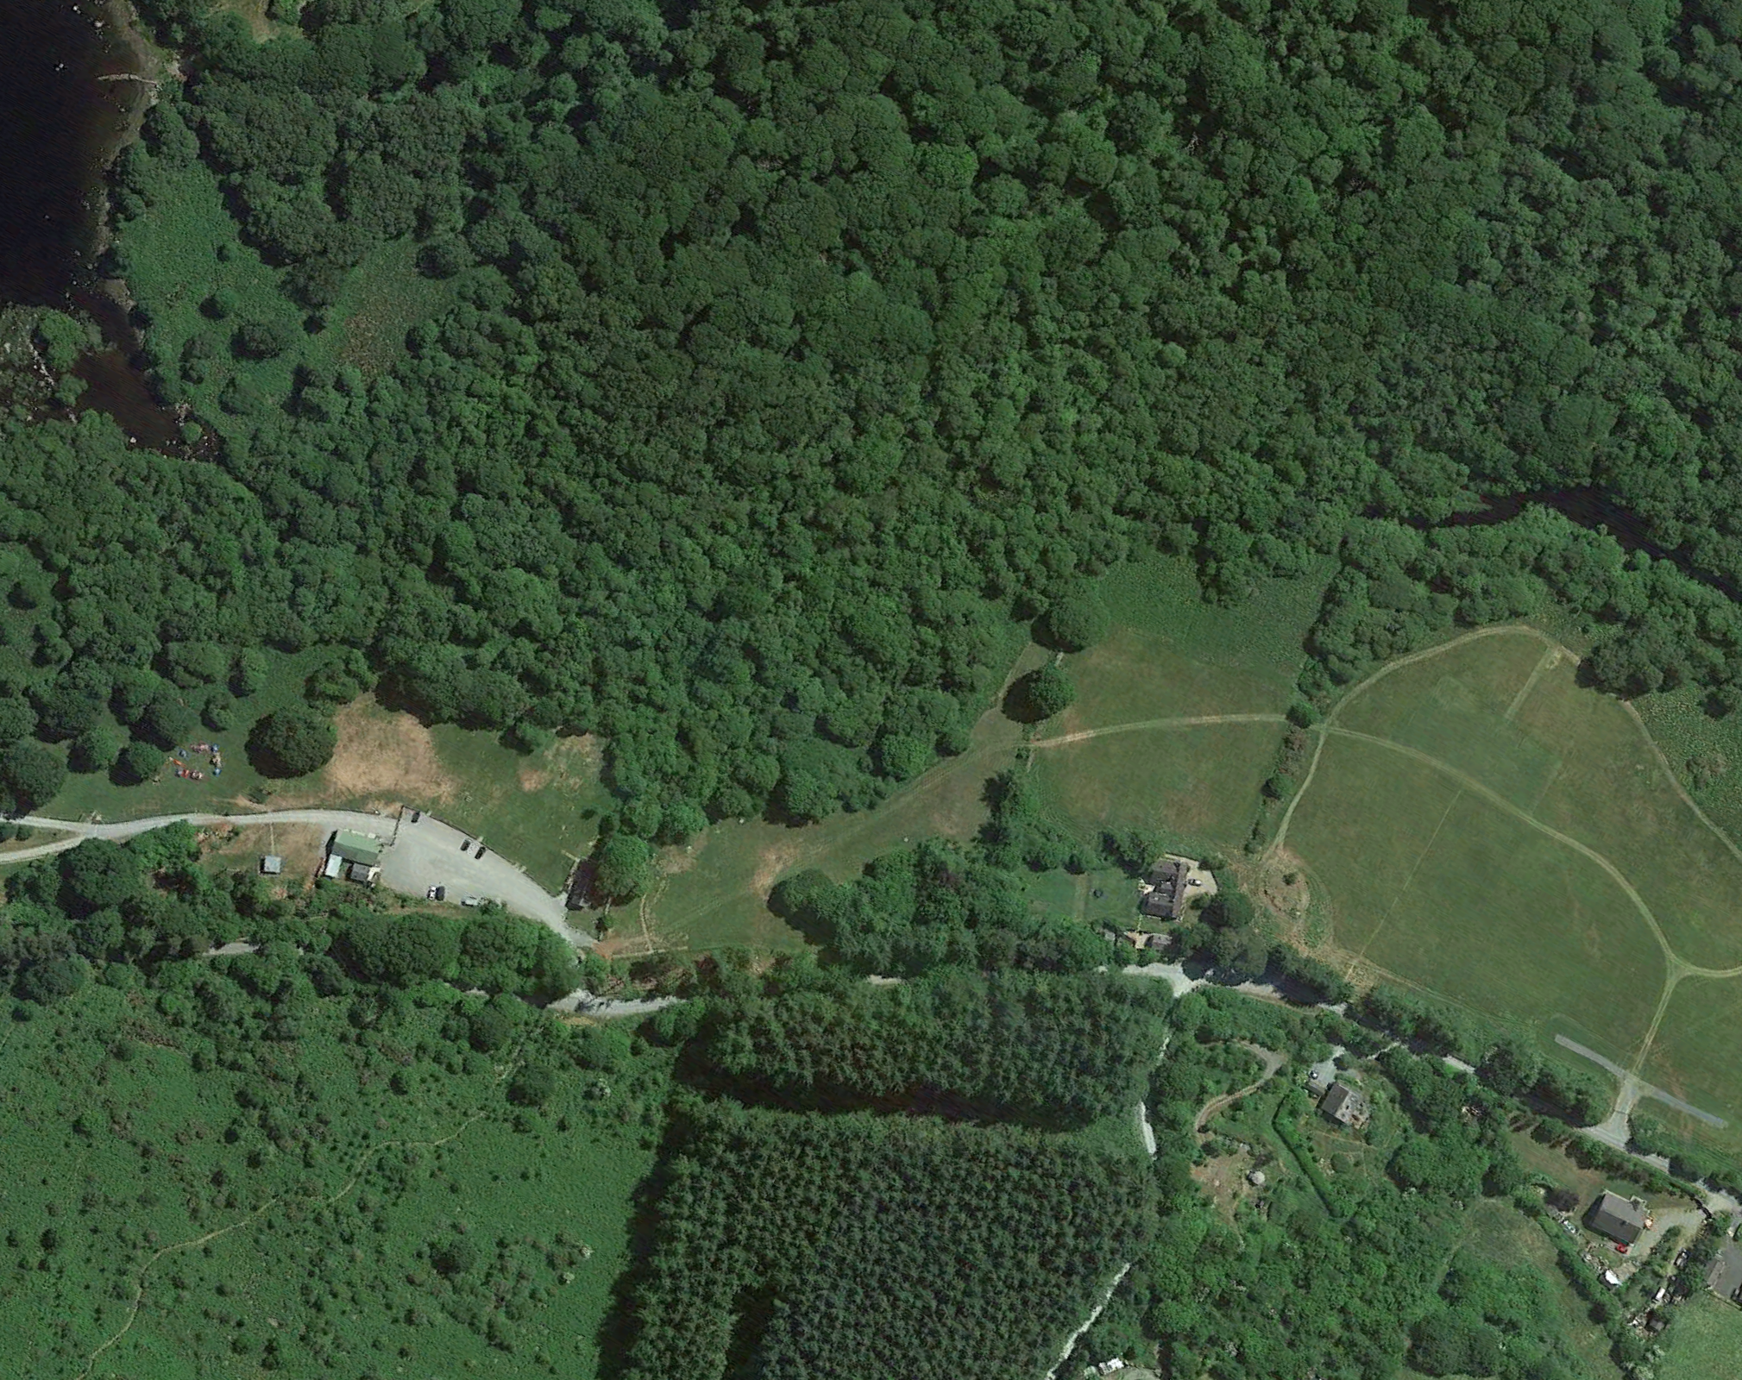
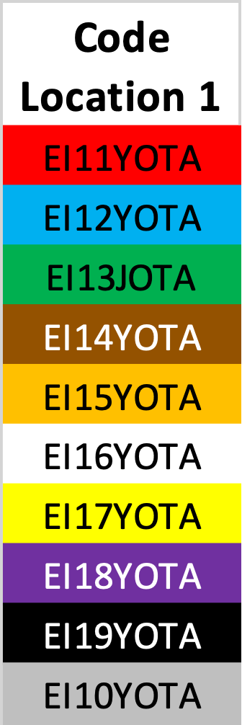
Overview - 30-180 mins Activity
Using the Walkie Talkie the Scout PLs or Cub Sixer or a leader must guide their Patrols/sixes to find the hidden callsign cards around the site. They are the Command leader
The APL or search team lead receives the grid location directions and clue from the PL or leader and leads the search team to look for the hidden card.
Only the Command Leader map has this map with the card locations & clues. The Search Leader map only has high level grid squares with no details
Command Leader will stay at command HQ and will direct their Search Leader with the search team (via walkie talkie to lat/long of each code to be retrieved as efficiently as possible – route plan.
The use of phonetic alphabet and good radio practice to direct their search team to main grid square gains extra points. e.g. Go to grid Latitude 11 longitude 02 would be called out ”Search team, Go to Grid Latitude 11 longitude 02 and await further instructions, QSL? over”. The search team reply should be “ QSL, Search team to Grid Latitude 11 longitude 02 and await further instructions, over” –good communication and radio practice.
When the search team arrives at the grid square they call the Command leader “”Search team, at Grid Latitude 11 longitude 02 awaiting further instructions, QSL? Over”. The Command leader then has to guide the search team to where the codes are hidden on their map using the clues on their sheet as necessary. –good communication and radio practice.
Each member of the search team(agents) must pass at least one callsign back and spell their name using phonetic code (Alpha, Bravo, Charlie etc) to the search Commander at the other end of the radio. –good communication and radio practice. Red team red codes, blue team blue codes etc.
Both the Search commander and search leader make note of each agent name & code communicated on their check sheet. – Attention to detail
Once all codes are radioed back to Command HQ the Search team returns to command HQ to have their team score checked. 5 points are scored for each code and agent name that match on the Search Leader and Command Leader. 5 points are scored for the 1st team back with all codes correct, 4 for 2nd, 8 for 3rd etc
Radio communications will be monitored and an extra 10 points will be awarded for the use of phonetic code and good communication/radio use. With 5 points for the next best team. However, beware! Up to 10 points will be deducted for any messing or bad language.
The winners might be given a prize – evening off camp wash up, badge , treat etc as appropriate
Northing/Latitude
 | 15
 | 14
 | 13
 | 12
 | 11
 | 10
 | 09
 | 08
 | 07
 | 06
 | 05
 | 04
 | 03
 | 02
 | 01
 | 00
 |  | 00 | 01 | 02 | 03 | 04 | 05 | 06 | 07 | 08 | 09 | 10 | 11 | 12 | 13 | 14 | 15
 |  | Easting/Longitude
N
N
Command post
7
9
4
6
1
2
10
5
8
3
Note: With multiple teams it is good to set each teams walkie talkies to a different channel

Slide 3
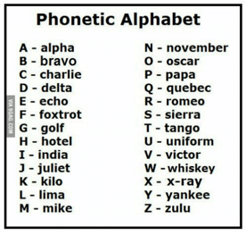
Command - Scout PLs or Cub Sixer or a leader log Team/colour:
# | Direction Clue | Easting/ Longitude | Northing/ Latitude | Call Sign | Scout name | Call sign Country Optional* (Check Qrz.com)
1 | A strong signal may help you find the 1st code | 065 | 040
2 | Seek what you want in the spooky forest glade you’ll need no spade | 070 | 075
3 | Escape the backwoods towards the road | 048 | 092
4 | Don’t be left behind managing the wildlife | 072 | 103
5 | Near the gate to hunters house your clue might be, but beware of the dogs! | 050 | 113
6 | Orienteering behind the hedgerow | 077 | 127
7 | Seek your next code near the waters edge | 094 | 155
8 | When you come in on the left there's a grey box on the wall, find it and there’s no need to bawl | 045 | 054
9 | In the long grass try to find the 2nd last clue, but hurry up mind! | 070 | 032
10 | Some bird tweet, other birds twitter, your on the last code, hurry don’t flitter! | 060 | 002
Some Q-Codes
“QSL?”= Did you hear me – “QSL QSL!”= Yes I heard you or “Negative again again” if you didn’t and need the other party to repeat the message
QTH = Location
“What is your QTH?” = What is your location
Good radio operations
1.) Listen and wait for other operator to finish
2.) Wait half a second after pressing the transmit button before speaking
3.) Say “over” at the end of your communication so the other operator knows you have finished speaking
4.) Say “ Say again please, over” if you need the other operator to repeat what they said.
5.) When you repeat your message confirm you have been heard by adding QSL? E.g. My message was “go to Deserted shacks - Latitude 11, Longitude 02, QSL?” QSL means did you hear me?
6.) If you have heard the repeated message you answer saying QSL twice and repeating back the message and over. e.g. “QSL, QSL Go to Deserted shacks Latitude 11, Longitude 02, Over”
7.) Scout leaders/game supervisor listen in an award points for good radio operation
Note: Trust you map reading! There maybe some intentional mistakes in the lat/long columns or no Lat long at all on this sheet ☺
With multiple teams it is good to suggest that each team starts at different locations e.g. Blue team start at Callsign 1, then 2,3 etc. Red team start at Callsign 10, then 9,8 etc Green team start at Callsign 5, then 6,7 and back to 1,2,3 etc
* While search team is moving between locations, if there is a computer and web browser available, the PL/Sixer can look up the callsign on qrz.com and see details like the operators country etc.

Slide 4
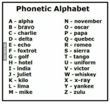
Northing/Latitude
 | 15
 | 14
 | 13
 | 12
 | 11
 | 10
 | 09
 | 08
 | 07
 | 06
 | 05
 | 04
 | 03
 | 02
 | 01
 | 00
 |  | 00 | 01 | 02 | 03 | 04 | 05 | 06 | 07 | 08 | 09 | 10 | 11 | 12 | 13 | 14 | 15
 |  | Easting/Longitude
Search Leader Map & instructions
1.) Find the code cards hidden around the site and relay the codes accurately to the radio base over the radio
2.) As. Search Leader your job is to take direction from your Command Leader and lead your agents to find the codes and return to base as quickly as possible.
2.) Your Search Command Leader and assistant will stay at Command HQ with one other team member and direct the search via walkie talkie to the location of each code to be retrieved. For example the 1st code is at the “Deserted shacks”- Latitude 11, Longitude 02
4.) The use of phonetic code and good radio practice to direct their search team to main grid square gains extra points. e.g. Go to grid Latitude 11 longitude 02 would be called out ”Search team, Go to Grid Latitude 11 longitude 02 and await further instructions, QSL? over”. The search team reply should be “ QSL, Search team to Grid Latitude 11 longitude 02 and await further instructions, over” –good communication and radio practice.
5.) When the search team arrives at the grid square they call the Command leader “”Search team, at Grid Latitude 11 longitude 02 awaiting further instructions, QSL? Over”. The Command leader then has to guide the search team to where the codes are hidden on their map using the clues on their sheet as necessary. –good communication and radio practice.
3.) Each member of the search team(agents) must pass at least one code and spell their name using phonetic code (Alpha, Bravo, Charlie etc) to the search Commander at the other end of the radio. –good communication and radio practice.
4.) Both the Search commander and search leader make note of each agent name & code communicated on their check sheet. – Attention to detail
5.) Once all codes are radioed back to Command HQ the Search team returns to command HQ to have their team score checked. 5 points are scored for each code and agent name that match on the Search Leader and Command Leader. 5 points are scored for the 1st team back with all codes correct, 4 for 2nd, 8 for 3rd etc
6.) Radio communications will be monitored and an extra 10 points will be awarded for the use of phonetic code and good communication/radio use. With 5 points for the next best team. However beware! Up to 10 points will be deducted for any messing or bad language.
7.) The winners might get a prize – evening off wash up, badge etc as appropriate
N
N
N
7
9
4
6
1
2
10
5
8
3

Slide 5
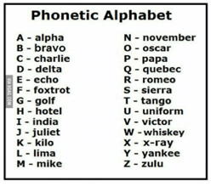
Search team Callsign log Team radio colour:
Callsign Location | Easting/ Long | Northing/ Lat | Callsign collected | Scout name
1
2
3
4
5
6
7
8
9
10
11
12
Some Q-Codes
“QSL?”= Did you hear me – “QSL QSL!”= Yes I heard you or “Negative again again” if you didn’t and need the other party to repeat the message
QTH = Location
“What is your QTH?” = What is your location
Good radio operations
1.) Listen and wait for other operator to finish
2.) Wait half a second after pressing the transmit button before speaking
3.) Say “over” at the end of your communication so the other operator knows you have finished speaking
4.) Say “ Say again please, over” if you need the other operator to repeat what they said.
5.) When you repeat your message confirm you have been heard by adding QSL? E.g. My message was “go to Deserted shacks - Latitude 11, Longitude 02, QSL?” QSL means did you hear me?
6.) If you have heard the repeated message you answer saying QSL twice and repeating back the message and over.g. “QSL, QSL Go to Deserted shacks Latitude 11, Longitude 02, Over”
7.) Scout leaders listen in an award points for good radio operation
1.) Write down the Lat/Long as it is called out and then go to that location to look for the callsign that matches your team colour. Ask for the hint when you get there.
2.) Each member of the team should call back with a callsign found as well as their name using the phonetic alphabet

Slide 6
Callsign Cards
 | Location 1 |  | Location 2 |  | Location 3 |  | Location 4 |  | Location 5 |  | Location 6 |  | Location 7 |  | Location 8
 | EI3IT |  | DH1MM |  | JA2KGH |  | G6EKB |  | F6HRP |  | BG0BBB |  | EA3AR |  | CE0Y
 | EI3IX |  | DH1PAN |  | JA3ADW |  | G6INU |  | F6KOP |  | BG0CAB |  | EA3ARB |  | CE2SV
 | EI3IXB |  | DH1PS |  | JA3ALY |  | G6LKB |  | F8AEJ |  | BG1UG |  | EA3ATD |  | CE3BT
 | EI3JB |  | DH1RGS |  | JA3DAZ |  | G6LSO |  | F8AIP |  | BG2AUE |  | EA3BEM |  | CE3JBD
 | EI3JHB |  | DH1TT |  | JA3EGE |  | G6NNS |  | F8AOF |  | BG2QMO |  | EA3BP |  | CE3VBK
 | EI3JRB |  | DH2NJS |  | JA3FHL |  | G6NYG |  | F8BON |  | BG4LSA |  | EA3BR |  | CE4HUS
 | Location 9 |  | Location 10 |  | Location 11 |  | Location 12 |  | Location 13 |  | Location 14 |  | Location 15 |  | Location 16
 | RW6FY |  | S50XX |  | SV1CNS |  | PY2DV |  | ON5UN |  | NA8V |  | LX1CC |  | M6UIT
 | RW9JZ |  | S51CK |  | SV1CQN |  | PY2EIO |  | ON6FDP |  | NC1CC |  | LX1FF |  | M6UKZ
 | RX3AM |  | S51DD |  | SV1DZB |  | PY2ERA |  | ON6ID |  | ND3L |  | LX1GQ |  | M6WYD
 | RX3ASQ |  | S51DX |  | SV1EBV |  | PY2FZ |  | ON6PRO |  | ND4Q |  | LX1HD |  | M7BLX
 | RX4CD |  | S51RB |  | SV1EDY |  | PY2HT |  | ON6PV |  | ND9G |  | LX1JAZ |  | M7BXV
 | RX6ASO |  | S51TA |  | SV1EGE |  | PY2NA |  | ON6VDS |  | NE8Z |  | LX1JH |  | M7CKR

Slide 7
Activity Customisation
The enclosed is a walkie talkie code hunt is designed for a circa 45 minute Base activity in Castle Saunderson. However, it can easily be customised to any camp or park location. Course can be made shorter or longer by placing code farther away, placing more codes, making code more difficult to find with more quirky clues etc.
To customize, drag the grid square overlay to the side on slides 2 and 4
Delete the google earth screen shot of lough dan on slides 2 and 4 and replace it with a google earth image or map of your camp/park etc. (move the screen shot to the back and then drag the grid square overlay back over your screen shot
Walk the area of your camp/park and pick out interesting places to place or hide the code cards note the lat/long/easting/northing locations based on the map you have created. Think about funny entertaining clues related to the surroundings. The number of locations and the distance between them determine how long the activity takes
Move the red location area dots on slide 2 to the new locations and Replace the lat/long info and clues in slide 3 and print out one copy of slide 5 & 6 for each Command/PL leader
Print out a copy of slide 2-4 as required for each search one for each team
Laminated sheets and dry whiteboard markers can used so sheets and game can be re-used to avoid waste and make waterproof.

