Slide 1
COMPETITOR LOCAL ASSETS

Slide 2
COMPETITOR LOCAL ASSETS ANALYSIS
CAMPAIGN AND SOCIAL CONTENT WITH CELEB
CAMPAIGN
SOCIAL CONTENT
EVENT & EXHIBITION
STRENGTHS:
WEAKNESSES:

Slide 3
COMPETITOR LOCAL ASSETS
DATE | PROJECT | ASSETS | SOCIAL | EC | AD
JULY 2-3TH | COCO CRUSH FINE JEWELLRY AD WITH WANG YIBO AND LEAH DOU | VIDEO | WEIBO/RED/WECHAT | N/A | N/A
JULY 9TH | CHANEL FALL-WINTER 2026/27 HAUTE COUTURE COLLECTION SHOW | PHOTO | WEIBO/RED | N/A | N/A

Slide 4

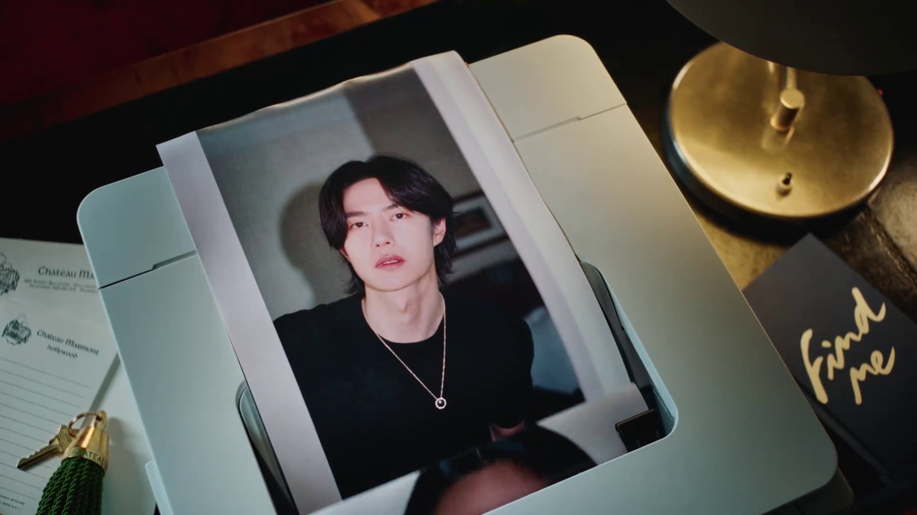
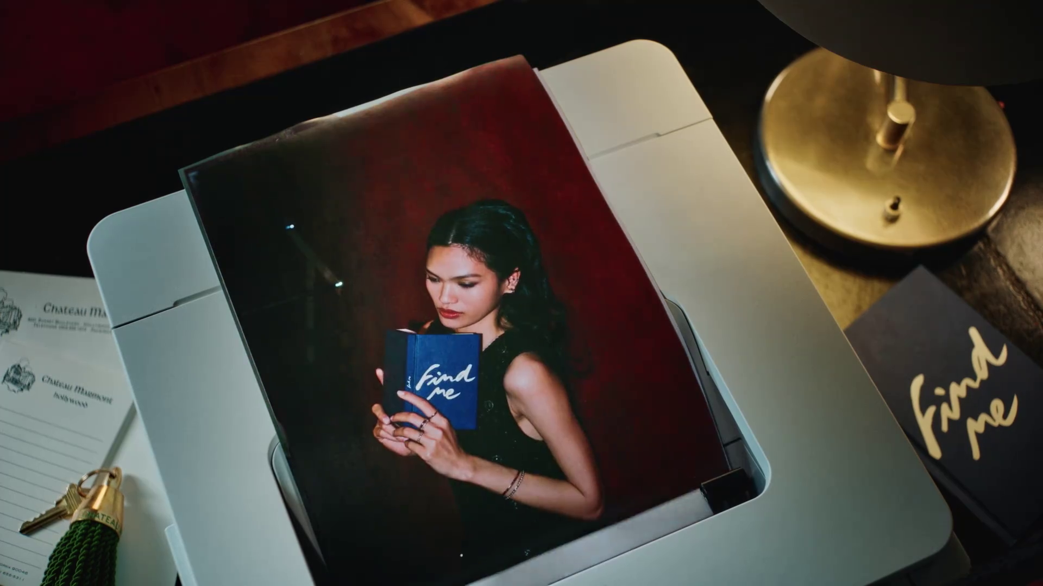
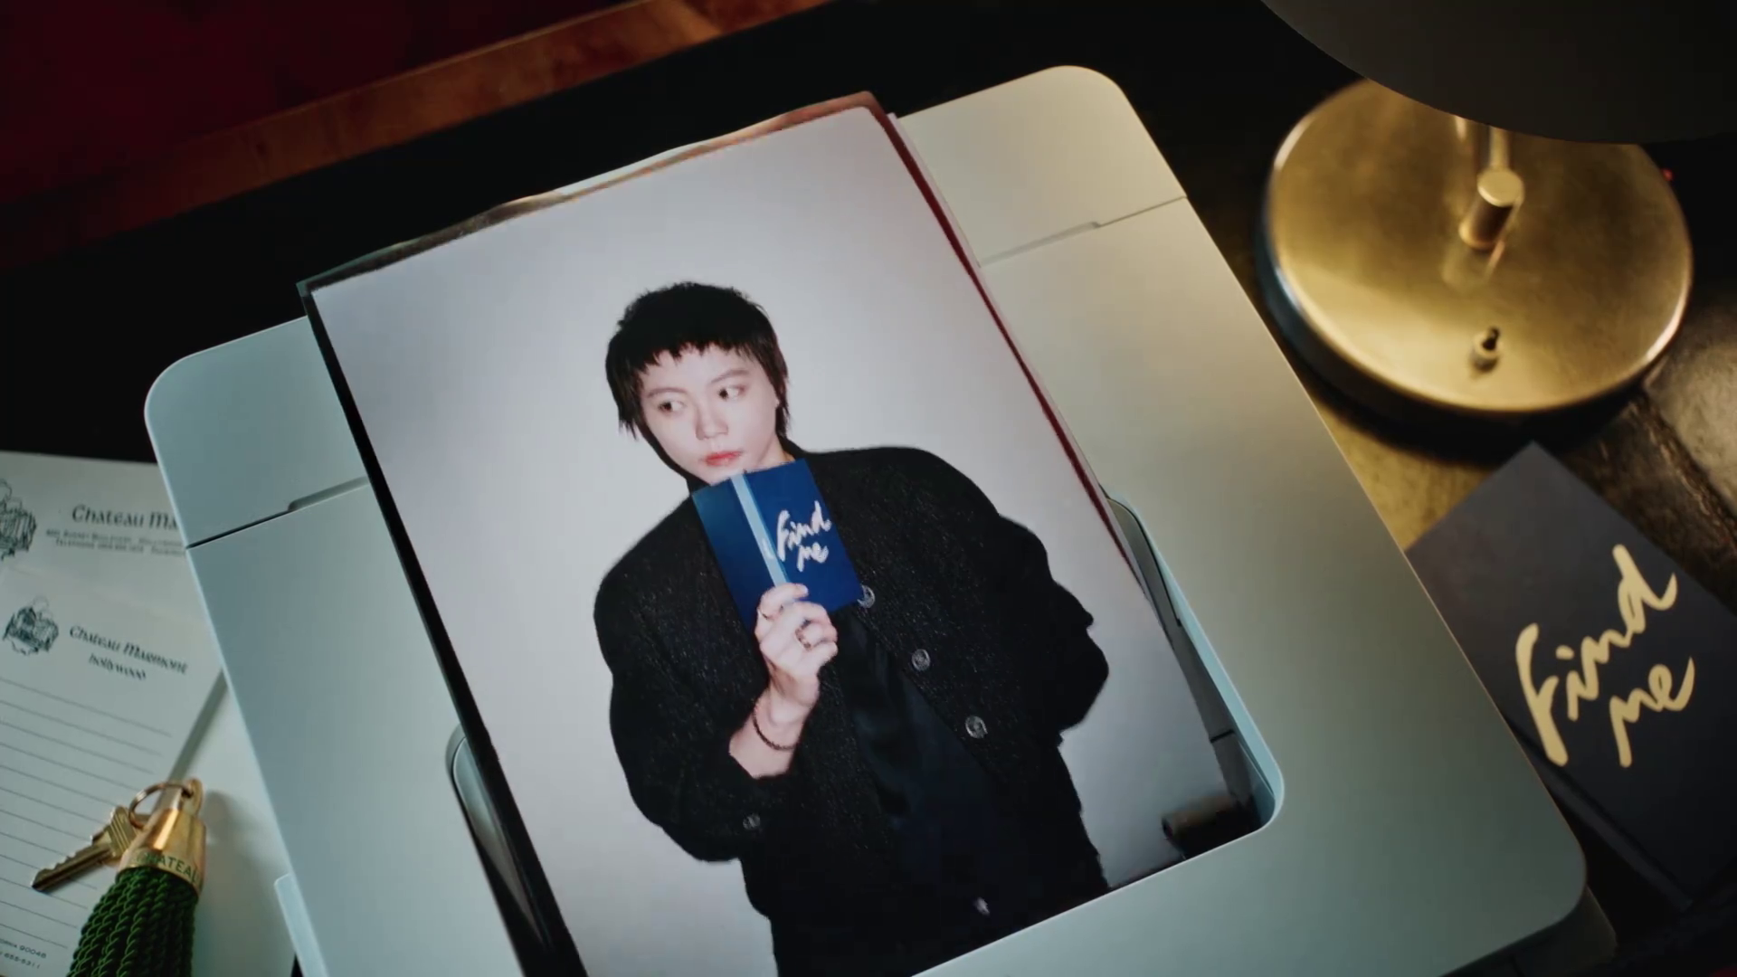



COMPETITOR LOCAL ASSETS
CHANEL
COCO CRUSH FINE JEWELLRY AD WITH WANG YIBO AND LEAH DOU
SOCIAL CONTENT
http://t.cn/AXoVkDwT
http://t.cn/AXob0bba
BRAND AMBASSADOR
WANG YIBO
BRAND AMBASSADOR
LEAH DOU

Slide 5

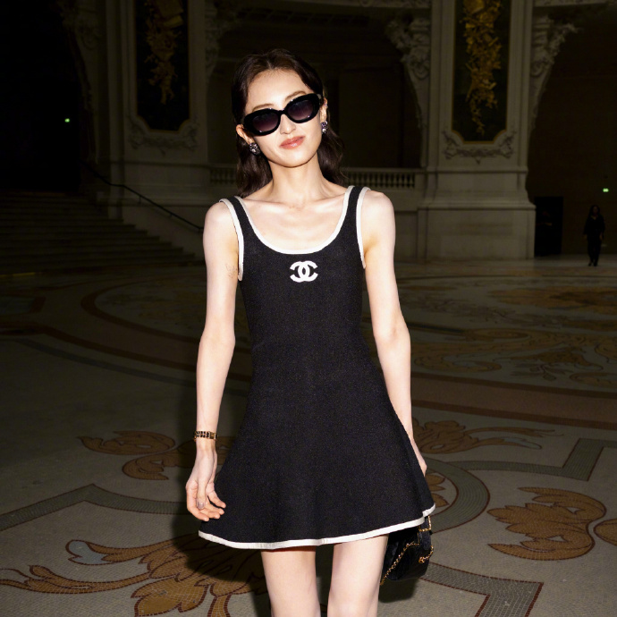
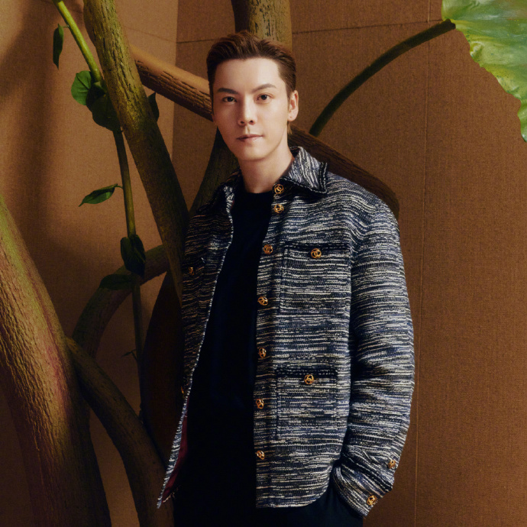
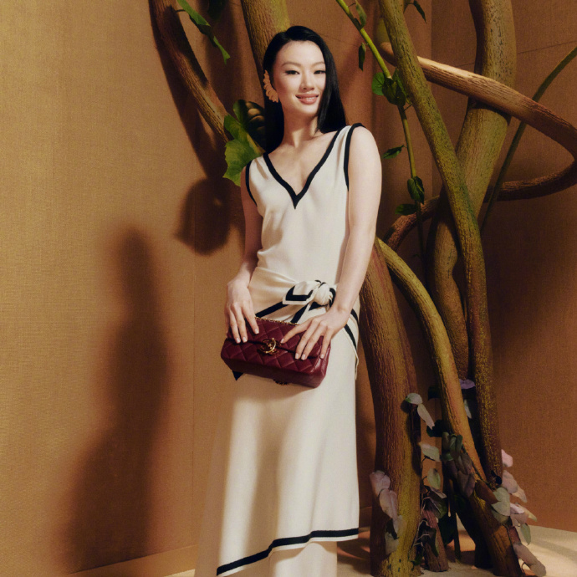
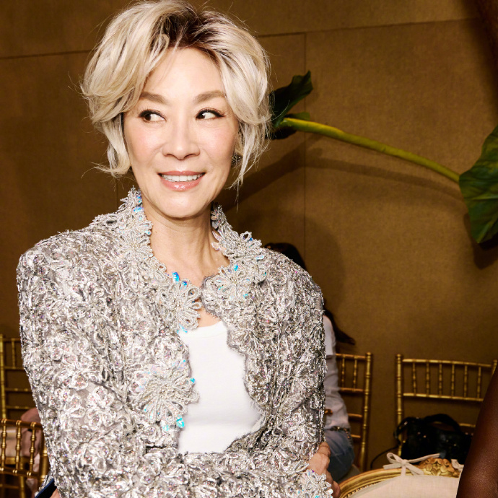
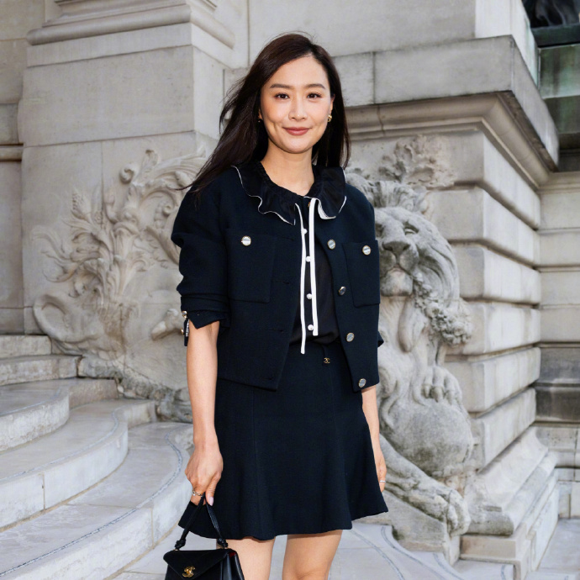
COMPETITOR LOCAL ASSETS
CHANEL
CHANEL FALL-WINTER 2026/27 HAUTE COUTURE COLLECTION SHOW
SOCIAL CONTENT
BRAND AMBASSADOR
ZHANG ZIFENG
BRAND AMBASSADOR
WILLIAM CHAN
BRAND FRIEND
SHAN YICHUN
BRAND FRIEND
MICHELLE YEOH
BRAND FRIEND
FALA CHEN

Slide 6

COMPETITOR LOCAL ASSETS
DATE | PROJECT | ASSETS | SOCIAL | EC | AD
JULY 1ST | REBONDS RELAUNCH FOR THE LOIS VUITTON X UNICEF 10th ANNIVERSARY | PHOTO | WEIBO/RED | N/A | N/A

Slide 7
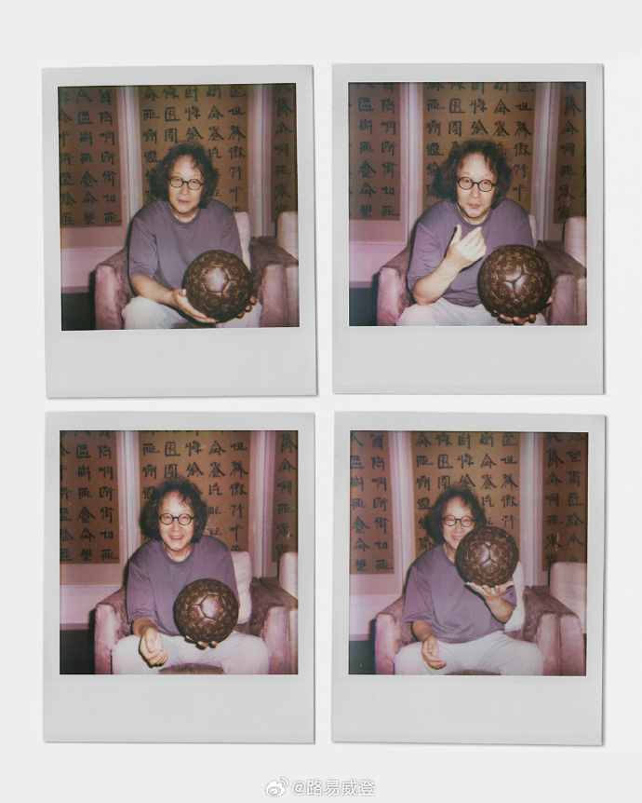
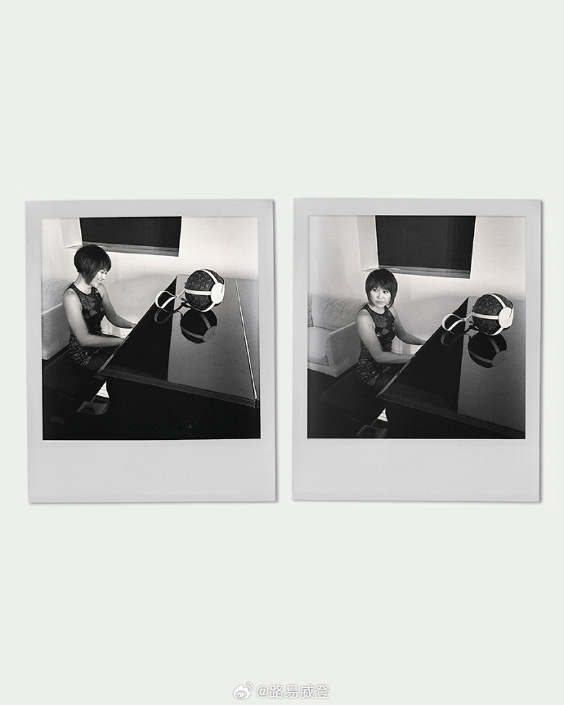
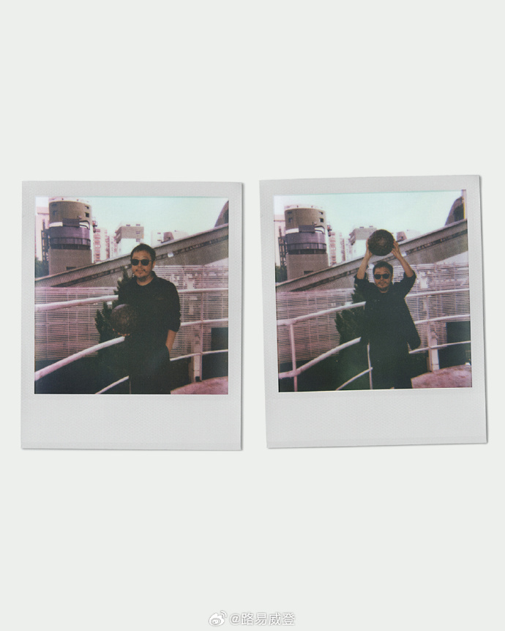
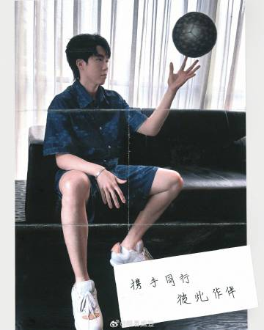
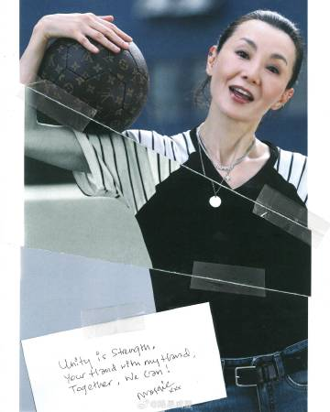
COMPETITOR LOCAL ASSETS
LOUIS VUITTON
REBONDS RELAUNCH FOR THE LOIS VUITTON X UNICEF 10th ANNIVERSARY
SOCIAL CONTENT
ARTIST
XU BING
PIANIST
YUJA WANG
DIRECTOR
JIA ZHANG-KE
BRAND AMBASSADOR
WANG CHUQIN
BRAND FRIEND
MAGGIE CHEUNG

Slide 8
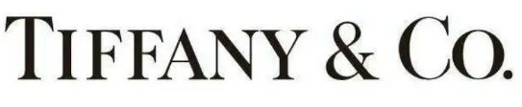
COMPETITOR LOCAL ASSETS
DATE | PROJECT | ASSETS | SOCIAL | EC | AD
JULY 1ST | LI YUNRUI VISITS OAK SPRING GARDEN, TRACING SCHLUMBERGER’S LEGACY | PHOTO | WEIBO/RED | N/A | N/A
JULY 2ND | LI YUNRUI VISITS VIRGINIA MUSEUM OF FINE ARTS, TRACING SCHLUMBERGER’S LEGACY | PHOTO | WEIBO/RED | N/A | N/A
JULY 13th | TIFFANY NEW CAMPAIGN FACE WITH SAMMI CHENG, TITLE TBD | PHOTO | WEIBO/RED/WECHAT/TIKTOK | N/A | N/A

Slide 9
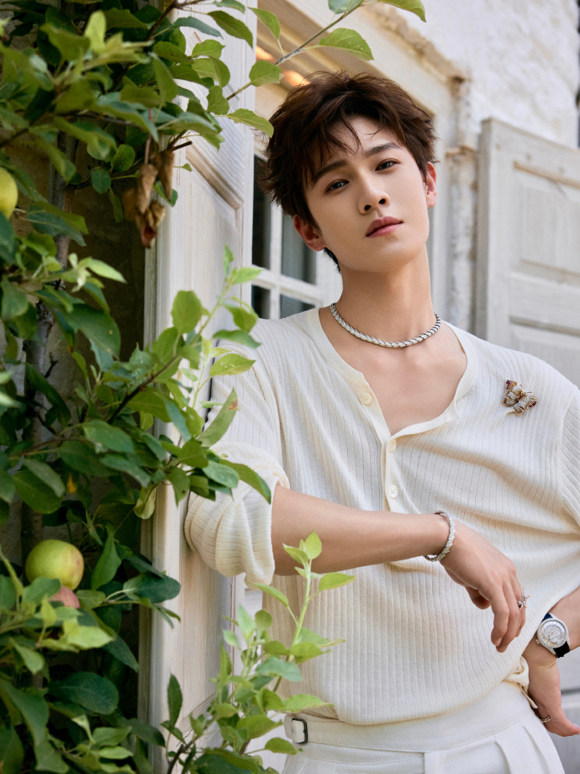
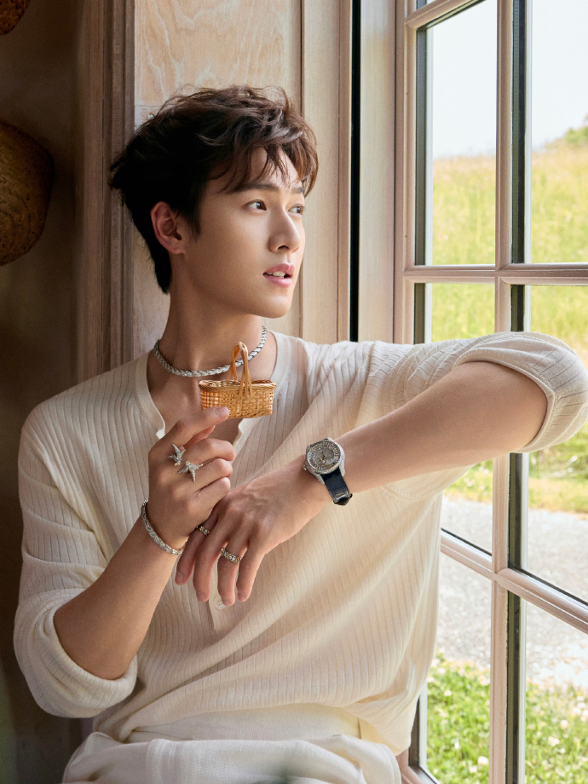
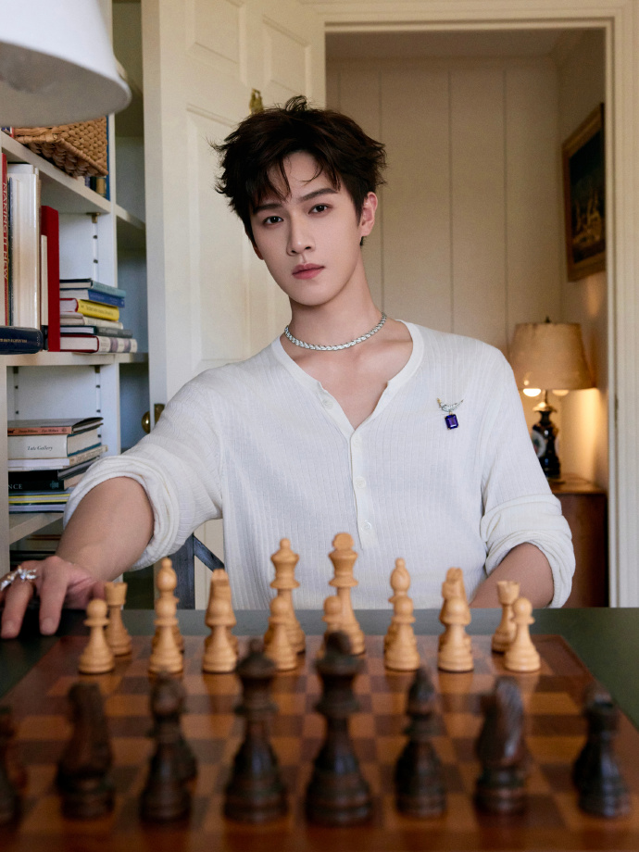
COMPETITOR LOCAL ASSETS
TIFFANY & CO.
LI YUNRUI VISITS OAK SPRING GARDEN, TRACING SCHLUMBERGER’S LEGACY
SOCIAL CONTENT
BRAND AMBASSADOR
LI YUNRUI

Slide 10
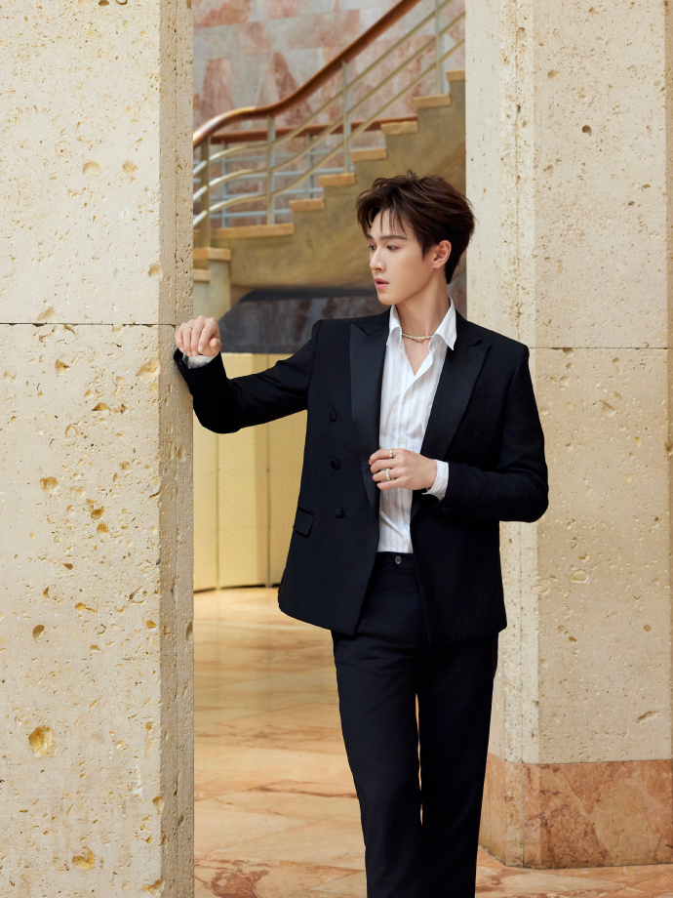
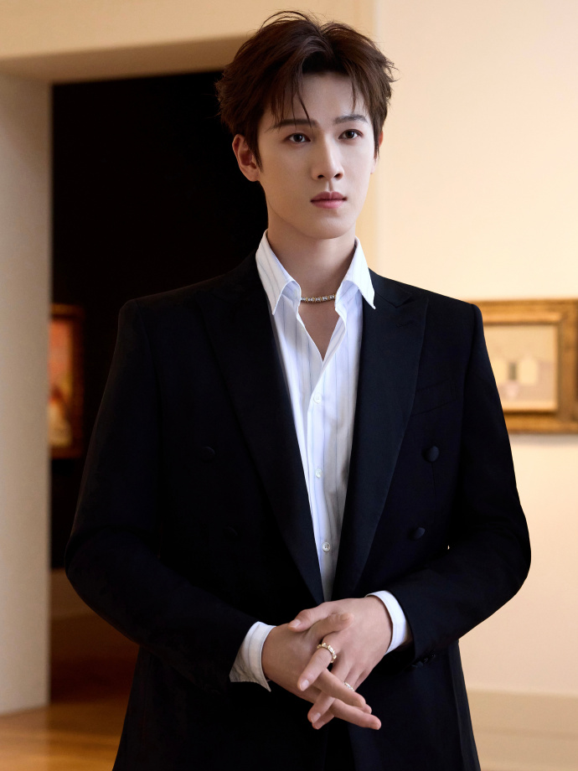
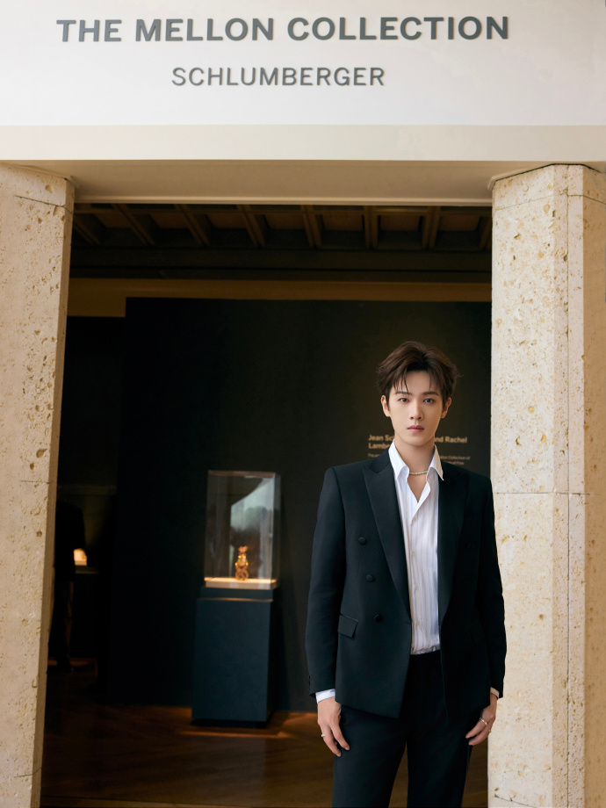
COMPETITOR LOCAL ASSETS
TIFFANY & CO.
LI YUNRUI VISITS VIRGINIA MUSEUM OF FINE ARTS, TRACING SCHLUMBERGER’S LEGACY
SOCIAL CONTENT
BRAND AMBASSADOR
LI YUNRUI

Slide 11
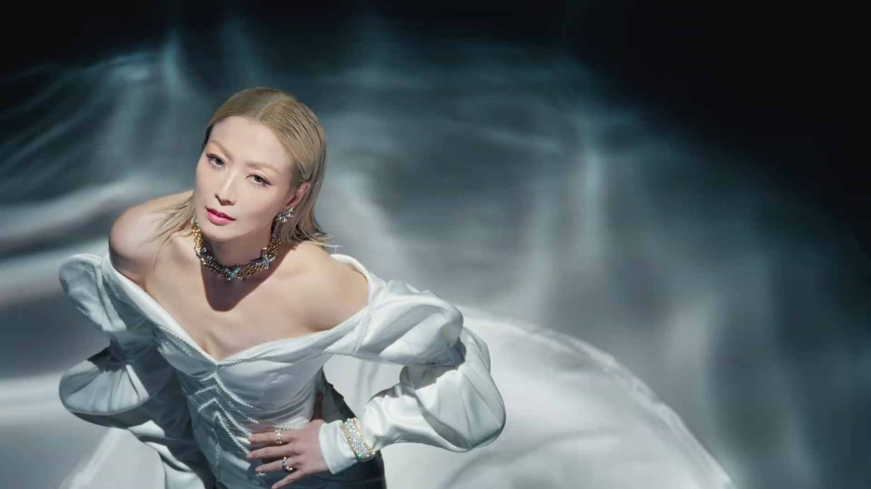

COMPETITOR LOCAL ASSETS
TIFFANY & CO.
TIFFANY NEW CAMPAIGN FACE WITH SAMMI CHENG, TITLE TBD
SOCIAL CONTENT
http://t.cn/AXfEHxdQ
http://t.cn/AXKxyjz0
BRAND FRIEND
SAMMI CHENG

Slide 12

COMPETITOR LOCAL ASSETS
DATE | PROJECT | ASSETS | SOCIAL | EC | AD
JULY 2ND | GUCCI MONTE CARLO WITH TIAN XIWEI | PHOTO | WEIBO/RED | N/A | N/A
JULY 9TH | BAZAAR MEN CHINA’S JUNE 2026 ISSUE WITH SONG WEILONG | PHOTO | WEIBO/RED | N/A | N/A
JULY 9TH | MARIE CLAIRE CHINA JUNE 2026 ISSUE WITH ZHANG LINGHE | PHOTO | WEIBO/RED | N/A | N/A

Slide 13
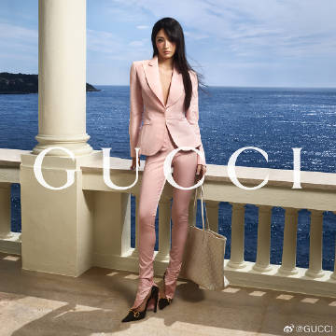
COMPETITOR LOCAL ASSETS
GUCCI
GUCCI MONTE CARLO
SOCIAL CONTENT
BRAND FRIEND
TIAN XIWEI

Slide 14
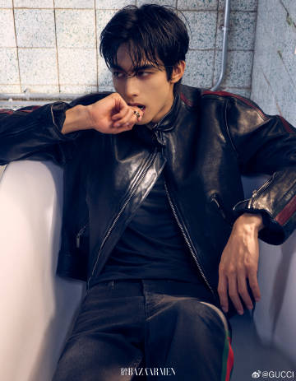
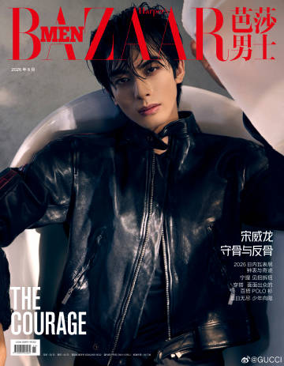
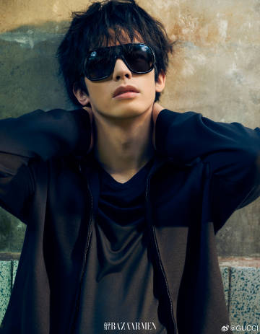
COMPETITOR LOCAL ASSETS
GUCCI
BAZAAR MEN CHINA’S JUNE 2026 ISSUE WITH SONG WEILONG
SOCIAL CONTENT
BRAND AMBASSADOR
SONG WEILONG

Slide 15
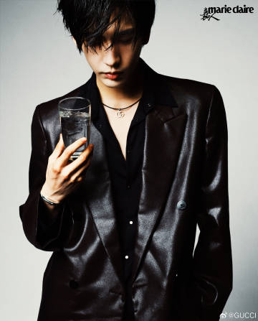
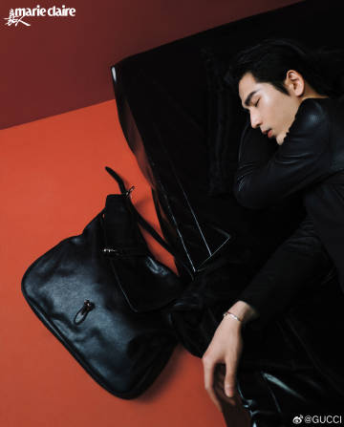
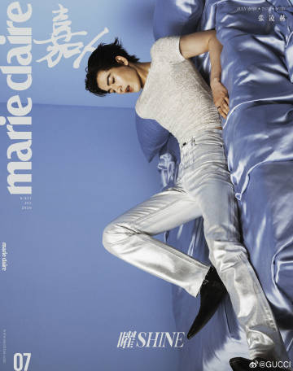
COMPETITOR LOCAL ASSETS
GUCCI
MARIE CLAIRE CHINA JUNE 2026 ISSUE WITH ZHANG LINGHE
SOCIAL CONTENT
BRAND AMBASSADOR
ZHANG LINGHE

Slide 16

COMPETITOR LOCAL ASSETS
DATE | PROJECT | ASSETS | SOCIAL | EC | AD
JULY 1-TBDST | FENDI BAGUETTE | PHOTO | WEIBO/RED | N/A | N/A
JULY 6-9th | FENDI’S FW26/27 COUTURE SHOW WITH TIFFANY TANG-ARRIVAL | PHOTO | WEIBO/RED | N/A | N/A
JULY 10-13th | AT FENDI’S FW26/27 COUTURE SHOW WITH TIFFANY TANG | PHOTO | WEIBO/RED/WECHAT/TIKTOK | N/A | N/A

Slide 17
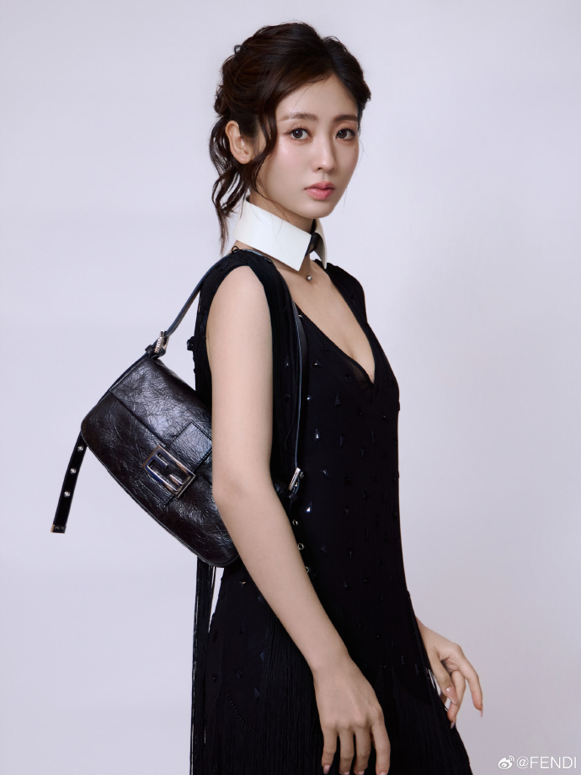
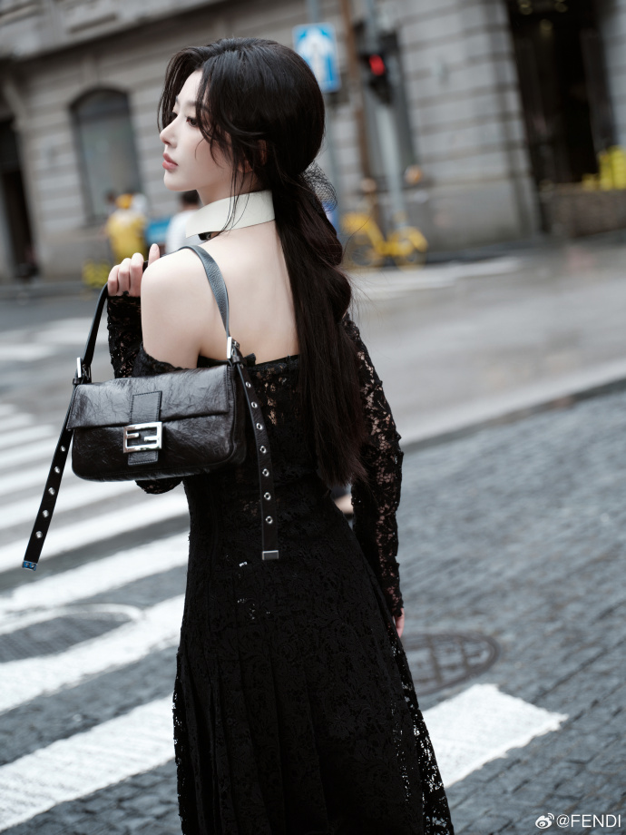
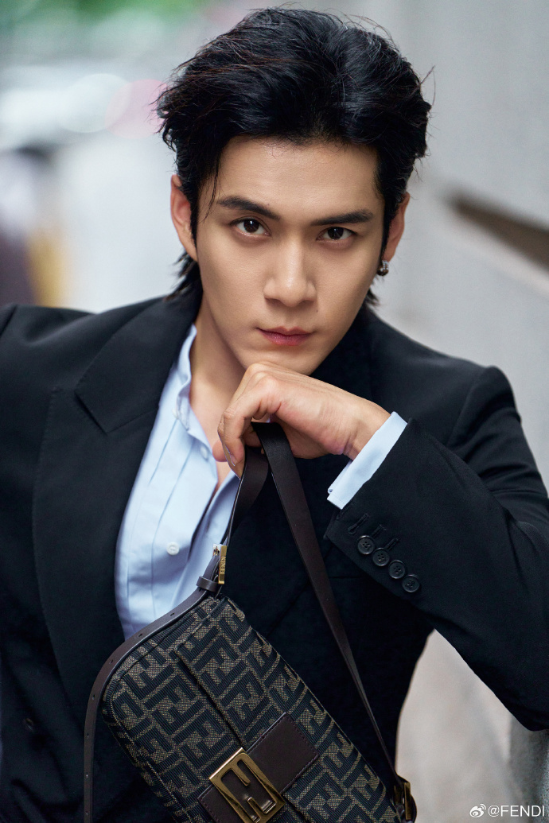
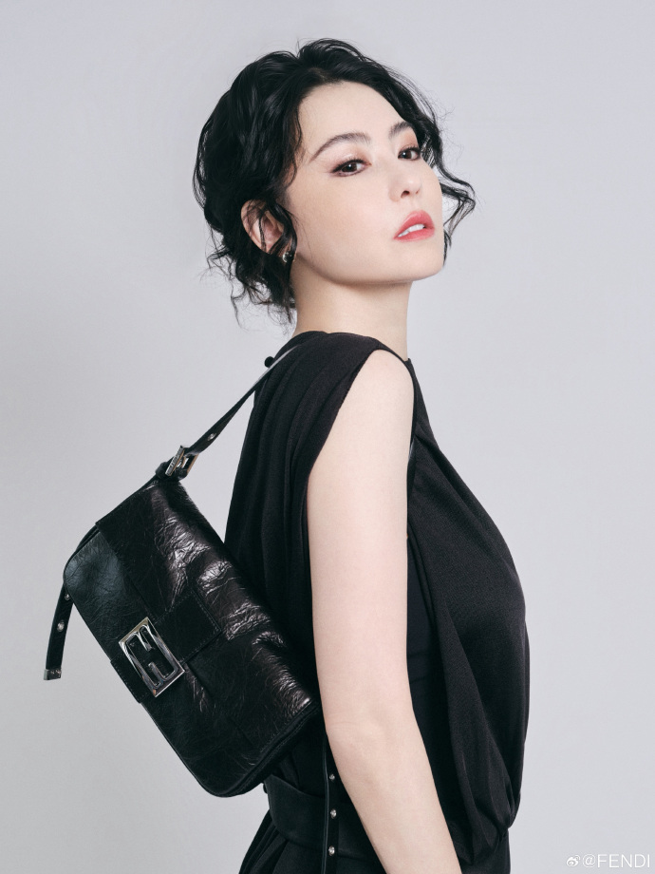
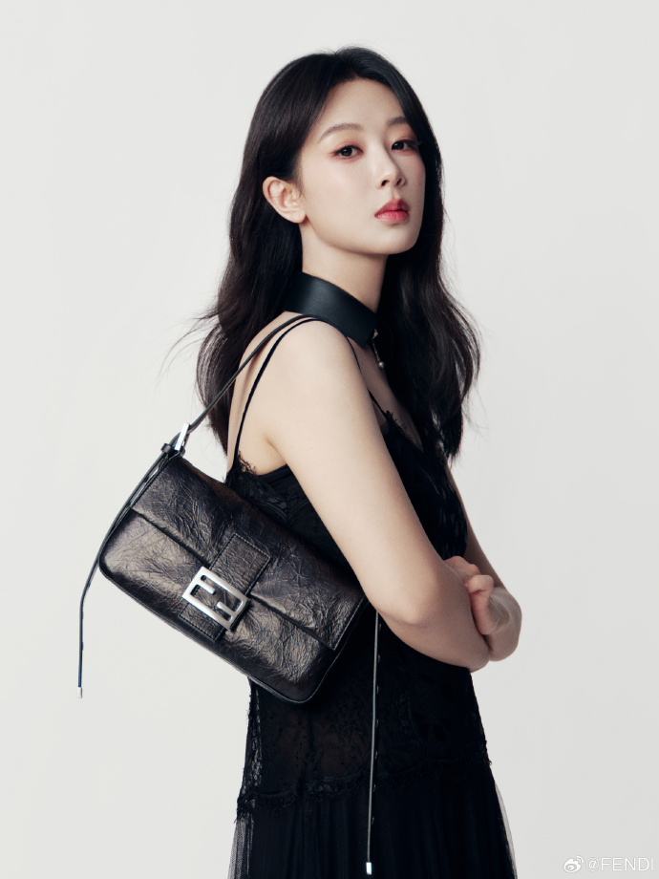
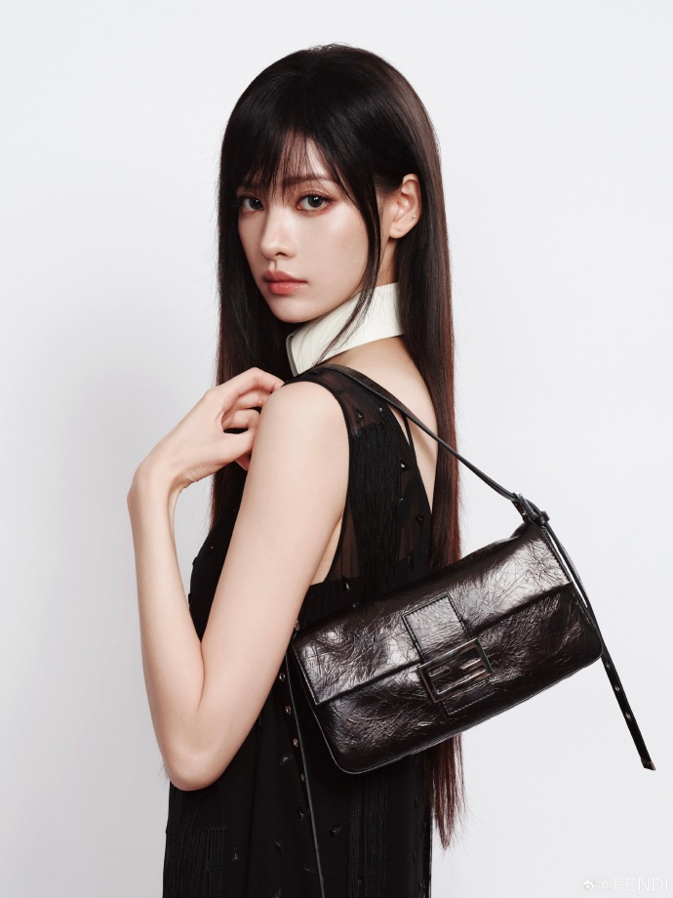
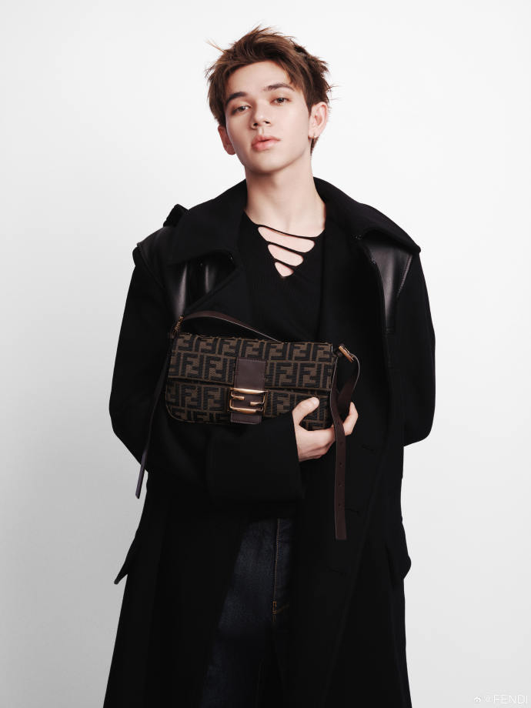
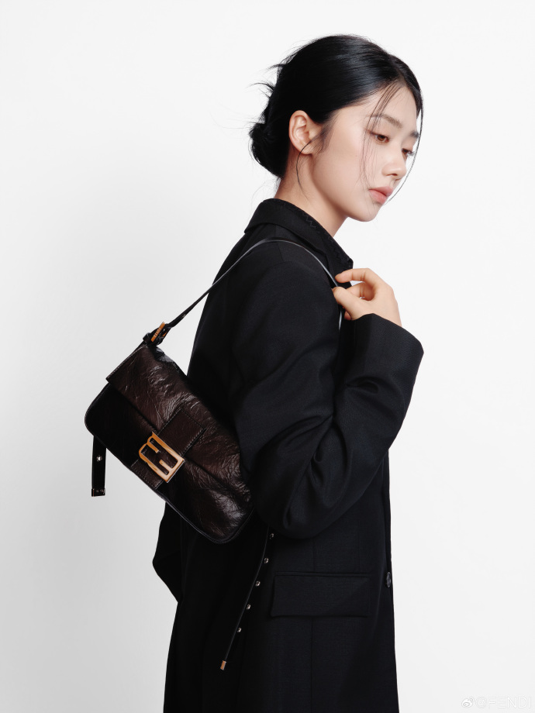
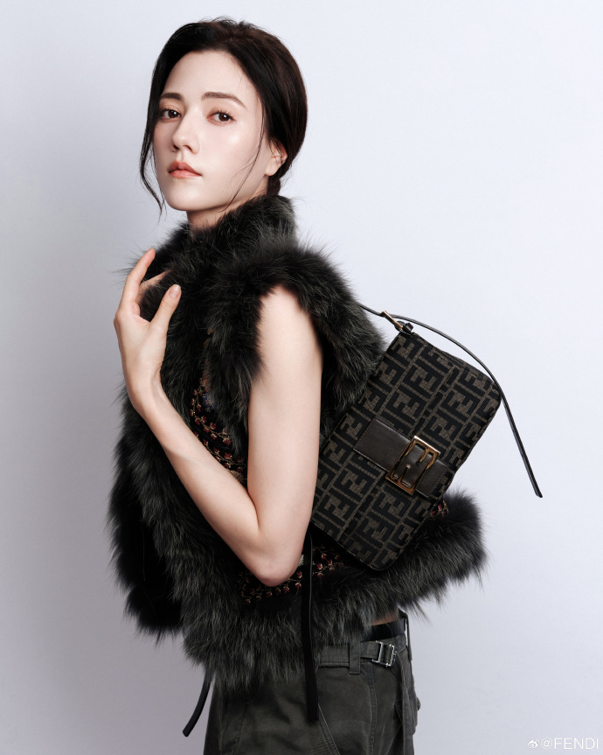
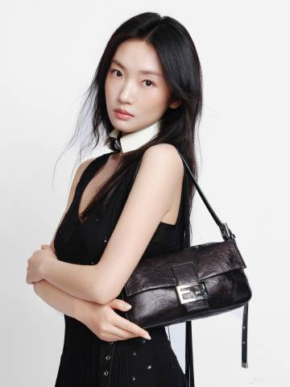
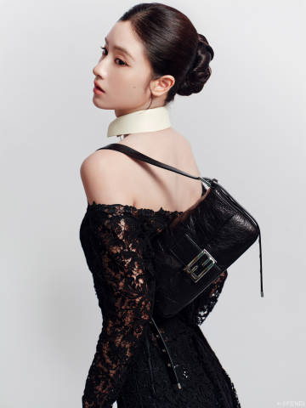
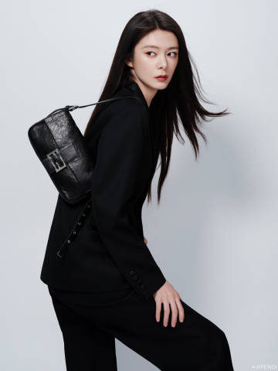
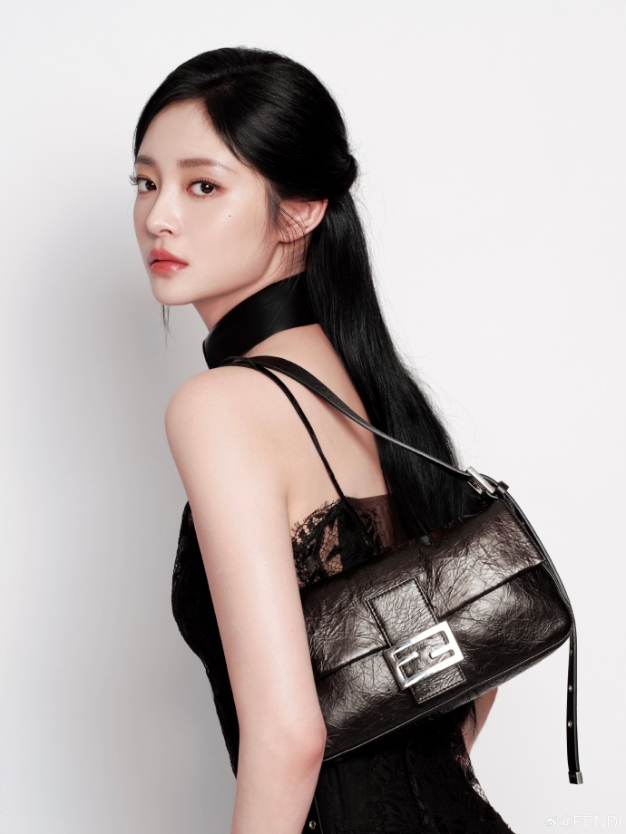
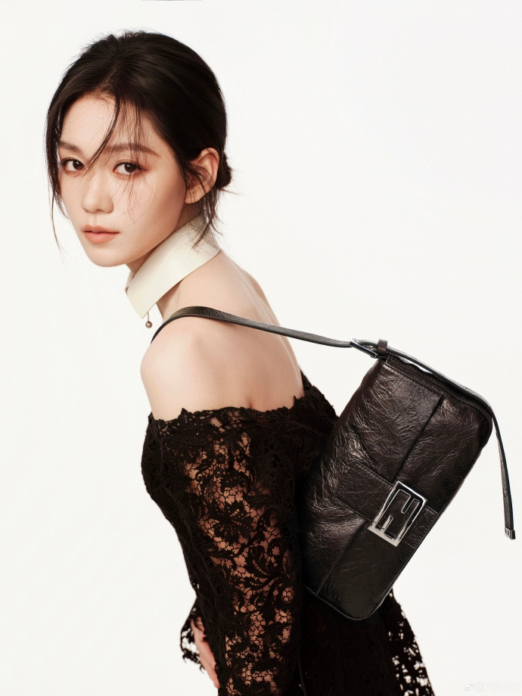
COMPETITOR LOCAL ASSETS
FENDI
FENDI BAGUETTE
SOCIAL CONTENT
ACTRESS
FAIR XING
ACTRESS
SNOW KONG
ACTOR
ELVIS HAN
ACTRESS
CECILIA CHEUNG
ACTRESS
ANDY YANG
ACTRESS
ZHANG YISHANG
SINGER
QING LIAN
ACTRESS
WANG YINGLU
ACTRESS
NARAN
ACTRESS
ZHOU YIRAN
ACTRESS
MAO XIAOHUI
SINGER
FU JING
ACTRESS
KYULKYUNG
SINGER
CLARE DUAN

Slide 18
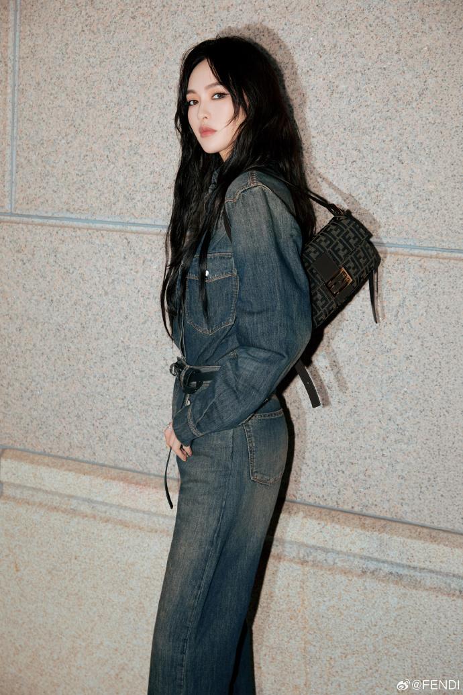
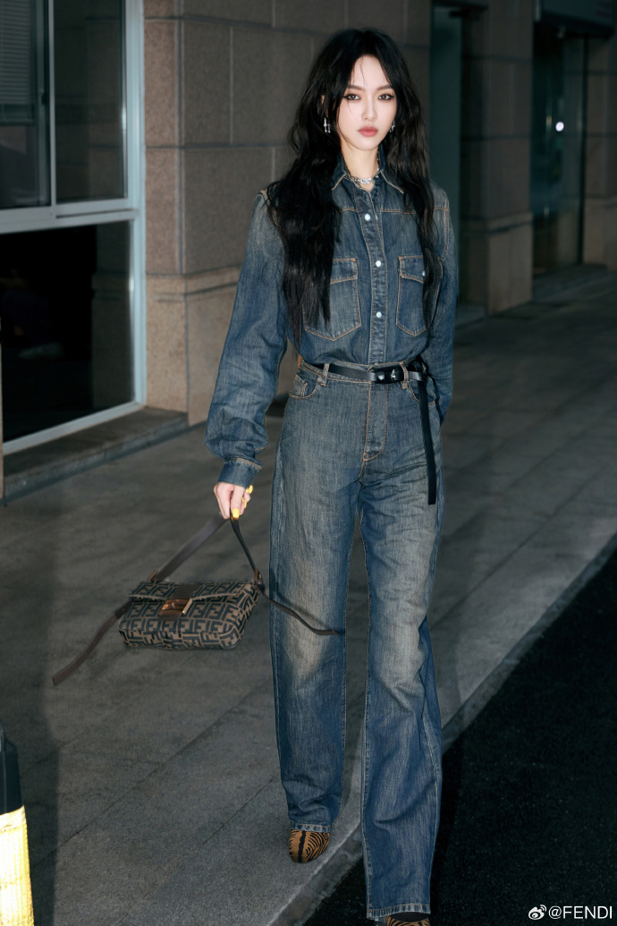
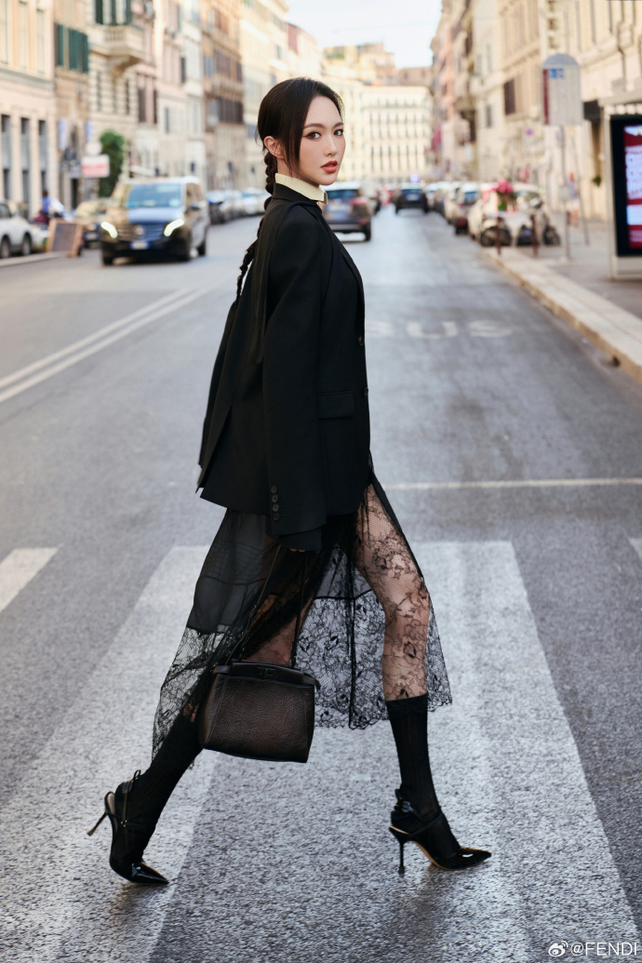
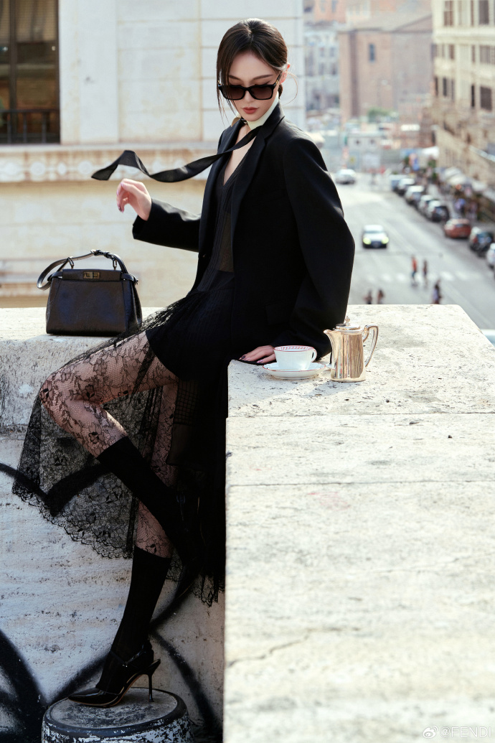
COMPETITOR LOCAL ASSETS
FENDI
FENDI’S FW26/27 COUTURE SHOW WITH TIFFANY TANG-ARRIVAL
SOCIAL CONTENT
BRAND AMBASSADOR
TIFFANY TANG

Slide 19
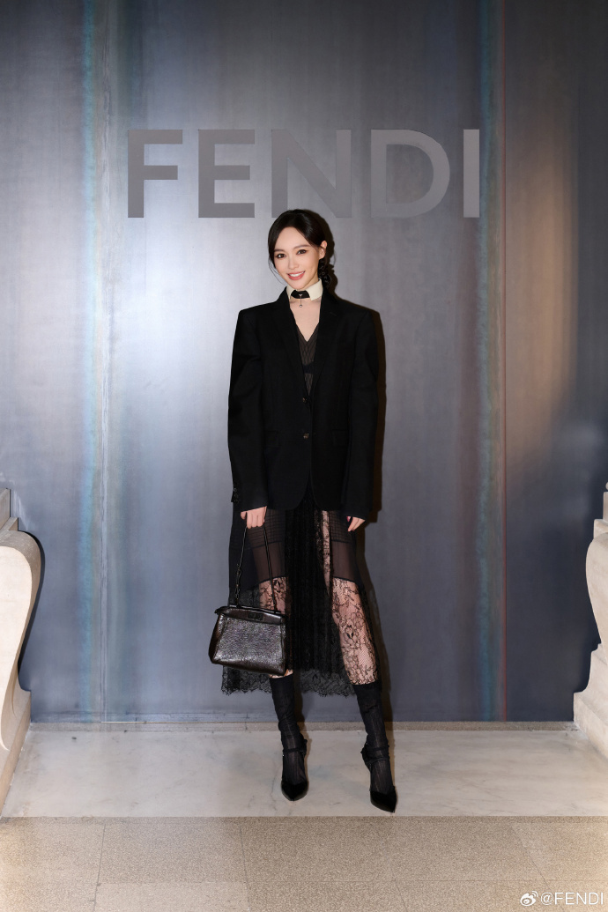
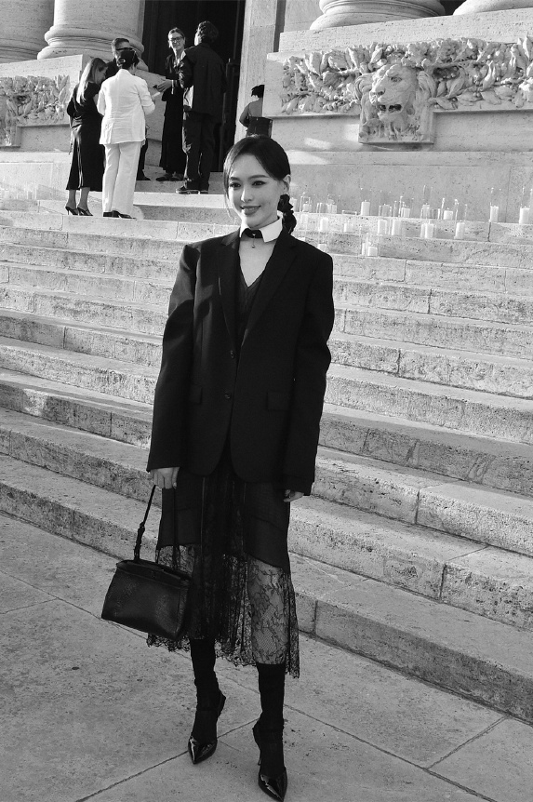
COMPETITOR LOCAL ASSETS
FENDI
AT FENDI’S FW26/27 COUTURE SHOW WITH TIFFANY TANG
SOCIAL CONTENT
BRAND AMBASSADOR
TIFFANY TANG

