Slide 1

North American
Parliamentary Procedure
MITMUNC/MUNOS 2011

Slide 2
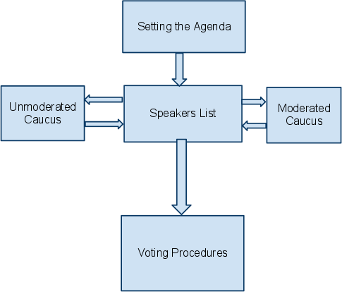
Flow of the Committee

Slide 3
Setting the Agenda
  Delegate proposes next topic to discuss for the committee
  Motion to set the agenda
    Two speakers for the motion, two against
    Simple Majority (>50%)

Slide 4
Speaker's List
  Delegates will make speeches in the order of the speakers' list
  Delegates join the speakers list by sending the chair a note
  Motion to set the speaking time
    Simple majority (>50%)
  Motion to move to voting procedure
    Two speakers against the motion
    2/3 vote (>66%)

Slide 5
Caucuses
  Much of the debate will occur during caucuses, which allow for shorter, more specific speeches from the delegates.
  There are two types of caucuses:
    Moderated, in which there is a set speaking time and a set specific sub-topic, as decided by the motioning delegate
    Unmoderated, in which delegates may talk to each other without any set structure, generally for the purpose of collaborating on resolutions.
  Delegates can motion for caucuses at any time.
  Requires simple majority (>50%) votes

Slide 6
Voting
  Motion to go into voting procedures
    Two delegates must speak against this motion.
    Requires 2/3 vote
  Motion to Divide of the Question
    Split Resolutions into multiple resolutions
  Motion for a Roll Call Vote
    Each delegate is called on to vote individually instead of as a group
  Motion to Change the Order of Voting (to change the order in which the resolutions are voted on)

Slide 7
Resolutions
  UN committees express their decisions using resolutions
  Each resolution must have at least two sponsors and five signatories
    Sponsors are delegates who actively participated in writing the content of the resolution
    Signatories are delegates who support debating the resolution, without necessarily expressing their support for its content.
  Resolutions have preambulatory and operative clauses
    Please see the North American MUN Procedures Guide for detailed information about resolutions.

Slide 8
Amendments
  Format information is in the Parliamentary Procedure Guide
  Resolutions and Unfriendly Amendments require at least 2 sponsors and 5 signatories
  Friendly Amendments require the sponsorship of all sponsors of the resolution it is modifying

Slide 9
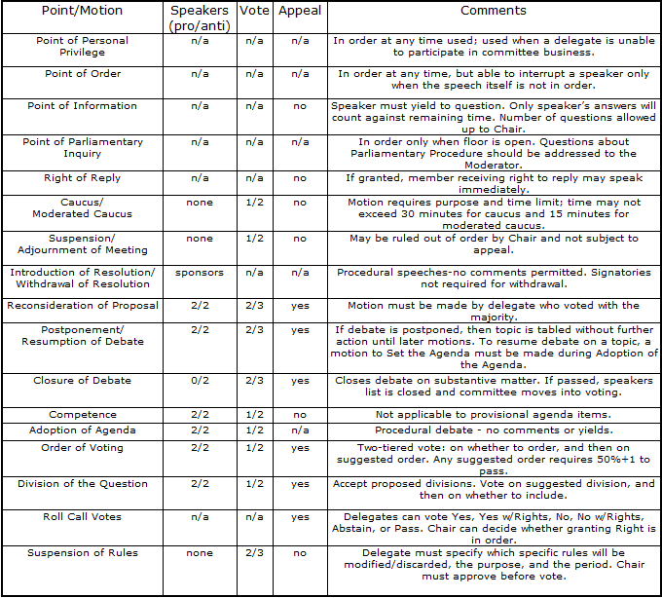
Points And Motions

