Slide 1
20.09.2022
-1-
ADAS-HiL
PECN-EE

Slide 2
Jupiter Twins - V2X Integration
20.09.2022
-2-
ADAS-HiL
PECN-EE

Slide 3

Project Structure
HV
(Host Vehicle)
Scenario
RV
(Remote Vehicle)
TCP/IP
Carla Server
PevaTec Carla
Carla-ROS-Bridge / Carla API
Jupiter Twins Node
OBU 1
RV_Msg
HV_Msg
BSM_Msg
V2X ROS Driver Node
Signal Generator
V2X_Msg
V2X Safety Function Node
OBU 2
ROS Environment
V2X System
20.09.2022
-3-
ADAS-HiL
PECN-EE

Slide 4
Scenario
HV
(Host Vehicle)
Scenario
RV
(Remote Vehicle)
TCP/IP
Carla Server
PevaTec Carla
Carla-ROS-Bridge / Carla API
Jupiter Twins Node
OBU 1
RV_Msg
HV_Msg
BSM_Msg
V2X ROS Driver Node
Signal Generator
V2X_Msg
V2X Safety Function Node
OBU 2
ROS Environment
V2X System
20.09.2022
-4-
ADAS-HiL
PECN-EE

Slide 5

Scenario Description (demo 1: Forward Collision Warning)
Brake point
Actors: Ego vehicle + Remote vehicle
Map: DripLake
Weather: Sunny
Tool: Scenario Runner
Sensors: radar, lidar, front camera, depth camera, semantic camera, gnss, imu
Remote vehicle
Ego
20.09.2022
-5-
ADAS-HiL
PECN-EE

Slide 6
ScenarioRunner – FCW scenario
FCW
Composite sequence root node
Contains all the children behaviors required to perform a FCW scenario
JustDrive
Composite parallel node
SUCCESS_ON_ONE
Drives the target vehicle at a defined speed
StopVehicle
Input: vehicle1, max_brake
SUCCES if the actor stopped moving
StandStill
Input: ego vehicle, duration
SUCCES if the vehicle does not move
InTriggerDistanceToVehicle
Input: vehicle1, ego vehicle, trigger_distance
SUCCES if relative distance < trigger_distance
Waypointfollower
Input: vehicle1, velocity1
Drives vehicle1 at velocity1 along the road
FCW scenario created using pyTrees.
20.09.2022
-6-
ADAS-HiL
PECN-EE

Slide 7
Scenario Description (demo 2: Side Collision Warning)
Brake point
Actors: Ego vehicle + Remote vehicle (First vehicle, Second vehicle)
Map: DripLake
Weather: Foggy
Tool: Scenario Runner
Sensors: millimeter wave radar + front rgb camera
First vehicle
Ego
Second vehicle
20.09.2022
-7-
ADAS-HiL
PECN-EE

Slide 8
SCW
Composite sequence root node
Side actor behavior
StopVehicle
Input: vehicle1, max_brake
SUCCES if the actor stopped moving
InTriggerDistanceToLocation
Input: vehicle1, target_location, trigger_distance
SUCCES if relative distance<trigger_distance
StandStill
Input: ego vehicle, duration
SUCCES if the vehicle does not move
JustDrive
WaypointFollower
Input: vehicle2, velocity2
Drives vehicle2 at velocity2 along the road
InTriggerDistanceToVehicle
Input: vehicle1, vehicle2, trigger_distance
SUCCES if relative distance<trigger_distance
AccelerateToCatchUp
Input: vehicle1, vehicle2, trigger_distance, delta_velocity
SUCCES if relative distance<trigger_distance
keep_drive
Drives the target vehicle at a defined speed until it reaches a defined distance
WaypointFollower
Input: vehicle2, velocity2
Drives vehicle2 at velocity2 along the road
InTriggerDistanceToLocation
Input: vehicle2, target_location, trigger_distance
SUCCES if relative distance<trigger_distance
StopVehicle
Input: vehicle2, max_brake
SUCCES if the actor stopped moving
Leading actor behavior
WaypointFollower
Input: vehicle1, velocity1
Drives vehicle1 at velocity1 along the road
keep_velocity
ScenarioRunner – SCW scenario
SCW scenario created using pyTrees.
20.09.2022
-8-
ADAS-HiL
PECN-EE

Slide 9
Jupiter Twins
HV
(Host Vehicle)
Scenario
RV
(Remote Vehicle)
TCP/IP
Carla Server
PevaTec Carla
Carla-ROS-Bridge / Carla API
Jupiter Twins Node
OBU 1
RV_Msg
HV_Msg
BSM_Msg
V2X ROS Driver Node
Signal Generator
V2X_Msg
V2X Safety Function Node
OBU 2
ROS Environment
V2X System
20.09.2022
-9-
ADAS-HiL
PECN-EE

Slide 10
Jupiter Twins ROS Topic
HV_Msg
RV_Msg
20.09.2022
-10-
ADAS-HiL
PECN-EE

Slide 11
ROS Driver
HV
(Host Vehicle)
Scenario
RV
(Remote Vehicle)
TCP/IP
Carla Server
PevaTec Carla
Carla-ROS-Bridge / Carla API
Jupiter Twins Node
OBU 1
RV_Msg
HV_Msg
BSM_Msg
V2X ROS Driver Node
Signal Generator
V2X_Msg
V2X Safety Function Node
OBU 2
ROS Environment
V2X System
20.09.2022
-11-
ADAS-HiL
PECN-EE

Slide 12
Send
Decode
JSON format
ASN.1
UPER Coding
Basic Safety Message (BSM)
UDP
Recv
Encode
V2X ROS Driver
msg Handler
OBU
20.09.2022
-12-
ADAS-HiL
PECN-EE

Slide 13
brakes | brakes.brake_padel_opt | /
 | brakes.brake_padel | BrakePadel
 | brakes.wheel_brakes_opt | /
 | brakes.wheel_brakes | WheelBrakes
 | brakes.traction_opt | /
 | brakes.traction | Traction
 | brakes.abs_opt | /
 | brakes.abs | ABS
 | brakes.scs_opt | /
 | brakes.scs | SCS
 | brakes.brake_boost_opt | /
 | brakes.brake_boost | BrakeBoost
 | brakes.aux_brakes_opt | /
 | brakes.aux_brakes | AuxBrakes
veh_size | veh_size.width | Width
 | veh_size.length | Length
 | veh_size.height_opt | /
 | veh_size.height | Height
vehicle_classification | vehicle_classification.classification | BasicVehicleClass
 | vehicle_classification.fuel_type_opt | /
 | vehicle_classification.fuel_type | FuelType
events_opt |  | /
events |  | Events
lights_opt |  | /
lights |  | Light
path_his_opt |  | /
path_his | path_his.count | /
 | path_his.points | /
path_pre_opt |  | /
path_pre | path_pre.curve_radius | /
 | path_pre.confidence | /
veh_emergency_ext_opt |  | /
veh_emergency_ext | veh_emergency_ext.response_type_opt
 | veh_emergency_ext.response_type | ResponseType
 | veh_emergency_ext.siren_use_opt | /
 | veh_emergency_ext.siren_use | SirenInUse
 | veh_emergency_ext.lights_use_opt | /
 | veh_emergency_ext.lights_use | LightbarInUse
Basic Safety Message
Signal in OBU(parent signal) | Signal in OBU(child signal) | Signal in JSON(UDP)
host_flag |  | HostFlag
id |  | Id
time_stamp |  | /
pos | pos.latitude | Latitude
 | pos.longitude | Longitude
 | pos.elevation_opt | /
 | pos.elevation | Elevation
pos_acc_opt |  | /
pos_acc | pos_acc.smajor_dev | SemiMajorAxisAccuracy
 | pos_acc.sminor_dev | SemiMinorAxisAccuracy
 | pos_acc.smajor_orien | SemiMajorAxisOrientation
pos_confidence_opt |  | /
pos_confidence | pos_confidence.pos | PostionConfidence
 | pos_confidence.elevation_opt | /
 | pos_confidence.elevation | ElevationConfidence
trans_opt |  | /
trans |  | TransmissionState
speed |  | Speed
heading |  | Heading
angle_opt |  | /
angle |  | SteeringWheelAngle
accel_set | accel_set.acc_lng | LongitudalAcceleration
 | accel_set.acc_lat_opt | /
 | accel_set.acc_lat | LateralAcceleration
 | accel_set.acc_vert_opt | /
 | accel_set.acc_vert | VerticalAcceleration
 | accel_set.yaw_rate | YawRate
20.09.2022
-13-
ADAS-HiL
PECN-EE

Slide 14
OBU
HV
(Host Vehicle)
Scenario
RV
(Remote Vehicle)
TCP/IP
Carla Server
PevaTec Carla
Carla-ROS-Bridge / Carla API
Jupiter Twins Node
OBU 1
RV_Msg
HV_Msg
BSM_Msg
V2X ROS Driver Node
Signal Generator
V2X_Msg
V2X Safety Function Node
OBU 2
ROS Environment
V2X System
20.09.2022
-14-
ADAS-HiL
PECN-EE

Slide 15
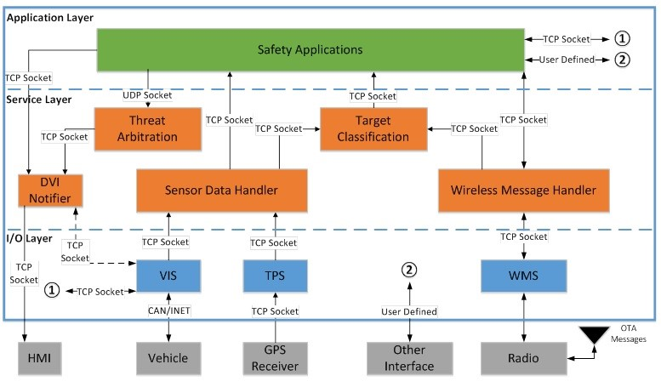
OBU App
JSON Msg Receiver
Wireless Message Handler
Application
OBU-116 (Remote OBU)
PC5
Test
JSON Msg Sender
Wireless Message Handler
Application
OBU-115 (Host OBU)
20.09.2022
-15-
ADAS-HiL
PECN-EE

Slide 16
V2X Safety Function
HV
(Host Vehicle)
Scenario
RV
(Remote Vehicle)
TCP/IP
Carla Server
PevaTec Carla
Carla-ROS-Bridge / Carla API
Jupiter Twins Node
OBU 1
RV_Msg
HV_Msg
BSM_Msg
V2X ROS Driver Node
Signal Generator
V2X_Msg
V2X Safety Function Node
OBU 2
ROS Environment
V2X System
20.09.2022
-16-
ADAS-HiL
PECN-EE

Slide 17
Warning Signal
Warning Canceled
Warning Type | Warning Level
None | 0
Emergency Brake Warning | 12
Forward Car Warning | 11
Forward Car Warning Canceled | 10
Side Car Warning | 21
Side Car Warning Canceled | 20
Forward Car Warning
Ego
Side Car Warning
Detect Scope
20.09.2022
-17-
ADAS-HiL
PECN-EE

Slide 18
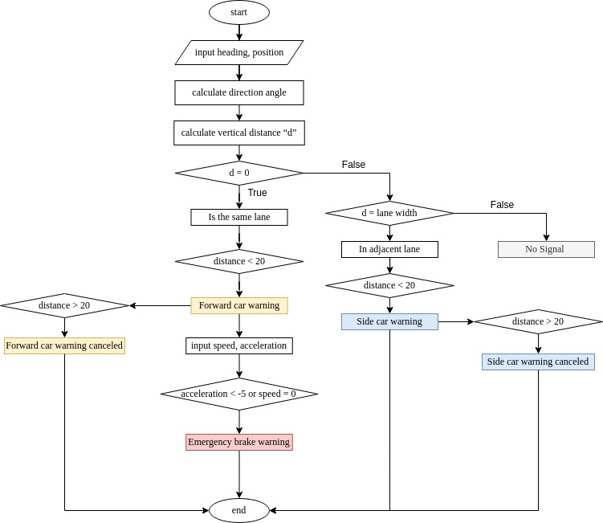
Flow chart
20.09.2022
-18-
ADAS-HiL
PECN-EE

Slide 19
Lane Judgement
vertical distance d = cos(α-β)×distance
heading β
x
direction angle α
y
20.09.2022
-19-
ADAS-HiL
PECN-EE

Slide 20
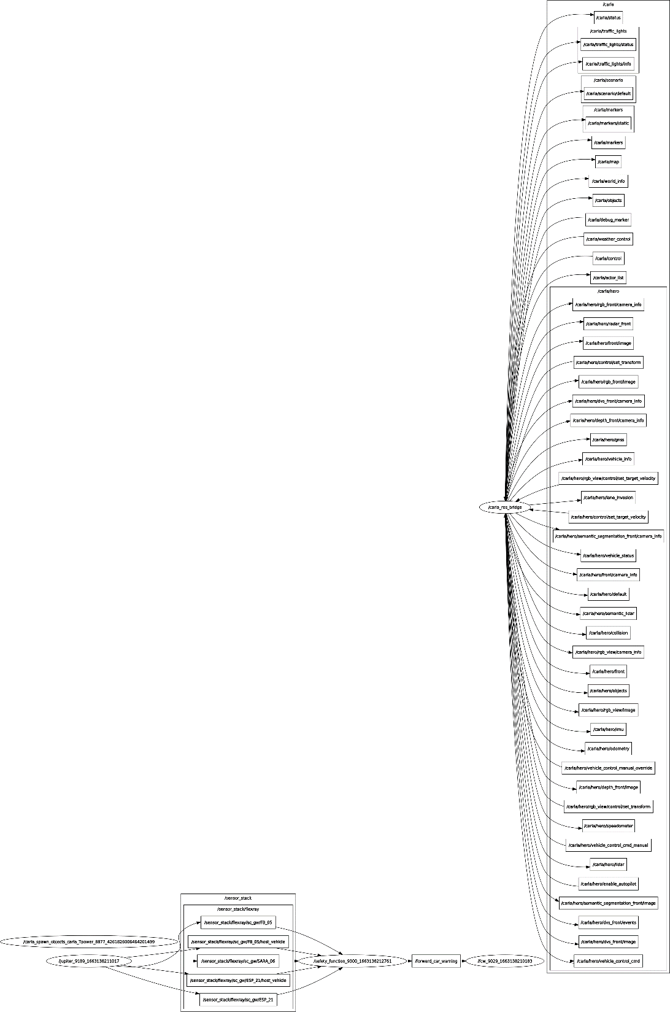
ROS Graph
Demo 1
Demo 2
20.09.2022
-20-
ADAS-HiL
PECN-EE

Slide 21
Jupiter Platform
20.09.2022
-21-
Jupiter – Platform
PEG

Slide 22

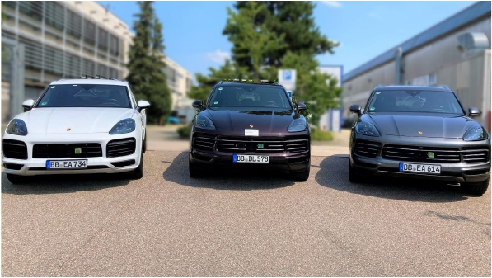



TheVisionofJupiter
The Benefits ofJupiter
JUPITER
FullyScalable Rapid Prototyping
Vehicle
ModularSoftwareArchitecture for
ADAS
Novel and State-of-the-Art ADAS
Algorithms
Collaboration Platform across
various domains
'images: Flaticon.com'
20.09.2022
-22-
Jupiter – Platform
PEG

Slide 23
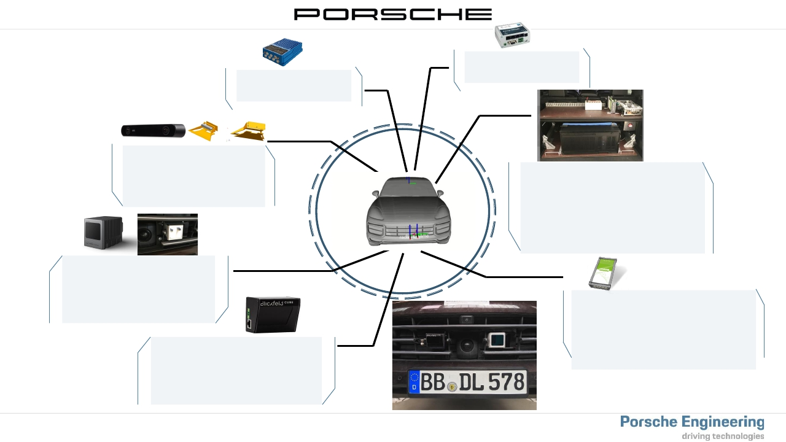
JupiterDE
Setup:
Mdex MX880 Router:
• 4G LTE /VPN Service
ADMASlim:
• Dual Antenna System
ZED2 Stereo camera:
• FOV(110° (H) x 70° (V))
• various resolution options (2K)
• Depth Range (0.2 -20 m)
Livox Lidar Horizon:
• FOV81,7° (H) x 25,1° (V)
• >240.000 Points/sec (64 lines)
• Up to 260 M (80% reflectivity)
• Low-cost (800$)
Blickfeld Cube1:
• Solid State Lidar (MEMS)
• FOV70° (H) x 30° (V)
• Scaning lines configurable (50 lines)
• Up to 250 M (80% reflectivity)
20.09.2022
-23-
Developmentplatform:
• powerful Server-CPU (512 GB RAM)
• high performance GPU (32VGB) for
AI-applications
• x86 architecture to ensure 3rd Party
compatibility (OpenCV, Python, …)
• High speed data logging (3 GB/s)
Bus data gatewaywith FlexDevice L2:
• Access ofvehicle bus data and
manipulation through own implemented
FlexRay to UDPGateway
• Performance evaluated with State ofthe
Art Gateways fromVector
Jupiter – Platform
PEG

Slide 24
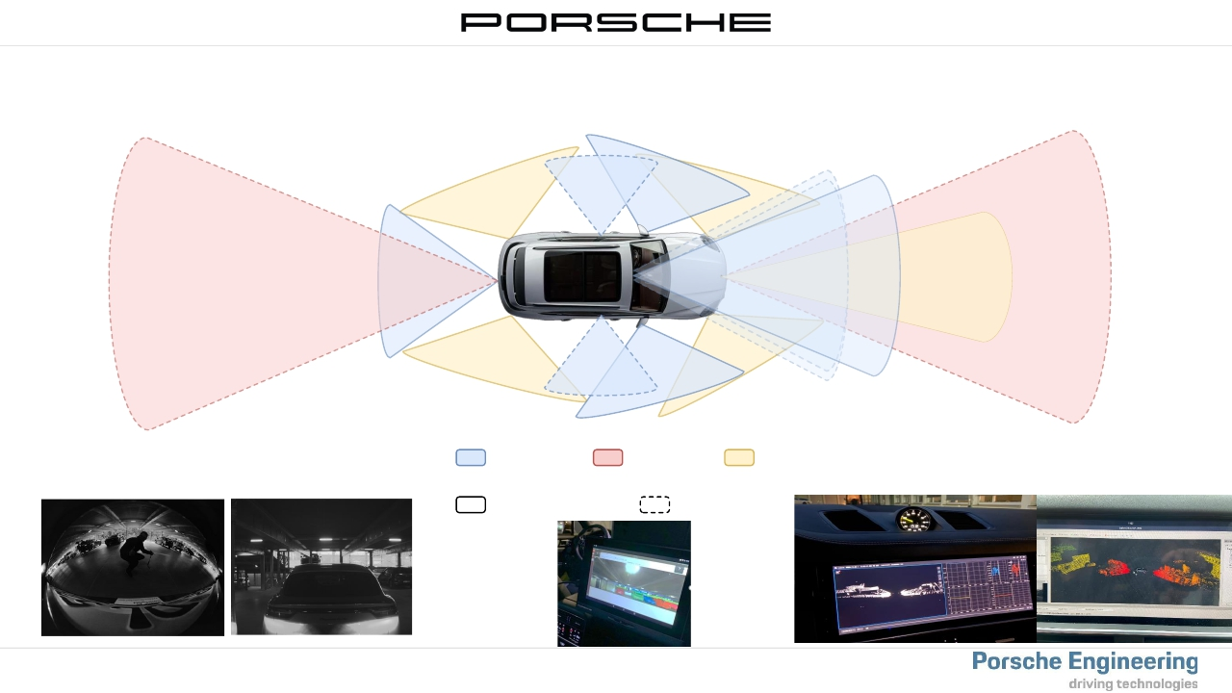
Sensor-Stack
Jupiter: Sensorset (schematic representation)
Kamera
LiDAR
Radar
Raw series camera image
MIB Display:
Sensors
Additional
Serienausstattung
Zusätzliche Sensorik
2x RSE:
20.09.2022
-24-
Jupiter – Platform
PEG

Slide 25

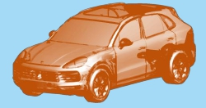
High-Level-Architecture
Jupiter
JUPITER
Service Stack
V2X
Software Stack
CLOUD
SIMULATION
MAP
LOCALIZATION
PERCEPTION
PREDICTION
PLANNING
CONTROL
Sensor Stack
Multiple Camera
(Stereo)
LIDAR
FlexRay
IMU
ULTRASONIC
GPS
Real Top View
Vehicle Stack
RADAR
CAN
Cayenne E3
(Architecture MLBevoGen2)
Jupiter – Platform
PEG
Workstation
(AMD Epyc / Nvidia Quadro)
Vehicle Setup
Powersupply
LIDAR
20.09.2022
-25-

Slide 26
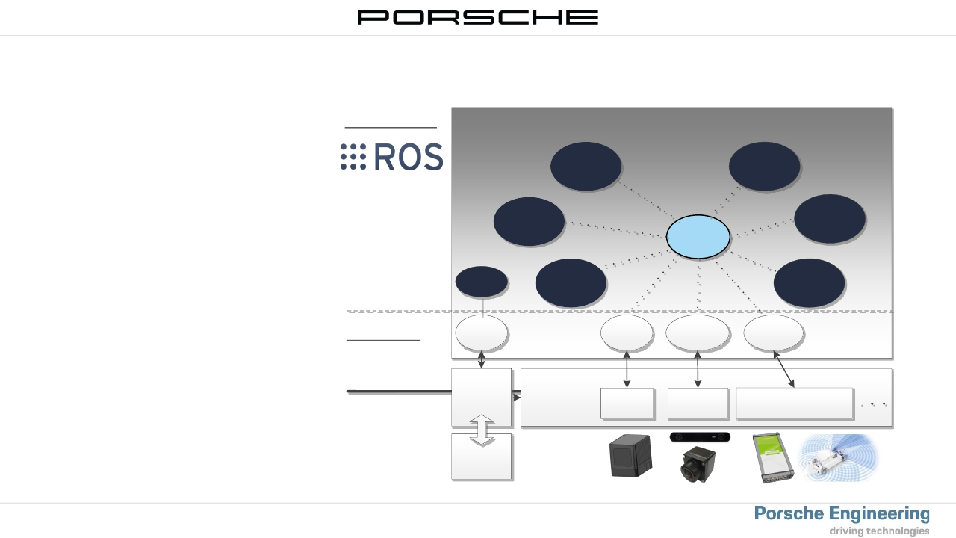
Software-Stack
ROS (Robot Operating System)
>
>
>
Standardised SW-framework
Basic idea fora robot
independent software sharing in
research
Currentlyin use byotherOEM‘s:
− BMW, MAN …
Software Stack
Register over
ROS-Master than
Publish/Subscribe
to all data in
Network
ROS Highlevel Nodegraph
Localization Prediction
ROS-
Master
Perception
MAP
Planning
Control
ROS-
Node
Driver Stack
Driver
node
Livox
SDK
GMSL /
ZED SDK
ROS_BUS
Driver
Ros Messages
and Services
ROS driver
Hardware
communication
Driver
packages
(Sensor Stack)
Livox
Lidar
PX2/ZED2
Camera
Vehiclebus
(CAN/FlexRay)
through
CAN, Serial,USB ..
Hardware
20.09.2022
-26-
Jupiter – Platform
PEG

Slide 27
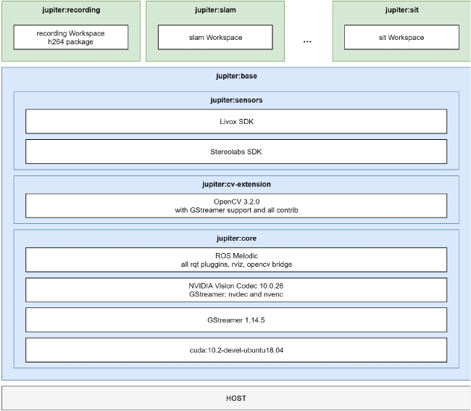
Software-Stack
Jupiter
>
>
>
>
>
Build up on different dockerimages
Jupiter: Base as starting point
Jupiter: Core
− Standard SW(JupiterPrague/Cluj) CUDA11.0
Jupiter: CV-Extension
− OpenCVSupport
Jupiter: Sensors
− SensorSDK
− ROS Device Drivers
Each project should build on top and deal
with different dependencies in dedicated
dockerimages
20.09.2022
-27-
Jupiter – Platform
PEG

Slide 28
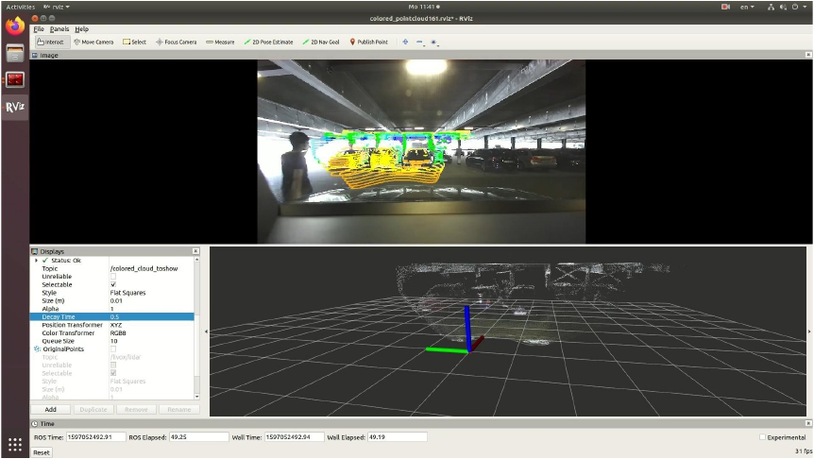
Sensors
SensorFusion: Camera-Lidar
20.09.2022
-28-
Jupiter – Platform
PEG

Slide 29
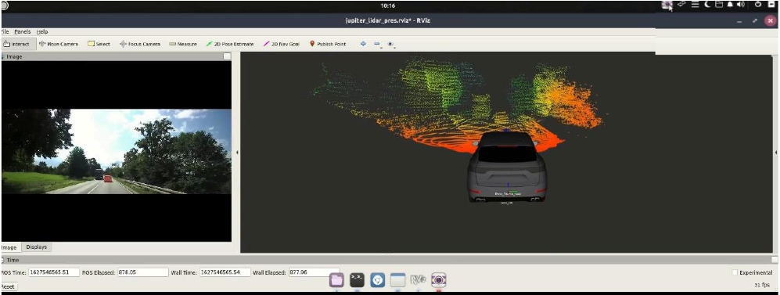
Observe
Camera and Lidar 3D PointCloud
20.09.2022
-29-
Jupiter – Platform
PEG

Slide 30
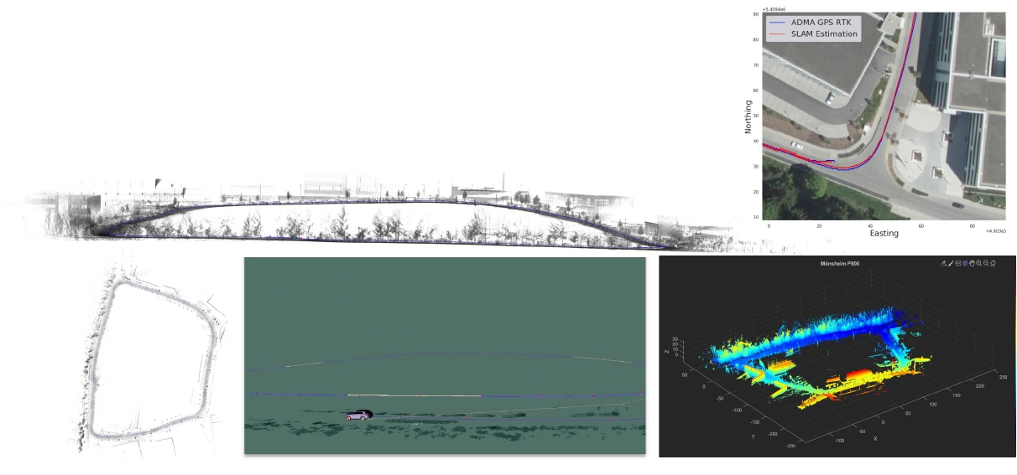
Observe/Orient
SLAM (Simultaneous Localisation and Mapping)
>
SLAM/Localisation
− Lidarbased SoASLAM algorithm
− Development ofa concept to analyse localization quality/performance
20.09.2022
-30-
Jupiter – Platform
PEG

Slide 31
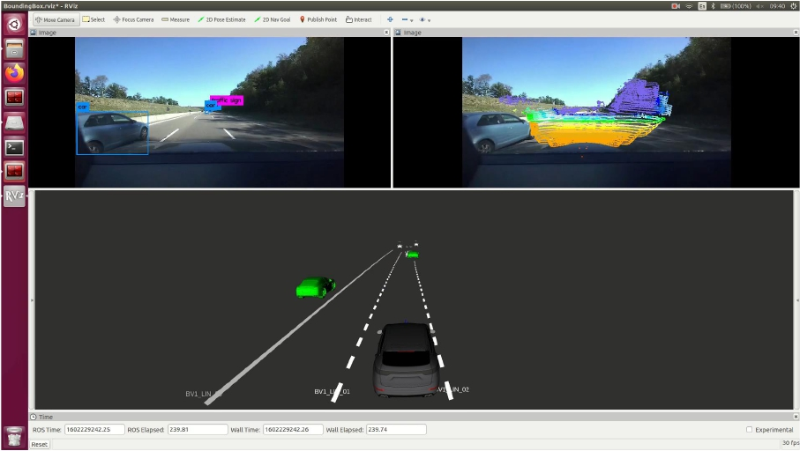
Observe/Orient
Artificial Intelligence (AI):„OnlineAI-based multimodal scene interpretation“
20.09.2022
-31-
Jupiter – Platform
PEG

Slide 32
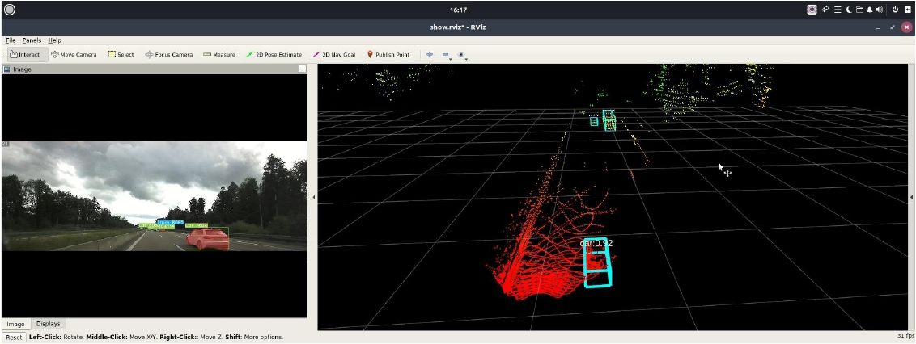
Observe/Orient
Artificial Intelligence (AI)
20.09.2022
-32-
Jupiter – Platform
PEG

Slide 33
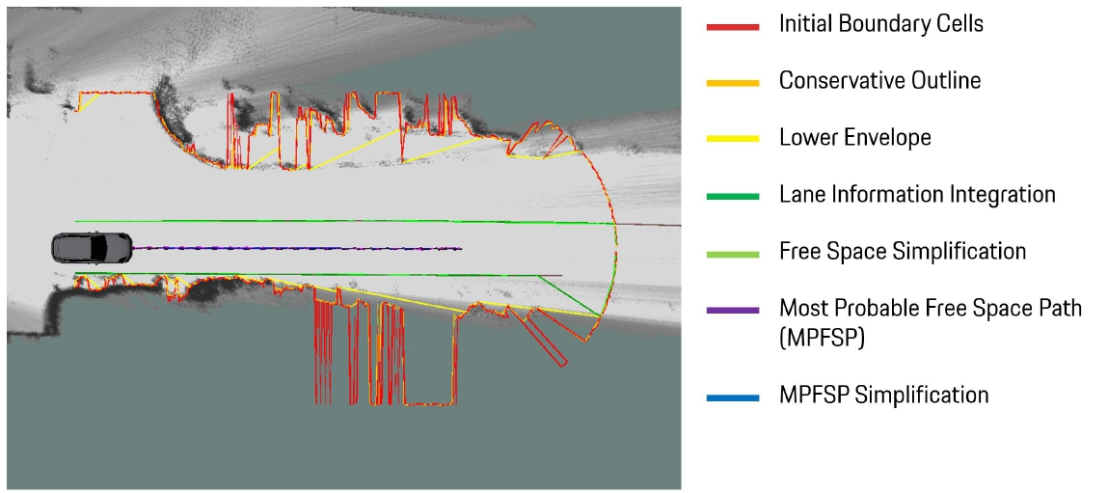
Decide
Lidar based Freespace Detection
20.09.2022
-33-
Jupiter – Platform
PEG

Slide 34
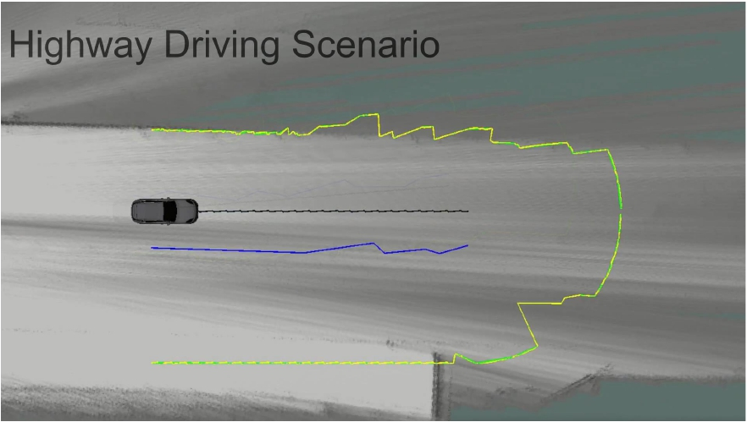
Decide
Lidar based Freespace Detection
20.09.2022
-34-
Jupiter – Platform
PEG

Slide 35
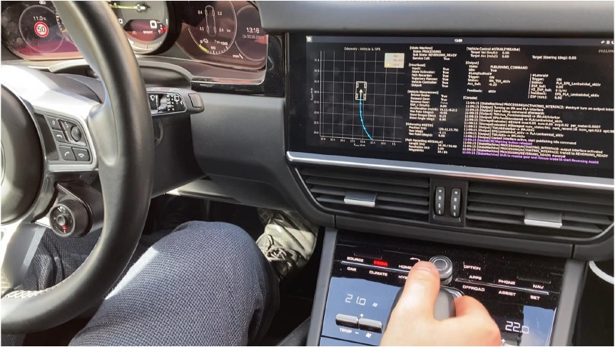
Decide/Act
Use-Case ReversingAssist
20.09.2022
-35-
Jupiter – Platform
PEG

Slide 36
Summary&Outlook
JupiterDevelopment Platform
>
>
>
>
Fast ProofofConcepts forSoAAlgorithms
− Common DevelopmentTime of6 PM
− Big ROS Communityto solve upcoming issues efficiently
Open Platform to covera wide varityofdifferent Use-Cases andApplications in the field of:
− ADAS,AI,V2X,Simulation, SensorBenchmark ....
Integration of projects that are close-to-series
Integration ofalgorithms from partnerlocations
− International DevelopmentTeam works on one common SW-Stack
20.09.2022
-36-
Jupiter – Platform
PEG

