Slide 2

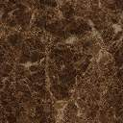

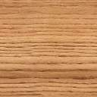
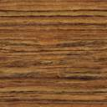
air film inside
air film outside
air film inside
air film outside
marble
brick
air gap
plaster
brick
air gap
plaster
Wooden roof deck
Fiberglass insulation
Wood rafter
plaster
Plaster board
air
Plaster board

Slide 3
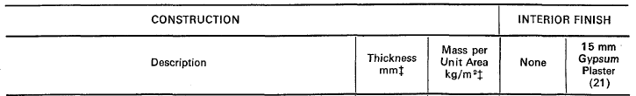
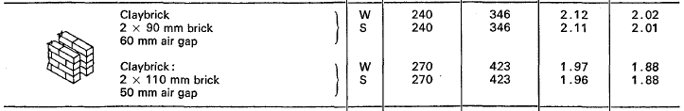

Slide 4
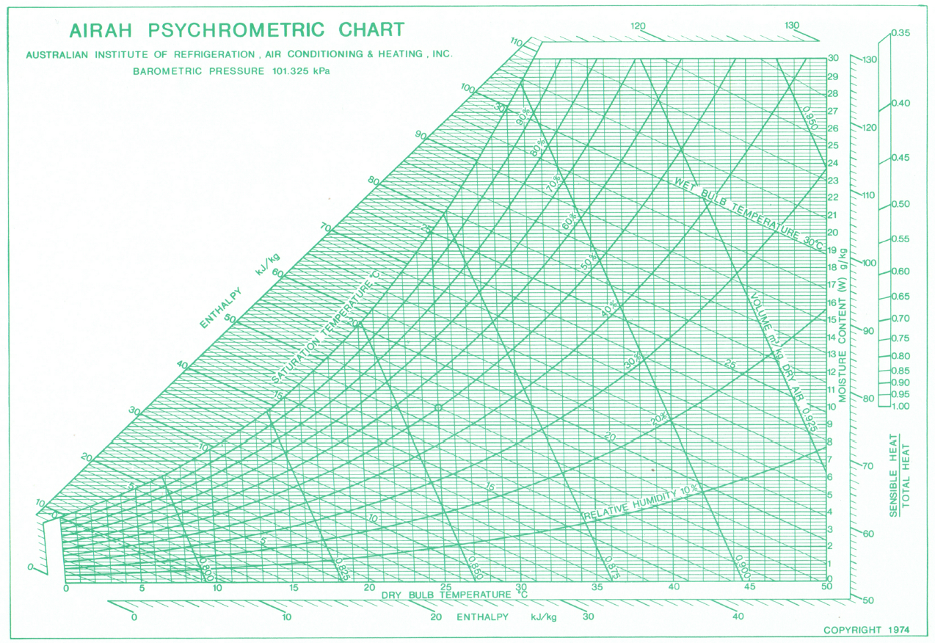
Room T.0.6
58kJ/kg
SHF = 0.72
OA
Mix
33kJ/kg
RA
ADP
SA

Slide 5
Room MM.0.3
57.5kJ/kg
SHF = 0.74
OA
Mix
33kJ/kg
RA
ADP
SA

