Slide 1

Never Stand Still
Faculty of Engineering
School of Mechanical and Manufacturing Engineering
Vibration Diagnosis of Planetary Gearbox under Variable Speed condition
Hengcheng Zhang – z5130844
Supervisor: Associate Professor Zhongxiao Peng
And Dr. Wade Smith

Slide 2
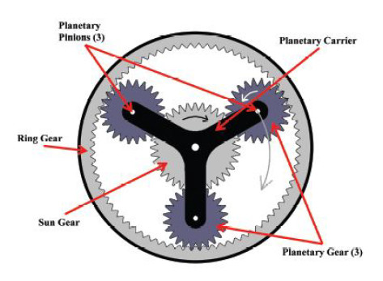
Introduction

Slide 3
Literature Review

Slide 4
Literature Review

Slide 5
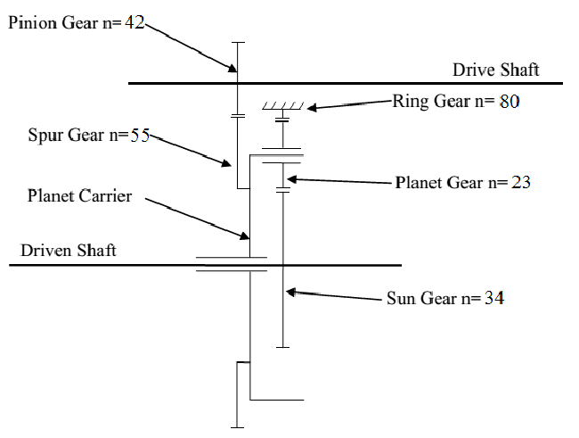
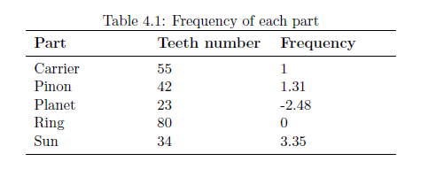
Methods

Slide 6
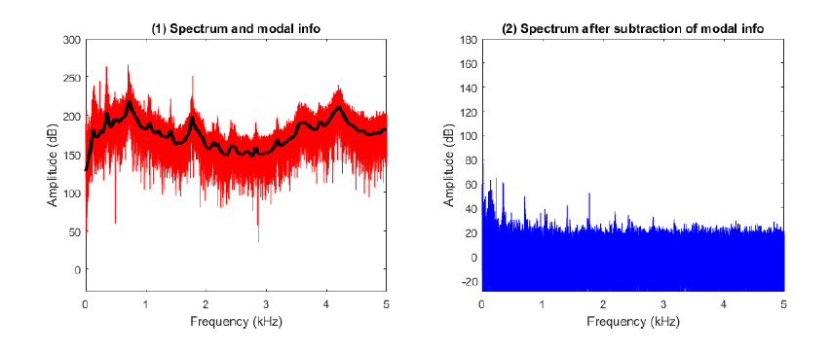
Methods

Slide 7
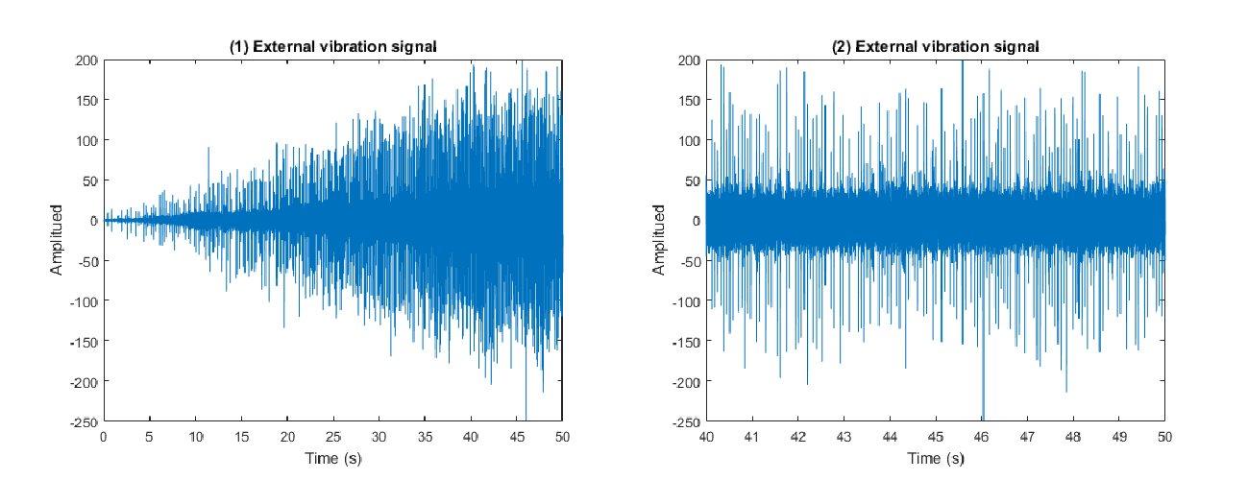
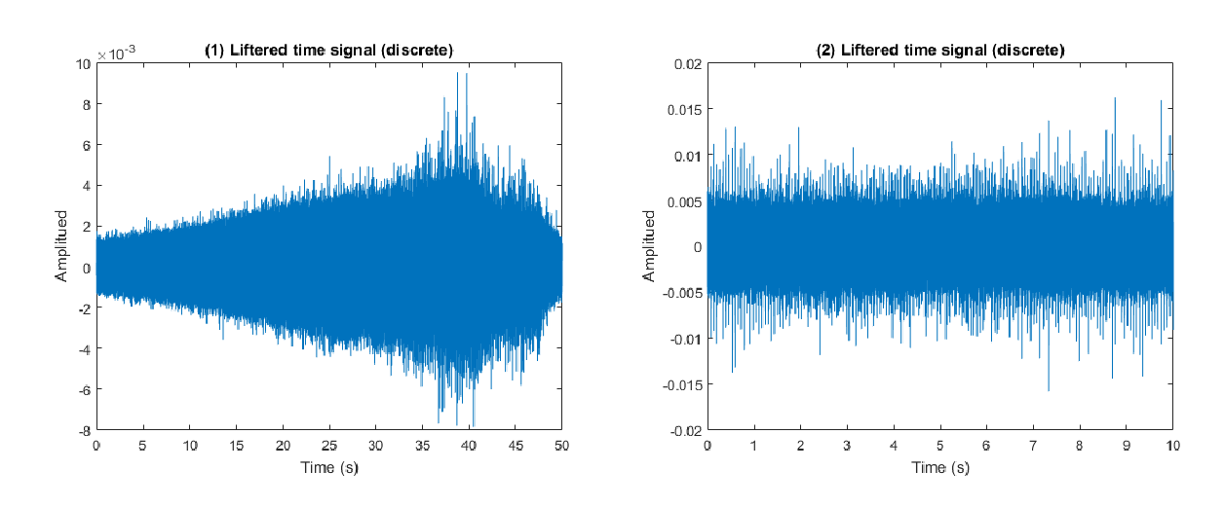
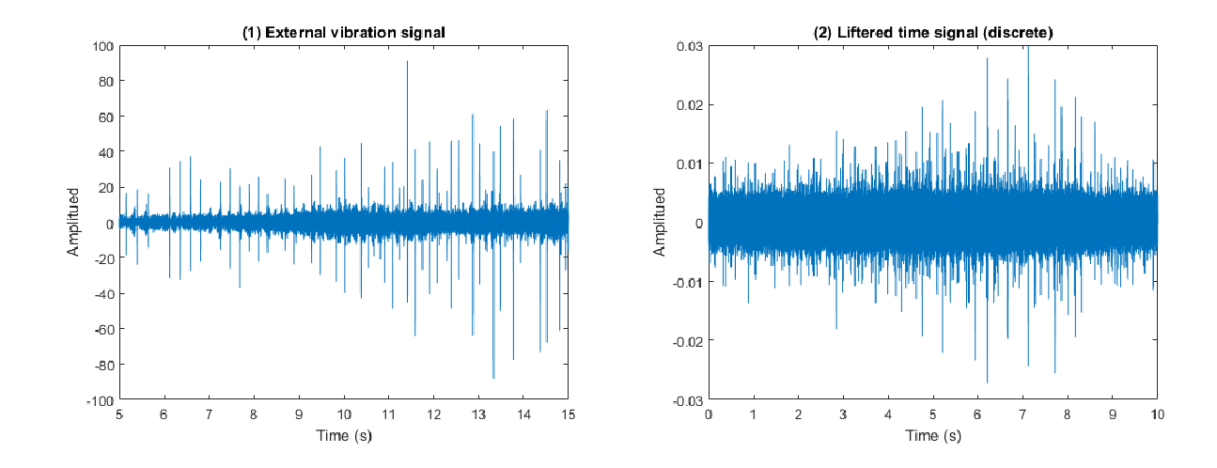
Progress to date

Slide 8
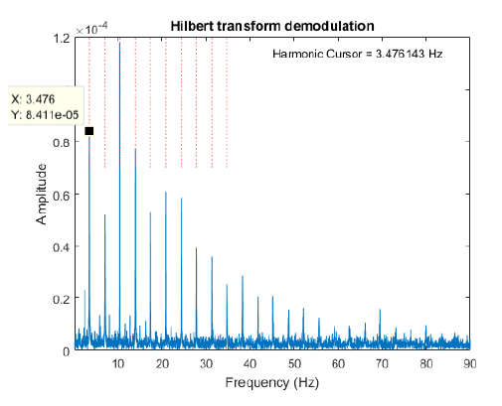
Progress to date

Slide 9
Progress to date

Slide 10
Conclusion and future work

