Slide 1
Soildiveragro analysis
Prediction of wheat yield and biodiversity

Slide 2
What do we want?
Soil characteristics, climate & management
Yield
16 indicators
Operator can predict
Biodiversity
pH_w, TOC, ,NtPav, SA, SI, CL, Mgex, Naex, Caex, Kex, EC, Agsd_b, Agsd_c, Agsd_d, Agsd_e

Slide 3
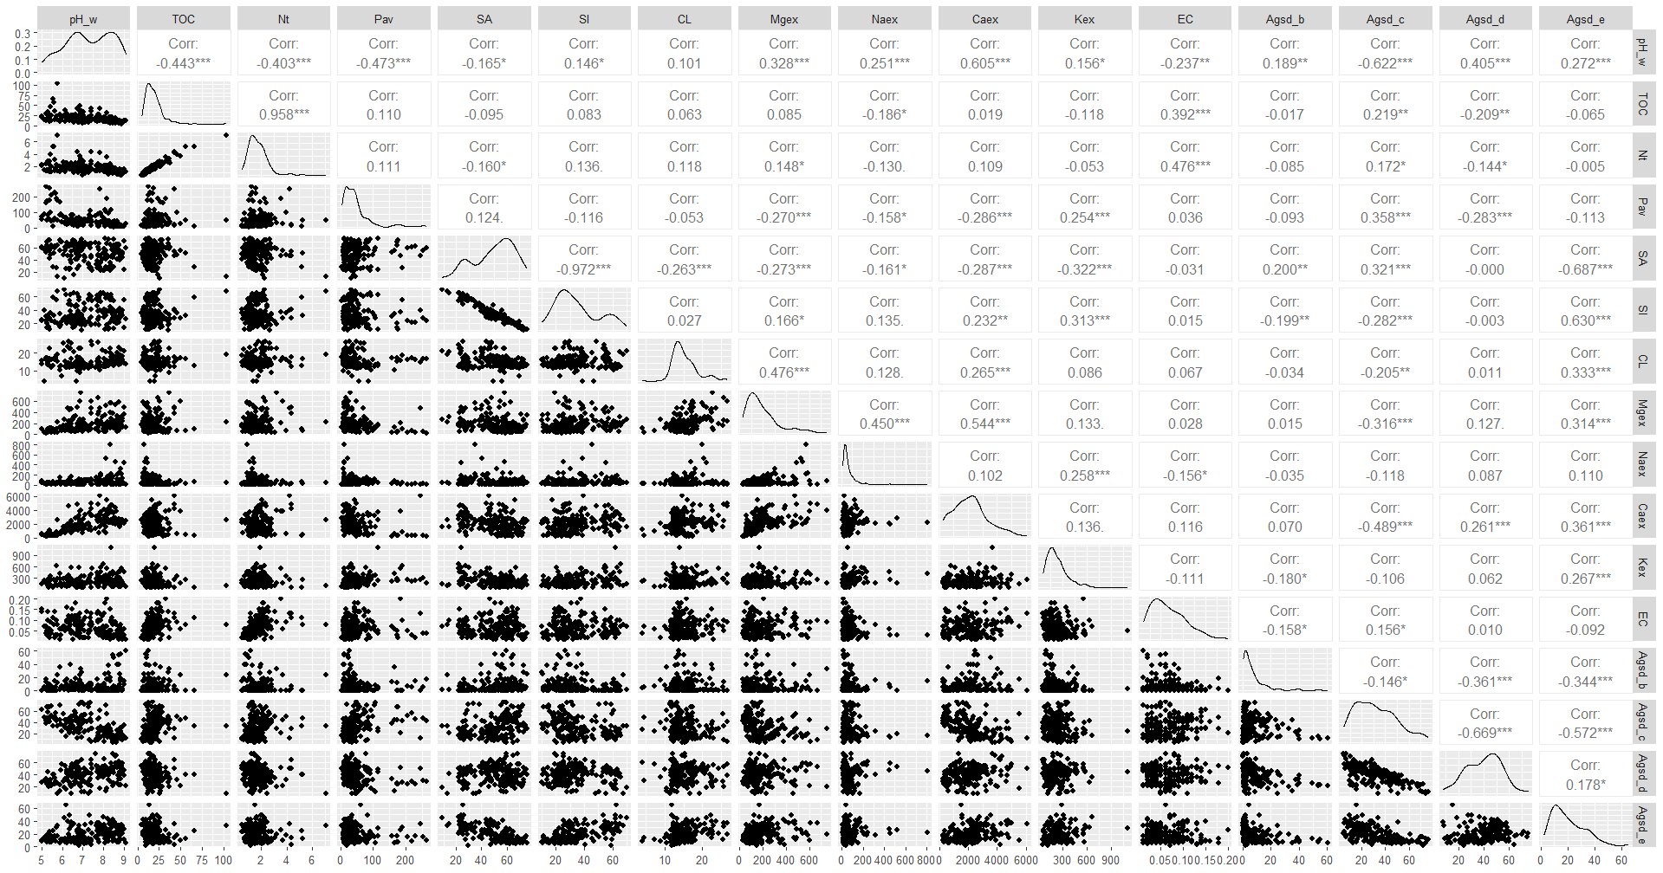
A couple of issues
Co-correlation
Not straightforward relations
What predictors?
What interactions?

Slide 4
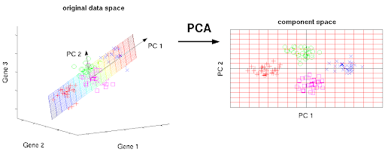
Dealing with co-correlation: PC regression
We do a PCA
Map from the observation to a component space
Regression on the component space
Question: how many components?

Slide 5
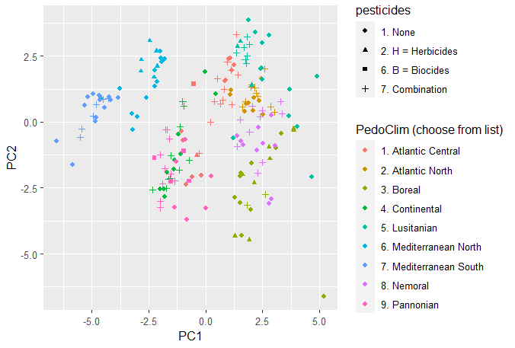
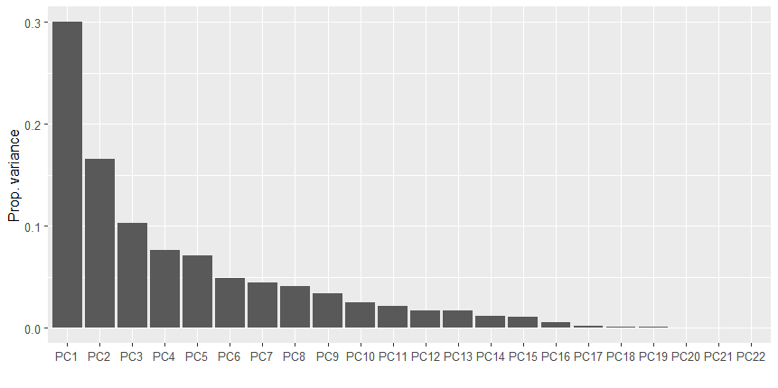
PCA

Slide 6
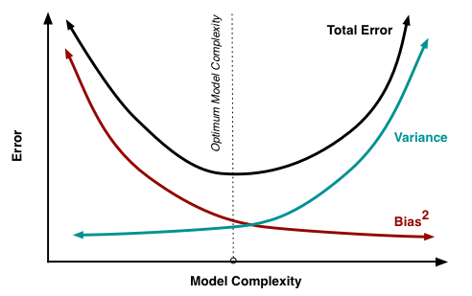
Dealing with model selection: stepwise AIC
Akaike Information Criterion (AIC):
Balances precision + parsimony (number of parameters)
We want max precision with highest parsimony
Stepwise AIC:
Starts with a model
Adds/removes parameters
Checks AIC of new models
Keep the one with the lowest AIC
Iterate

Slide 7
Models
Output | R2
Yield | 0.92
Fungal biod | 0.67
Bacterial biod | 0.83
Nema biod | 0.74
sq_yield ~ PC1 + PC2 + PC3 + PC4 + tillage + fertilization + pesticides + `PedoClim (choose from list)` + PC3:`PedoClim (choose from list)` + PC1:pesticides + PC4:`PedoClim (choose from list)` + PC2:fertilization
chao1 ~ PC1 + PC2 + PC3 + PC4 + tillage + fertilization + pesticides + `PedoClim (choose from list)` + PC3:tillage + PC4:`PedoClim (choose from list)` + PC1:fertilization
Chao1 ~ PC1 + PC2 + PC3 + PC4 + tillage + fertilization + pesticides + `PedoClim (choose from list)` + PC4:`PedoClim (choose from list)` + PC1:`PedoClim (choose from list)` + PC3:`PedoClim (choose from list)` + PC4:pesticides + PC3:tillage
chao1 ~ PC1 + PC2 + PC3 + PC4 + tillage + fertilization + pesticides + `PedoClim (choose from list)` + PC1:tillage + PC1:fertilization + PC4:pesticides + PC2:fertilization

