Slide 1

Improvement of object detection candidate certainty using redundant tracklets and situational information.
Mohammed Albhaisi
Supervisors:
Univ.-Prof. Dr.-Ing. Dirk Söffker
Waldemar Boschmann, M.Sc.
24. May 2023
Chair of Dynamics and Control (SRS)
University of Duisburg-Essen

Slide 2
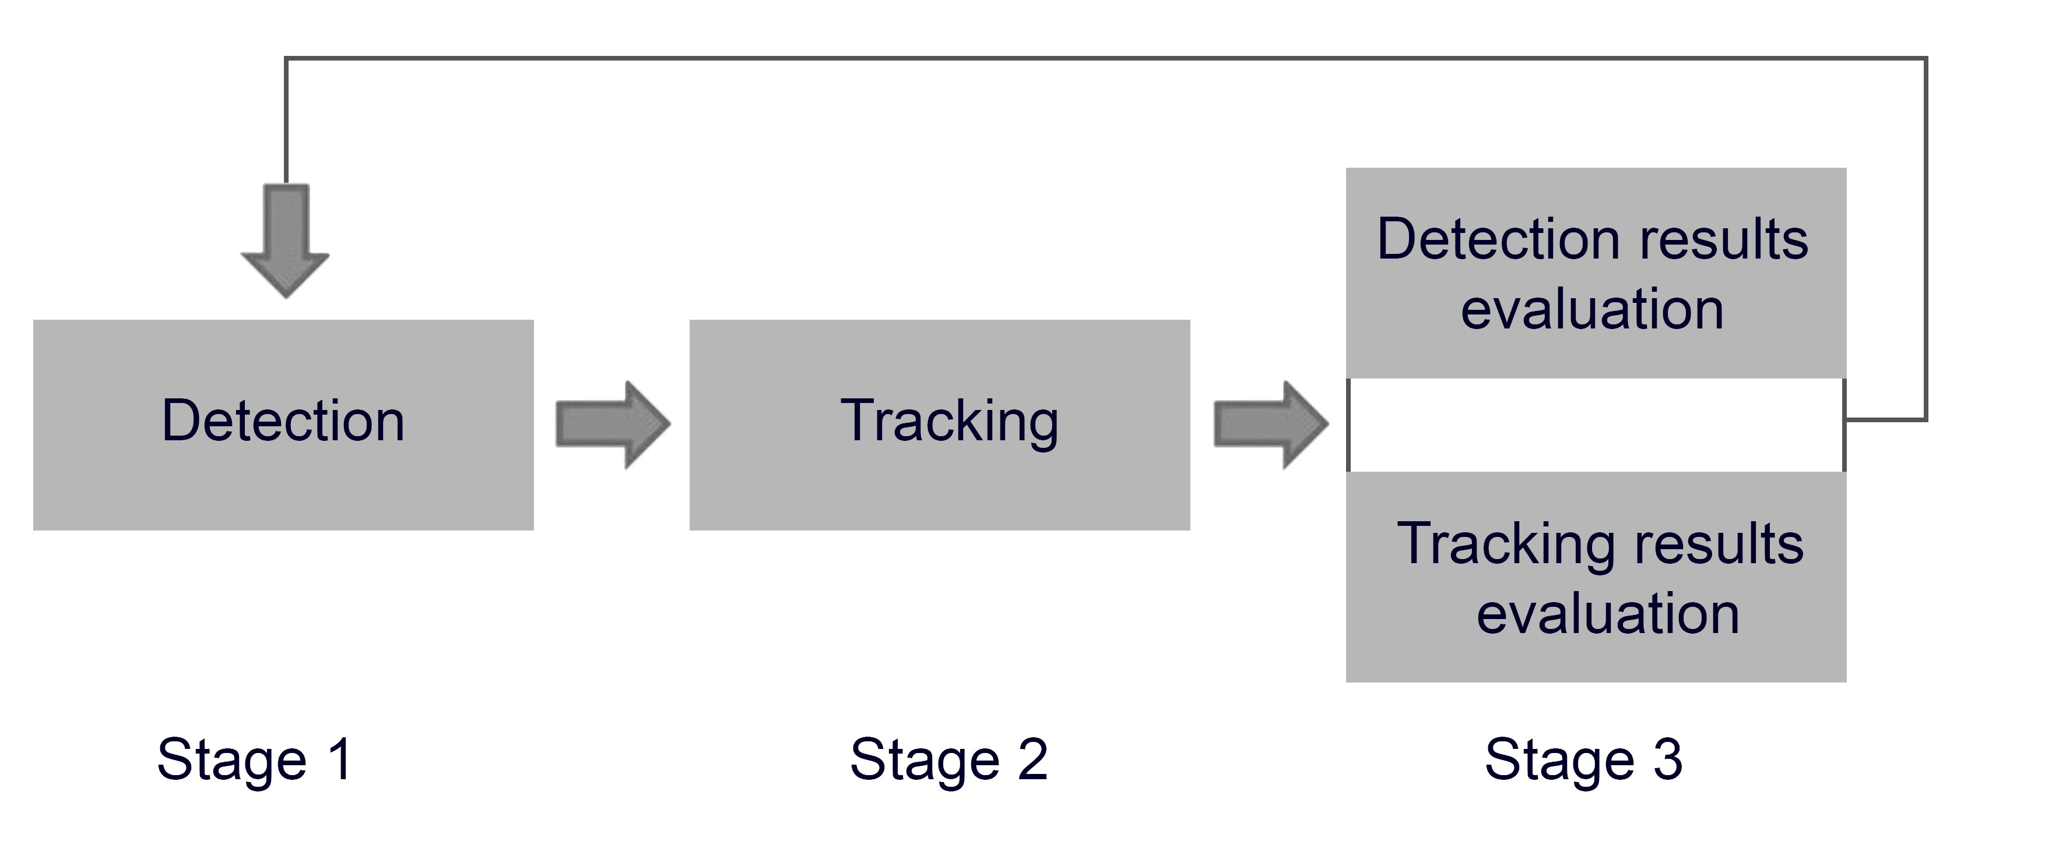
Motivation
2
Problem statement
The certainty of object detection approaches increasing
Lead to better decision-making and accident avoidance for Avs
Challenges
Object prediction
Uncertainty in the environment
Solution and goals
Redundant tracklets utilizing
Challenges handling
Task
The jointly work between object detection and tracking
Instances in different senarios tracking

Slide 3
Contents
3
Motivation
Theoretical background
Object detection
State-of-the-art
Object tracking
Multi object tracking
Immortal Tracker
Cross-validation
Evaluation metrics
Evaluation strategy
Introduction to dataset
Mmdetection3D
Experimental setup
Results and analysis
Summary, conclusion and outlook

Slide 4
Theoretical background: Object detection
4
State-of-the-art: detecting and localization objects within a video
State-of-the-art object detection
Pointpillar
Fast encoders
Sparse voxel of lidar point clouds
Centerpoint
Uses standard lidar-based backbone
Voxel divides a point cloud into equally spaced 3D voxels
Pillar representation of point clouds organized in vertical columns
Pointpillar and centerpoint are popular state-of-the-art in Avs

Slide 5
Theoretical background: Object Tracking
5
Multi object tracking: associating multiple objects according to object identites
Initially, unkown number of targets from a known set of classes must be tracked as bounding boxes.
The goal is to keep track of the identities and localization of multiple objects
Tracking by detection
In each fram, involves first detecting objects
Then track them across different frames
The tracking is done by matching object detections
Different methods such as Hungrian algorithm and Kalman filtering.
MOT can be used to improve the accuracy of object detection by providing additional information about the movement and location of multiple objects .

Slide 6
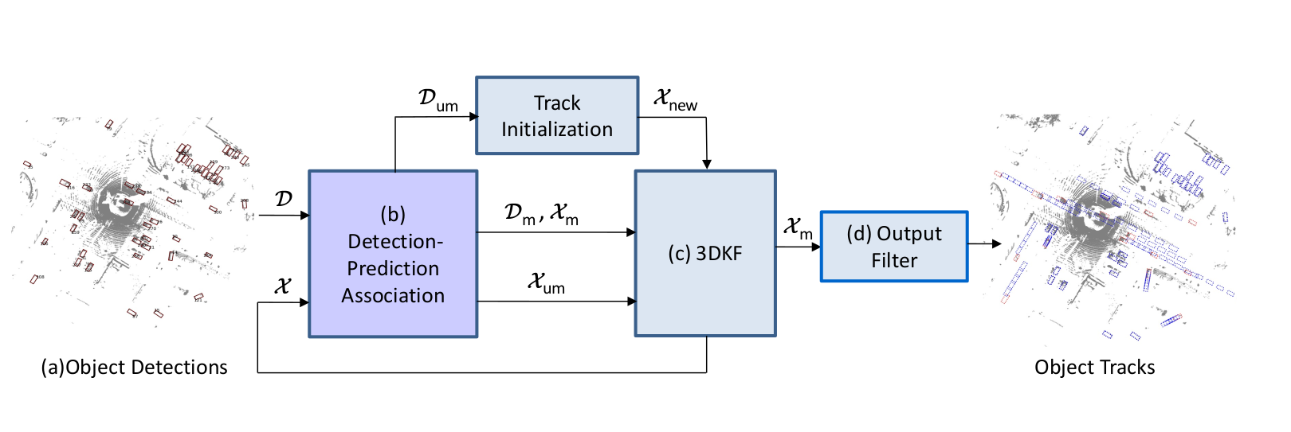
Theoretical background: Object Tracking
6
Immortal Tracker is built from a previous tracker called SimpleTrack paper
It preserves and maintains all tracklets for objects gone dark continuously
Immortal Tracker algorithm
Apply Non-Maximum Suppression (NMS):
Compute 3D IoU/GIoU
Perform Hungarian matching based on 3D IoU/GIoU
Vanila 3D Kalman filter for trajectory prediction
Matched detection used to update own tracklet
Unmatched detection used KF to predict next tracklet
Initially, all detections are Dum.
Immortal Tracker algorithm [Immortal Tracker, 2022]
Preseve tracklets from premature termination guaranteed using Immortal Tracker

Slide 7
Theoretical background: Cross-validation
7
Challenging: Models lose stability due to unbiased by unlucky distribution data
Task: Split the avaliable data into training and validation set
Used to evaluate the performance of object detection model
Type of cross-validation
LOOCV: 5 folds, 4 for training and one for validation
Useful when precise estimate of model performance important than computational cost of the method
E5CV: 5 folds, three folds for training, one for validation and fold for testing
Tests and learns all possible combinations of hyperarameters
Useful for selecting the optimal combination and improving the performance of the model.
Cross-validation is a powerful technique for evaluating the performance of predictive models and is widely used in machine learning researh and practice.

Slide 8

Evaluation metrics: Object detection metrics
8
Important definition
Precision
Recall
Matching criterion: 2D center distance thresholding
Decouple detection from object size and orientation
Small footprints, if detecte with a small trans error, give 0 IOU
Average precision: common metric used to measure the accuracy of detectors
Computes average precision recall value over the range[0,1]
Precision-recall curve over 10%
Finally, average over matching threshold of D= (0.5,1,2,4)m for set of classes C:
$$\frac{TP}{TP+FP}$$
$$\frac{TP}{TP+FN}$$
The common metric used for detction evaluation is mAP

Slide 9

Evaluation metrics: Object detection metrics
9
True positive metrics:
Average Translation Error (ATE): center distance in 2D in meters.
Average Scale Error (ASE): Calculated as 1 - IOU
Average Orientation Error (AOE): Smallest yaw angle difference between prediction and ground-truth in radians
Orientation error is evaluated at 360 degree for class car, pedestrian
Average Velocity Error (AVE): Absolute velocity error in m/s
Average Attribute Error (AAE): Calculated as 1 - acc
Each TP metric compute the mean TP metric over all classes:
Second metric is true positive metric used for detection evaluation

Slide 10

Evaluation metrics: Object detection metrics
10
mAP metric cannot capture all aspects of the nuScenes detection tasks (like velocity estimation)
Other methods defining threshold for each error type and recall threshold
nuScenes consolidating the different error types into a scalar score: The nuScenes detection score
Half of NDS based on the detection performance
Other half quantifies quality of the detections in terms of location, size, orientation, attributes, and velocity
Third main metric is nuScenes detection score (NDS)

Slide 11




Evaluation metrics: Object tracking metrics
11
Metrics for tracking evaluation
Metric | Formula | Worst | Description
Multi object Tracking Accuracy |  | 0 % | measure combines error sources FP, missed targets and IDs
Multi object Tracking Precision (m) |  | 2 m | misalignment between annotated and predicted bounding boxes
Average multi object Tracking Accuracy |  | 0 % | takes the average of MOTA across all recall thresholds
Average multi object tracking precision (m) |  | 2 m | average MOTP across all recall thresholds
Track initialization duration (TID) in sec | - | 20 s | measure initialization duration until first object was successfully detected
Longest gap duration (LGD) in sec | - | 20 s | measure how long an object has been missed
Multi object Tracking evaluation metrics used in nuScenes

Slide 12
Experimental setup:
12
Dataset selection: nuScenes
Object detection systems selection
Pointpillar
Centerpoint pillar02,voxel01 and voxel0075
Data splitting [done by other colleague]
Original splitting: 1 model
LOOCV: 5 models
E5CV: 10 models
Data training (4 arch & 3 splits, totally 64 models) [done by other colleague]
Detection results evaluation
Tracking results generation and evaluation
Start with results confusion

Slide 13
Evaluation strategy: Introduction to dataset
13
Mashine learning methods need to be trained and evaluated on dataset include range sensor data
nuScenes large-scale autonoumous driving dataset
850 scenes, 700 train, 150 val- around 40 frames every scene
Each scene comes with a set of information
Different times, locations, weather condistions, lidar, visibility, .. etc.
10 object classes used in detection task based on lidar data
Car, pedestrian, bicycle, motorcycle, barrier, cone, bus, construction vechicle, trailer, and truck
Range 50m for car
NuScenes dataset is a large-scale Avs driving dataset used in train and evaluate task

Slide 14
Evaluation strategy: Mmdetection3D
14
MMdetection3d: an open-source object detection toolbox based on PyTorch
300+ models, methods of 40+ papers, and modules supported in MMDetection
LiDAR-based 3D detection in MMDetection3D
Input: Expects the given model to take any number of points with features collected by LiDAR
Predict the 3D bounding boxes and category labels for each object of interest
Prepare data, train, and test a model on a standard 3D detection benchmark using e.g., PointPillar
Visualize and validate the results
Mmdetection3D trains faster than other
codebases
MMDetection 3D outdoor [MMDetection3D,2020]
MMdetection3D tool used in data training task

Slide 15
Results: Detection results
15
Mean average precision, set of the five mean TP metrics and NDS
The results can be started to comparing and see which results are better than other
Detection architecture | mAP | mATE | mASE | mAOE | mAVE | mAAE | NDS
PointPillar | 0.3487 | 0.4402 | 0.2840 | 0.5124 | 0.3396 | 0.1779 | 0.4989
Pillar 02 | 0.3898 | 0.3240 | 0.2647 | 0.3693 | 0.3916 | 0.1962 | 0.5403
Voxel 01 | 0.5144 | 0.2979 | 0.2545 | 0.3170 | 0.2888 | 0.1929 | 0.6221
Voxel 0075 | 0.5076 | 0.2912 | 0.2536 | 0.3103 | 0.2678 | 0.1965 | 0.6218
All models have been evaluated using mAP, TP metrics, and NDS and can be started to confuse them

Slide 16
Results: Tracking results
16
Firstly, overall system tracking results
All scene evaluation
Approach | MOTA | MOTAR | MOTP (m) | AMOTA | AMOTP (m) | IDS | TID (s) | LGD (s) | Rec | FP | FN
PointPillar | 0.2892 | 0.6307 | 0.4413 | 0.3454 | 0.7793 | 408 | 0.7188 | 1.1497 | 0.4399 | 16359 | 35553
Voxel 01 | 0.5530 | 0.7993 | 0.3709 | 0.6553 | 0.6139 | 463 | 0.5692 | 0.8122 | 0.6869 | 13860 | 23194
Voxel 0075 | 0.5446 | 0.8039 | 0.3573 | 0.6449 | 0.6204 | 332 | 0.5939 | 0.8126 | 0.6727 | 12365 | 23643
Pillar 02 | 0.4568 | 0.7669 | 0.3639 | 0.5375 | 0.6586 | 472 | 0.6565 | 0.9600 | 0.5869 | 13853 | 27676
Four tracking results generated using immortal tracker and evaluated.
The results can be confused with other. Best tracker Voxel01, lowest IDs voxel0075

Slide 17
Results: Tracking results
17
Secondly, every scene evaluation
Scene with good result for class car
Approach | MOTA | MOTAR | MOTP (m) | AMOTA | AMOTP (m) | IDS | TID (s) | LGD (s) | Rec | FP | FN
PointPillar | 0.898 | 0.919 | 0.313 | 0.916 | 0.337 | 0 | 0.25 | 0.25 | 0.977 | 7 | 2
Voxel 01 | 0.989 | 0.989 | 0.255 | 0.995 | 0.216 | 0 | 0 | 0 | 1 | 1 | 0
Voxel00 75 | 1 | 1 | 0.222 | 1 | 0.197 | 0 | 0 | 0 | 1 | 0 | 0
Pillar 02 | 0.966 | 0.988 | 0.291 | 0.971 | 0.292 | 0 | 0.25 | 0.25 | 0.977 | 1 | 2
Every scene has been tracked using redundant tracklets and then evaluated to make it easy to know which scenes have bad results and which have good results

Slide 18
Results: Tracking results
18
Secondly, every scene evaluation
Complex scene, most IDS in pointpillar
Approach | MOTA | MOTAR | MOTP (m) | AMOTA | AMOTP (m) | IDS | TID (s) | LGD (s) | Rec | FP | FN
PointPillar | 0.584 | 0.704 | 0.455 | 0.662 | 0.699 | 17 | 0.383 | 0.65 | 0.872 | 98 | 51
Voxel 01 | 0.737 | 0.845 | 0.364 | 0.713 | 0.543 | 3 | 0.45 | 0.633 | 0.88 | 54 | 48
Voxel 0075 | 0.719 | 0.837 | 0.326 | 0.712 | 0.509 | 1 | 0.448 | 0.638 | 0.862 | 56 | 55
Pillar 02 | 0.652 | 0.788 | 0.358 | 0.632 | 0.619 | 1 | 0.75 | 0.893 | 0.83 | 70 | 68
Scenes with most IDS for different approaches.

Slide 19
Results: Tracking results
19
Secondly, every scene evaluation
Worst result
Approach | MOTA | MOTAR | MOTP (m) | AMOTA | AMOTP (m) | IDS | TID (s) | LGD (s) | Rec | FP | FN
PointPillar | 0 | 0 | 1.055 | 0 | 1.561 | 0 | 0.25 | 0.5 | 0.714 | 45 | 2
Voxel 01 | 0.286 | 0.5 | 0.63 | 0.263 | 1.281 | 0 | 0 | 0.5 | 0.571 | 2 | 3
Voxel 0075 | 0.286 | 0.4 | 0.684 | 0.27 | 1.11 | 0 | 0 | 0 | 0.714 | 3 | 2
Pillar 02 | 0 | 0 | 0.903 | 0 | 1.424 | 0 | 0 | 1 | 0.429 | 11 | 4
Scene with worst result for all approaches

Slide 20
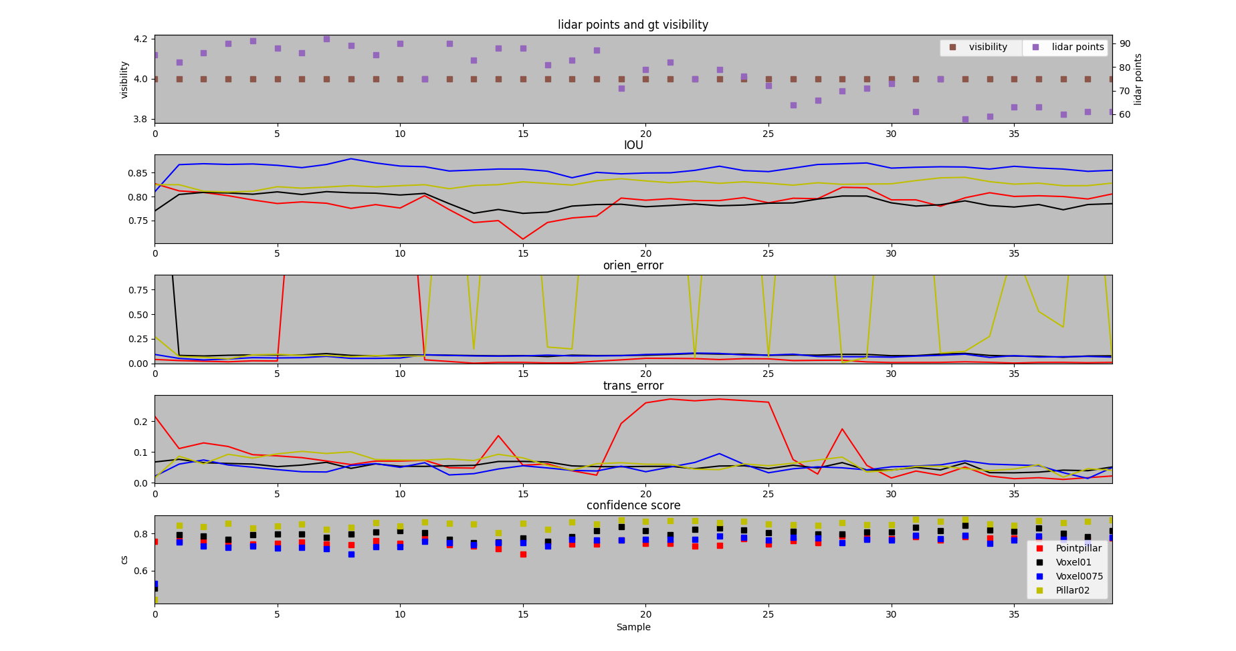
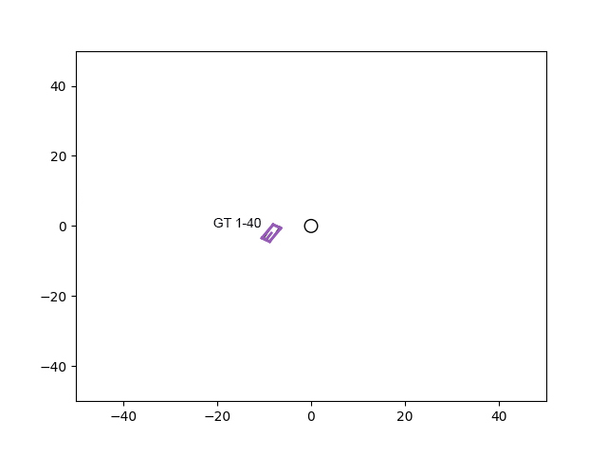
Results: Tracking results examples
20
Example 1: instance with good result
Stationary car near ego
Different trackers used for track the same object

Slide 21
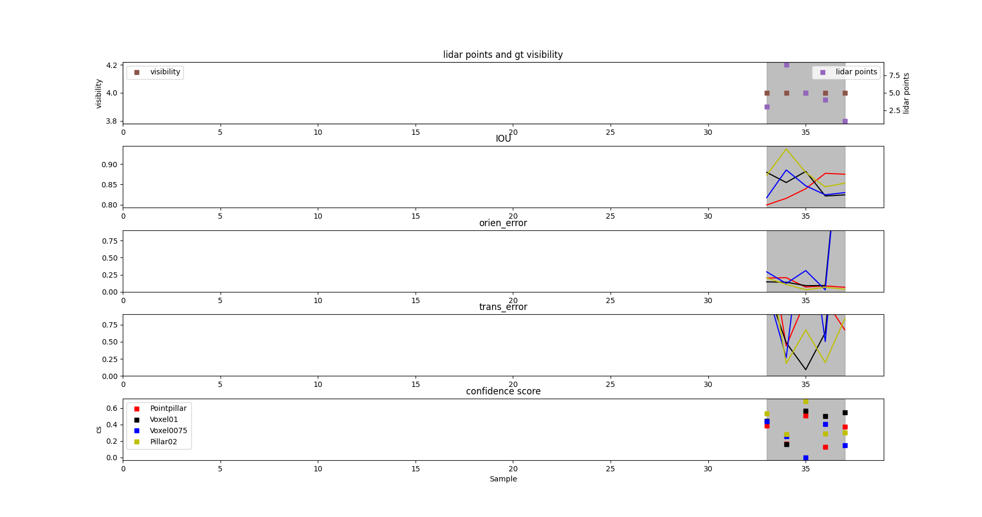
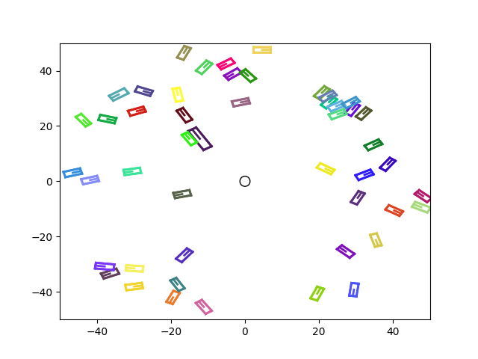
Results: Tracking results examples
21
Example 1: worst result
7 gt
from sample 0 to 30 no gt
just number of fn and fp
Good visibility, but bad lidar points
Scene with worst result example, bad lidar ponts, high number fp and fn, high tran error, lead to low cs

Slide 22
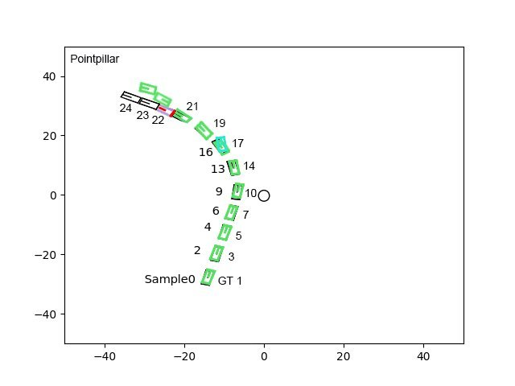
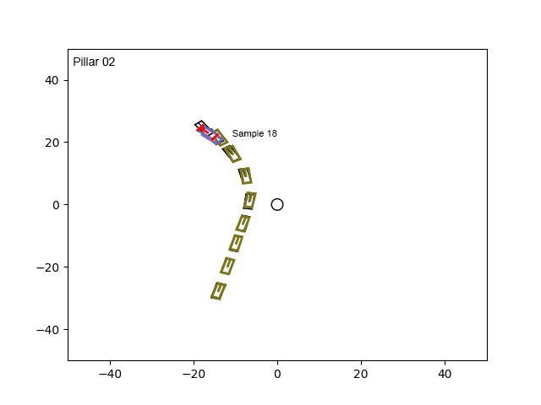
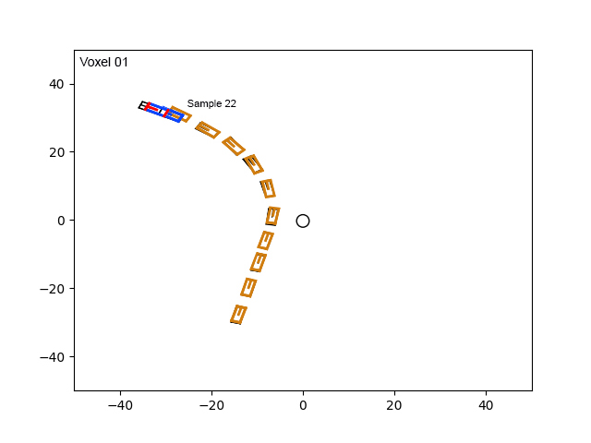
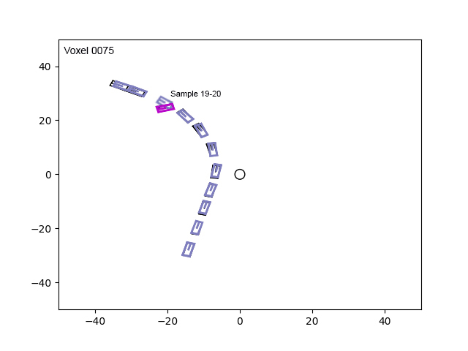
Results: Tracking results examples
22
Example 3: Some trackers can fail to track instance while other have tracked it successfully till end
It is difficult to keep track instances as orientation changed which can lead to high orientation errors or to ids, and therefore to decrease cs.

Slide 23
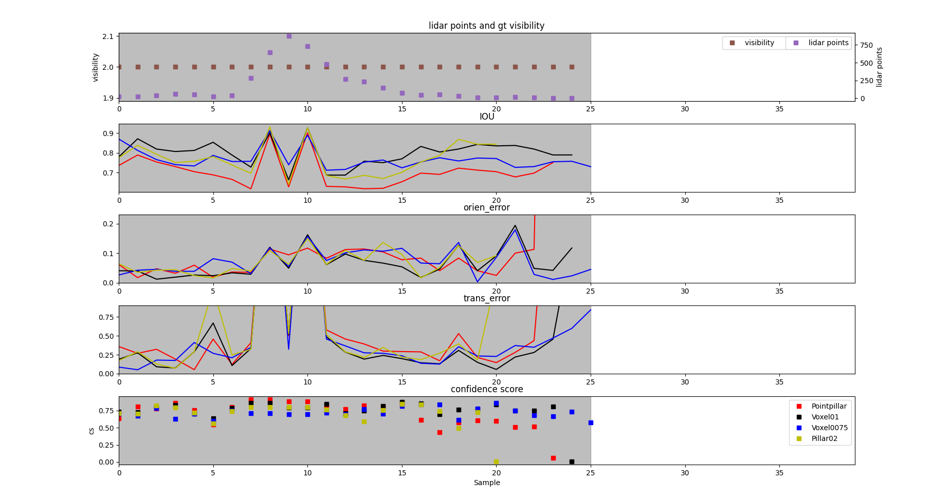
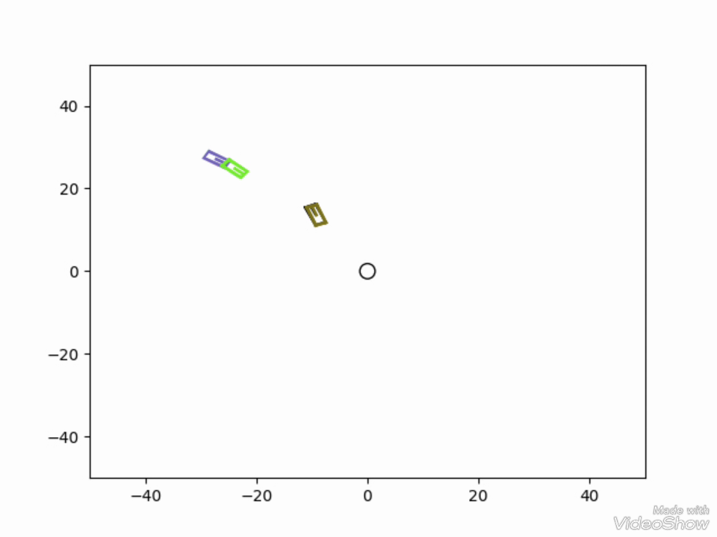
Results: Tracking results examples
23
Example 3: Car turned and identity switch occoured
Important to handle orientation error
Some trackers can fail to track instance while other can track it successfully till end

Slide 24
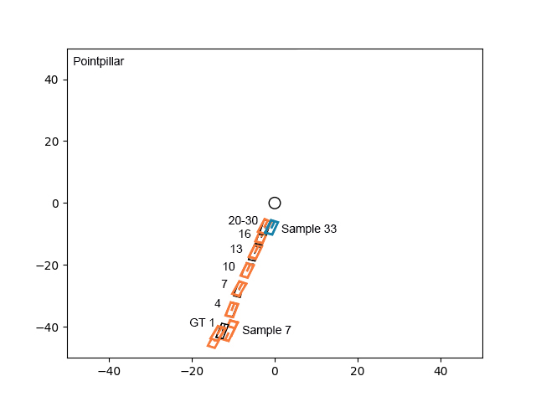
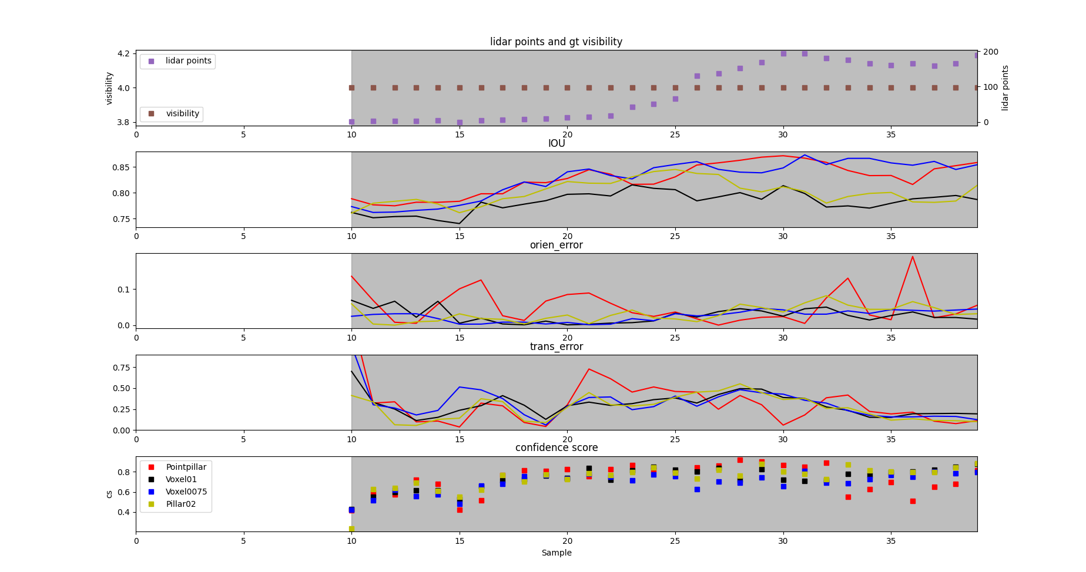
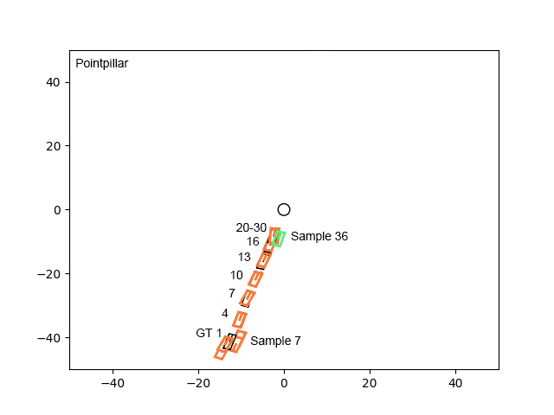
Results: Tracking results examples
24
Example 4: Car moved toward ego and parked there
As another tracker comes near from particular tracker, confidence score becomes lower

Slide 25
Summary, conclusion and outlook
25
Summary
Increasing detection certainty lead to increase safety of Avs
Evaluation results using different metrics
Challenges handling helps to increase the confidence score
Conclusion
Redundant tracklets can aid in improving the performance of object detection
Lead to robust object detection, especially in complex senarios
Can be used to address diffecult challenges such as changing in orientation, reducing the number of fps and fns
Outlook
Develope algorithms that address challenges
Integration of redundant tracklets from different modalities
Development of datasets and evaluation metrics
Redundant tracklets can lead to more accurate and robust detection systems, especially in difficult and complex senarios

Slide 26
Thank you for your attention.
26

