Slide 1
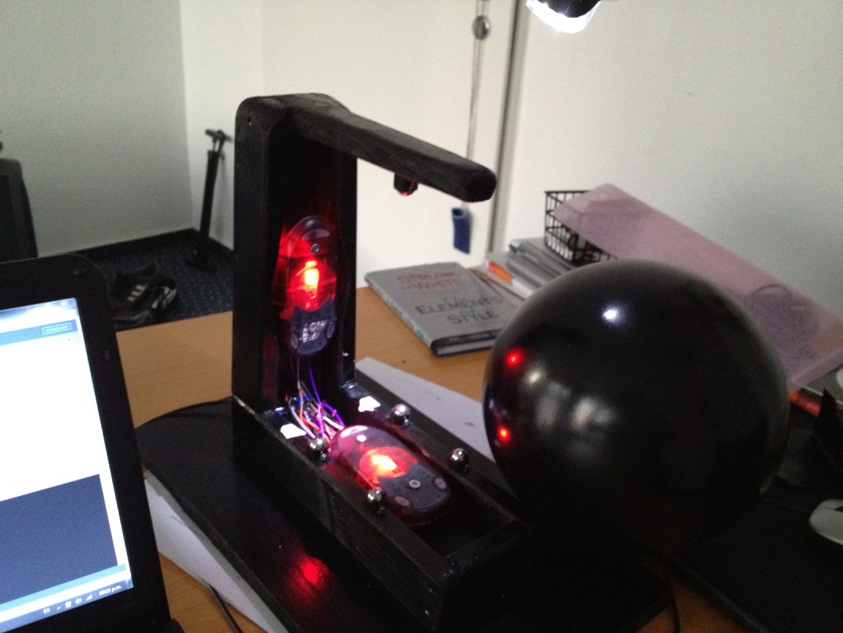
MATERIALS
1 Arduino board
1 ball (10 cm diameter)
2 mice (ADNS-2610 optical sensor)
Wood case
5 caster balls

Slide 2
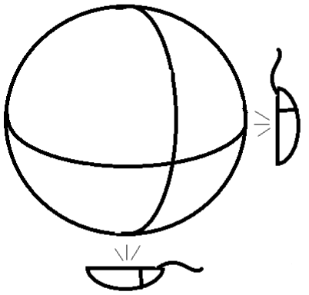

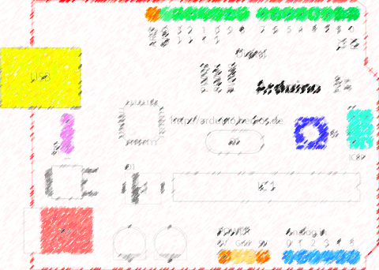


SCHEMA
Serial communication
Client
Server

