Slide 1



TECHNICAL OPERATIONS
© Gruppo Euris spa – Confidential & Proprietary

Slide 2


AperiTech. Renew your .NET

Slide 3

Blue print
The AperiTech will deal with the evolutions that C# and.NET have faced over time and through the use of a program will be shown the main changes that have transformed the architecture of the code.

Slide 4



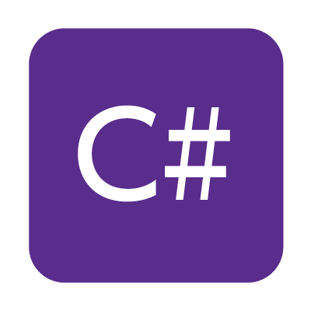



Agenda
History
Not Mentioned Milestones
Code Introduction
Git History
Documentation
Questions and Answers

Slide 5
History

Slide 6
History
C# 2.0 released in 2005 and it moved from a generic to object-oriented language.
Thi version introduces generics types.
2.0 includes iterators that enhanced programmers ability to read th language.
Addition features included partial types, anonymous methods, nullable value types and covariance and contravariance.
C# was created for Microsoft’s internal use in 2002, alongside Visual Studio.
This modern object oriented language shared key similarities to Java.
Included classes, structs, interfaces, events, properties, delegates, operators, expressions, statements, attributes
The fourth version was released in 2010.
Other features included the addition of dynamic keyword (binding), named/optional arguments and generic covariance and contravariance
C# 1.0
C# 2.0
C# 4.0
2002
2003
2005
2007
2010
2012
C# 1.2
C# 3.0
C# 5.0
C# 1.2 released 2003, it contained a few small enhancements to the language.
The code generated in a foreach loop called Dispose on an IEnumerator when that IEnumerator implemented IDisposable.
Released in 2007, 3.0 began to truly diverge from Java
It's thought that C# version's killer feature was the query expression, also known as Language-Integrated Query (LINQ).
C# included features like auto-implemented properties, anonymous types, query expressions, lambda expressions, expression trees, extension methods, implicitly typed, local variables (var) and object and collection initializers
C# 5.0 was released in 2012, with a focus on asynchronous programming.
The “async and await” updates were introcuced, enhancing the language’s ability to run long operationg codes.
Caller info attributes were another important feature, with made retrieving context easier.
Notes:
© Copyright PresentationGO.com – The free PowerPoint and Google Slides template library

Slide 7
History
C# 8.0 was released in 2019, adding CLR capabilities and library types in .Net Core.
Features included default interface methods, readonly members, static local fanctions, using declarations, and nullable reference types.
The lastest version of C# was released in November 2022.
It included record struct, global using, file scoped namespaces, extended property patterns and record types can seal ToString()
C# was released in 2015, boastring cleaner and simpler code.
Features such as static imports, null propagation operator, and index initializers made inputting code easier.
C# 6.0
C# 8.0
C# 10.0
2015
2017
2019
2020
2022
2023
C# 7.0
C# 9.0
C# 11.0
The 7th version was released in 2017, allowing developers to write cleaner code than ever.
For the first time, C# could be used with operating systems for loud and .NET core.
C# 7.0 comes with many subversions:
7.1 async Main method, default literal expressions.
7.2 private protected access modifier, fixed statement.
7.3 enable safe code to be as performant as unsafe code.
The 9th version of C# was released in Sptember 2020.
Novel features included record, init only setters, top-level statements, pattern matching enhancements and more.
Coming soon …
Notes:
© Copyright PresentationGO.com – The free PowerPoint and Google Slides template library

Slide 8
Not Mentioned Milestones

Slide 9
Not Mentioned Milestones
Name | Version
Generics | C# 2.0
Covariance and Contravariance | C# 2.0
Generic Covariance and Contravariance | C# 4.0
LINQ | C# 3.0
Asynchronous members | C# 5.0
Tuples | C# 7.0

Slide 10
Code
Introduction

Slide 11
Date Transefer Object (DTOs)
0 - 9
The application DOMAIN is represented by a single DTO called SHAPE.
0 - 9
Type | Name | Permitted Values
int | Id | [0, 1, 2, 3, 4, 5 ,6 ,7 ,8 , 9]
int | Angles | [0, 4]
string | Color | [R, G, B, NULL]
0 - 9
0 - 9
0 - 9
0 - 9
0 - 9
0 - 9

Slide 12
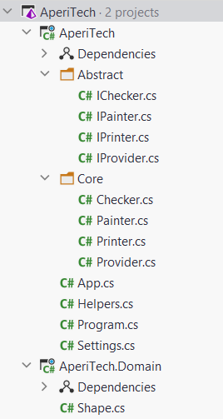
Architecture
SOLUTION
1st PROJECT
CONSOLE APP
INTERFACES
CORE
BOOTSTRAP
STATIC
2nd PROJECT
CLASS LIBRARY
DTO

Slide 13

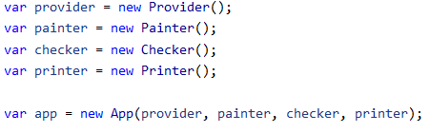

Application Startup
The application bootstrapping is demand to two classes, Program and App.
Program.cs
Main
App.cs
DI
Run
Welcome
PROVIDER
App.Run()
PAINTER
Wait
CHECKER
SeeYouSoon
PRINTER

Slide 14
APPLICATION FLOW
The conceptual flow is the following:
Provider: the GET method instantiate Shape objects without valorized Color property, it is set to NULL.
Painter: it valorized Color property with one of the three primary colors, but somewhere it missing and leave NULL
Checker: it has its own list of valid colors, with Color property valorized, and compare it with the input shapes, verify it is present in valid list and return.
Printer: In base of input shape it write to console a message
20% NULL
 | Message
 | ID={Id} SQUARE is red
 | ID={Id} CIRCLE is red
 | ID={Id} SQUARE is yellow/blue
 | ID={Id} CIRCLE is yellow/blue

Slide 15
APPLICATION FLOW
Provider
Painter
Checker
Printer
Get
Paint
Check
Printer
FOREACH
WHILE
FOREACH
FOREACH
NEW SHAPE
SET COLOR
EQUALITY
CONSOLE
CONSOLE
CONSOLE
CONSOLE
ACCUMULATE
ACCUMULATE
PRINT
SLEEP
SLEEP
SLEEP
SLEEP
15

Slide 16
GIT History

Slide 17
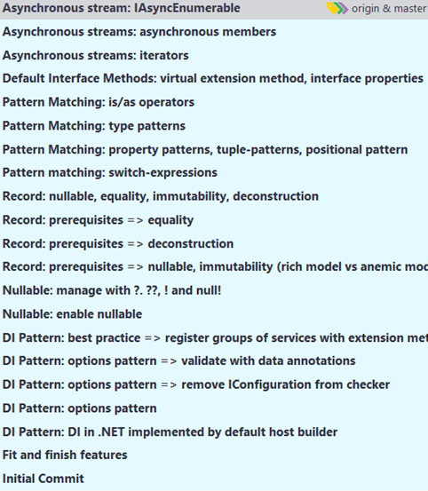
GIT HISTORY
ASYNCHRONOUS STREAM
DEFAULT INTERFACE METHOD
iterators
asynchronous stream
8
7
PATTERN MATCHING
6
property patterns
tuple patterns
position patterns
type patterns
is/as operator
RECORD
5
deconstruction
nullable, immutability
equality
record
NULLABLE
4
nullable enable
?, ??, !, null!
DI PATTER
string interpolation
declarative using
static local functions
auto property
file scoped namespaces
3
options pattern
validation
INITIAL COMMIT
FINISH FEATURES
1
2

Slide 18
Documentation

Slide 19
DOCUMENTATION
MAIN PAGES:
https://docs.microsoft.com/en-us/aspnet/core/
https://docs.microsoft.com/en-us/dotnet/
https://docs.microsoft.com/en-us/dotnet/csharp/
NEWS:
https://docs.microsoft.com/en-us/dotnet/csharp/whats-new/csharp-version-history
https://docs.microsoft.com/en-us/dotnet/csharp/whats-new/csharp-8
https://docs.microsoft.com/en-us/dotnet/csharp/whats-new/csharp-9
https://docs.microsoft.com/en-us/dotnet/csharp/whats-new/csharp-10
REFERENCES:
https://docs.microsoft.com/en-us/dotnet/csharp/language-reference/
https://docs.microsoft.com/en-us/dotnet/csharp/programming-guide/
https://docs.microsoft.com/en-us/dotnet/api/
TUTORIALS:
https://docs.microsoft.com/en-us/dotnet/csharp/fundamentals/types/
https://docs.microsoft.com/en-us/dotnet/core/tutorials/top-level-templates
https://docs.microsoft.com/en-us/dotnet/csharp/whats-new/tutorials/records
https://docs.microsoft.com/en-us/dotnet/csharp/whats-new/tutorials/patterns-objects
https://docs.microsoft.com/en-us/dotnet/csharp/whats-new/tutorials/default-interface-methods-versions
https://docs.microsoft.com/en-us/dotnet/csharp/whats-new/tutorials/mixins-with-default-interface-methods
https://docs.microsoft.com/en-us/dotnet/csharp/whats-new/tutorials/generate-consume-asynchronous-stream
https://docs.microsoft.com/en-us/dotnet/csharp/whats-new/tutorials/interpolated-string-handler

Slide 20
Q&A

Slide 21
Thanks
for watching

