Slide 1

CSS
Notes:
The World Wide Web became popular because ordinary people can use it to do really useful things with minimal training. But behind the scenes, the Web is also a powerful platform for distributed computing.
The principles that make the Web usable by ordinary people also work when the “user” is an automated software agent.
The Web is based on three technologies:
the URL naming convention,
the HTTP protocol,
HTML document format.
For now, I want to focus on URL and HTTP, and use HTML solely as an example.

Slide 2
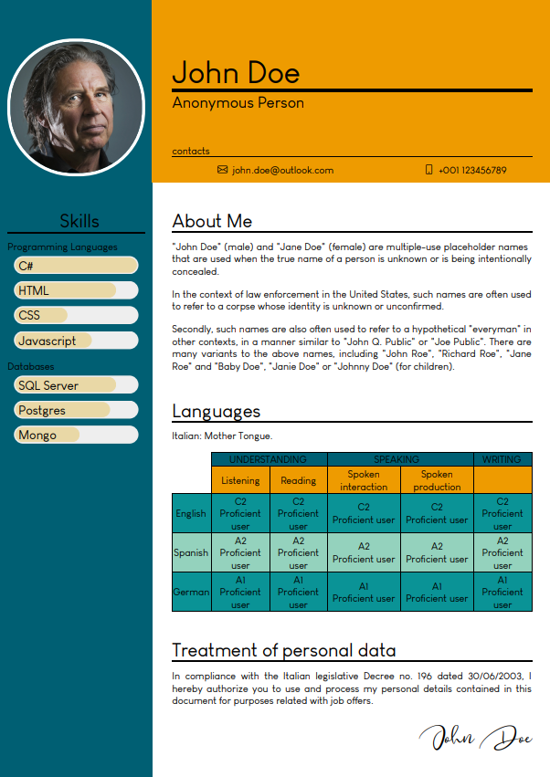
CSS | Curriculum Vitae

Slide 3
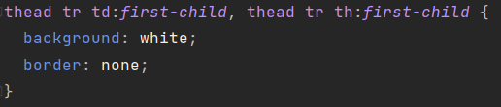

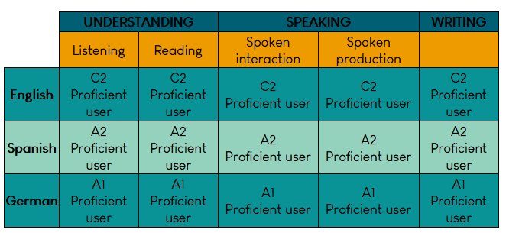



CSS | Advanced Selector
colspan=“2”

Slide 4
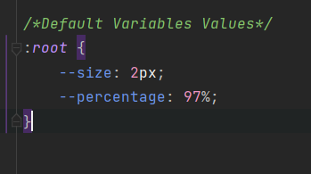
CSS | Variables
Declare Variable inside style element:
Use Variable in CSS file:
Default variables value

Slide 5
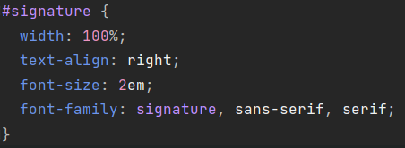


CSS | custom fonts
Web fonts allow Web designers to use fonts that are not installed on the user's computer.
Your "own" fonts are defined within the CSS @font-face rule.

Slide 6
CSS | custom fonts
Different Font Formats
TrueType Fonts (TTF)
OpenType Fonts (OTF)
The Web Open Font Format (WOFF)
The Web Open Font Format (WOFF 2.0)
SVG Fonts/Shapes
Embedded OpenType Fonts (EOT)
https://www.dafont.com/it/

Slide 7
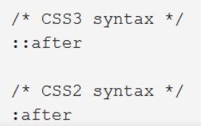

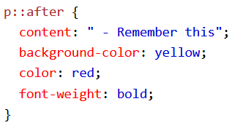
CSS | ::after ::before
The ::after selector inserts something after the content of each selected element(s).
The ::before selector inserts something before the content of each selected element(s).
Use the content property to specify the content to insert.

Slide 8

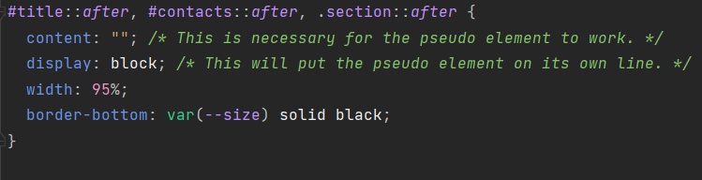

CSS | underline

Slide 9
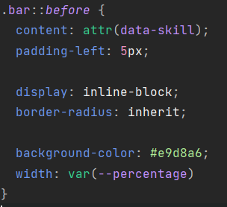

CSS | bar

Slide 10
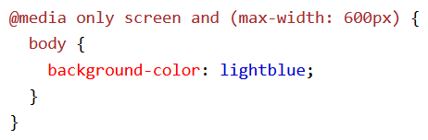
CSS | @media Rule
The @media rule is used in media queries to apply different styles for different media types/devices.
Using media queries are a popular technique for delivering a tailored style sheet (responsive web design) to desktops, laptops, tablets, and mobile phones.
You can also use media queries to specify that certain styles are only for printed documents or for screen readers.
Mediatypes:
Print
Screen
Speech
Change the background color of the <body> element to "lightblue" when the browser window is 600px wide or less:

Slide 11

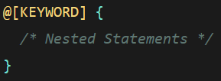

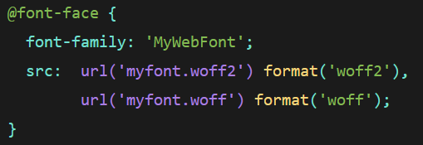
CSS | at-Rules (@-Rules)
The at-rule is a statement that provides CSS with instructions to perform or how to behave.
Each statement begins with an @ followed directly by one of several available keywords that acts as the identifier for what CSS should do.
Regular Rule
Nested Rule

Slide 12
CSS | repo
https://github.com/aviezzi/john-doe

