Slide 1

Krishna Maruti Limited (Seat-4)
Company Overview

Slide 2
Table of Contents
Introduction to Group Profile
Plant Locations & message from management
Our Vision, Core Value & Mission
Introduction for Company Profile & Products along with its variants/ Product Range, Major Customers etc.
Plant Layout
2/19

Slide 3

Introduction to Group Profile

Slide 4
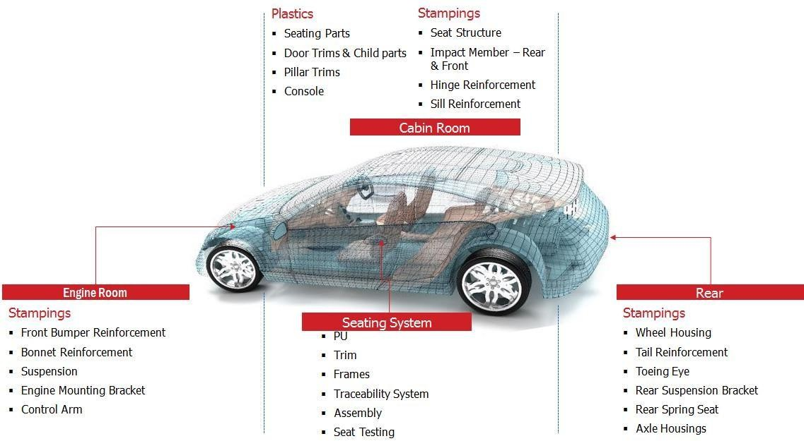
Introduction to Group Profile

Slide 5
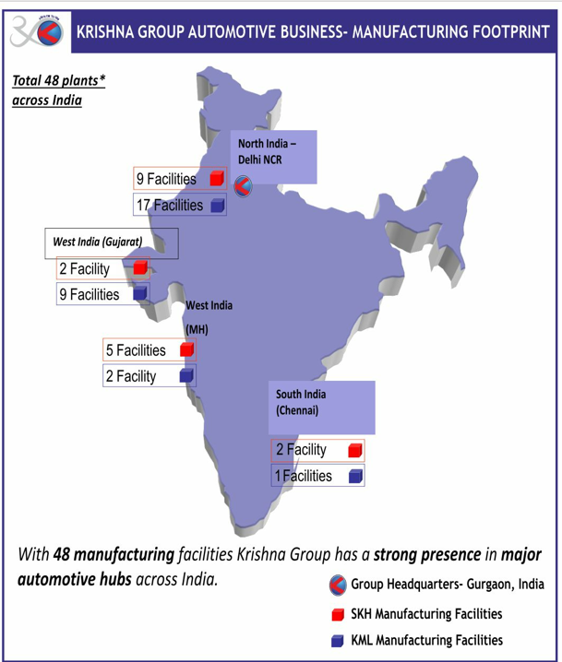
Plant Locations

Slide 6
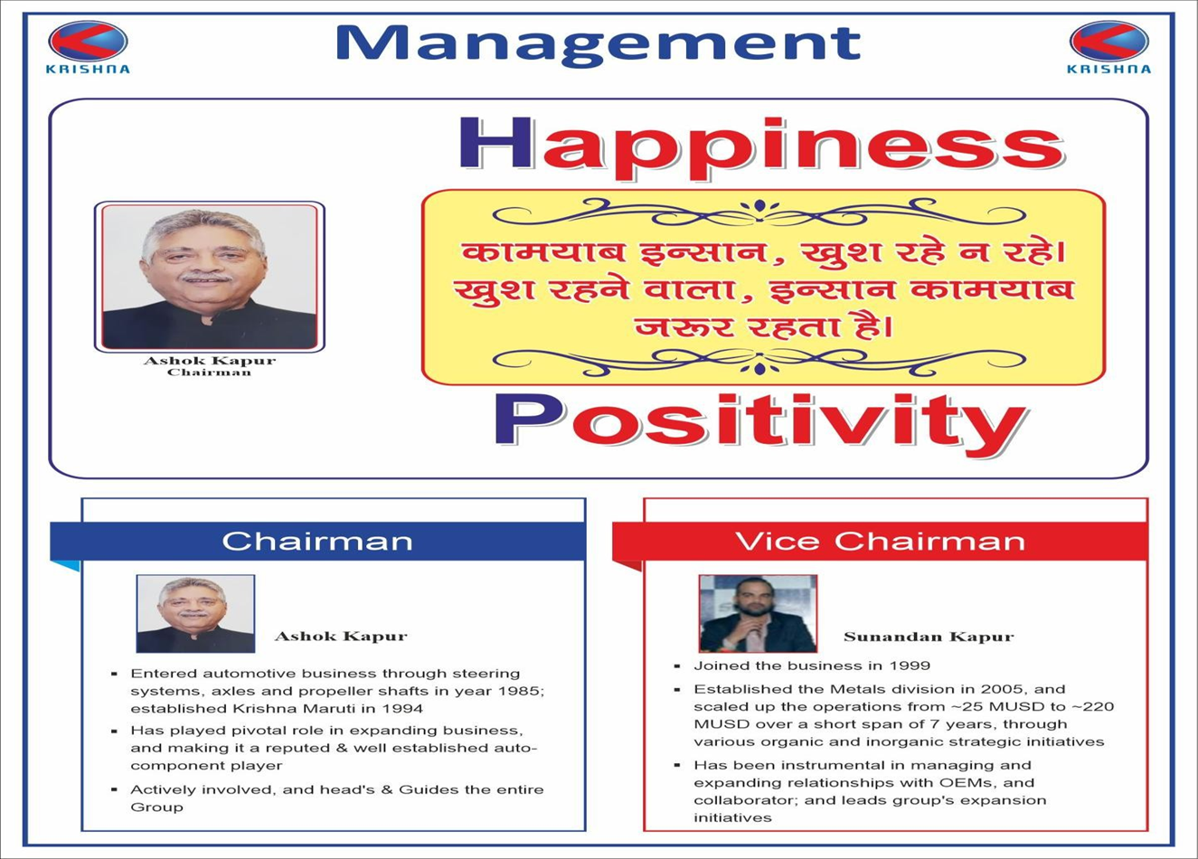
Message from Management

Slide 7


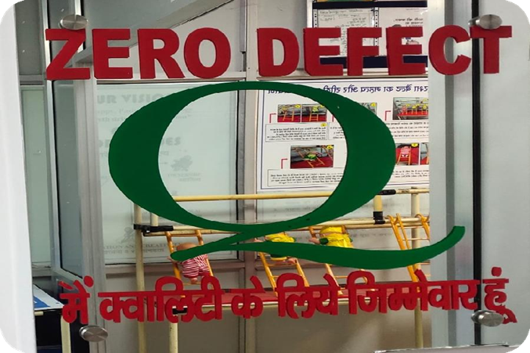
Our Vision, Core Value & Mission
Our Mission

Slide 8
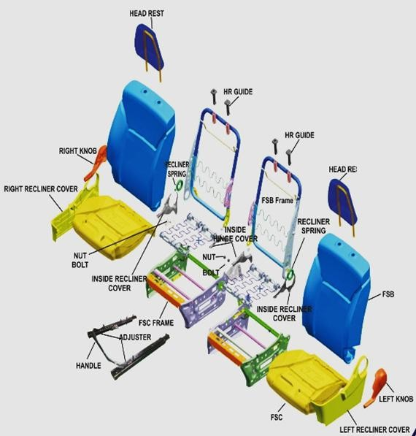
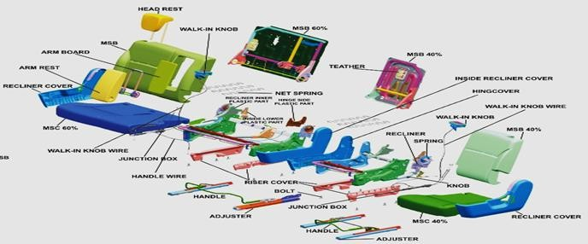
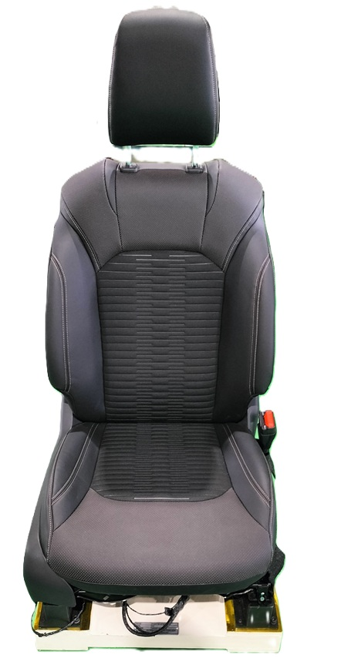
Our Products along with its variants
Sno | Model | Short code | No of varients | Vehicle Type
1 | Y17 | Y17 | 8 | 5 seater

Slide 9
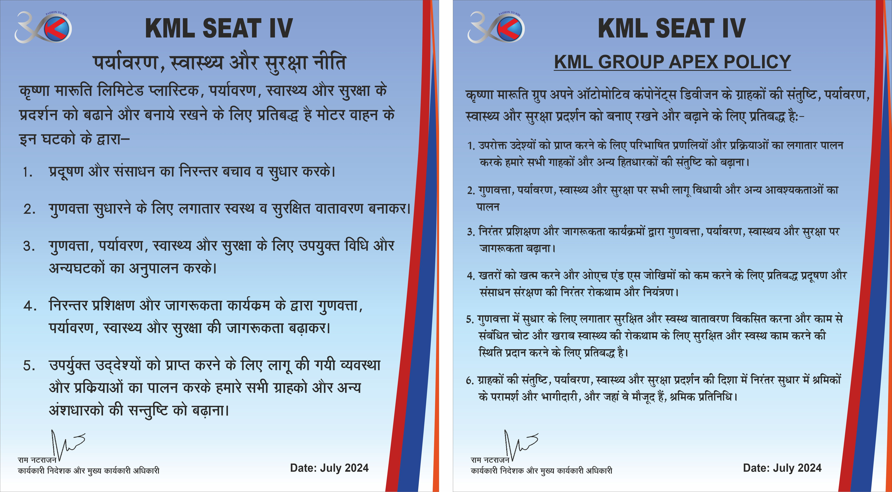
Policy

Slide 10
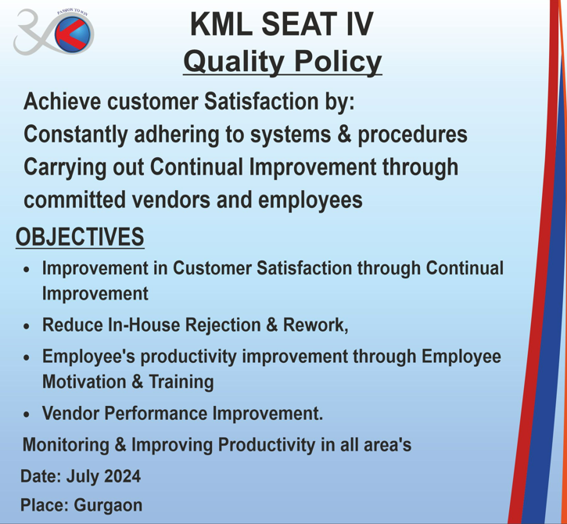
Policy

Slide 11

Thank You

