Slide 1
Liquid Lens
Submitted by,
Albin P M
I9MCA
Roll.no: 5

Slide 2
Introduction
Liquid lenses are a new technology rapidly gaining popularity in the industrial sector.
First of all lets first understand what a liquid lens is...

Slide 3
What is liquid lens?
Just like other lenses, liquid lenses are also transperant objects used to converge or diverge rays of light.
But unlike other lenses, liquid lenses are made of liquids (like water and oil).
Before knowing the working of liquid lens lets first know about a processs called electro-wetting.

Slide 4
How Does Liquid Lens Technology Work?
Liquid lenses use an electrowetting process to achieve superior autofocus capabilities.
The lens itself is a sealed cell with water and oil inside.
The electrowetting process shapes the oil drop into an effective lens quickly and accurately.
The process is continuous, reversible and fast for small and large focus steps alike.

Slide 5
What is Electrowetting?
If a drop of liquid is placed on a hydrophobic surface (something that repels liquids), then the molecules in the liquid will bond together and form a bead since they are repelled by the hydrophobic nature of the surface.

Slide 6
When an electric field is applied to that liquid and another conductive material such as aluminum that’s on the opposite side of the hydrophobic barrier, the liquid becomes electrostatically attracted to the aluminum.

Slide 7
The molecules that make up the liquid will spread out as they try to reach the aluminum, resulting in the water droplet drastically changing shapes. This process is called electrowetting, and it’s the basis of liquid lens technology.

Slide 8
The stronger the electric field that’s applied, the more attracted the liquid is to the conductive material.
So by varying the amounts of electricity used, the liquid can be forced to take many shapes.
If that liquid is used as a lens, then the different shapes it changes into each have a different focal length that can drastically alter the image that the sensor picks up.

Slide 9
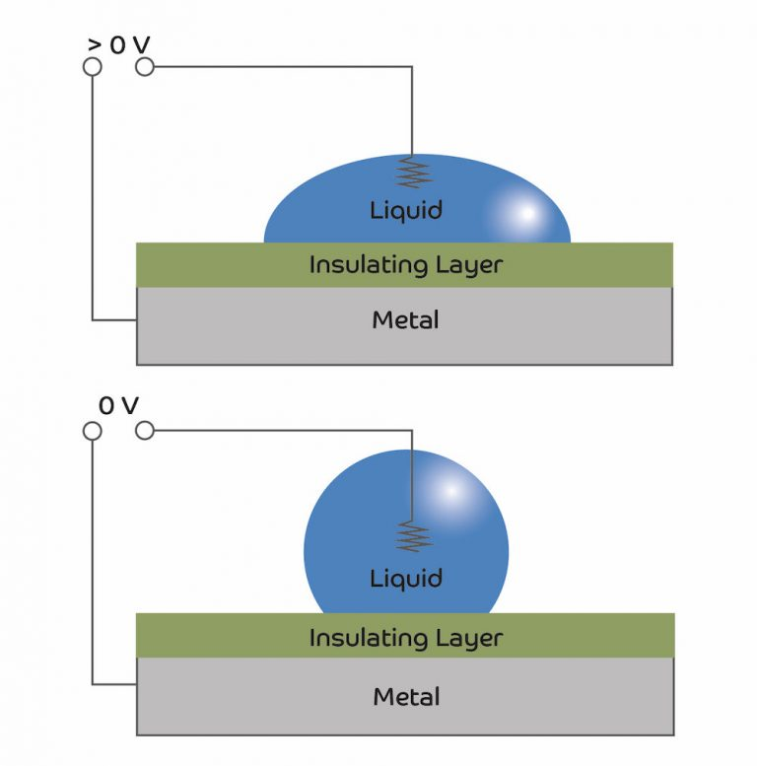

Slide 10
Advantages of Liquid Lenses
Multiple Focal Lengths in One Lens
Change Focus and Focal Length in Milliseconds
No Mechanical Parts to Damage
Excellent Lifespan
Much Smaller Than Traditional Lenses
Improved Image Stabilization
Close Focusing Abilities
Energy Efficient

Slide 11
Disadvantage of Liquid Lenses
It can’t be used in cold temperature since the liquid inside freezes.
It can’t be used in high temperature since the liquid inside boils.

