Slide 1
BEAUTY SPA MANAGEMENT

Slide 2
Beauty spa management system is a project which is developed in PHP and MySQL. The objective of this project is to facilitate accessing beauty spa services products.

Slide 3
PROPOSED SYSTEM
The system will enable users find a service based on their needs. It is most helpful when they do not really know what really suits their needs. The system also introduces carts so users can choose multiple services and products,then pay on one go. Users will be able book for a staff for a particular service and buy products.

Slide 4
Functional Modules
Registration
Registration module only allows only the registered users to access website. It is also a security measure that the unauthorised users can’t access the site. When a user register in the site he/she can access his account by a valid email id. If the user has forgot the password, there is an option for forgot password in the website.
Appointment
Users can choose to get an appointment on their preferred services and offers.
Buy products
Users can buy the beauty products form the website.
Service Recommendations
Sometimes users may be searching for a service for a specific problem and they may find it difficult to choose a specific one. This feature is able to suggest them a service that best suit their needs through predictions.

Slide 5
Carts
Users can go through available services and products, add them to cart and pay for them on the go. Carts offers much flexibility while selecting services and products. They can add and remove services and products and then find the total costs. Carts helps users to finalize their bookings before payment.
Payment
This module describes the payment done by the customer. The payment information can include information like the services, taxes included and mode of payment i.e., cash on delivery or credit card payment or debit card payment.

Slide 6
Types of user in this system
User/customer
Users/Customers can login through their accounts and view the services and products. Users can find a service based on their needs. After that users can choose to get an appointment on their preferred services and offers. After choosing a service or product, users can opt to pay either online or offline. After availing the service and product user has an option to submit feedback. User has a cart where he can add services and products and then pay for it together.
Employees
Employee has their own login through which they can update available services . Their also responsible for clarifying users enquires. Employees can request for leaves from admin apply though the application.
Admin
Admin has control over the users and employees of the application. Admin is responsible for adding employees to the application when they join. Their login credentials are forwarded to their email.

Slide 7
UML DIAGRAMS

Slide 8
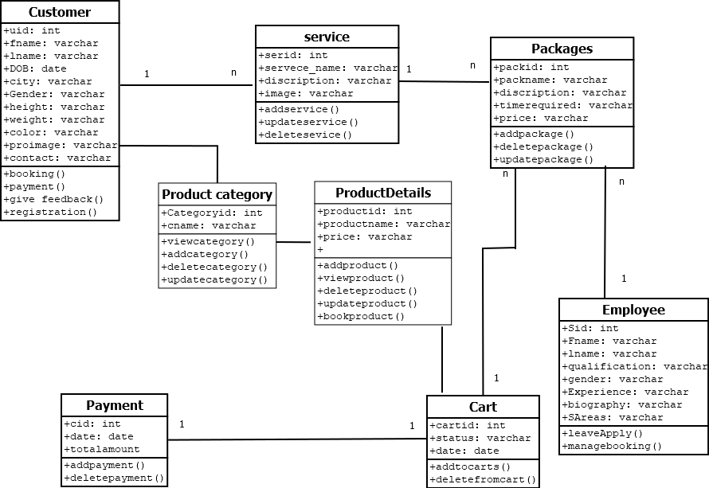
1.Class diagram

Slide 9
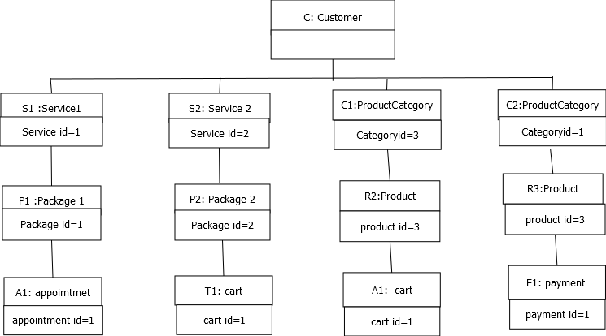
2.Object diagram

Slide 10
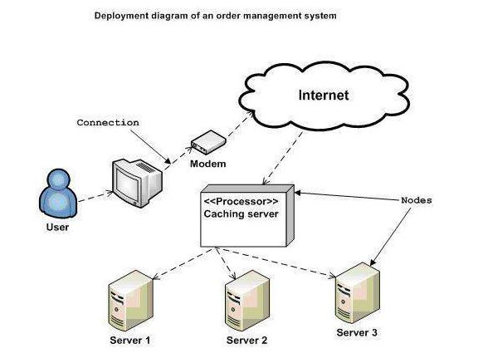
3.Deployment diagram

Slide 11
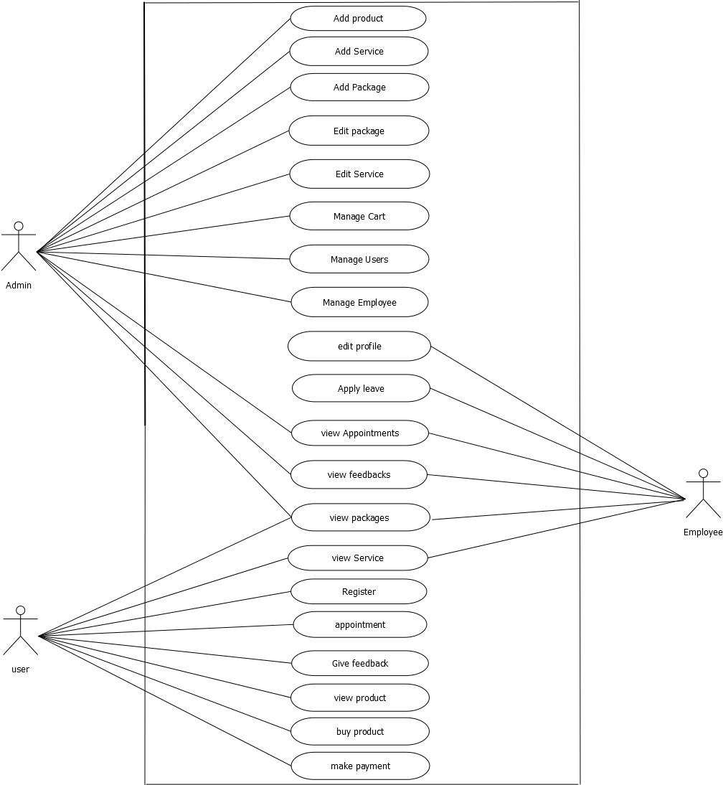
Use case diagram

Slide 12
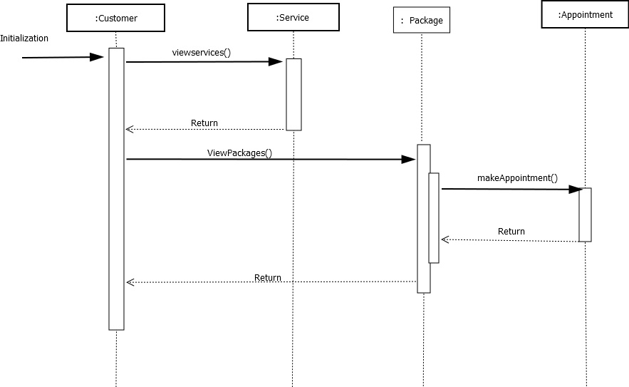
Sequence diagram

Slide 13
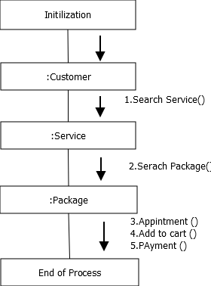
Collaboration diagram

Slide 14
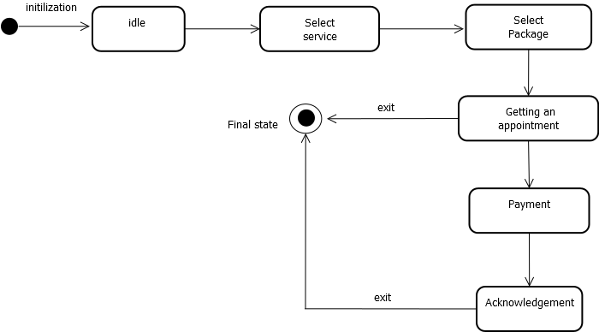
Statechart diagram

Slide 16
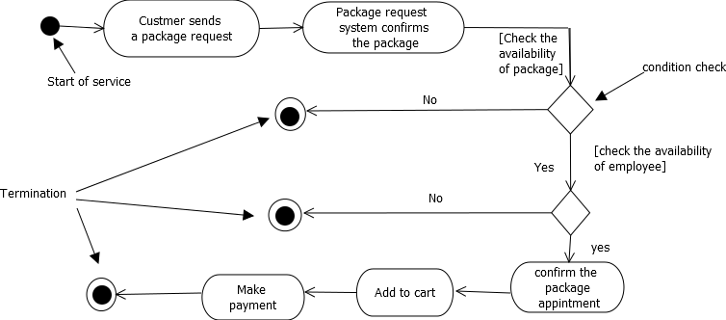
Activity diagram

Slide 17
TABLE DESIGN

Slide 18
1 .Tb_Login
Sl no | Attribute name | Data Type | Description
1 | userid | Int(11) | id
2 | usertype | Varchar(50) | User type
3 | status | Int(11) | Status
4 | email | Varchar(50) | Email
5 | password | Varchar(50) | password

Slide 19
Tb_UserRegistration
Sl no | Attribute name | Data Type | Description
1 | userid | Int | id
2 | fname | Varchar(50) | First name
3 | lname | Varchar(50) | Last name
4 | proimage | Varchar(50) | image
5 | contact | Int(30) | Contact number

Slide 20
Tb_UserSpecifications
Sl no | Attribute name | Data Type | Description
1 | userid | int | Userid PK(FK)
2 | gender | Varchar(50) | gender
3 | height | Varchar(50) | height
4 | weight | Varchar(50) | weight
5 | DOB | date | Date of birth
6 | colorid | int | colorid(FK)
Tb_UserColorType
Sl no | Attribute name | Data Type | Description
1 | colorid | int | Colour id
2 | type | Varchar(50) | Colour type

Slide 21
Staff Registration
Sl no | Attribute name | Data Type | Description
1 | userid | Int(11) | Staff id PK(FK)
2 | fname | Varchar(50) | First name
3 | lname | Varchar(50) | Last name
4 | qualification | Varchar(50) | Qualification
5 | experiences | Varchar(50) | experience
6 | roleid | int | Employee role
7 | bio | Varchar(100) | Biography
8 | img | Varchar(50) | images
9 | contact | Vatchar(50) | contact

Slide 22
Tb_Service
Sl no | Attribute name | Data Type | Description
1 | serId | Int(11) | id
2 | servname | Varchar(30) | Service name
3 | serDic | Varchar(50) | Service decription
4 | image | Varchar(50) | image
Tb_Package
Sl no | Attribute name | Data Type | Description
1 | packId | Int(11) | Id
2 | servid | Int(11) | Service id(FK)
3 | packname | Varchar(30) | Package name
4 | packdecr | Varchar(30) | Package Decriptuirion
5 | timed | Varchar(30) | Time reqquired
6 | price | Varchar(30) | price
7 | image | Varchar(30) | image

Slide 23
Tb_ProductCategory
Sl no | Attribute name | Data Type | Description
1 | categoryid | int | Product category id (PK)
2 | cname | varchar | Category name
Tb_ProductDetails
Sl no | Attribute name | Data Type | Description
1 | productid | int | Product id (PK)
2 | pname | Varchar(50) | Product name
3 | pdescription | Varchar(50) | Product description
4 | categoryid | int | Category id(FK)
5 | price | int | Product price
6 | pstock | int | product stock

Slide 24
Employee Leave
Sl no | Attribute name | Data Type | Description
1 | levId | Int(11) | id
2 | leavedate | date | Leave date
3 | reson | Varchar(50) | reson
4 | empid | Int(11) | Employee id (FK)
5 | status | Int(11) | status
Feedback
Sl no | Attribute name | Data Type | Description
1 | fId | Int(11) | id
2 | feedb | Varchar(50) | feedback
3 | userid | Int(11) | User id(FK)

Slide 25
cart/transaction
Sl no | Attribute name | Data Type | Description
1 | cartid | int | Cart id
2 | userid | int | User id (FK)
3 | status | int | status
4 | date | date | date
cart items
Sl no | Attribute name | Data Type | Description
1 | cartitemid | in | Cart item id
2 | cartid | int | Cart id(FK)
3 | referenceid | int | prodoctid/packageid(FK)
4 | type | enum | product/package
5 | empid | int | Employee id
6 | date | date | date
6 | time | timestamp | time

Slide 26
Tb_Payment
Sl no | Attribute name | Data Type | Description
1 | cid | int | Cart id (FK),PK
2 | date | date | date
3 | tamount | Varchar(50) | Total amount

Slide 27
FORM DESIGN

Slide 28
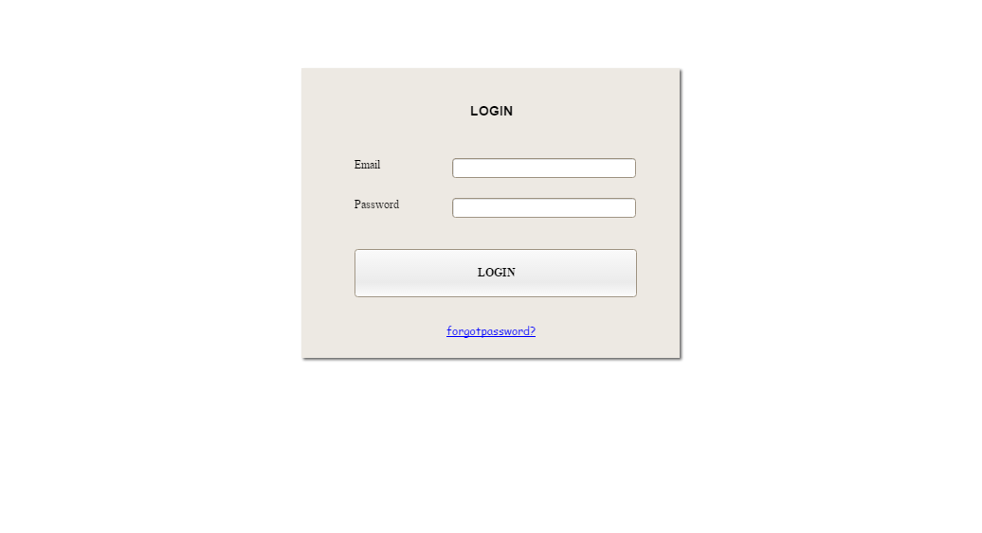
Login

Slide 29
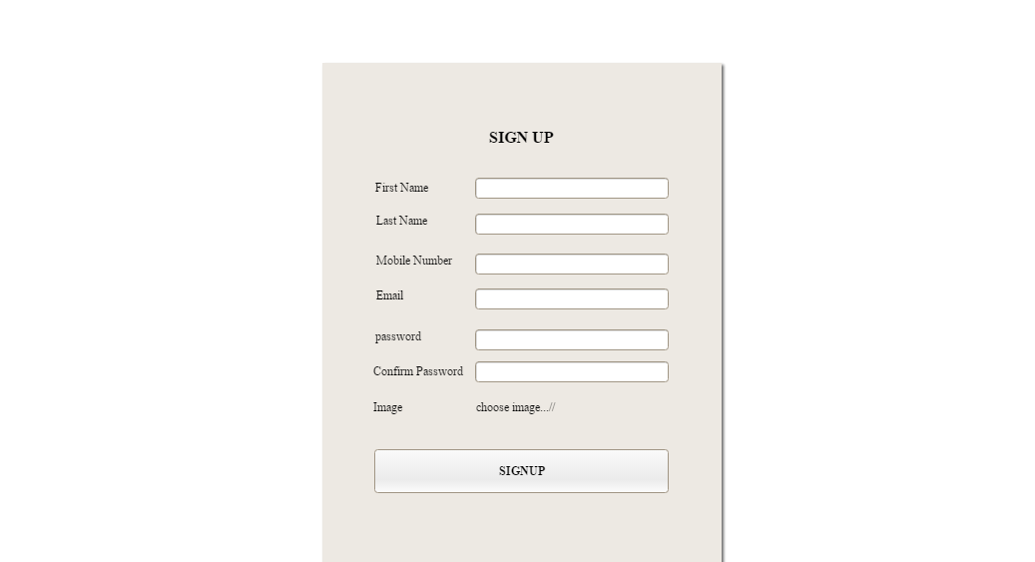
User Registration

Slide 30
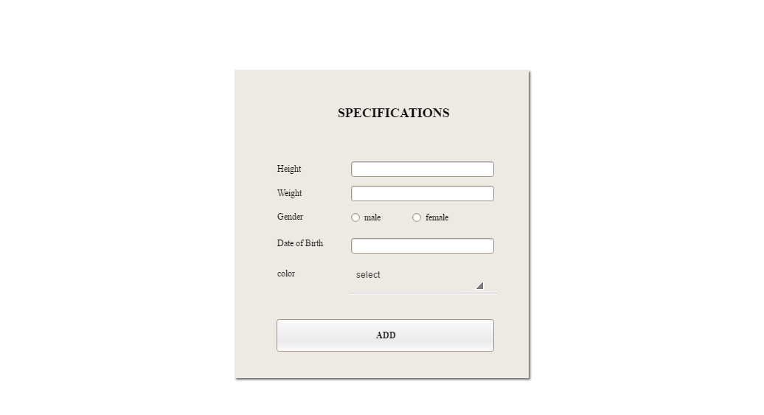
User Specification

Slide 31
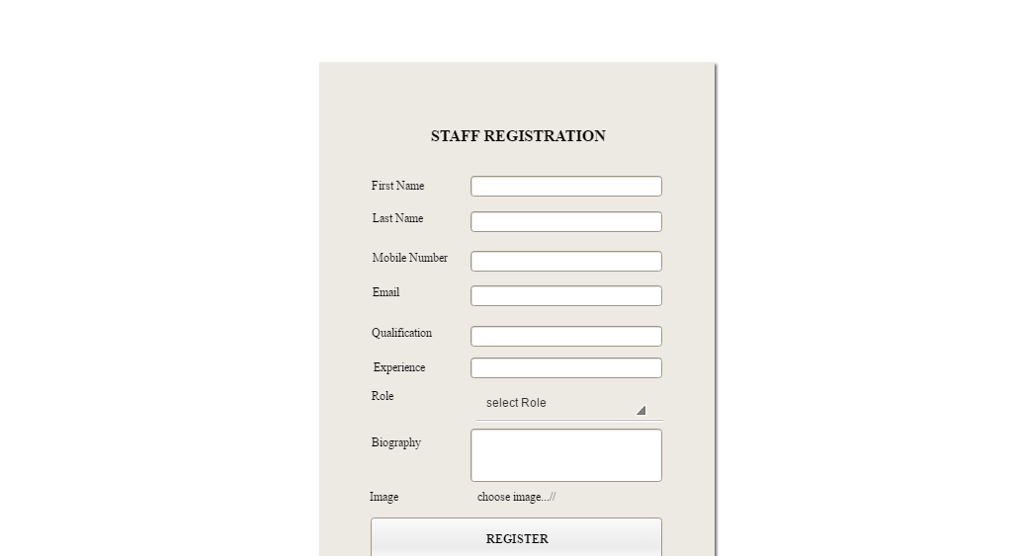
Staff Registration

Slide 32
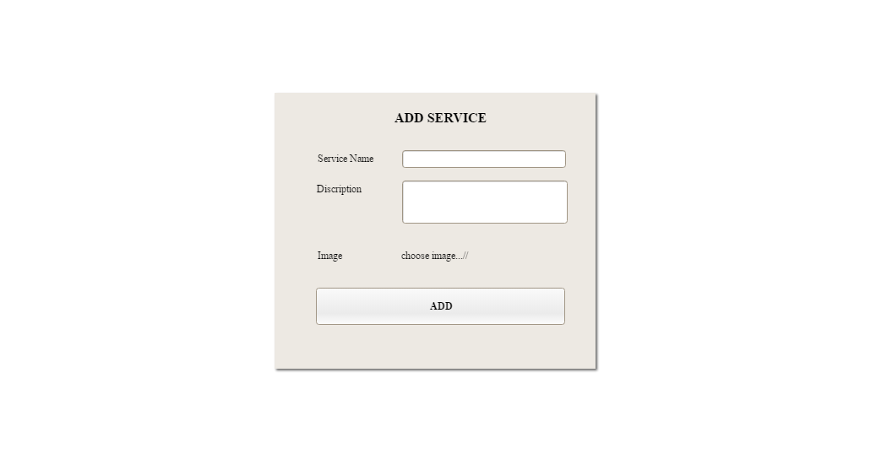
Add Service

Slide 33
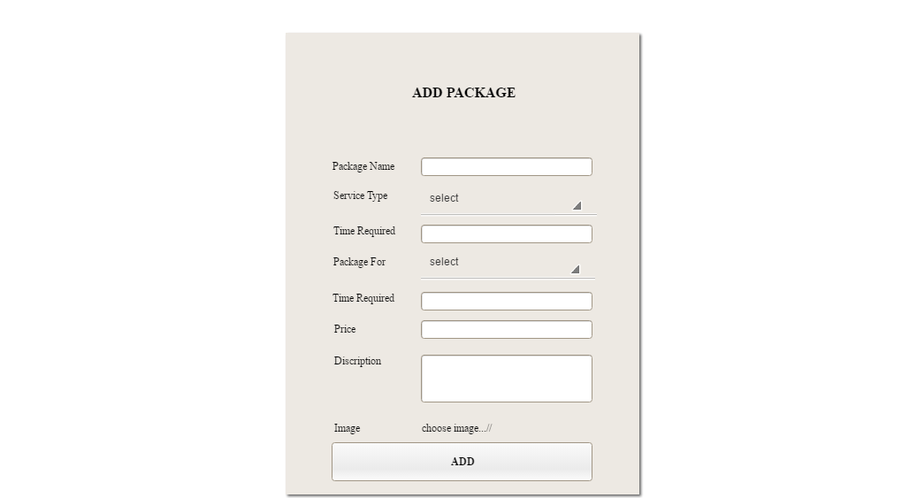
Add Package

Slide 34
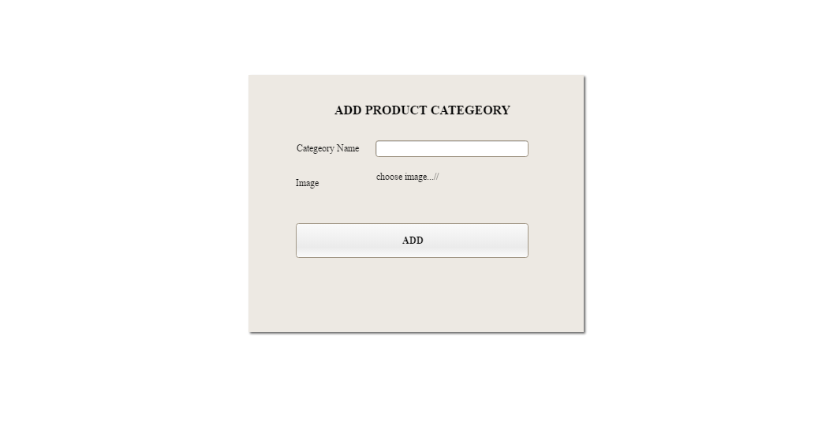
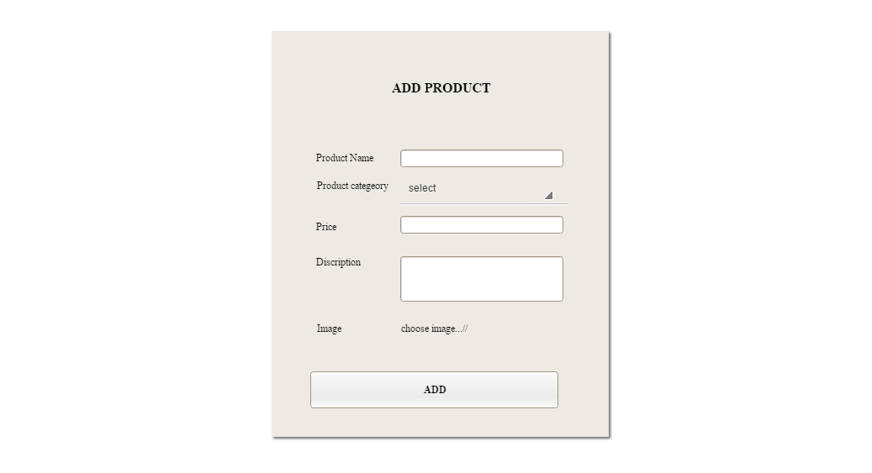
Add Product categeory
Add Product

Slide 35
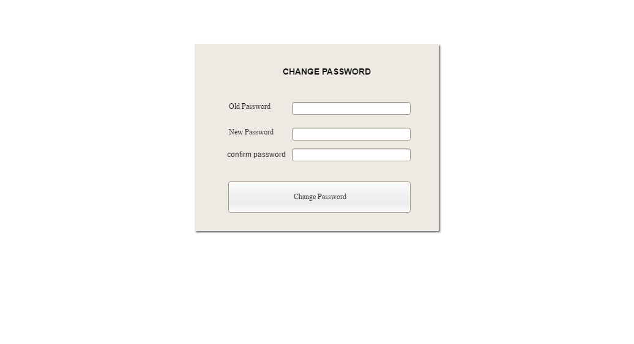
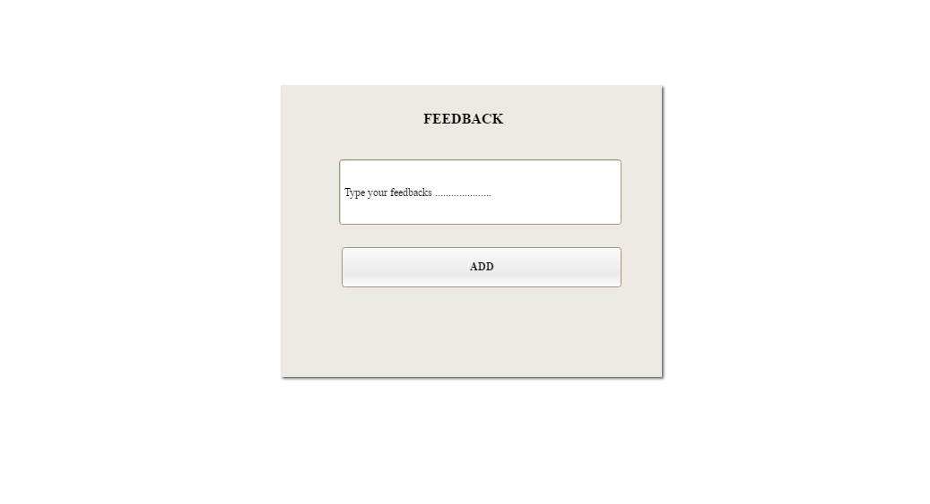
Change Password
Feedback

Slide 36
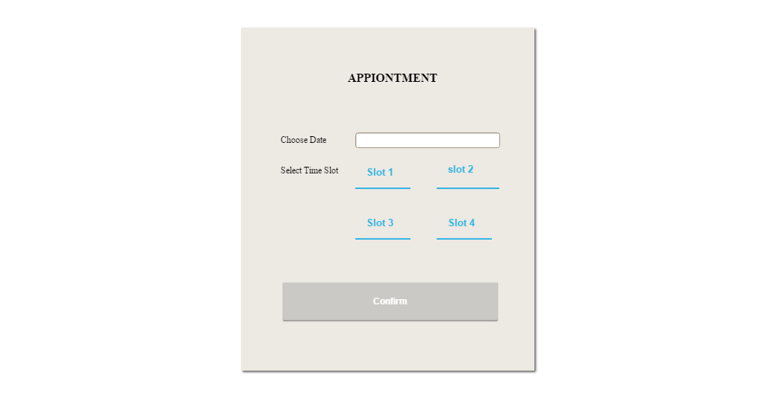
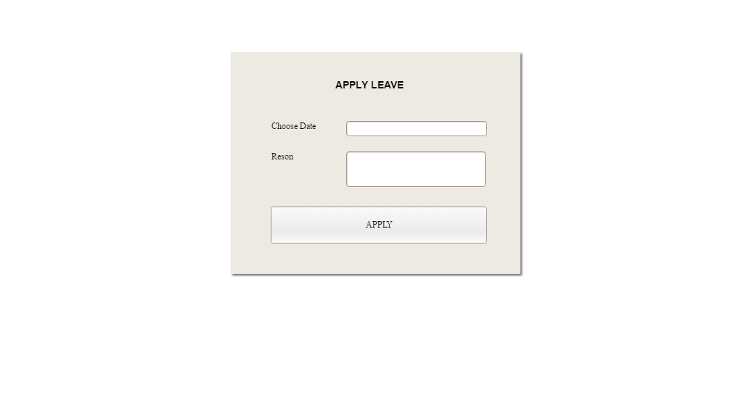
Appointment
Employee Leave

