Slide 1
Project 2:
Ames, Iowa
Housing Price Prediction
Albin Wan

Slide 2
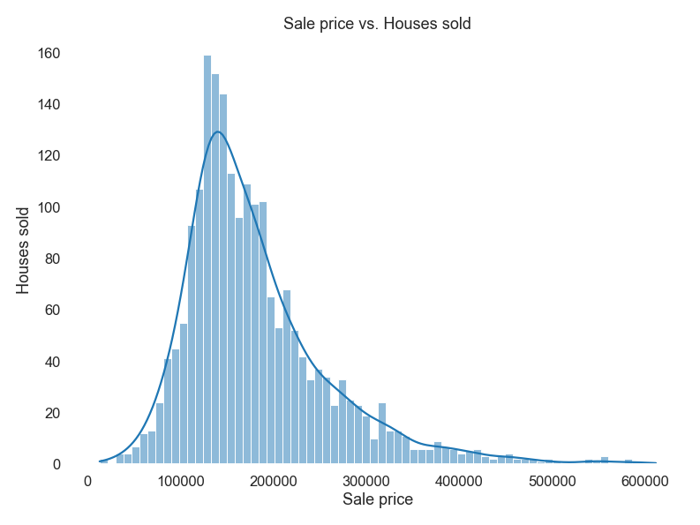
EDA
sns.displot(SalePrice)
The average house sold for $181,469,
the most expensive sold for $611,657 and the cheapest sold for $12,789

Slide 3
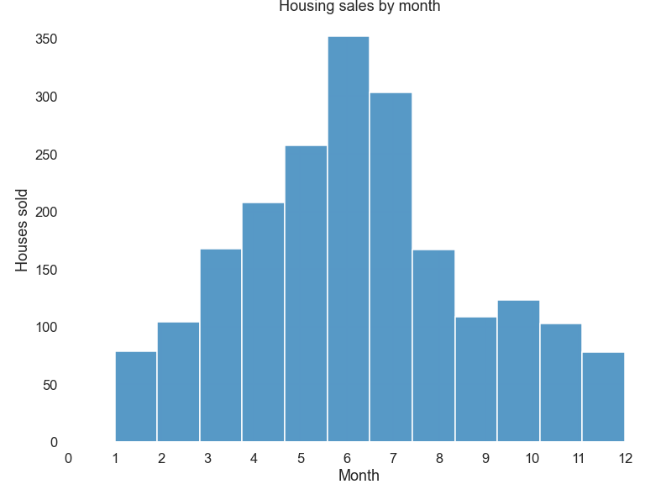
sns.displot(MoSold)
EDA
Most sales occur in the middle of the year, particularly in June.

Slide 4
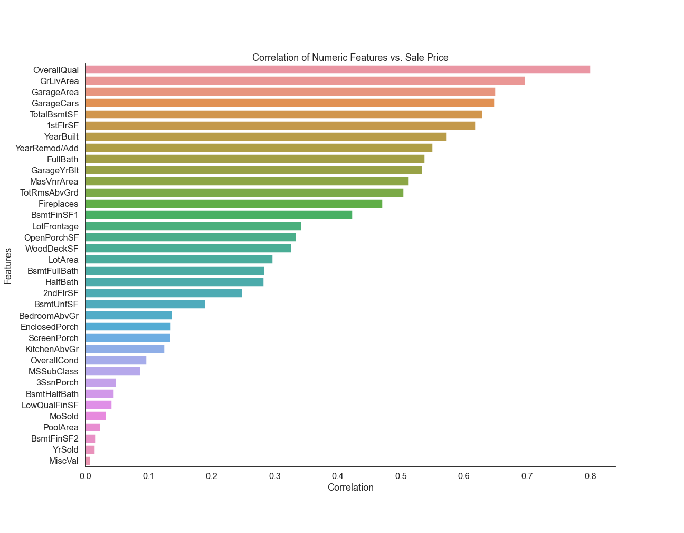
EDA
sns.barplot(df.corr()[SalePrice])
Size, furnishing and age matter in housing sale price

Slide 5
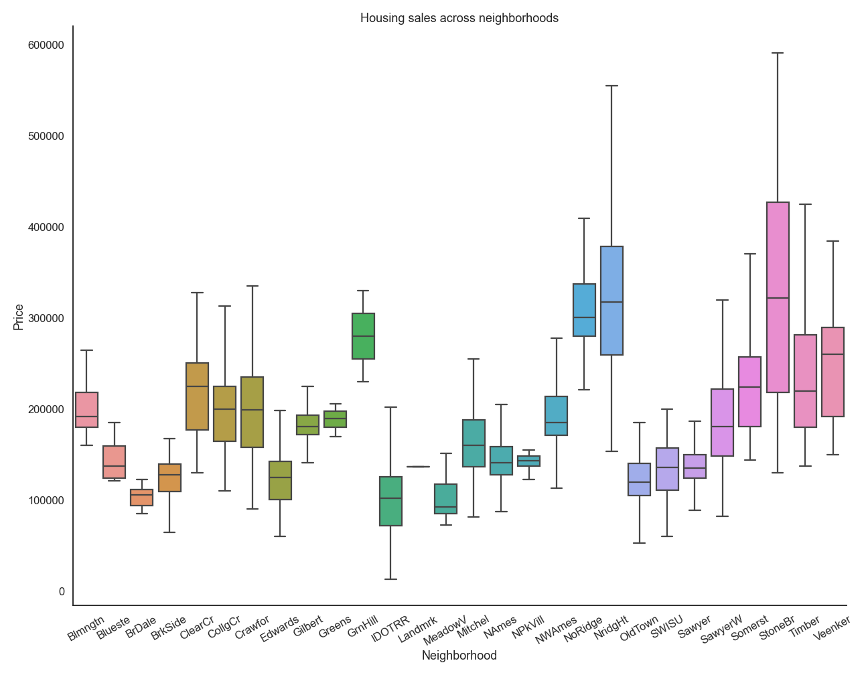
EDA
sns.boxplot(Neighborhood)
..and location

Slide 6
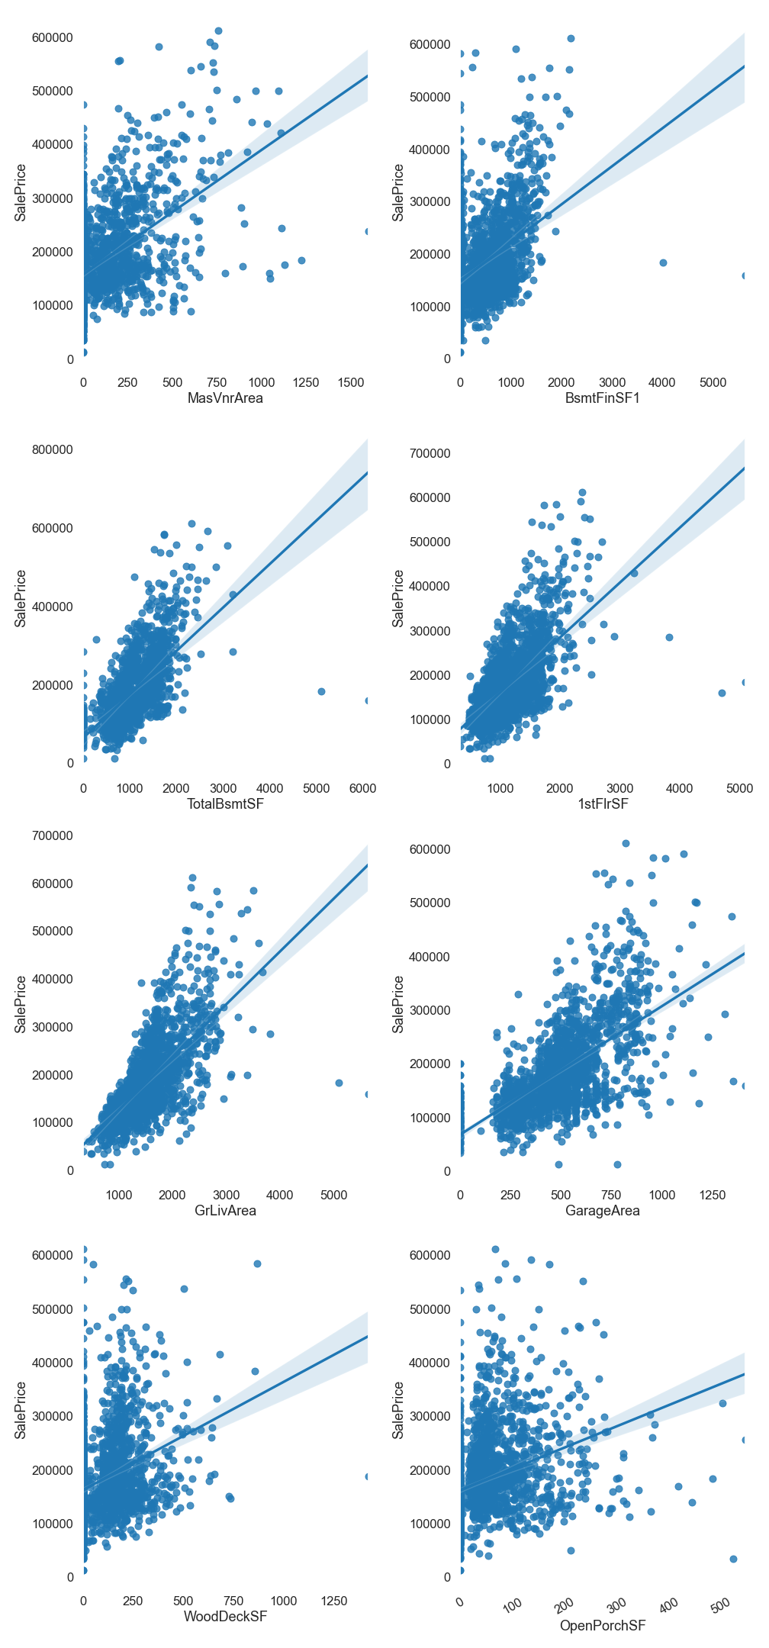
Multicollinearity amongst area features?

Slide 7
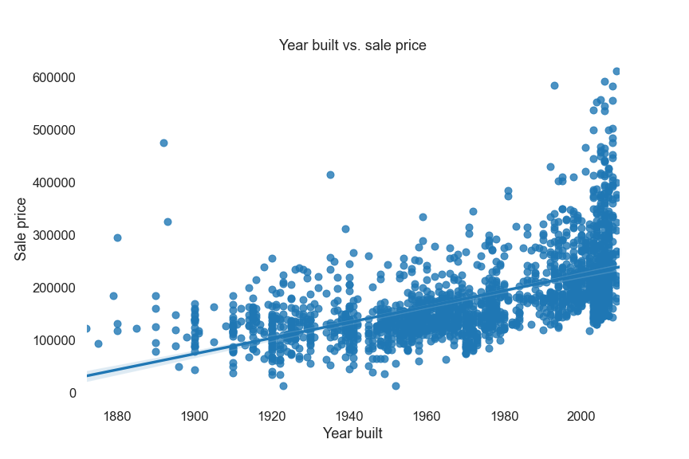
Feature Engineering
Create Age feature to use YearBuilt

Slide 8
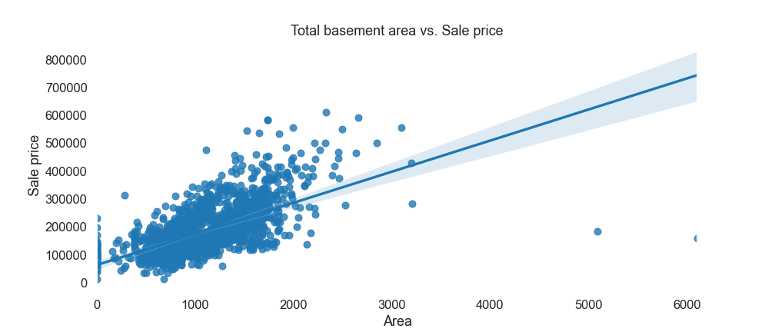
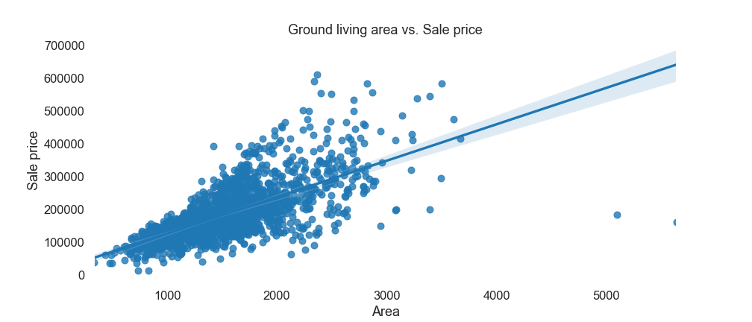
Feature Engineering
Create Interior_Sqft feature by merging GrLivArea and TotalBsmtSF

Slide 9
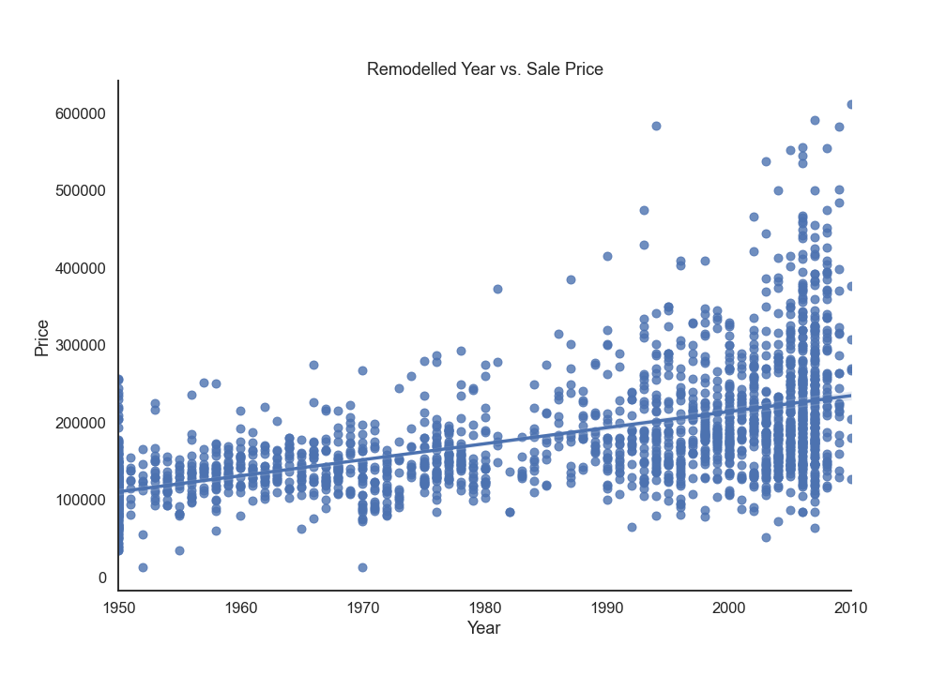
EDA
Create YearSinceRemod feature to use YearRemod/Add

Slide 10
Modelling
Feature selection
Use Lasso to reduce features
Throw all numeric features into a Lasso regression and eliminate features which were reduced to 0. Select top 30.
Cross validate against hold-out set
Obtain cross validation scores across both models and compare suitability
2nd step
4th step
1st step
3rd step
Categorical features
Add in categorical dummies which were shortlisted from EDA (MSZoning and Foundation), replacing the worst performing features from Lasso.
Predict on test set
Combine train and hold-out set and fit to model. Predict test set and upload to Kaggle.

Slide 11
Modelling
Comparison of models
Lasso-reduced numeric features RMSE: 28,528
+ categorical* dummies
RMSE: 27,734
*MSZoning + Foundation

Slide 12
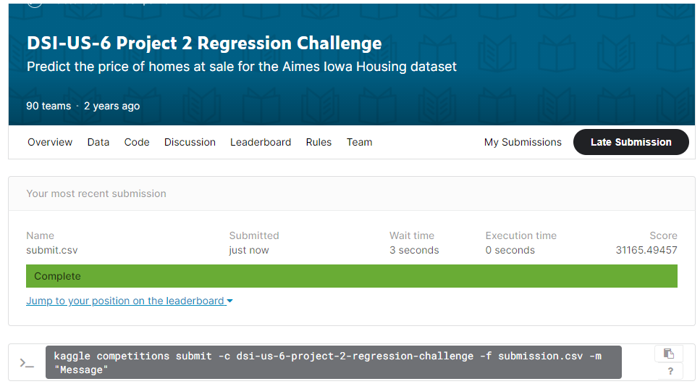
Modelling

Slide 13
Conclusion
01
Low usage of location features
Only MSZoning was used
Most location features were categorical. Dummy variables takes up too many feature space
02
Best predictors are area and overall quality
‘GrLivArea’ and ‘OverallQual’ are kings
03
Occam’s razor stands true
Feature engineering did not provide big benefits

